Slide 1

e

Slide 2
Table of contents
Our team
Idea
Stages of working
Technologies used
Project

Slide 3
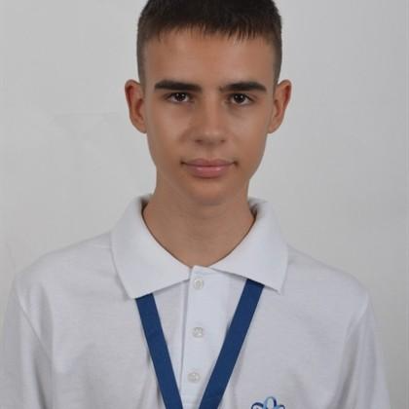
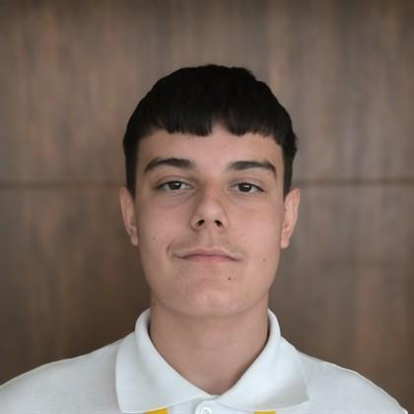
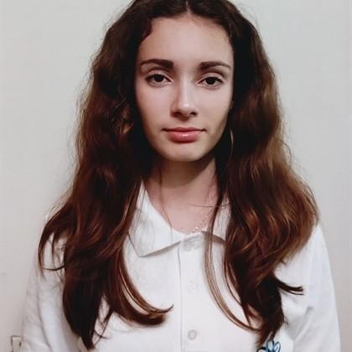
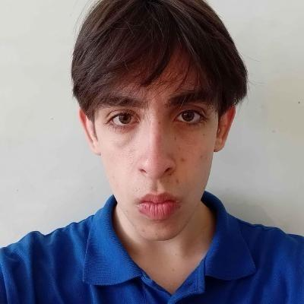
TEAM
Bozhidar Stanev
Aleksandar Petrov
Mustafa Husein
Nikoleta Georgieva
9B
9B
9G
9A
Front-end Developer
Back-end Developer
Designer
Scrum Trainer

Slide 4
IDEA
The game selects a secret word and the player must guess the letters of the word one by one. For each incorrect guess, a part of the hangman figure is drawn. The player wins by guessing the entire word before the hangman figure is complete, or loses if the figure is completed.

Slide 5
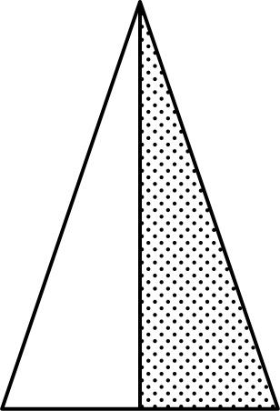
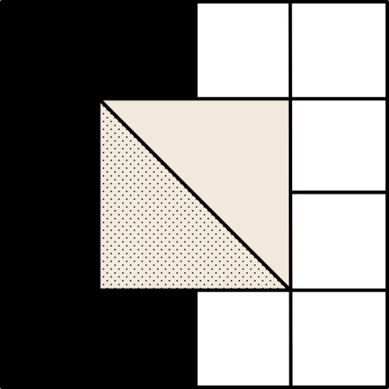
STAGES OF WORKING
1st week
2nd week
3rd week
4th week
Starting to work on the game.
Adding new ideas or changing old ones.
Still to work on the game.
Adding new ideas or changing old ones.
Finishing the game
Create documentation​
Create presentation​
Create the design​
Create the logo​
Finding a mentor

Slide 6






TECHNOLOGIES USED

Slide 7
Now let’s see the project

