Slide 1

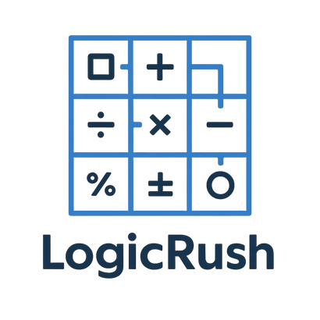

Logic Rush

Slide 2
By Team Logic Legends
Logic Rush is a grid-based math challenge game where every move requires logical thinking.
The player begins at the top-left cell (0,0) and must reach the final cell (N-1, N-1).
Each cell contains a math problem that must be solved correctly to enter it.
Correct answers give points, while mistakes cost lives.

Slide 3
Gameplay Overview
  The game creates a grid depending on the selected difficulty.
  The player can move up, down, left, or right.
  Every cell contains a randomly generated math task.
  A correct answer allows the player to enter the cell and earn points.
  A wrong answer takes away a life and keeps the player in the same position.
  The game is won by reaching the final cell.
  The game is lost when all lives reach zero.

Slide 4
Features
  Three difficulty levels with unique rules
  Randomly generated math challenges
  Grid-based movement system
  Lives, points, bonus cells, and traps
  Increasing complexity from Easy to Hard

Slide 5




Our team
Martin Atanasov Jelev
Dimitar Plamenov
Nyagalov
Georgi Ivaylov Nikolov
Plamen Nikolaev Rusev
SCRUM TRAINER
FRONT-END DEVELOPER
BACK-END DEVELOPER
DESIGNER

Slide 6







Technologies used

Slide 7
Thanks for your time!

