Slide 1


Slide 2

TABLE OF CONTENTS
1
2
Our Team
Work progress
3
Programs we used

Slide 3
1
OUR TEAM

Slide 4
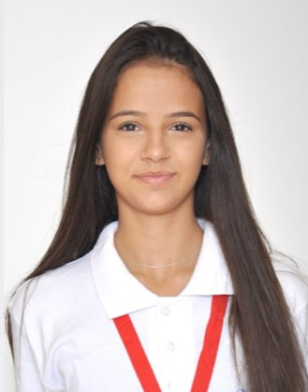
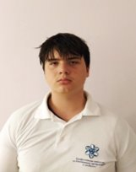
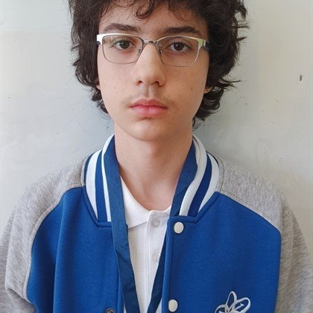
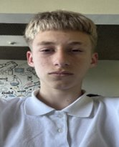
Kristiyana Ivanova​
Scrum Trainer
Denis Paspalov​
Designer
Loris Zadikqn​
BackEnd Developer
Vasilen Gospodinov​
FrontEnd Developer

Slide 5
2
WORK PROGRESS

Slide 6
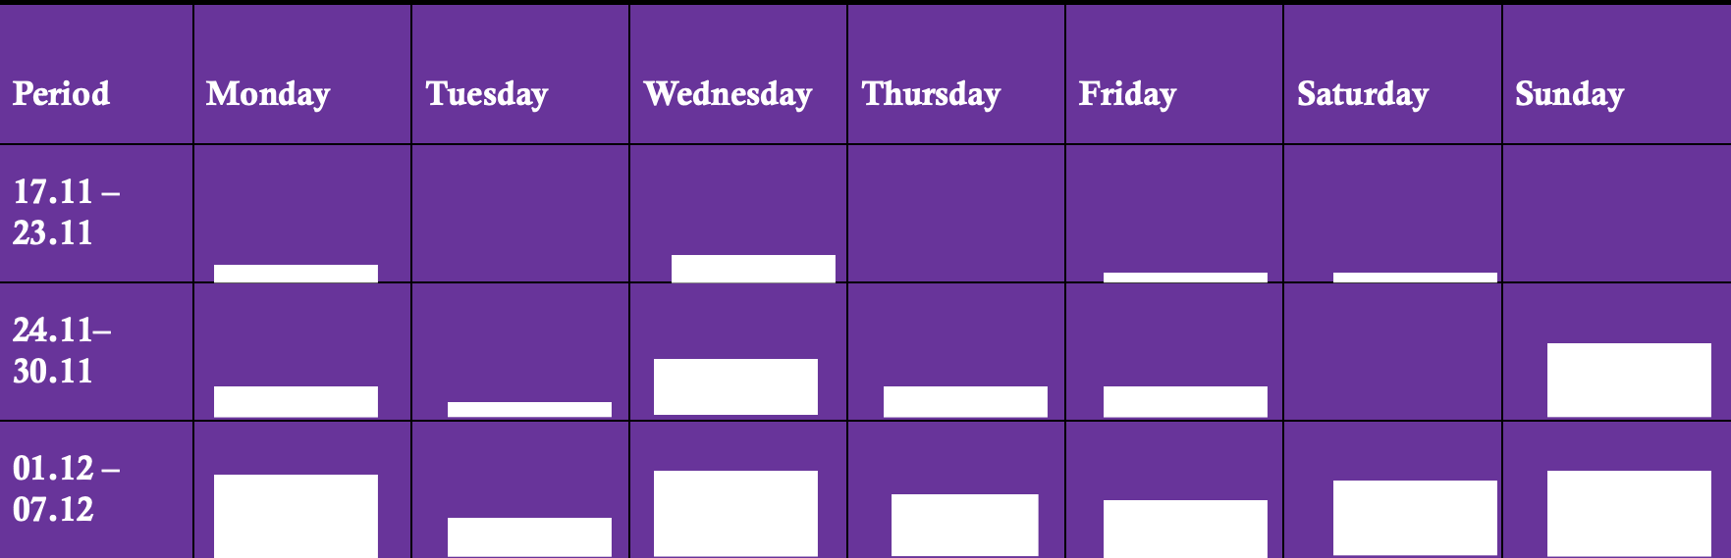

Slide 7
3
PROGRAMS WE USED

Slide 8







Slide 9
Thank you for your attention, and now let's head to the game!

