Slide 1

PROJECT PRESENTATION

Slide 2
TABLE OF CONTENTS
01
OUR TEAM
02
OUR GOAL
03
USED TECHNOLOGIES

Slide 3

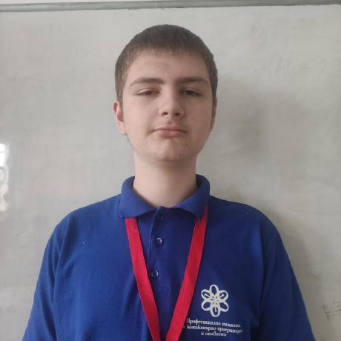
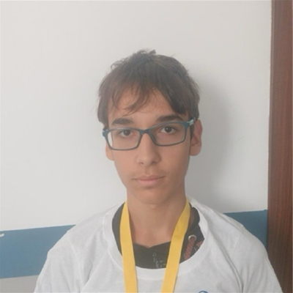

OUR TEAM
Иван Трифонов
Алтай Йеменджиев
Мирослав Илиев
Ростислав Иванчев
SCRUM TRAINER
BACK-END DEVELOPER
DESIGNER
FRONTEND DEVELOPER

Slide 4
OUR GOAL
Our goal is for the player to have fun playing our game
and also to test their general education knowledge

Slide 5






USED TECHNOLOGIES

Slide 6
LET’S CONTINUE WITH THE GAME!

