Slide 1
NovaCode

Slide 2
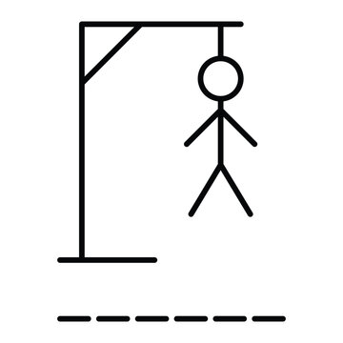
Our game
We have created a simple HangMan game. Its an easy word‑guessing game where players are given empty spaces for letters where they have to gues what letters to put in the spaces to form a word. It’s a relaxing game with which people can both chill and compete with eatchother.

Slide 3




The creators
Scrum Trainer – Ангел Фриедериш
BackEnd Developer – Георги Христов
FrontEnd Developer – Димитър Янакиев
Designer – Виктор Георгиев

Slide 4
Our time spent
Week 1
Week 2
Week 3

Slide 5




Technologies Used

Slide 6
Lets get to the game!
Thanks for the attention!

