Slide 1





HOME
ABOUT
MORE
SPECTRACORE

Slide 2
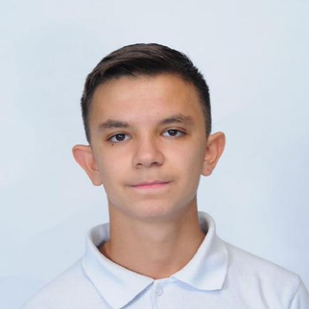
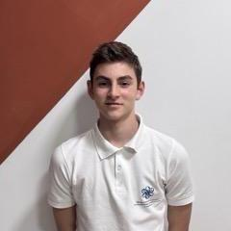
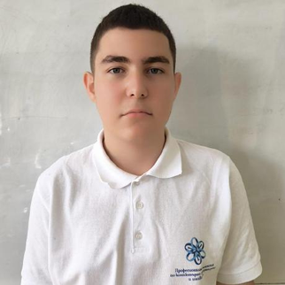

HOME
ABOUT
MORE
ABOUT US
Scrum Trainer
Back-end developer
Front-end developer
Designer
STOYAN SAVAKOV
ANTONIO IVANOV
IVAN LAPCHEV
GEORGI GEORGIEV

Slide 3
HOME
ABOUT
MORE
OUR MISSION
OUR MISSION IS TO CREATE AN ENTERTAINING AND RELAXING GAME FOR PEOPLE TO PLAY.
OUR GAME IS AIMED AT PEOPLE THAT HAVE A RICH VOCABULARY AND WANT TO PRACTICE IT. OUR GAME OFFERS DIFFERENT LANGUAGES FOR PEOPLE FROM DIFFERENT COUNTRIES.

Slide 4
HOME
ABOUT
MORE
WORK PROGRESS
16.11 - 22.11 | 23.11 – 29.11 | 30.11 - 07.12
12
7
1

Slide 5






HOME
ABOUT
MORE
Programs we used

Slide 6
HOME
ABOUT
MORE
THANK YOU
LET COUNTINUE TO THE DEMO

