Slide 1

SynoNum
Add the Numbers, Find the Words. ☺
Presentation made by the SynoNum team

Slide 2

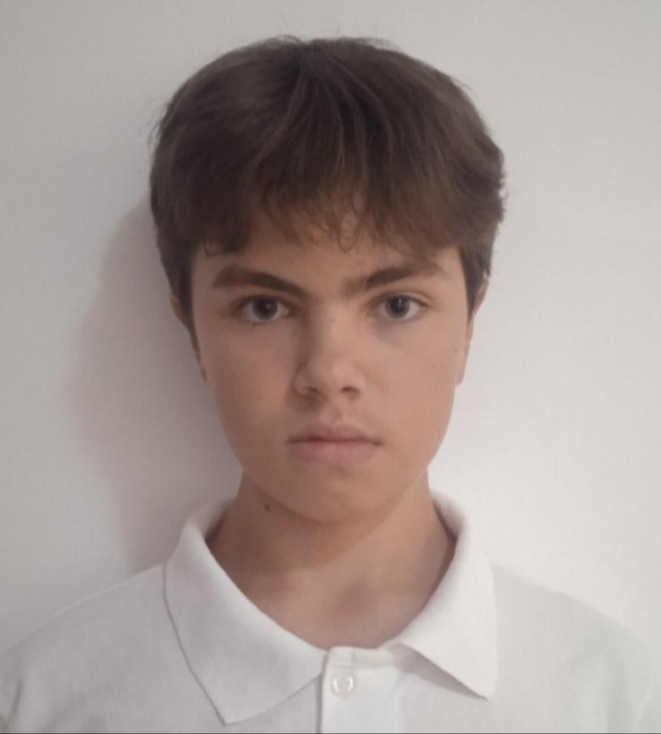
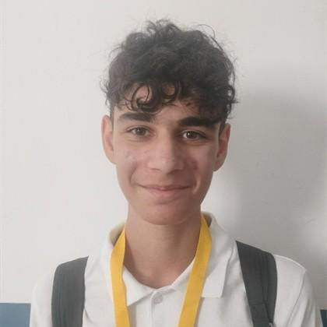
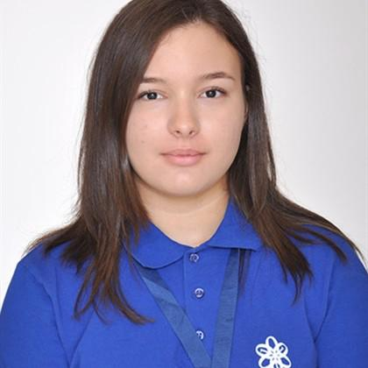
Our team
Dimana Foteva, 9.G
Mariela Apostolova, 9.B
Vsevolod Bolotov, 9.V
Radostin Dimkirichev, 9.A
Front-end Developer
Back-end Developer
Scrum Trainer
Designer

Slide 3
About our project
Fun games to choose from
Entertainment
Our project
Clean and understandable formatting
Functionality
Includes classic games everyone loves
Classics

Slide 4
Our progress
First step
Second step
Third step
Fourth step
Team assembling
Project developing
Finalization
Presenting

Slide 5







Used softwares and programmes and languages

Slide 6
Now let’s move onto the project…

