Slide 1

Synonum
<game>

Slide 2
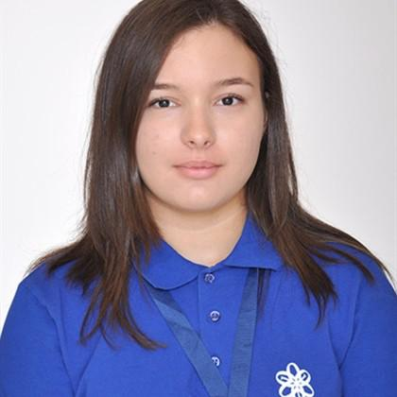

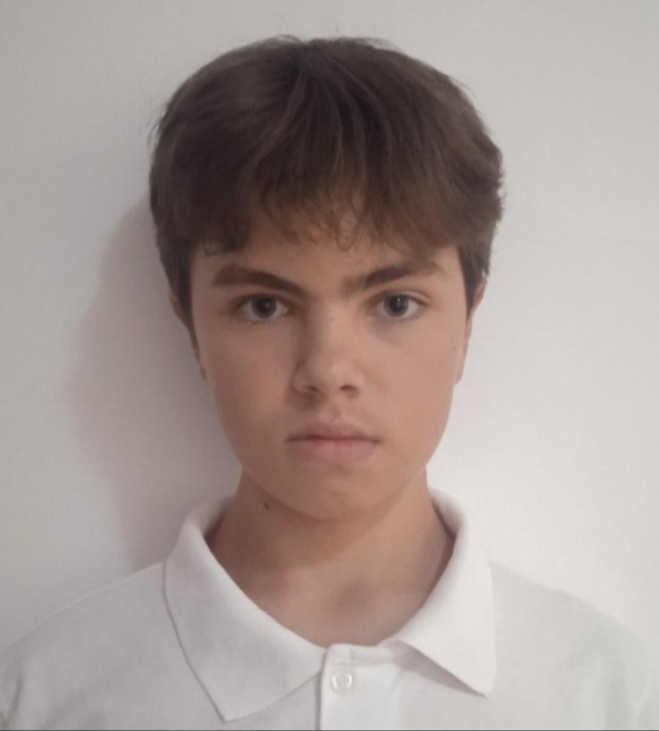
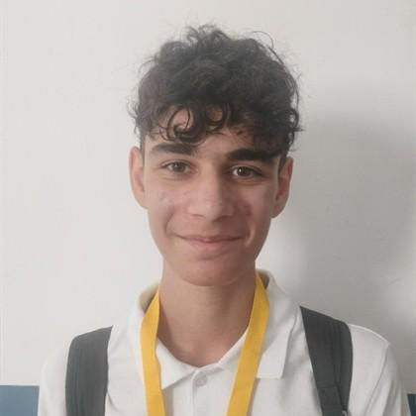
Our team
Dimana Foteva, 9.G
Mariela Apostolova, 9.B
Vsevolod Bolotov, 9.V
Radostin Dimkirichev, 9.A
Dimana Foteva
Mariela Apostolova
Vsevolod Bolotov
Radostin Dimkirichev
Scrum trainer
Front-end Developer
Front-end developer
Back-end Developer

Slide 3
About our project
This project is a Hangman × Math game that gives players the opportunity to choose what game they would like to play. The game encourages both critical thinking and problem-solving while keeping the gameplay fun and engaging.
It is designed to be simple, interactive, and easy for players.
Our project

Slide 4
Progress
First step
Second step
Third step
Fourth step
Team assembling
Project developing
Finalization
Presenting

Slide 5






Used softwares and programmes and languages

Slide 6
Now let’s move onto the project…

