Slide 1
Team “X”

Slide 2
Table of contents
01
Team members
02
Project idea
03
Technologies used
04
Work plan

Slide 3
01
Team members

Slide 4
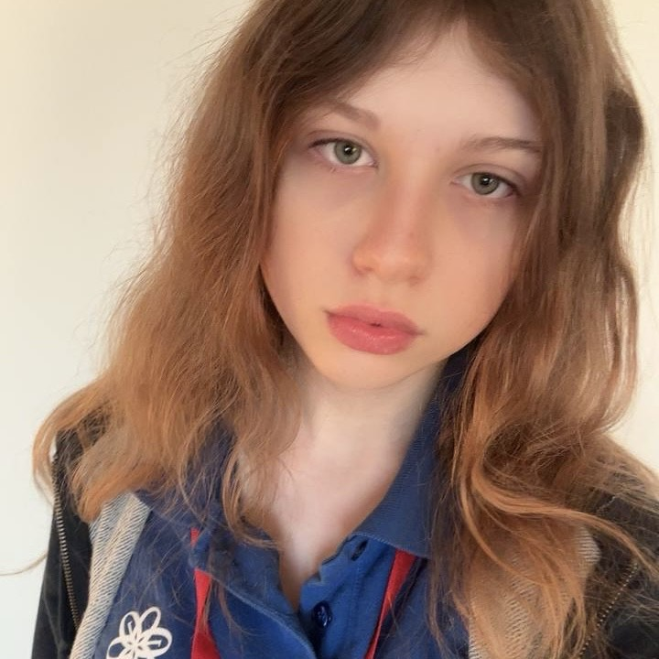
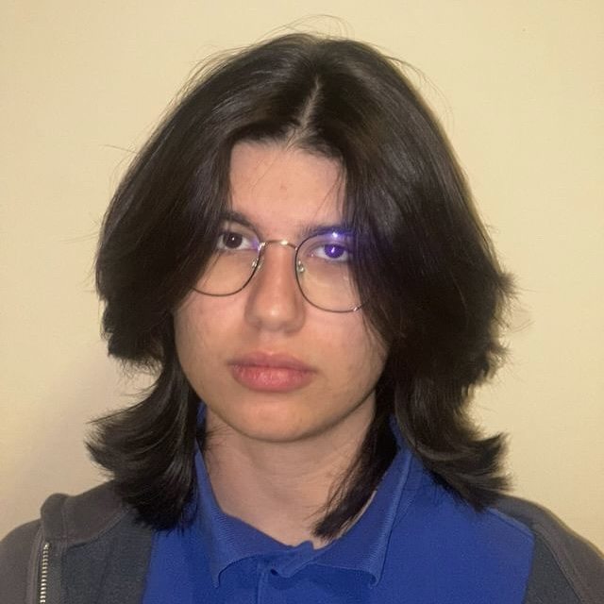
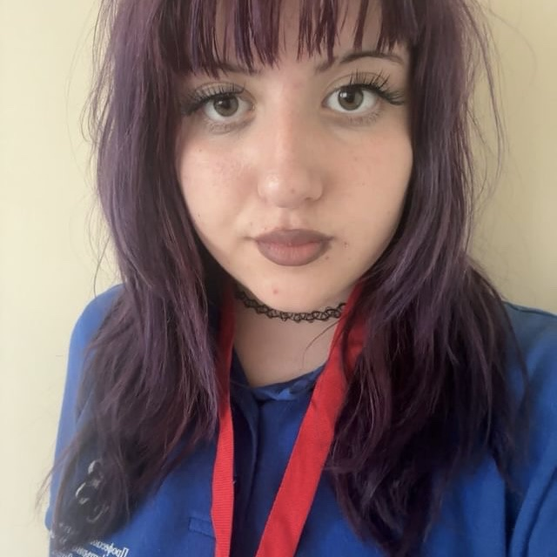
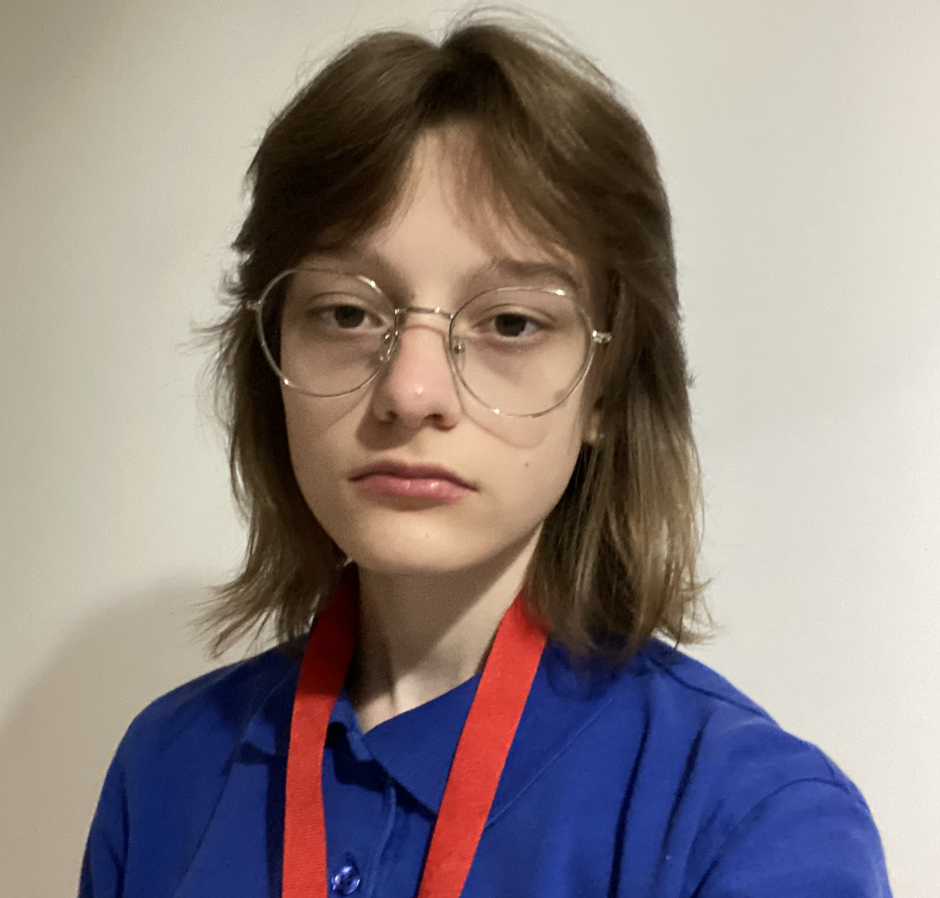
01. Team members
Leya Susova
Back-End Developer
Roberta Hristova
Front-End Developer
Nia Georgieva
Designer
Ekaterina Zalinskaya
Scrum trainer

Slide 5
02
Project idea

Slide 6
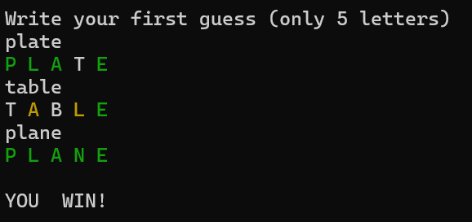
02. Project idea
Our team decided to recreate a simple, yet entertaining game, named Wordle. In this game you get three, five or eight attempts (depending on the mode you choose) to guess a five-letter word.
Work in progress

Slide 7
03
Technologies used

Slide 8





03. Technologies used

Slide 9
04
Work plan

Slide 10
04. Work plan
Make up a feasible idea
Distributing the tasks
Start writing the code
2.1. Main menu
2.2. The rest of the structure
4. Create a documentation
5. Create a presentation

Slide 11
Now let's jump into the game!

