Slide 1

Project

Slide 2
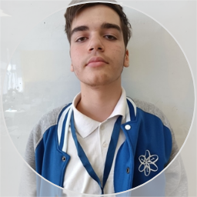
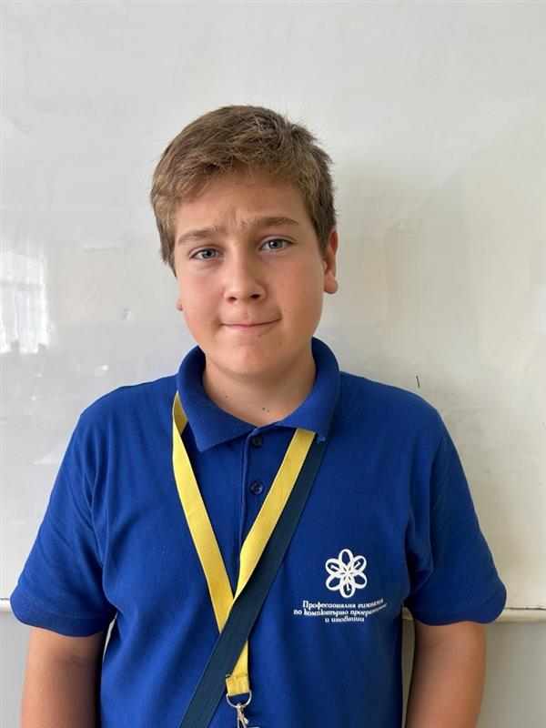
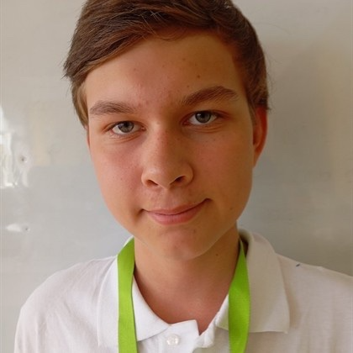
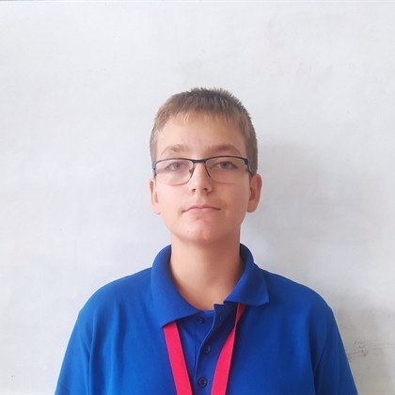
1.People in the team
Михаил Мавродиев
Йоан Георгиев
Атрем Бок
Йордан Райнов

Slide 3






2.Apps We used in the project

Slide 4

3.Our Inspiration
We were somewhat inspired by the game Called Wordle – made by Josh Wardle.
Some of out games mechanic were inspired by it ,but it still has its own differences from ours, just as we have differences from it .

Slide 5

4.Our Goal
Our goal is to make a nice project for people to enjoy games about words and make it a nice little challenge for people who have a great verity and knowledge of the English dictionary.

Slide 6
Thank you for your attention !

