Slide 1
Index
Slide 1 -> Index
Slide 2 -> JVM,JRE and JDK
Slide 3 -> Memory Management i7/8
Slide 4 -> Garbage collection
Slide 5 -> Garbage collection part 2
Slide 6 -> Serialization
Slide 7 -> Exception and Error

Slide 2
JVM JRE and JDK
Set of Libraries (rt.jar)
Compile
Development tools e.g., javac, java
Javac
JVM
+
+
Other Files
.java
JDK
.class
JRE
JDK
JDK
Development tools
JRE + JVM also is part of JFK
Responsible for converting .java code to .class or byte code.
Types of class loader
Bootstrap class loader: Its job is to first load the pure java class loader. Load classes from rt.jar Doesn’t have any parent class loader
Extension class loader: It is the child of bootstrap class loader and load the extension of core java classes from jre/lib/ext directory or any other directory pointed by java.ext.dirs
System class loader: Application class loader loads the classes found in -classpath
JVM
Java Virtual Machine is responsible for executing the java program.
Also known as interpreter
Bootstrap class loader is part of JVM
JRE
Lang and util base libraries
JVM
User Interface toolkits
Integration Libraries
Deployment technologies
Responsible for initiating JVM for the program and load classes in JVM

Slide 3
Memory Management in Java7/8
Method Area
Heap
PermGen Memory
Heap Memory
Other memory
Stack Area
Native Method/C Stack
- Only one method area created at the time of JVM started
- Class name, parent class name , method and variable information is stored.
- Constructor field data
- Can be fixed or dynamic
Heap Area:
- Real object of all the classes and instances
Size can be dynamic or fixed
Object is reclaimed by GC
Maximum java heap size: -xmx
Initial java heap size: -xms
PermGen Memory(Applicable till Java 7)
Stores class related metadata
Static data, primitive variable
Constant pool, method code field
Default size: 64 Mb
Max perm be set by –XX:MaxPermSize
Initial size: -xx: PermSize
Other Memory:
Used to store JVM code, internal structure
Stack Area
Store method specific values
Reference to the other object in heap
Need not be contiguous
Size can either be dynamic or fixed
Variables stored in the stack will have certain visibility
Native stack
Written in other programming language not is java
The Java Native Interface called Native stack
Size can be dynamic or fixed.
MetaSpace From Java 8:
MetaSpace auto increases its size
Garbage collection is more efficient
It is not a part of heap area anymore. Now part of native memory
Does not store static variables and string pool anymore.
Young Generation
Old Generation
Stores newly created object and instances
Minor Garbage collection runs on it.
Longed lived objects which survive many rounds of minor garbage collection.

Slide 4
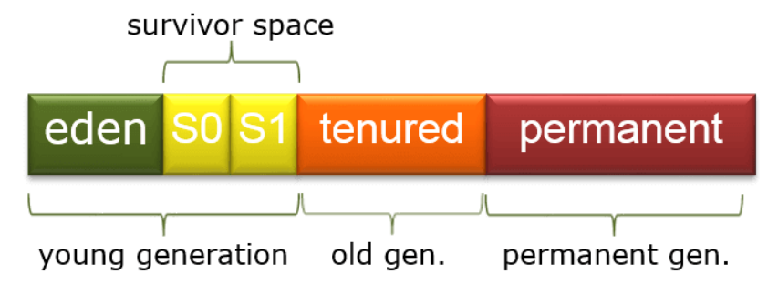
Garbage collection in Java
During full garbage collection, objects from all generations are collected and cleaned.
Newly created objects
Eden Space and two survivor space.
Minor garbage collection
Long lived which survived minor garbage collection
Major garbage collection
Used to store metadata of the class.
No more available from Java 8
Concurrent Mark Sweep
- Multiple threads are used for minor garbage collection
Major GC is multi threaded, but CMC runs concurrently alongside application process.
Garbage First
- Its is parallel and concurrent like CMS
- Intended to design for multi threaded application
- It partitioned the heap size into multiple sets and run multiple threads on each set
Serial
- All garbage collection events are conducted serially in one thread
- Is the application being small and run-on single processor.
Parallel
- Multiple threads are used for minor garbage collection
- A single thread is used for major GC.

Slide 5

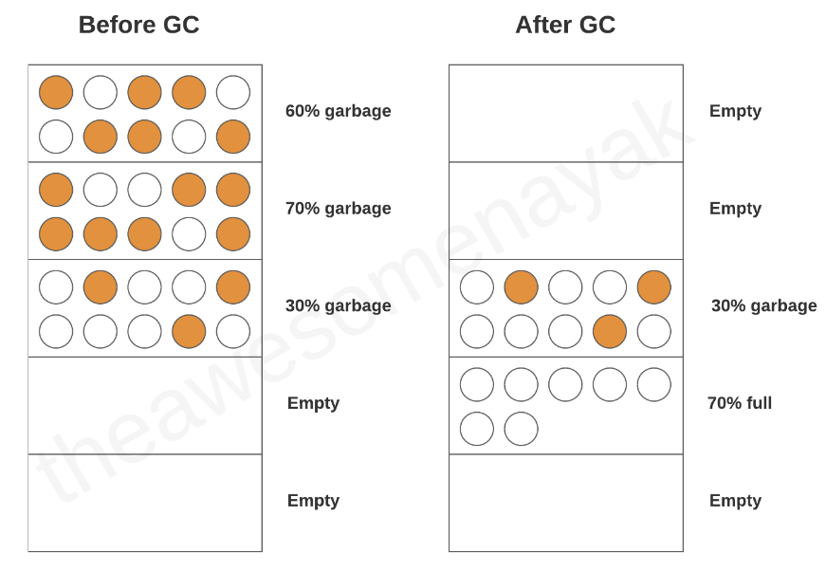
Garbage collection in Java Part 2
Garbage First (G1)
Intended for large multithreaded application (Heap size > 4GB)
Each gen is a set of regions which allows the resizing of the young gen
It partition the heap into set of equal sizes and run parallel multiple threads
After the mark phase is completed, G1 knows which has large number of garbage objects, it perform GC on that region first.
Can be set by -XX:+UseG1GC
Two more regions
Humongous for large objects
Available for unused and unallocated space.
ZGC
Intended for low latency (10 ms pause) application and have large Heap (multi terabyte)
Low latency, scalability and ease of use.
ZGC allows a java application running while it performs all garbage collection operation.
Set -XX:+UnlockExperimentalVMOptions -XX:+UseZGC
Epsilon Garbage Collector
Do nothing GC which is present in JDK 11.
Handles memory allocation but does not perform any reclaim mechanism
Once the heap size is full, application will come to halt.
It can be used in ultra latency-sensitive application.
Can be set by:
XX:+UnlockExperimentalVMOptions -XX:+UseEpsilonGC
Garbage Collector Best Practices
Avoid manual triggers.
Use tool for analysis
Default settings are Good
Use JVM flags for tuning
Select the right collector.

Slide 6
Serialization in Java
Java Object
Serialization
010111011
Serialization with inheritance
Deserialization
Process to convert Java object to Binary object or Streams is called Serialization and the reverse is deserialization.
The class needs to implement java.io.serializable interface which is marker interface.
ObjectInputStream.readObject is used to deserialize
ObjectOutputStream.writeObject is used serialize.
If we want o not serialize any data member of the class, just annotate it with transient keyword.
Uses:
Communication
Caching
Persistence
Deep Copy
Cross JVM synchronization
class Foo {
public String name;
public Foo() {
this.name = "Default";
} // Default constructor is important.
public Foo(String name) {
this.name = name;
}
}
class Bar extends Foo implements java.io.Serializable {
public int id;
public Bar(String name, int id) {
super(name);
this.id = id;
}
}
Notice that Foo doesn't implement Serializable. So what happens when bar is serialized?
it prints "Default 21"
To allow subtypes of non-serializable classes to be serialized, the subtype may assume responsibility for saving and restoring the state of the supertype's public, protected, and (if accessible) package fields. The subtype may assume this responsibility only if the class it extends has an accessible no-arg constructor to initialize the class's state. It is an error to declare a class Serializable if this is not the case.
During deserialization, the fields of non-serializable classes will be initialized using the public or protected no-arg constructor of the class. A no-arg constructor must be accessible to the subclass that is serializable. The fields of serializable subclasses will be restored from the stream.
Thus, default no-arg constructor of class Foo called of, resulted in initialization.
Class Refactoring in serialization/deserialization
Some of the changes are allowed in the class after the object is serialized.
Adding new variable to the class
Changing the variable from transient to non transient
Changing the variable from static to non static.
- All this is allowed only if we assign the serialVersionUID to the class.
Before serialization:
Class student{
static String name;
transient int rollNum;
}
After serialization:
Class student{
String name; // removed static keyword
int rollNum; // removed transient label
int marks; // Added new field allowed
}

Slide 7
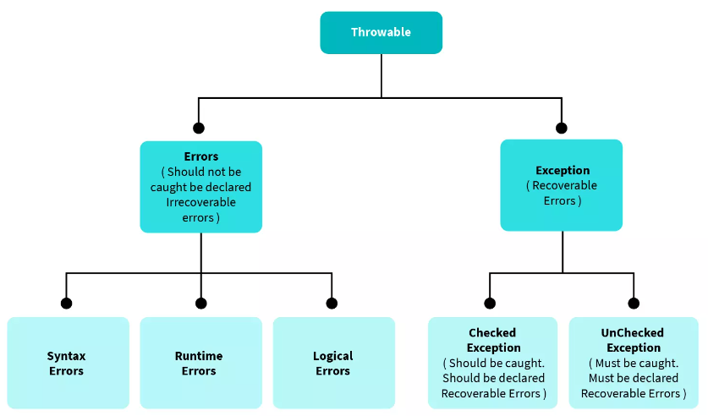
Exception & Errors in Java
Error: Unrecoverable system condition, can’t be handled by code. (Unchecked Type)
Exception: Recoverable condition and can be handled by code. (Checked Type)
Errors:
Errors are critical conditions that occurs because of lack of system resources. Stackoverflow, outOfMemoryError, system crash error. Error will always of the unchecked type exception. Compiler has no idea about the errors in the system.
Exception:
Exceptions are happening because of the problem in the code. It can be recovered or catches in catch block of the code. Exceptions can be classified as checked or unchecked types.
Creating a custom exception class
class InvalidAgeException extends Exception {
public InvalidAgeException (String str)
{
// calling the constructor of parent Exception
super(str);
}
}

Slide 8
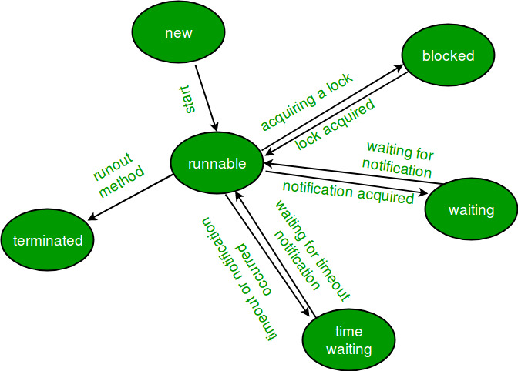
Threads/Cucurrancy in Java
In 1.x release: Some Exception
java.lang.Thread java.lang.IllegalMonitorStateException
java.lang.Runnable java.lang.IllegalStateException
java.lang.ThreadGroup java.lang.IllegalThreadStateException
java.lang.Process
java.lang.ThreadDeath
In 5.x release:
Executor
Semaphore
latch
barrier
concurrent collection
In 7.x release:
forkJoinPool
Thread class Vs Runnable Interface:
Runnable is preferred over Thread class to create a Thread as it allows to extend other class as well where as if we try to create a thread by extending Thread class, we cannot extend any other class as multiple inheritance is not allowed in Java.
When we extend Thread class, each of our thread creates unique object and associate with it. When we implements Runnable, it shares the same object to multiple threads.
Important Keywords related to threads in java
Join(): public final void Join() throws InterruptedException
This method is used to join the start of a thread execution to
the end of another thread execution.
Giving a timeout within a join will make join effect over after
the specified time.
Yield():
Suppose there are 3 threads T1, T2
T1 -> execution time -> 5 hour
T2 -> execution time -> 5 min
If T2 has same or higher priority than T1, T1 can request the
scheduler to schedule another thread which is in
read/runnable state. It is a request and scheduler can ignore it.
3. wait():
Thread acquires the intrinsic lock when it enters a synchronized method. Thread inside the synchronized method is set as the owner of the lock and is in RUNNABLE state. Any thread that attempts to enter the locked method becomes BLOCKED.
When thread calls wait it releases the current object lock (it keeps all locks from other objects) and than goes to WAITING state.
When some other thread calls notify or notifyAll on that same object the first thread changes state from WAITING to BLOCKED, Notified thread does NOT automatically reacquire the lock or become RUNNABLE, in fact it must fight for the lock with all other blocked threads.
WAITING and BLOCKED states both prevent thread from running, but they are very different.
WAITING threads must be explicitly transformed to BLOCKED threads by a notify from some other thread.
WAITING never goes directly to RUNNABLE.
When RUNNABLE thread releases the lock (by leaving monitor or by waiting) one of BLOCKED threads automatically takes its place.
So to summarize, thread acquires the lock when it enters synchronized method or when it reenters the synchronized method after the wait.
public synchronized guardedJoy() {
// must get lock before entering here
while(!joy) {
try {
wait(); // releases lock here // must regain the lock to reentering here
} catch (InterruptedException e) {}
}
System.out.println("Joy and efficiency have been achieved!");
}
Life Cycle of a thread.

Slide 9
Programs
Recursion

Slide 10
Recursion 4 basic things: 1. Recursion 2. Base condition 3. Stack overflow/ Stack space 4. Recursion Tree
1. Print Name 5 times.
2. Print linearly from 1 to N
3. Print from N to 1.
4. Print linearly from 1 to N (using backtrack)
5. Print linearly N to 1 (using backtrack)
1. Print Name 5 times
void f(int i){
if(i>5){
return;
}
print(“Kuhu”);
f(i+1)
}
main(){
int n;
f(1, n);
}
2. Print linearly from 1 to N
void f(int i, int n){
if(i>n){
return;
}
print(i);
f(i+1, n)
}
main(){
int n;
f(1, n);
}
2. Print linearly from N to 1
void f(int i){
if(i<1){
return;
}
print(i);
f(i-1)
}
main(){
int n;
f(n);
}
4. Print linearly from 1 to N (Backtracking)
void f(int i){
if(i<=0){
return;
}
f(i-1);
print(i);
}
main(){
int n;
f(1);
}
5. Print linearly from N to 1 (Backtracking)
void f(int I, int n){
if(i>n){
return;
}
f(i+1,n);
print(i);
}
main(){
int n;
f(0,n);
}

Slide 11
Sum of first N number:
Using for loop
void f(int i){
int sum = 0;
for(int i=0; i<=n ; i++){
sum = sum + i;
}
}
2. Parameterised Function call
void f(int I, int sum){
if(i<1){
print(sum);
return;
}
f(i - 1, sum + i);
}
Main(){
int n;
f(n, 0);
}
2. Functional Recursion call
int f(int n){
if(n<0){
return 0;
}
return n + f(n-1);
}
Main(){
int n;
f(n);
}
Factorial of first N number:
Using for loop
int f(int n){
if(n == 0 || n ==1) return 1;
int fact =1;
for(int i=2; i<=n ; i++){
fact = fact * i;
}
}
Main(){
f(n);
}
Using functional loop
int f(int n){
if(n <=1) return 1;
return n * f(n-1);
}
Main(){
f(n);
}

Slide 12
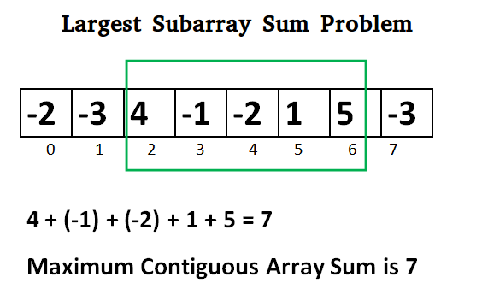
Largest Sum Contiguous Subarray (KADANE’s Algorithm)
Given an array arr[] of size N. The task is to find the sum of the contiguous subarray within an arr[] with the largest sum
class SubArrayProblem {
static void maxSubArraySum(int a[], int size)
{
int max_so_far = Integer.MIN_VALUE,
max_ending_here = 0, start = 0, end = 0, s = 0;
for (int i = 0; i < size; i++) {
max_ending_here = max_ending_here + a[i];
if (max_so_far < max_ending_here) {
max_so_far = max_ending_here;
start = s;
end = i;
}
if (max_ending_here < 0) {
max_ending_here = 0;
s = i + 1;
}
}
System.out.println("Maximum contiguous sum is " + max_so_far);
System.out.println("Starting index " + start);
System.out.println("Ending index " + end);
}
// Driver code
public static void main(String[] args)
{
int a[] = { -2, -3, 4, -1, -2, 1, 5, -3 };
int n = a.length;
maxSubArraySum(a, n);
}
}
Pseudocode:
Initialize: max_so_far = INT_MIN max_ending_here = 0
Loop for each element of the array
(a) max_ending_here = max_ending_here + a[i] (b) if(max_so_far < max_ending_here) max_so_far = max_ending_here (c) if(max_ending_here < 0) max_ending_here = 0 return max_so_far

