Slide 1



Proposal Title
2026
PREPARED BY PLUS 94 RESEARCH
{{DATE}}

Slide 2
RESEARCH BACKGROUND
Section 01
Technical Proposal
PROPOSAL TEMPLATE FOR: {{CLIENT_NAME}}
PREPARED BY PLUS 94 RESEARCH
{{DATE}}
01

Slide 3


CONTENTS
4
5
6
7
8
9
12
15
14
16
20
Introduction
Research Background
Research Objectives
Research Universe
Research Methodology
Quality Controls
Project Risk
Project Plan and Timeline
Project Deliverables
Project Assumptions
Financial Costing
Company Profile

Slide 4

INTRODUCTION
STUDY TYPE:
{{STUDY_TYPE}}
INDUSTRY:
{{INDUSTRY}}
www.plus94.co.za

Slide 5
RESEARCH BACKGROUND
{{BACKGROUND}}
www.plus94.co.za

Slide 6
RESEARCH OBJECTIVES
{{OBJECTIVES}}
www.plus94.co.za

Slide 7
RESEARCH UNIVERSE
{{UNIVERSE}}
www.plus94.co.za

Slide 8
RESEARCH METHODOLOGY
{{METHODOLOGY}}
www.plus94.co.za

Slide 9
QUALITY CONTROLS
{{QUALITY_CONTROLS}}
www.plus94.co.za

Slide 10
QUALITY CHECKING SYSTEM
Plus 94 Research has developed and implemented a structured quality assurance system that ensures mandatory quality checks are conducted at every critical stage of the research process, as illustrated below:
Field
Web Server
Database
IT
Department
Web
Interface
Editing
Coding
Verification
Supervisor
Statistician
Data
Processing
Client
This system promotes consistency, accuracy, completeness and compliance with established research standards and project requirements. It incorporates predefined quality control measures, review procedures and verification checkpoints to identify and address potential errors, discrepancies or omissions before deliverables are finalised. This ensures that all research outputs meet the required quality standards and are thoroughly reviewed before submission to clients.
www.plus94.co.za

Slide 11
Overall Project Quality Standards
Quality standards are of the utmost importance to Plus 94 Research. The following are brief descriptions of how we approach projects:
Experienced and qualified researchers are responsible for the project management and the design of the discussion guide, interview guide, or questionnaire.
Data is double captured, and integrity testing is done.
Methodologies are carefully followed and monitored throughout the survey period.
Coding, data capturing, processing, and statistical analyses are done in-house by highly skilled and experienced personnel.
Specialists conduct statistical analysis with recognised SPSS software.
Experienced research executives report survey findings.
11
www.plus94.co.za

Slide 12
PROJECT RISK
{{RISKS}}
www.plus94.co.za

Slide 13
FINANCIAL PROPOSAL
Section 01
Timeline, Deliverables,
Costing & Terms
PROPOSAL TEMPLATE FOR: {{CLIENT_NAME}}
PREPARED BY PLUS 94 RESEARCH
{{DATE}}
01

Slide 14
PROJECT TIMELINE
{{TIMELINE}}
Activity | Responsibility | Week 1 | Week 2 | Week 3 | Week 4 |  | Week 5 | Week 6 | Week 7 | Week 8
Project Set-up
Proposal agreement and signing | Plus 94 Research & Client
Project set-up (implementation plan, group schedule, and sample approval) | Plus 94 Research & Client
Fieldwork
Design of research instruments | Plus 94 Research
Approval of research instruments | Client
Fieldwork: Phase 1 & Phase 2 | Plus 94 Research
Analysis and Reporting
Quality controls of all fieldwork | Plus 94 Research
Data processing and analysis | Plus 94 Research
Report writing | Plus 94 Research
Quality controls | Plus 94 Research
Delivery of final report | Plus 94 Research
www.plus94.co.za

Slide 15
PROJECT DELIVERABLES
{{DELIVERABLES}}
www.plus94.co.za

Slide 16
PROJECT ASSUMPTIONS
{{ASSUMPTIONS}}
www.plus94.co.za

Slide 17
FINANCIAL COSTING
Description | Qty | Unit Cost | Total (Excl. VAT)
TAPI (Tablet-assisted personal interviews)- for a maximum interview of 20 – 30 minutes. | 64
Total (Excl. VAT)
Vat Amount
Total (Inc. VAT)
*A Total of approximately 64 interviews will be conducted.
www.plus94.co.za

Slide 18


Tel : +27113272020
Fax: +27113272019
Website: www.plus94.co.za
Sandton Gate Central
Block 2 Level 2
25 Minerva Ave
Glenadrienne
Sandton
Ms Bulelwa Prens
ADMINISTRATIVE SUPPORT TO THE CEO'S OFFICE
Bulelwa@plus94.co.za
Rendani Nemavhulani
STRATEGIC SERVICES EXECUTIVE
Rendani@plus94.co.za
www.plus94.co.za

Slide 19

Standard Terms and Conditions
Unless otherwise specified in this document, the following conditions of engagement apply between Plus 94 Research (Pty) Ltd (Plus 94) and the Client:
This proposal in its entirety remains valid for acceptance for a set period of 60 days from the date on which it was sent to the Client. In the event that the work contained specifically in this quote is not commissioned within 60 days from the date on this quote, Plus 94 reserves the right to amend the proposal and the quoted fee and the initial quote will therefore not be open for acceptance. Furthermore, Plus 94 is not obligated to complete any task in terms of the initial proposal after the 60-day period for acceptance has expired.
Payment of the agreed upon remuneration shall be done on a 60/40 basis, unless otherwise agreed upon between the parties in writing and undersigned by both. 60% of the agreed upon remuneration shall become payable upon date of undersigning and be paid within seven days thereafter. The remaining 40% shall be payable upon date of completion of the project and no more than 30 days thereafter.
Any Client who is engaging the services of Plus 94 for the first time will correspondingly be liable for payment of the aforesaid 60% deposit and in the event that payment does not reflect within the seven-day period specified in (2) herein above, Plus 94 reserves the right not to commence with the project until such time as the deposit reflects in Plus 94’s nominated bank account. Plus 94 will not accept responsibility for payments made into incorrect account numbers or faulty administration of whatever nature and the project will only commence on the date that payment reflects in said bank account.
The agreed upon remuneration for Plus 94’s services covers the preparation and delivery of the final report (and up to three copies) and does not cover any additional work carried out at the Client’s specific written insistence and request, outside the scope of the proposal. Additional copies of reports over and above the three copies provided for will be charged at a rate that is in line with the actual cost of printing, as well as preparing the further bundle(s).
In the event that the Client requires any additional work from Plus 94, the Client shall indicate the aforesaid intention in writing (in the form of an additional purchase order) to the duly authorised representative of Plus 94. The additional purchase order shall be attached to the existing agreement between the parties on this particular project and shall be subject to any and all conditions stipulated in the aforementioned agreement.
This proposal is considered a fixed-price bid, except when the actual project specifications or parameters differ substantially from those described in the proposal. In that case, Plus 94 will notify the Client immediately following determination of those differences and discuss with the Client appropriate changes and/or the relevant cost implications.
In the event that the Client requests that the specifications/schedule for a specific study be altered, the Client agrees to submit such a request in writing to Plus 94 for consideration. A separate addendum, that reflects the amendments (if any), will be drafted and signed by both parties and will be attached to the main agreement between the parties. Plus 94 reserves the full right to amend the cost schedule for the project accordingly. The Client will (if applicable) be provided with an amended cost schedule for the proposed amendments which the Client will be required to sign. The amended schedules shall be regarded as valid amendments to the existing agreement between the parties and shall be subject to the exact same terms and conditions as the initial project parameters.
Plus 94 shall endeavour to achieve the dates mentioned in the proposal and notify the Client in writing if and when it is reasonably apparent that a delay may occur. The Client however indemnifies Plus 94 against the consequences of any unforeseen delays in full.
If the Client cancels a survey after it has been commissioned, a cancellation fee will be charged sufficient to cover the costs incurred by Plus 94, as well as the added value of the ideas that have gone into the design of the survey and questionnaires. The total value of the work done to date of cancellation will be calculated in Rand value by Plus 94 and the Client hereby agrees to pay the full amount stipulated on the invoice upon presentation thereof within 30 days.
Any and all disputes shall only be entertained once Plus 94’s non-negotiable fee in terms hereof has been paid in full.
The Client shall indemnify Plus 94 against all proceedings, costs, claims, expenses, and liabilities whatsoever that may occur wholly, or in part as a consequence of the use by or demonstration to third parties of any goods or services of the Client which, in accordance with the proposal, Plus 94 may give, loan, or sell to such third parties. Plus 94, as agent for the Client, will make any such gift, loan, or sale.
The Client furthermore indemnifies Plus 94 against any force majeure including, but not limited to: employee strikes, floods, fire, lightning damage, cyber terrorism, storm damage, employee illness or death, etc.
Plus 94 will always seek to ensure that surveys addressing public policy issues or other controversial subjects are balanced, comprehensive, and unbiased. Plus 94 will not agree to conduct surveys that do not meet these criteria. Plus 94 will work closely with the Client in the preparation of all study materials and will be responsible for the design of the study, the wording of questions and interpretation of survey findings. If, however, the Client does not provide its full and timeous co-operation for the duration of the project, Plus 94 will not be held liable for any consequences resulting from the Client’s actions.
The Client furthermore indemnifies Plus 94 against any and all action and/or consequences resulting from the Client’s dishonesty and/or misrepresentations. Plus 94 reserves the right to discontinue all work with immediate effect, cancel any agreement and claim damages in the event that information provided to Plus 94 was false, fraudulent, or misrepresented.
In all matters, Plus 94, as a research agency, adheres to the current Code of Standards for Survey Research of the Southern African Marketing Research Association (SAMRA). Clients who commission surveys for publication shall ensure that the form of publication complies with industry standards. In the event that the Client releases data from a survey that was not originally intended for publication, this Code will apply to it as if it had originally been commissioned for publication. The Client may choose to publish or not to publish a Plus 94 report. However, should the Client release any findings from a survey, it must also be willing to release the complete report.
Unless specifically requested to do so, Plus 94 will not keep paper questionnaires for more than 12 months after the completion of fieldwork. Data tapes on ad hoc research are kept for 24 months and permanently for a tracking study. If the tracking study is terminated, existing data tapes will be kept for 24 months after termination and will thereafter be given to the Client for longer-term storage.
Plus 94 remains the owner of any and all existing patents, copyrights and other relevant intellectual property registered in the name of Plus 94, as well as any and all patentable/copyrightable materials and/or intellectual processes that directly result from the project commissioned by the Client, insofar as it relates to the research field.
Plus 94 and the Client acknowledge that any and all information shared between the parties for the duration of the relationship shall remain confidential, even after the agreement between the parties has been terminated. However, the information contained in any report/proposal provided to the Client in terms of the agreement may be published, unless stated otherwise in the main agreement.
The Client agrees and accepts herewith that presentation of the final report will be limited to two contact sessions with the Plus 94 Project Director and Project Manager. One shall be the presentation of the results to the Client’s authorised representative(s) as stipulated in the agreement. In the event that it is necessary, the report/findings will be presented to the Client’s Executive Committee upon request and same shall form part of the agreed upon project amount. Any further presentations must be requested from Plus 94 in writing and will be charged at the actual cost of the presentation of the results including, but not limited to: travelling costs, hourly staff rates of staff involved with the presentation, preparation costs and other direct disbursement involved therewith. An additional invoice will be prepared for the additional presentation(s) and the Client hereby agrees that the aforementioned additional invoice will be paid no more than 30 days after presentation thereof to the Client.
The Client agrees that the Laws of the Republic of South Africa shall govern the entirety of the relationship between the parties.

Slide 20
PLUS 94 RESEARCH
Section 01
Company Profile
PROPOSAL TEMPLATE FOR: {{CLIENT_NAME}}
PREPARED BY PLUS 94 RESEARCH
{{DATE}}
01

Slide 21

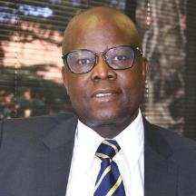


Plus 94 Research was founded in 1998 by its main shareholders, Dr Sifiso Falala and Dr Tirhani Mabunda. The organisation has since grown to become a world-class, full-service market research company.
Dr Sifiso Falala
Dr Tirhani Mabunda
Chief Executive Officer
Plus 94 Research
Shareholder
Plus 94 Research
The name Plus 94, which is a celebration of diversity and nationhood, means:
Celebrating over 27 years in the business, Plus 94 Research offers its clients tools with which to make effective decisions. We are a team of highly qualified and dedicated researchers. Plus 94 Research employs over 140 full-time research professionals (research executives, field managers/supervisors, data processing staff, and other administrative staff). The company also has a reservoir of approximately 1 500 interviewers on call around South Africa.
After the watershed year 1994
Transparency
World-class quality
Beckoned by its values of being dynamic, intellectual, and authentic, Plus 94 Research celebrates its 28th year in the market research industry. This is 28 years of offering our clients quality market research services that are, at their core, solution driven and inform the key decisions that our clients need to make. We are the science of decision-making.
Plus94 Research - The science of decision-making

Slide 22
Mission
Our mission is simply to establish a research business whose technical and financial competencies defy conventional wisdom about its presumed capabilities, given its global location and history. We seek to enhance the commercial and social interests of our clients and thus have an incrementally significant impact in our communities.
Vision
We leave no stone unturned in deploying the best possible people and technology to do the research job. Our people have a strong performance ethic, the will and means to improve continually, as well as a focus on maximising quality while minimising the time taken.
Plus 94 Research Solutions
Business To Business
Focus
Groups
Online Surveys
Research
Consumer Research
In-depth Interviews
CATI Interviews
TAPI Interviews
Propriety Panel Building
Observation Surveys
Mystery Shopping

Slide 23
Plus 94 Research continues to conduct research and development work as part of an ongoing service to our clients. We are positioned as a dynamic and innovative post-apartheid organisation that is committed to world-class practices in the delivery of quality market research solutions to our clients.
We deliver actionable market research solutions to our clients, achieved through uncompromising professionalism, commitment and integrity.
These are some of the attributes that give us the edge in helping our clients take strategic future decisions with greater degrees of confidence:
A multidisciplinary team of qualified experts
Many years of experience in handling complex projects
An unbeatable empowerment record
Global best practice
Expertly designed research surveys
Dedicated team players who work with the client every step of the project
Strategic insights and value addition
Personal and professional integrity

Slide 24
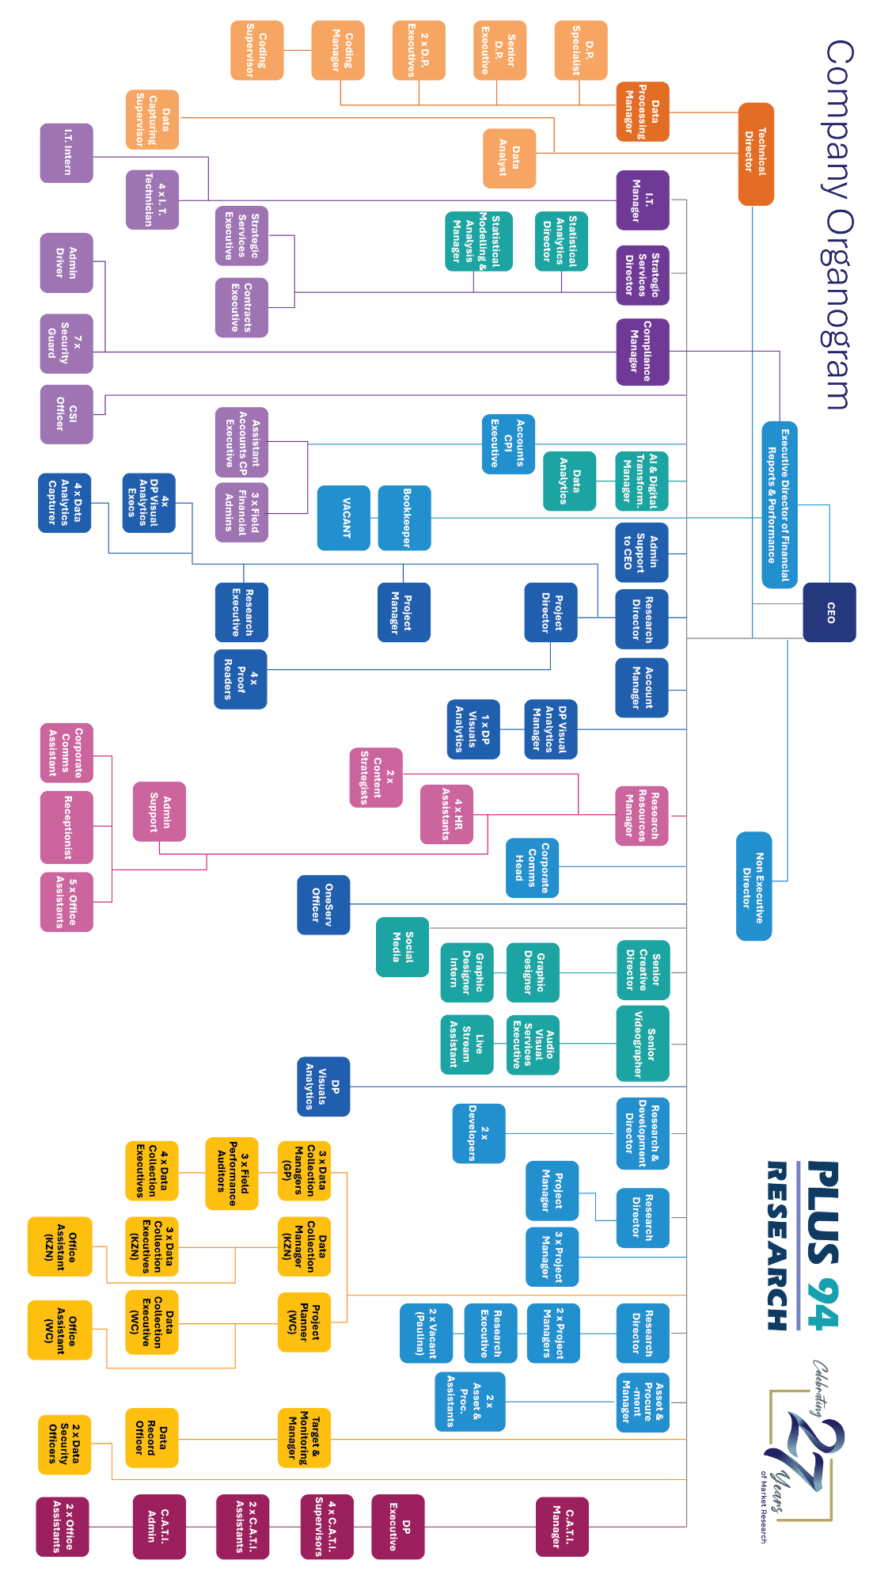

Slide 25

















Our Clients
Plus 94 Research has conducted numerous, extensive and complex national research surveys over the years comparable in nature to the one at hand. Plus 94 Research has a client base consisting of 42 current projects. The duration of project contracts varies from three weeks to three years. A few of our recent clients are shown here:
Research Express – Product Overview
Research Express is an affiliate of Plus 94 Research that conducts digital in-depth and analytical surveys via a secure website that hosts live research discussions.
Research Express takes advantage of text-based online social interaction, much like social networks such as Facebook and Twitter, which have rapidly substituted traditional social interactions. Text is powerful, direct, introspective and could potentially be more precise in unearthing true views and emotions. Research Express provides a secure, professional environment where participants register with a username, are authenticated and segmented, and the discussions are research objective driven. The platform is also fully POPIA compliant. Text mining allows for reports to be made available almost immediately.

Slide 26

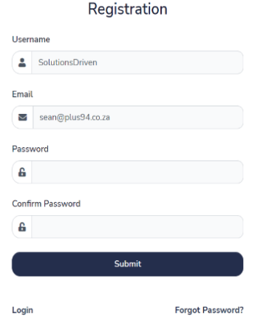
The platform differs from standard social chat groups such as WhatsApp, in that there is respondent confidentiality, yet the back-end data can be segmented in a manner that retains this anonymity with the added benefit of providing clients with demographically accurate research results. It is also designed for research purposes and managed by a research company. The respondents are also sourced from a large and growing database of relevant consumers.
Compare and Contrast to FGD’s and IDI’s
FOCUS GROUP/IDI (In-depth Interview) | RESEARCH EXPRESS
Physical meeting | Virtual meeting
Voice | Text with videos and pictures
Moderator | Possibility of several/self-moderation
About two hours long | About 70 minutes long
Slow build-up | Fast paced
Starts on the day | Can begin before the day
Recruit and moderate | Invite from a panel
Harder to ascribe individuals | Information has individual footprint
Confirmation is by call or physical | Confirm on the Research Express site
Usually a dedicated topic | Can multitask topics
Recording and transcription | Automatic transcription
One voice at a time | Multiple voices
Only 8-12 respondents | 15-45 respondents
Steered group dynamics | Natural group dynamics

Slide 27
Thank You
2026
www.plus94.co.za

