Slide 1


Slide 2
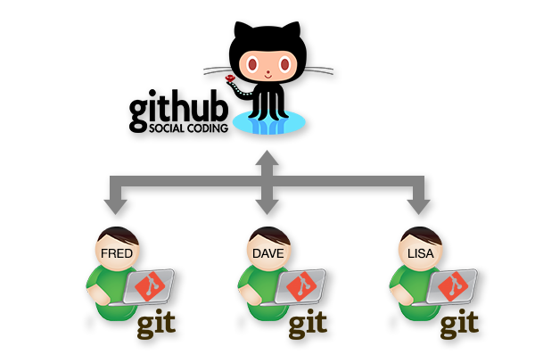
What is GitHub?
A collaborative tool used to keep track of changes to a project.
Tracks the changes, who made the changes, and when.
GitHub is a remote server where you store all your project files.
https://github.com/

Slide 3
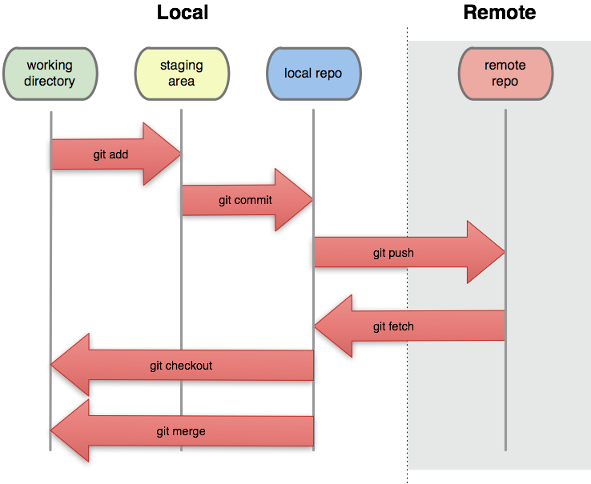
What is Git?
Command line tool used to track file changes on a local machine.
Can be setup for collaboration through the use of remote repositories.
Basic commands:
Git init
Git status
Git commit -m
Git push
Git pull
https://git-scm.com/

Slide 4
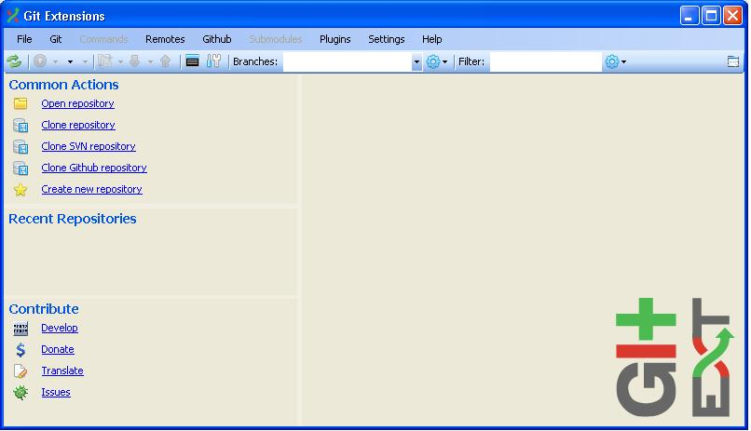
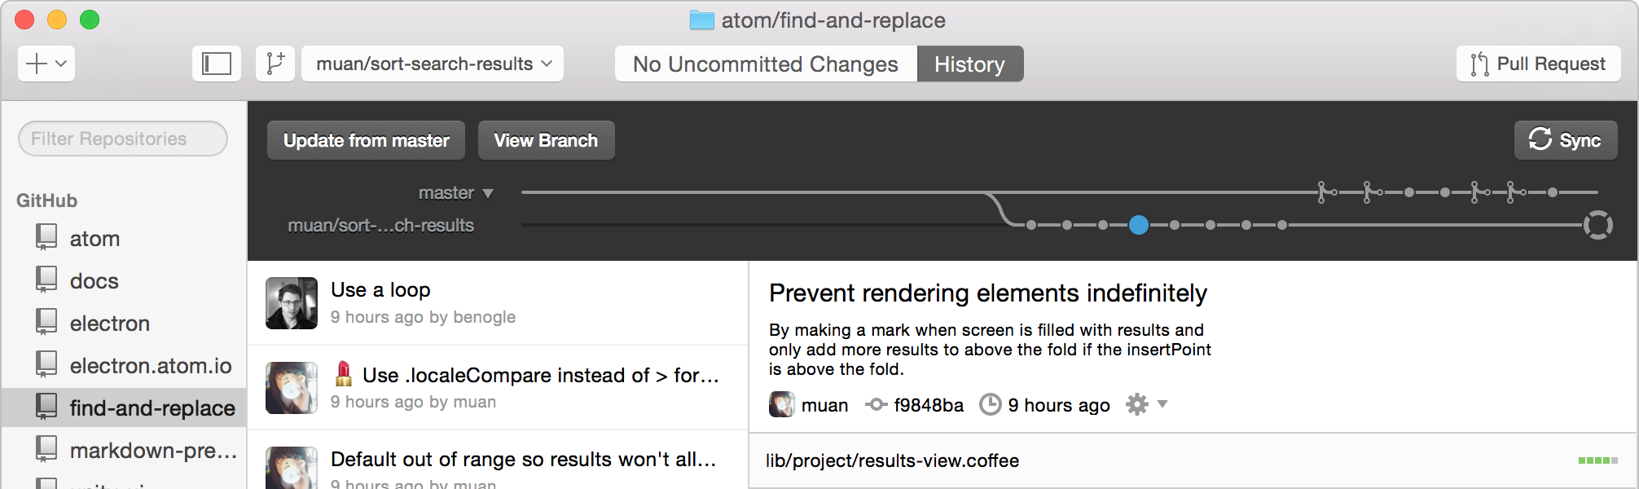
First thing
Sign up for a GitHub account
Download Git
Options:
GitHub desktop
Git Extensions
Just Git on command line

Slide 5
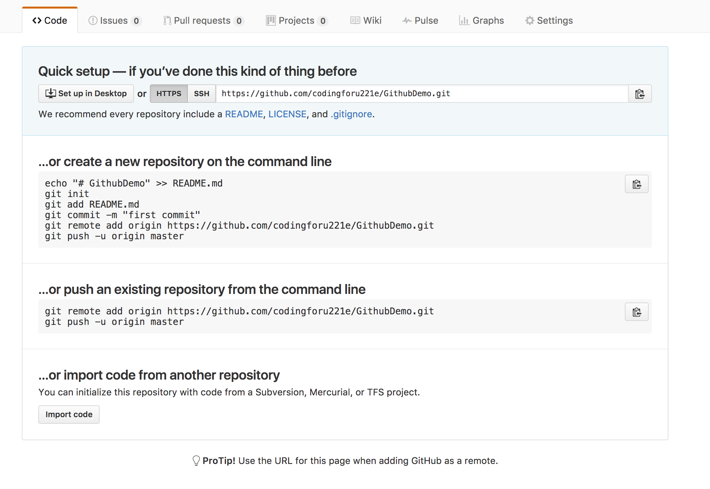
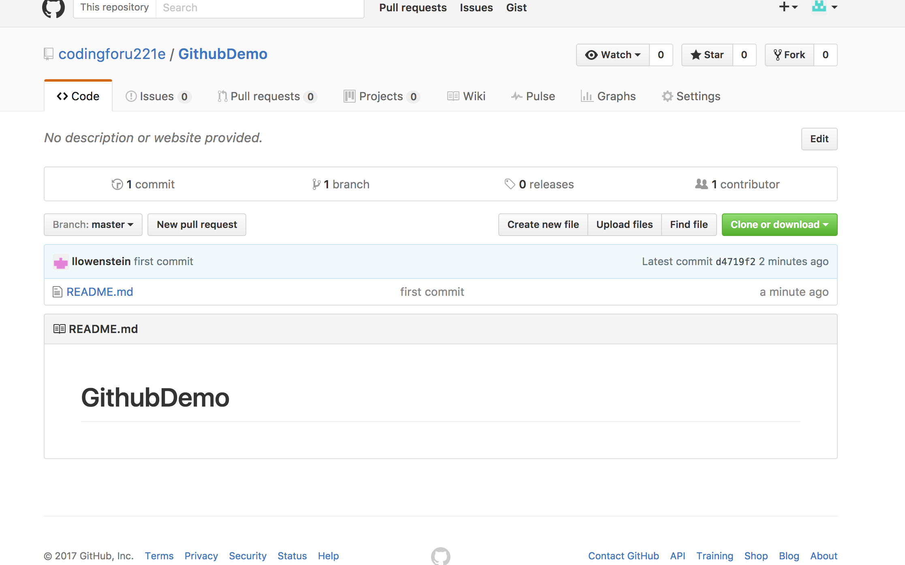
Getting set up

Slide 6
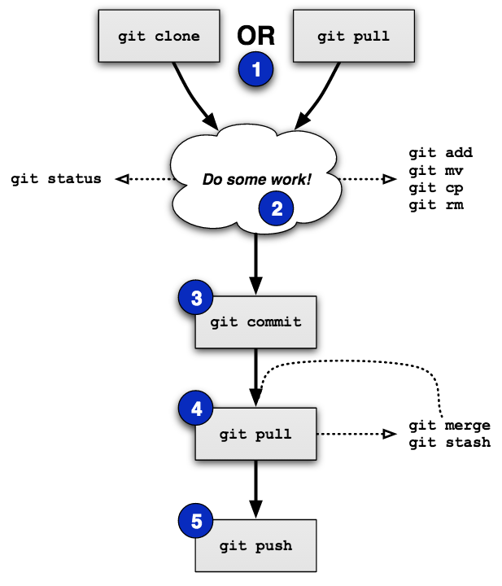
Using Git
Git init <name>
Initializes the repo
Git pull <name?
Downloads changes that are on GitHub onto your local machine
Git add name.txt OR *:
Add a single file
* for all unstaged files
Git commit -m:
Commits your staged items.
-m should be followed by a message between quotes.
Ex. commit -m “Fixed UI bugs”

Slide 7

Using Git
Git push <name>
Pushes your changes to the GitHub repo
Git config --global user.name “Name here”
Git config --global user.email email@gmail.com
Git config --global --unset user.email
Git log
And many many more...

Slide 8

Scavenger hunt!
https://github.com/codingforu221e/GithubDemo
Clone the Coding for All repo
And pull to get the Git commands cheat sheet
Feel free to test out the different GitHub commands by pushing and pulling
**Please keep everything PG as this is completely public!**
Have Fun!!!

