Slide 1



Slide 2
CHANNEL PARTNER MEET · HOLIDAY INN
Beyond Business.
Beyond Boundaries.
THE JAIN GROUP · CARING FOR YOUR DREAMS
WWW.THEJAINGROUP.COM
Notes:
Open cold. Let the title card hold for a beat before speaking.

Slide 3



ABOUT US
The Jain Group
For decades the Jain Group has built landmark addresses across West Bengal under one promise — caring for your dreams. Today the group spans premium residential communities and hospitality, led by a vision to create homes families are proud to own.
Real Estate
Hospitality
Premium residential communities across West Bengal.
Hotels and premium banqueting under trusted brands.
CHANNEL PARTNER MEET · HOLIDAY INN
Notes:
One promise across three businesses — real estate, hospitality, finance & auto.

Slide 4






OUR PORTFOLIO
Landmark Addresses
Across Bengal
UNDER CONSTRUCTION
Dream Gurukul
LOCATION
Near Airport, Madhyamgram
UNIT & PRICE · ONWARDS
2 BHK
₹57 L
3 BHK
₹80 L

Slide 5
OUR PORTFOLIO
Landmark Addresses
Across Bengal
UNDER CONSTRUCTION
Dream Gurukul
LOCATION
Near Airport, Madhyamgram
UNIT & PRICE · ONWARDS
2 BHK
₹57 L
3 BHK
₹80 L

Slide 6
OUR PORTFOLIO
Landmark Addresses
Across Bengal
READY TO MOVE IN
Dream One
LOCATION
New Town, Kolkata
UNIT & PRICE · ONWARDS
2 BHK
₹1.15 Cr
3 BHK
₹2.01 Cr
4 BHK
₹3.40 Cr
Duplex
₹4.70 Cr

Slide 7
OUR PORTFOLIO
Landmark Addresses
Across Bengal
READY TO MOVE IN
Dream One
LOCATION
New Town, Kolkata
UNIT & PRICE · ONWARDS
2 BHK
₹1.15 Cr
3 BHK
₹2.01 Cr
4 BHK
₹3.40 Cr
Duplex
₹4.70 Cr

Slide 8
OUR PORTFOLIO
Landmark Addresses
Across Bengal
READY TO MOVE IN
Dream Exotica
LOCATION
Madhyamgram
UNIT & PRICE · ONWARDS
2 BHK
₹45 L
3 BHK
₹55 L

Slide 9
OUR PORTFOLIO
Landmark Addresses
Across Bengal
READY TO MOVE IN
Dream Exotica
LOCATION
Madhyamgram
UNIT & PRICE · ONWARDS
2 BHK
₹45 L
3 BHK
₹55 L

Slide 10
OUR PORTFOLIO
Landmark Addresses
Across Bengal
READY TO MOVE IN
Dream Valley
LOCATION
Siliguri
UNIT & PRICE · ONWARDS
3 BHK
₹74 L

Slide 11
OUR PORTFOLIO
Landmark Addresses
Across Bengal
READY TO MOVE IN
Dream Valley
LOCATION
Siliguri
UNIT & PRICE · ONWARDS
3 BHK
₹75 L

Slide 12
OUR PORTFOLIO
Landmark Addresses
Across Bengal
READY TO MOVE IN
Dream Eco City
LOCATION
Durgapur
UNIT & PRICE · ONWARDS
2 BHK
₹34 L
2.5 BHK
₹40 L

Slide 13
OUR PORTFOLIO
Landmark Addresses
Across Bengal
READY TO MOVE IN
Dream Eco City
LOCATION
Durgapur
UNIT & PRICE · ONWARDS
2 BHK
₹34 L
2.5 BHK
₹40 L

Slide 14
OUR PORTFOLIO
Landmark Addresses
Across Bengal
READY TO MOVE IN
Dream World City
LOCATION
Joka, Kolkata
UNIT & PRICE · ONWARDS
2 BHK
₹29 L
3 BHK
₹36 L

Slide 15
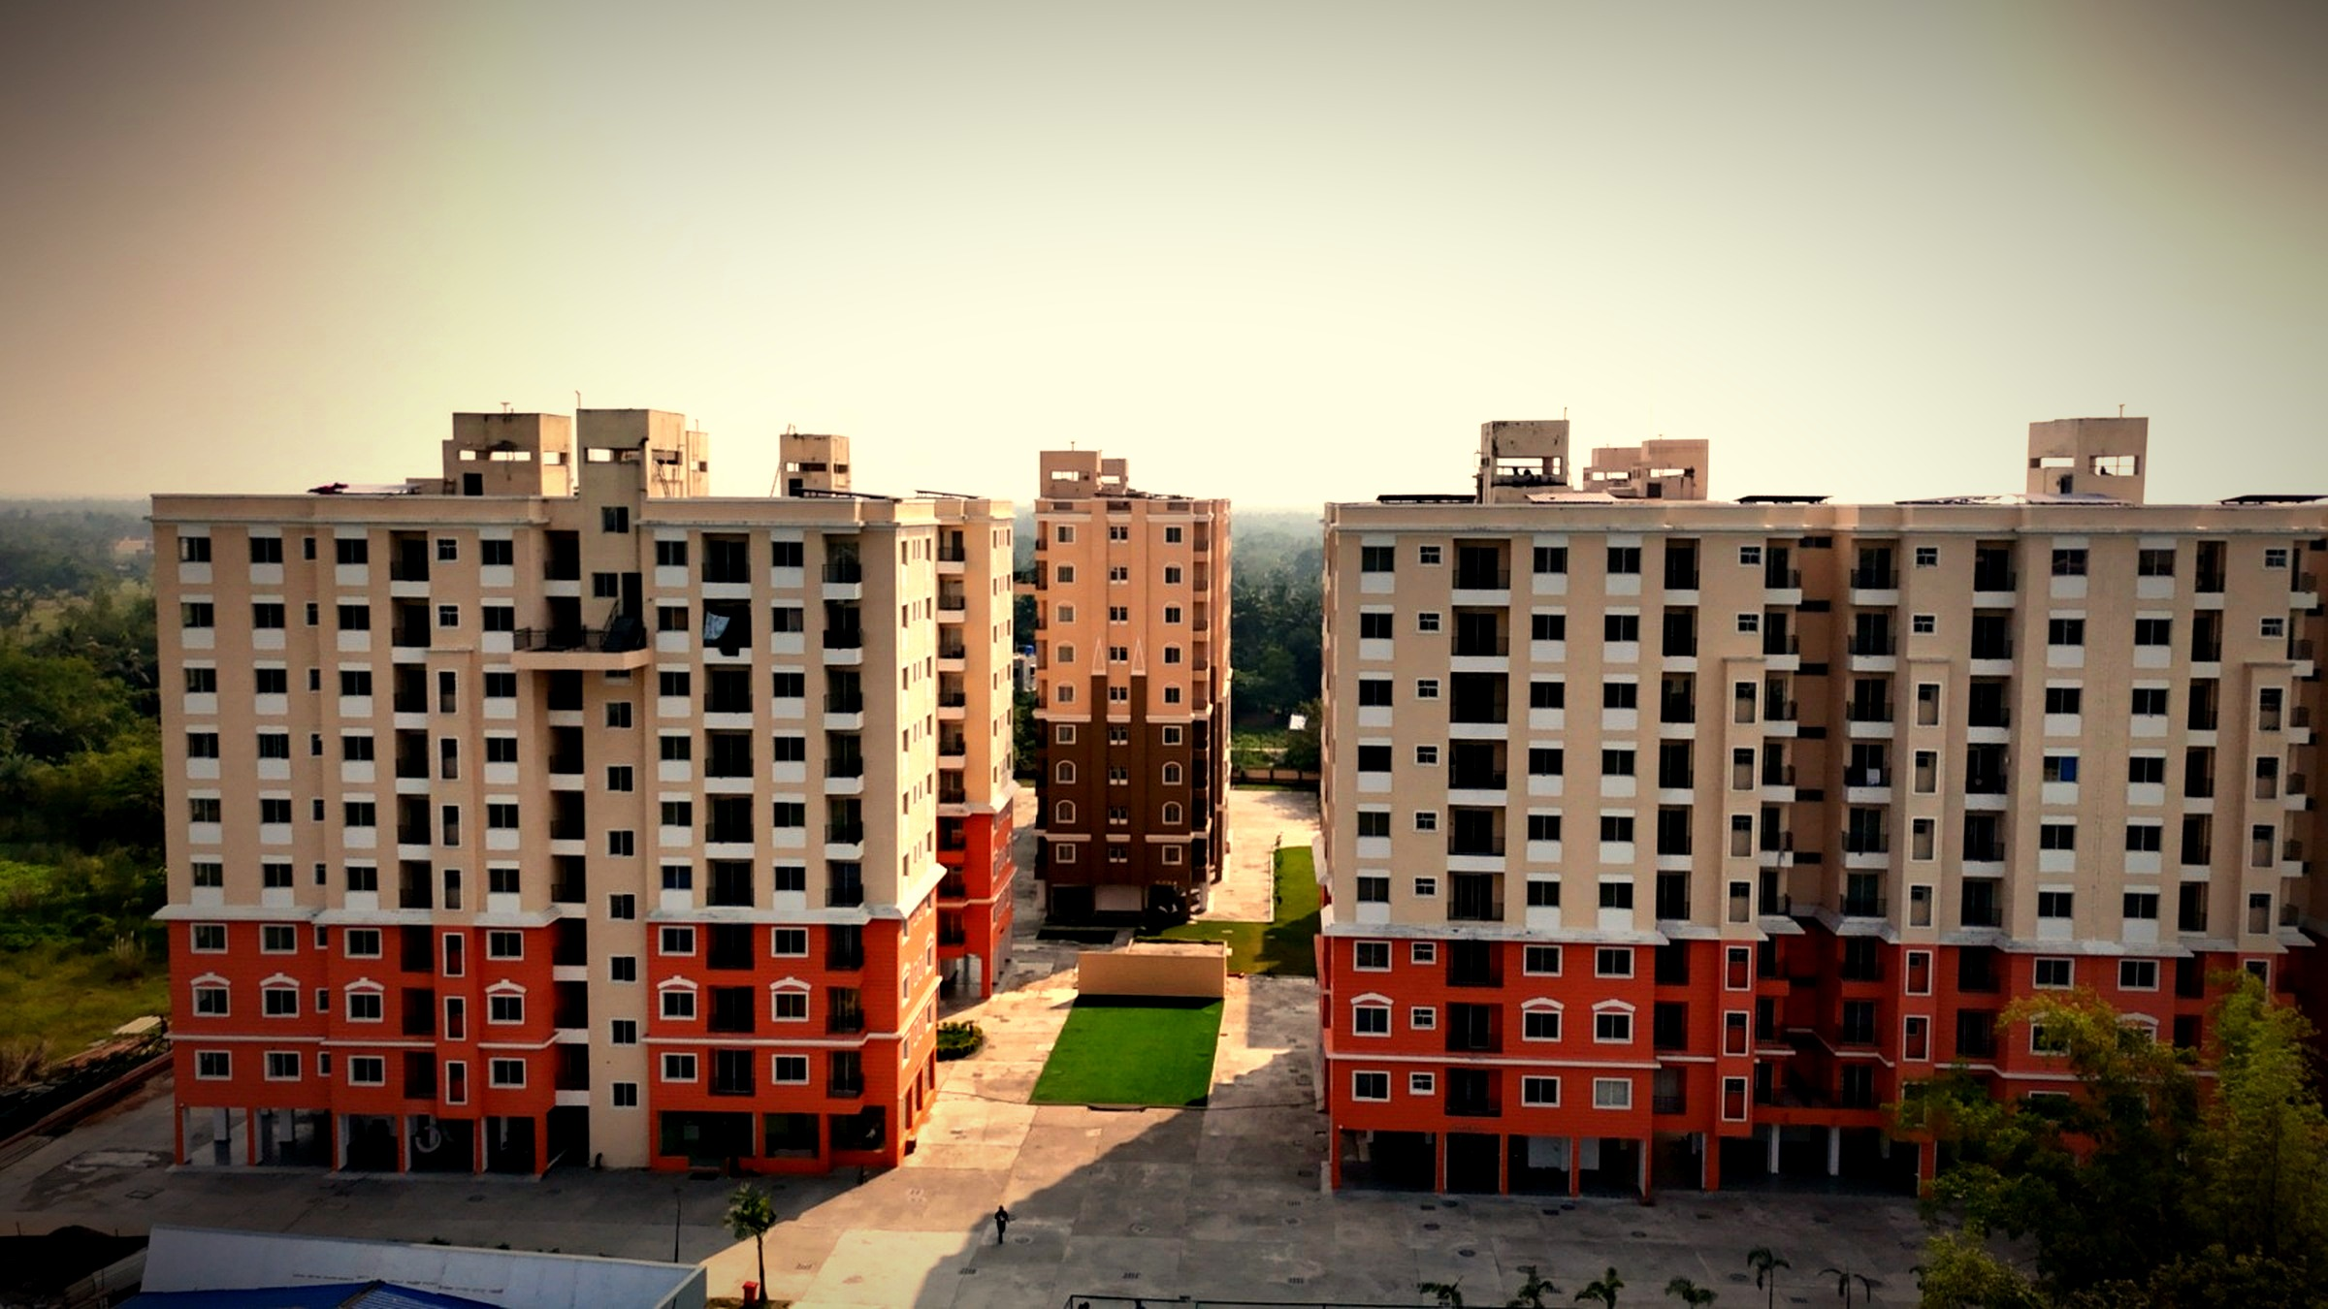



20 ACRES · 6 TOWERS
Ready to Move

Slide 16

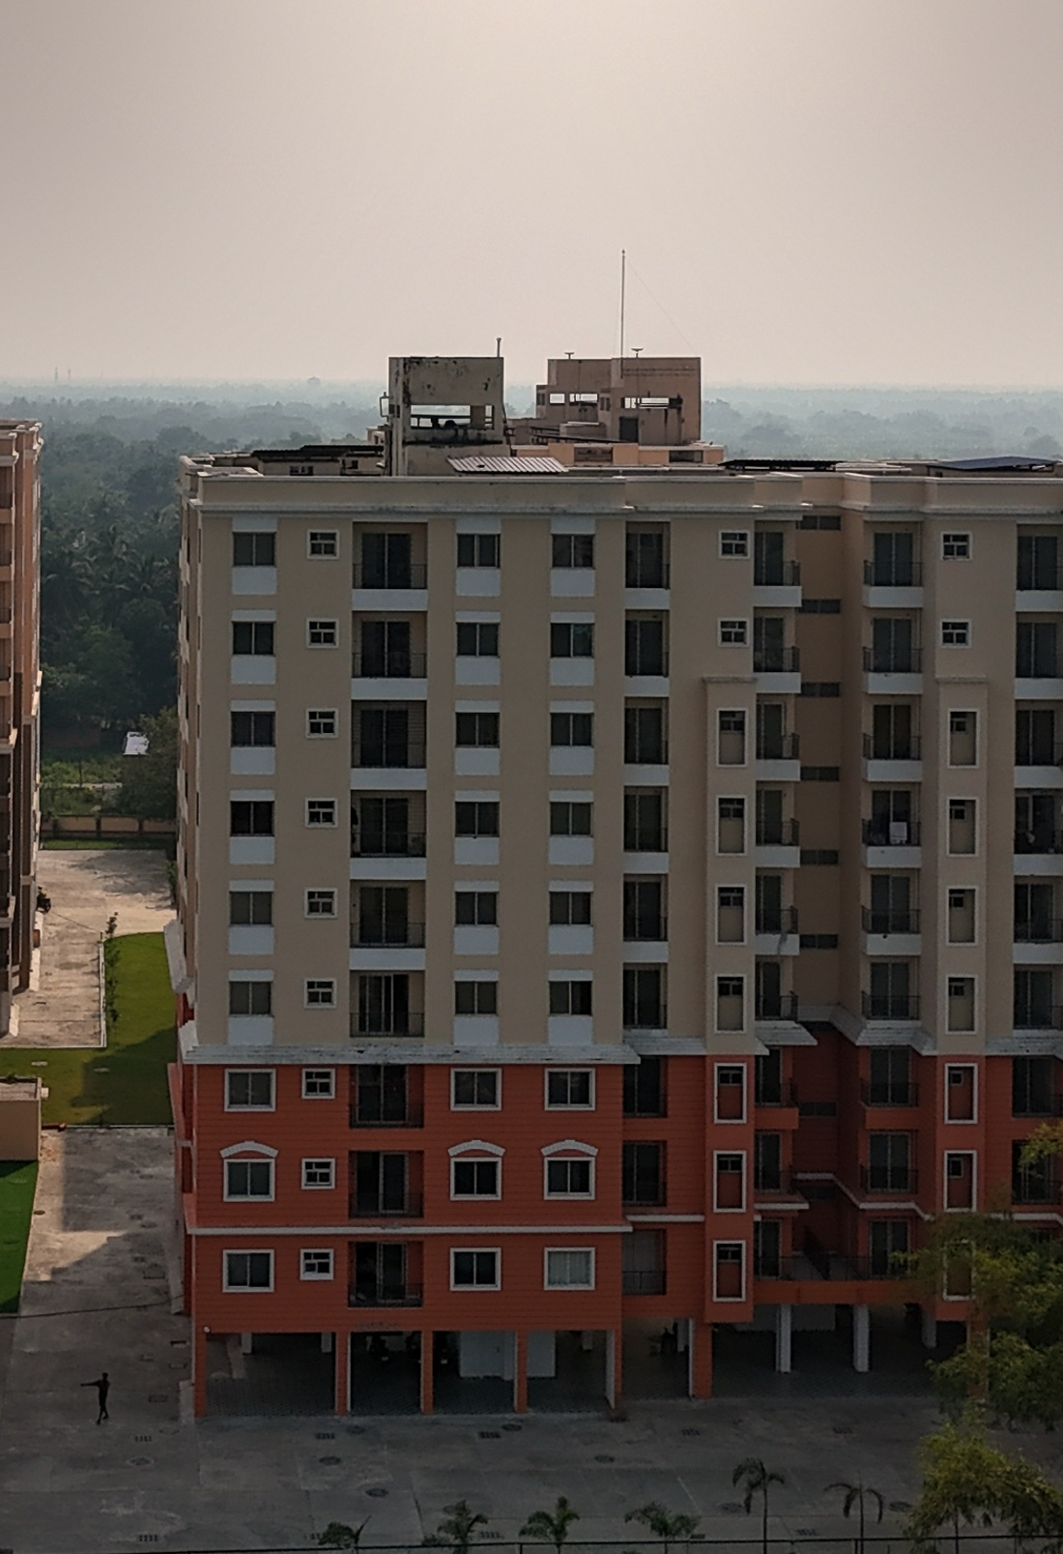




Behind many
milestones,
there was one of you.
Every site visit you arranged. Every doubt you settled. Every family you walked to the door of their first home.
TRUSTED ADVISORS
SHARED GROWTH
CELEBRATED WINS
CHANNEL PARTNER MEET · HOLIDAY INN
Notes:
Thank the room. Name the effort, not the numbers.

Slide 17





LOCATION ADVANTAGE
Everything,
already around you.
Pailan Market
Joka Metro
Main Road Connectivity
Daily Conveniences
DREAM WORLD CITY
CHANNEL PARTNER MEET · HOLIDAY INN
Notes:
Pailan Market · Joka Metro · main road · daily conveniences.

Slide 18
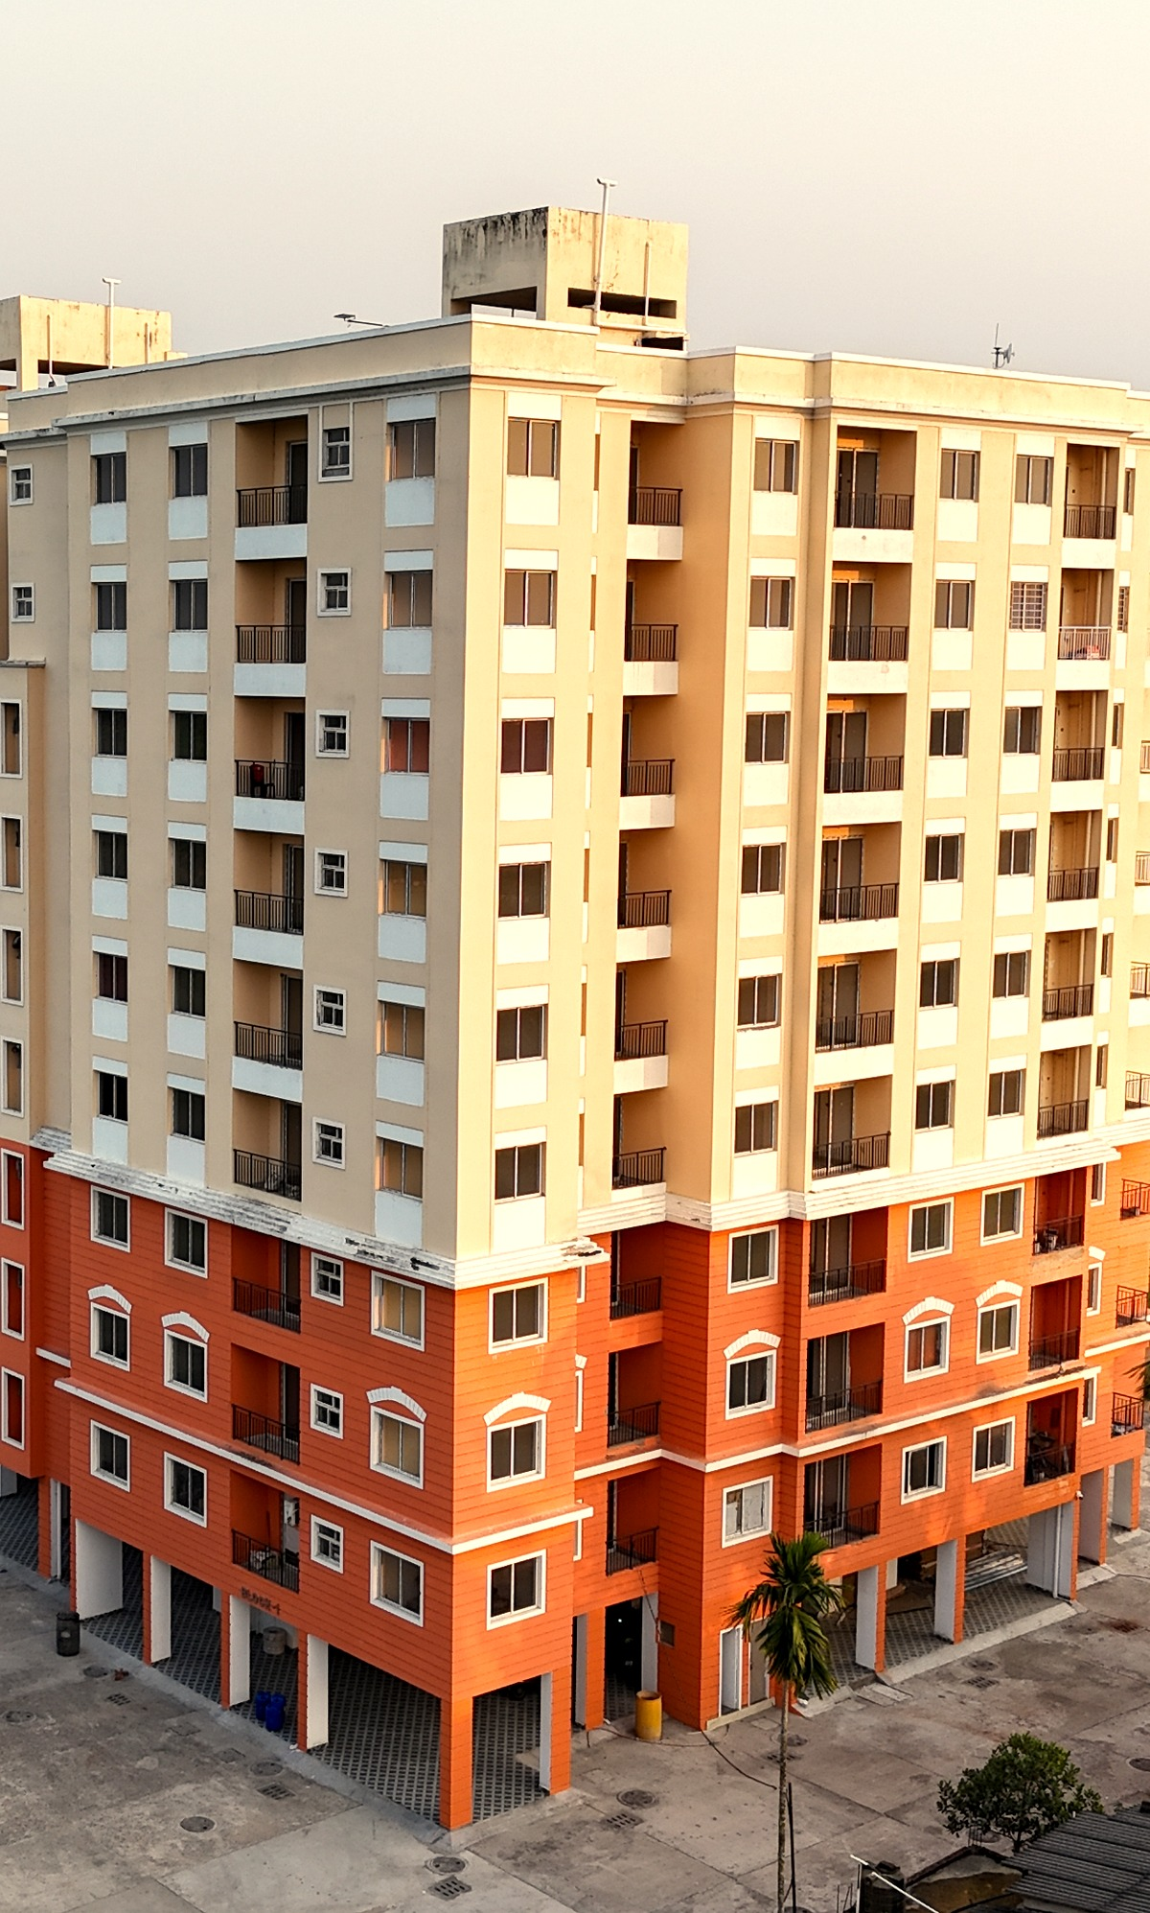

PROJECT OVERVIEW
A finished address,
at a glance.
20
6
G+9
ACRES
TOWERS
STOREYS
READY TO MOVE
CHANNEL PARTNER MEET · HOLIDAY INN
Notes:
20 acres · 6 towers · G+9 · ready to move · handover.

Slide 19


UNIT CONFIGURATIONS & PRICING
Two ways to own it.
2 BHK
3 BHK
CARPET RANGE
CARPET RANGE
630 – 800 sq. ft.
795 – 1010 sq. ft.
STARTING AT
STARTING AT
₹29 L+
₹36 L+
Sizes in sq. ft. · Prices onward. · Dream World City, Joka.
Notes:
1 BHK 560–575 sqft ₹25L+ · 2 BHK 630–800 sqft ₹29L+ · 3 BHK 795–1010 sqft ₹36L+

Slide 20


PROVEN MOMENTUM
Finished homes
closed on the day.
5%
More than four in every five site visits at Dream World City convert into a booking the same day. The buyer walks through a completed home, not a floor plan.
SPOT CLOSURE
100 site visits → 87 bookings
DREAM WORLD CITY · JOKA, KOLKATA
Notes:
Build frame 1 of 13 — advances itself. Do not click through.

Slide 21
PROVEN MOMENTUM
Finished homes
closed on the day.
6%
More than four in every five site visits at Dream World City convert into a booking the same day. The buyer walks through a completed home, not a floor plan.
SPOT CLOSURE
100 site visits → 87 bookings
DREAM WORLD CITY · JOKA, KOLKATA
Notes:
Build frame 2 of 13 — advances itself. Do not click through.

Slide 22
PROVEN MOMENTUM
Finished homes
closed on the day.
9%
More than four in every five site visits at Dream World City convert into a booking the same day. The buyer walks through a completed home, not a floor plan.
SPOT CLOSURE
100 site visits → 87 bookings
DREAM WORLD CITY · JOKA, KOLKATA
Notes:
Build frame 3 of 13 — advances itself. Do not click through.

Slide 23
PROVEN MOMENTUM
Finished homes
closed on the day.
15%
More than four in every five site visits at Dream World City convert into a booking the same day. The buyer walks through a completed home, not a floor plan.
SPOT CLOSURE
100 site visits → 87 bookings
DREAM WORLD CITY · JOKA, KOLKATA
Notes:
Build frame 4 of 13 — advances itself. Do not click through.

Slide 24
PROVEN MOMENTUM
Finished homes
closed on the day.
23%
More than four in every five site visits at Dream World City convert into a booking the same day. The buyer walks through a completed home, not a floor plan.
SPOT CLOSURE
100 site visits → 87 bookings
DREAM WORLD CITY · JOKA, KOLKATA
Notes:
Build frame 5 of 13 — advances itself. Do not click through.

Slide 25
PROVEN MOMENTUM
Finished homes
closed on the day.
33%
More than four in every five site visits at Dream World City convert into a booking the same day. The buyer walks through a completed home, not a floor plan.
SPOT CLOSURE
100 site visits → 87 bookings
DREAM WORLD CITY · JOKA, KOLKATA
Notes:
Build frame 6 of 13 — advances itself. Do not click through.

Slide 26
PROVEN MOMENTUM
Finished homes
closed on the day.
45%
More than four in every five site visits at Dream World City convert into a booking the same day. The buyer walks through a completed home, not a floor plan.
SPOT CLOSURE
100 site visits → 87 bookings
DREAM WORLD CITY · JOKA, KOLKATA
Notes:
Build frame 7 of 13 — advances itself. Do not click through.

Slide 27
PROVEN MOMENTUM
Finished homes
closed on the day.
57%
More than four in every five site visits at Dream World City convert into a booking the same day. The buyer walks through a completed home, not a floor plan.
SPOT CLOSURE
100 site visits → 87 bookings
DREAM WORLD CITY · JOKA, KOLKATA
Notes:
Build frame 8 of 13 — advances itself. Do not click through.

Slide 28
PROVEN MOMENTUM
Finished homes
closed on the day.
67%
More than four in every five site visits at Dream World City convert into a booking the same day. The buyer walks through a completed home, not a floor plan.
SPOT CLOSURE
100 site visits → 87 bookings
DREAM WORLD CITY · JOKA, KOLKATA
Notes:
Build frame 9 of 13 — advances itself. Do not click through.

Slide 29
PROVEN MOMENTUM
Finished homes
closed on the day.
75%
More than four in every five site visits at Dream World City convert into a booking the same day. The buyer walks through a completed home, not a floor plan.
SPOT CLOSURE
100 site visits → 87 bookings
DREAM WORLD CITY · JOKA, KOLKATA
Notes:
Build frame 10 of 13 — advances itself. Do not click through.

Slide 30
PROVEN MOMENTUM
Finished homes
closed on the day.
81%
More than four in every five site visits at Dream World City convert into a booking the same day. The buyer walks through a completed home, not a floor plan.
SPOT CLOSURE
100 site visits → 87 bookings
DREAM WORLD CITY · JOKA, KOLKATA
Notes:
Build frame 11 of 13 — advances itself. Do not click through.

Slide 31
PROVEN MOMENTUM
Finished homes
closed on the day.
84%
More than four in every five site visits at Dream World City convert into a booking the same day. The buyer walks through a completed home, not a floor plan.
SPOT CLOSURE
100 site visits → 87 bookings
DREAM WORLD CITY · JOKA, KOLKATA
Notes:
Build frame 12 of 13 — advances itself. Do not click through.

Slide 32
PROVEN MOMENTUM
Finished homes
closed on the day.
87%
More than four in every five site visits at Dream World City convert into a booking the same day. The buyer walks through a completed home, not a floor plan.
SPOT CLOSURE
100 site visits → 87 bookings
DREAM WORLD CITY · JOKA, KOLKATA
Notes:
85% spot closure at DWC. A finished product removes the hesitation.

Slide 33
CHANNEL PARTNER EARNINGS
Brokerage & Incentive (Quarterly)
1 – 3
4 – 6
7 & Above
BOOKINGS
BOOKINGS
BOOKINGS
2.5%
3.5%
4%
EXECUTIVE INCENTIVE
2 & 3 BHK
Over & above brokerage, per booking
₹10,000
Slab-based brokerage on consideration value (+ car parking, if any). The more you book within the project, the higher your percentage climbs.
Notes:
DWC: 2.5% / 3.5% / 4% by slab, plus ₹10,000 per booking on 2 & 3 BHK.

Slide 34



PAYOUT PROMISE
Your payout is guaranteed
within 7 days.
Fast Disbursal
Fully Transparent
Settled within 7 days of confirmation.
Clear, agreed slabs with no surprises.
CHANNEL PARTNER MEET · HOLIDAY INN

Slide 35
What if you are not
Currently operating in JOKA?
Notes:
Pause here. Let the question sit.

Slide 36
We have another
story to tell.
Notes:
Turn the room north — towards the airport.

Slide 37
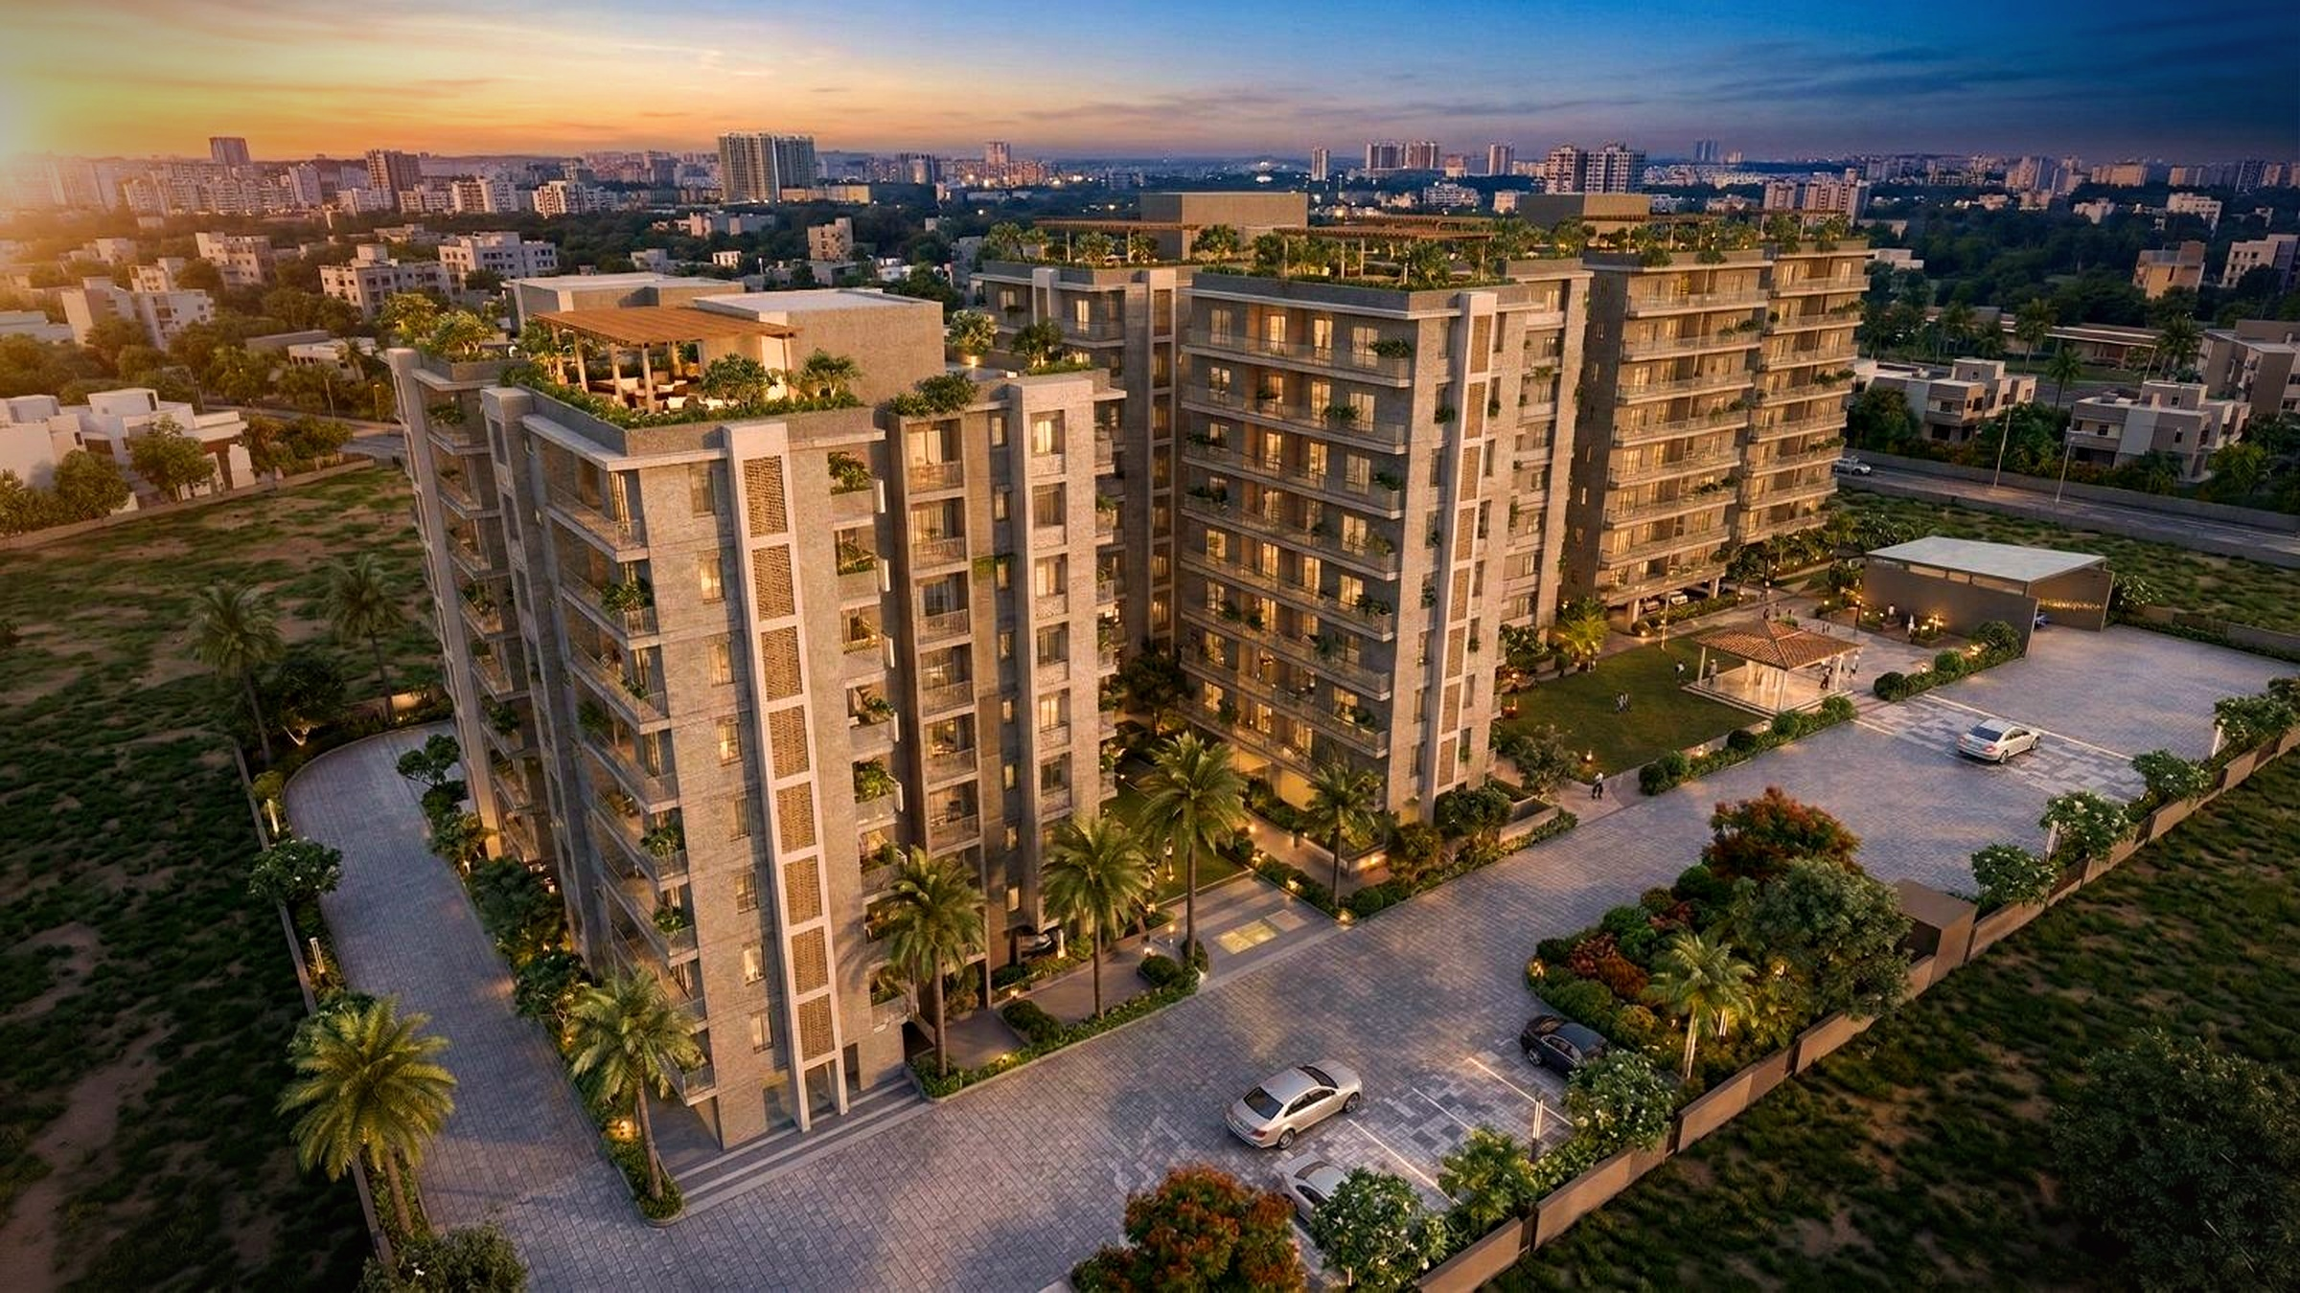








NEAR AIRPORT · MADHYAMGRAM
Launching Soon…
Notes:
Runs itself the moment the slide lands: the aircraft crosses and uncovers A-N-A-N-T-A letter by letter, then the sub-line and the two captions. No clicks until you move on.

Slide 38
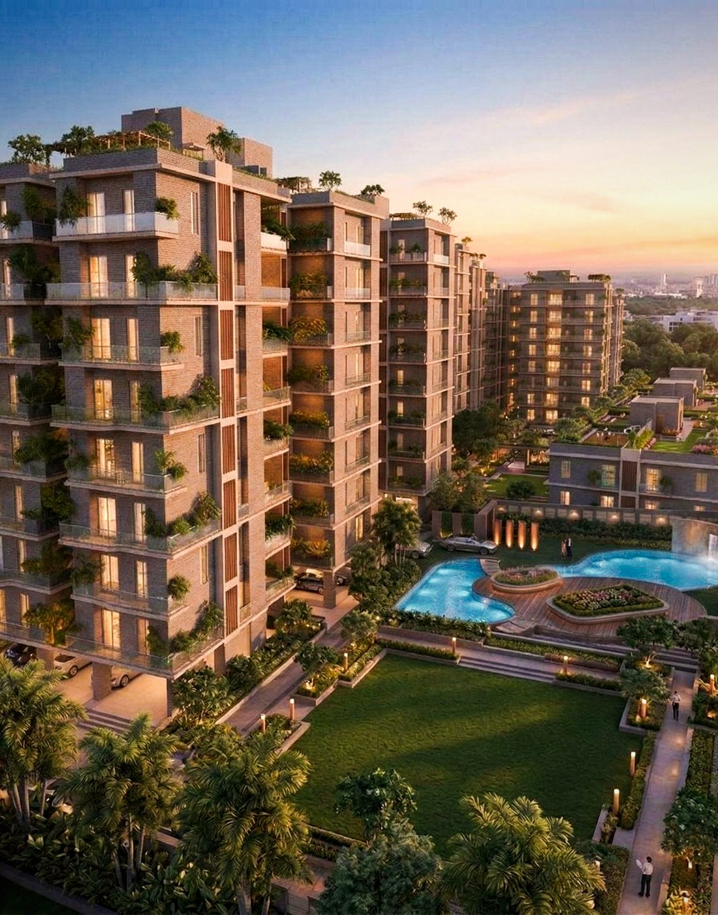


THE ADDRESS
Life at Ananta.
Premium residences rising beside Dream Gurukul, moments from the airport corridor at Madhyamgram — designed for families who want connectivity, comfort and a name they can trust.
Near Airport
Seamless airport connectivity.
2 · 3 · 4 BHK Homes
Resort-style amenities.
296 Limited Residences
Gated community living.
Notes:
Ananta USPs — straight from the Ananta deck.

Slide 39
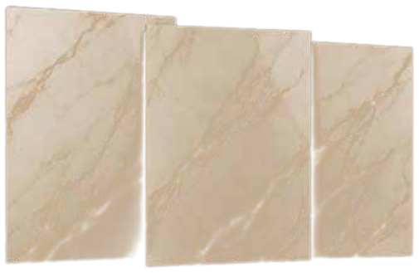
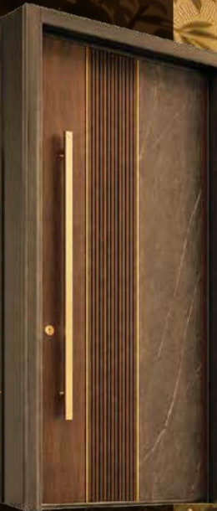

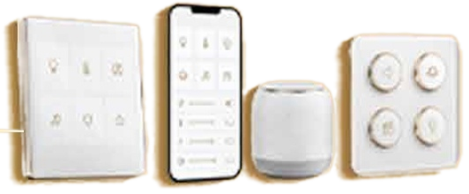



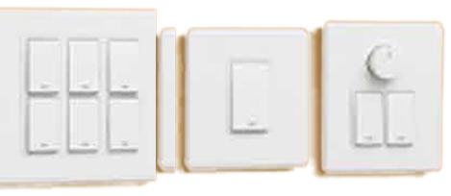
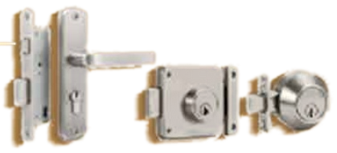
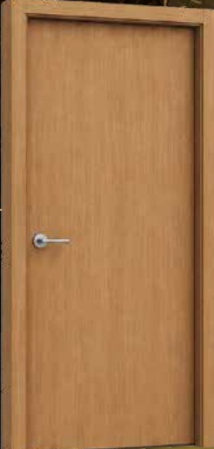
WHAT’S SPECIAL IN ANANTA
Thoughtfully upgraded.
ANANTA
USUALLY ELSEWHERE
1800 × 1200 mm tiles
Smart touch, app & voice (Home Automation)
Smart digital, keyless
Taller, extra-wide
Rainfall + multi-flow Shower Pannel
600 × 600 mm tiles
Basic manual switches
Conventional key lock
Standard height
Basic shower fitting
FLOORING
SWITCHES
LOCKS
ENTRANCE
BATHROOM
Specification highlights · subject to the final project specification.

Slide 40

Guaranteed Launching Rate
₹5,950 / sq. ft.
EXCLUSIVE FOR CHANNEL PARTNERS
SPECIAL LIMITED-PERIOD BENEFIT
Up to ₹6.30 Lakhs
For few more units
Notes:
₹5,950/sq.ft guaranteed launch rate · up to ₹6.30L benefit, first 25 units.

Slide 41

UNIT CONFIGURATIONS & PRICING
Space to grow into.
2 BHK
3 BHK
4 BHK
2T + 3T
UNIT SIZE
UNIT SIZE
UNIT SIZE
940 – 1015 sq. ft.
1075 – 1405 sq. ft.
1790 – 1805 sq. ft.
ONWARDS
ONWARDS
ONWARDS
₹65 L
₹75 L
₹1.25 Cr
Sizes in sq. ft. · Prices onward. · Ananta at Dream Gurukul, near NSCBI Airport.
Notes:
Ananta: 2 BHK 940-1015 sqft from Rs 65 L | 3 BHK (2T+3T) 1075-1405 sqft from Rs 75 L | 4 BHK 1790-1805 sqft from Rs 1.25 Cr.

Slide 42
CHANNEL PARTNER EARNINGS
Brokerage & Incentive (Quarterly)
1 – 2
3 – 4
5 & Above
BOOKINGS
BOOKINGS
BOOKINGS
3%
3.5%
4%
EXECUTIVE INCENTIVE
2 BHK
3 BHK
4 BHK
Over & above brokerage, per booking
₹20,000
₹25,000
₹35,000
Slab-based brokerage on the agreement value (+ car parking, if any), over and above the guaranteed launching rate benefits.
Notes:
Ananta: 3% / 3.5% / 4% by slab, plus ₹20k / ₹25k / ₹35k per booking by configuration.

Slide 43
PAYOUT PROMISE
Your payout is guaranteed
within 7 days.
Fast Disbursal
Fully Transparent
Settled within 7 days of confirmation.
Clear, agreed slabs with no surprises.
CHANNEL PARTNER MEET · HOLIDAY INN

Slide 44
PROVEN MOMENTUM
Two in three
book on the spot.
5%
SPOT CLOSURE
Nearly two in every three site visits convert into a booking on the day — a clear signal of strong demand and ready buyers for Ananta.
100 site visits → 71 bookings
ANANTA AT DREAM GURUKUL · MADHYAMGRAM
Notes:
Build frame 1 of 13 — advances itself. Do not click through.

Slide 45
PROVEN MOMENTUM
Two in three
book on the spot.
6%
SPOT CLOSURE
Nearly two in every three site visits convert into a booking on the day — a clear signal of strong demand and ready buyers for Ananta.
100 site visits → 71 bookings
ANANTA AT DREAM GURUKUL · MADHYAMGRAM
Notes:
Build frame 2 of 13 — advances itself. Do not click through.

Slide 46
PROVEN MOMENTUM
Two in three
book on the spot.
8%
SPOT CLOSURE
Nearly two in every three site visits convert into a booking on the day — a clear signal of strong demand and ready buyers for Ananta.
100 site visits → 71 bookings
ANANTA AT DREAM GURUKUL · MADHYAMGRAM
Notes:
Build frame 3 of 13 — advances itself. Do not click through.

Slide 47
PROVEN MOMENTUM
Two in three
book on the spot.
13%
SPOT CLOSURE
Nearly two in every three site visits convert into a booking on the day — a clear signal of strong demand and ready buyers for Ananta.
100 site visits → 71 bookings
ANANTA AT DREAM GURUKUL · MADHYAMGRAM
Notes:
Build frame 4 of 13 — advances itself. Do not click through.

Slide 48
PROVEN MOMENTUM
Two in three
book on the spot.
19%
SPOT CLOSURE
Nearly two in every three site visits convert into a booking on the day — a clear signal of strong demand and ready buyers for Ananta.
100 site visits → 71 bookings
ANANTA AT DREAM GURUKUL · MADHYAMGRAM
Notes:
Build frame 5 of 13 — advances itself. Do not click through.

Slide 49
PROVEN MOMENTUM
Two in three
book on the spot.
27%
SPOT CLOSURE
Nearly two in every three site visits convert into a booking on the day — a clear signal of strong demand and ready buyers for Ananta.
100 site visits → 71 bookings
ANANTA AT DREAM GURUKUL · MADHYAMGRAM
Notes:
Build frame 6 of 13 — advances itself. Do not click through.

Slide 50
PROVEN MOMENTUM
Two in three
book on the spot.
36%
SPOT CLOSURE
Nearly two in every three site visits convert into a booking on the day — a clear signal of strong demand and ready buyers for Ananta.
100 site visits → 71 bookings
ANANTA AT DREAM GURUKUL · MADHYAMGRAM
Notes:
Build frame 7 of 13 — advances itself. Do not click through.

Slide 51
PROVEN MOMENTUM
Two in three
book on the spot.
45%
SPOT CLOSURE
Nearly two in every three site visits convert into a booking on the day — a clear signal of strong demand and ready buyers for Ananta.
100 site visits → 71 bookings
ANANTA AT DREAM GURUKUL · MADHYAMGRAM
Notes:
Build frame 8 of 13 — advances itself. Do not click through.

Slide 52
PROVEN MOMENTUM
Two in three
book on the spot.
53%
SPOT CLOSURE
Nearly two in every three site visits convert into a booking on the day — a clear signal of strong demand and ready buyers for Ananta.
100 site visits → 71 bookings
ANANTA AT DREAM GURUKUL · MADHYAMGRAM
Notes:
Build frame 9 of 13 — advances itself. Do not click through.

Slide 53
PROVEN MOMENTUM
Two in three
book on the spot.
59%
SPOT CLOSURE
Nearly two in every three site visits convert into a booking on the day — a clear signal of strong demand and ready buyers for Ananta.
100 site visits → 71 bookings
ANANTA AT DREAM GURUKUL · MADHYAMGRAM
Notes:
Build frame 10 of 13 — advances itself. Do not click through.

Slide 54
PROVEN MOMENTUM
Two in three
book on the spot.
64%
SPOT CLOSURE
Nearly two in every three site visits convert into a booking on the day — a clear signal of strong demand and ready buyers for Ananta.
100 site visits → 71 bookings
ANANTA AT DREAM GURUKUL · MADHYAMGRAM
Notes:
Build frame 11 of 13 — advances itself. Do not click through.

Slide 55
PROVEN MOMENTUM
Two in three
book on the spot.
66%
SPOT CLOSURE
Nearly two in every three site visits convert into a booking on the day — a clear signal of strong demand and ready buyers for Ananta.
100 site visits → 71 bookings
ANANTA AT DREAM GURUKUL · MADHYAMGRAM
Notes:
Build frame 12 of 13 — advances itself. Do not click through.

Slide 56
PROVEN MOMENTUM
Two in three
book on the spot.
69%
SPOT CLOSURE
Nearly two in every three site visits convert into a booking on the day — a clear signal of strong demand and ready buyers for Ananta.
100 site visits → 71 bookings
ANANTA AT DREAM GURUKUL · MADHYAMGRAM
Notes:
Build frame 12 of 13 — advances itself. Do not click through.

Slide 57
PROVEN MOMENTUM
Two in three
book on the spot.
71%
SPOT CLOSURE
Nearly two in every three site visits convert into a booking on the day — a clear signal of strong demand and ready buyers for Ananta.
100 site visits → 71 bookings
ANANTA AT DREAM GURUKUL · MADHYAMGRAM
Notes:
67% spot conversion at Ananta — demand is already there at launch.

Slide 58




EMPOWERING OUR CHANNEL PARTNERS
Infrastructure & Dedicated Support
Wi-Fi Enabled Workspace
A ready, connected desk for you and your clients at our site office.
Dedicated Relationship Managers
We invest in your success.
A single point of contact who knows your deals and moves them fast.
Digital Campaign Assistance
Everything you need to sell with confidence — under one roof.
Co-branded creatives and lead support to amplify your outreach.
CHANNEL PARTNER MEET · HOLIDAY INN
Notes:
Workspace, RMs and campaign support — the infrastructure behind every booking.

Slide 59



EMPOWERING OUR CHANNEL PARTNERS
Sales, Operations & Logistics
On-the-Go Client Registration
Spot Booking Offers
Register your clients instantly and lock your lead from the first contact.
Special on-the-day incentives that help you close faster.
Zero Lead Clash
Cab & Logistics Support
Full protection from any conflict with our internal sales team.
Hassle-free client travel to site, arranged for you.
Notes:
Register on the go, spot offers, zero lead clash, cab support.

Slide 60



ALWAYS HERE FOR YOU
We're just a call away.
Your dedicated Channel Partner Relationship Manager is reachable whenever you need support — before, during and after every booking.
Dedicated RM
WhatsApp Support
On-Site CP Desk
Your single point of contact.
Quick answers on the go.
Help available right at site.
CHANNEL PARTNER MEET · HOLIDAY INN
Notes:
RM, WhatsApp and the on-site CP desk — three ways to reach us.

Slide 61
RECOGNITION
Honouring the few who
Lead.
Notes:
Bring the awardees up as each name lands.

Slide 62


SHINING STAR
Adobe Home
Presented at the Jain Group Channel Partner Meet — with thanks for your committed partnership.
CHANNEL PARTNER MEET · HOLIDAY INN
Notes:
Shining Star — Adobe Home. Invite up, hand over, photograph.

Slide 63
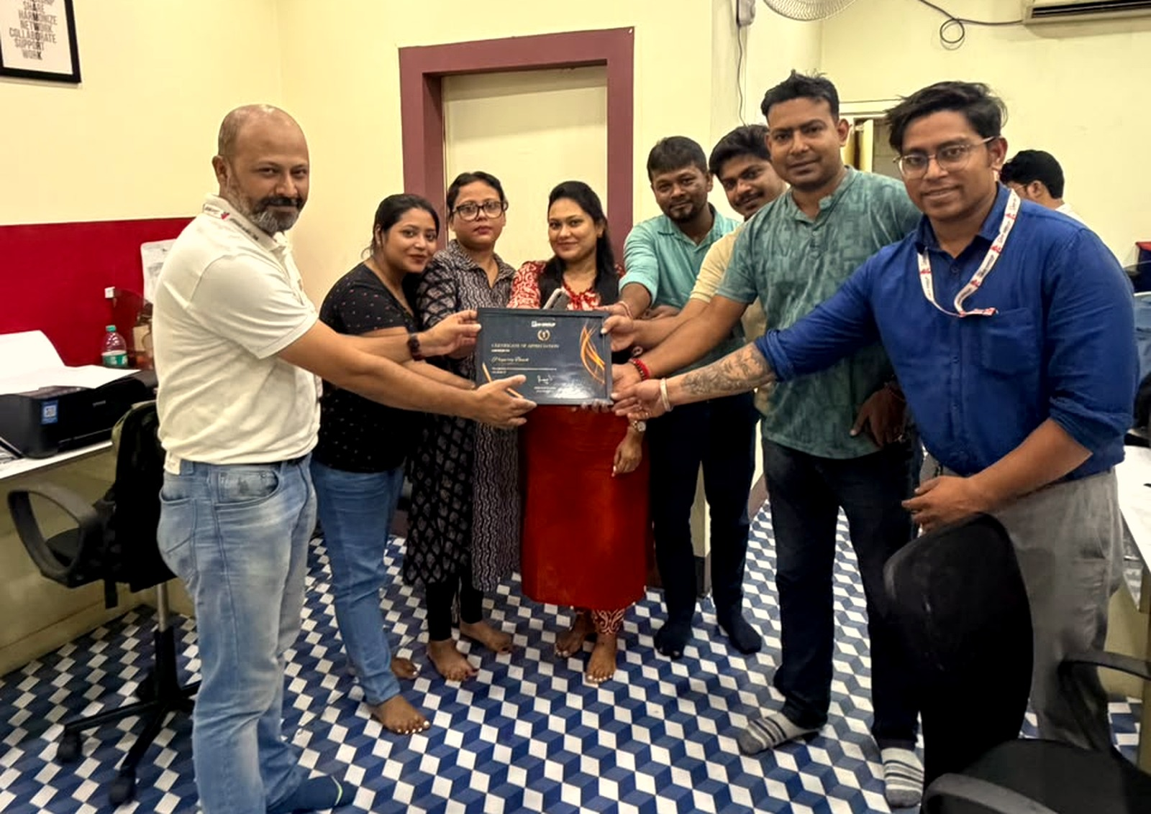
BUSINESS CONTRIBUTOR
Property Beach
Thanks for your committed partnership.
CHANNEL PARTNER MEET · HOLIDAY INN
Notes:
Recognition — Property Beach. Invite up, hand over, photograph.

Slide 64
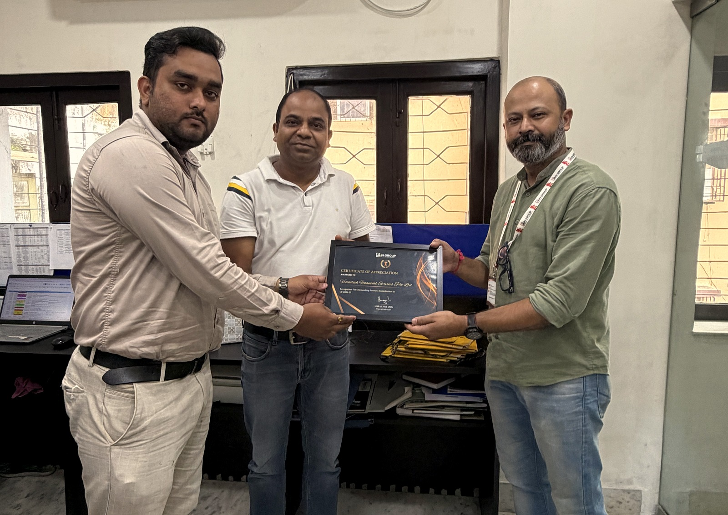
BUSINESS CONTRIBUTOR
UV Realtors
Thanks for your committed partnership.
CHANNEL PARTNER MEET · HOLIDAY INN
Notes:
Recognition — UV Realtors. Invite up, hand over, photograph.

Slide 65
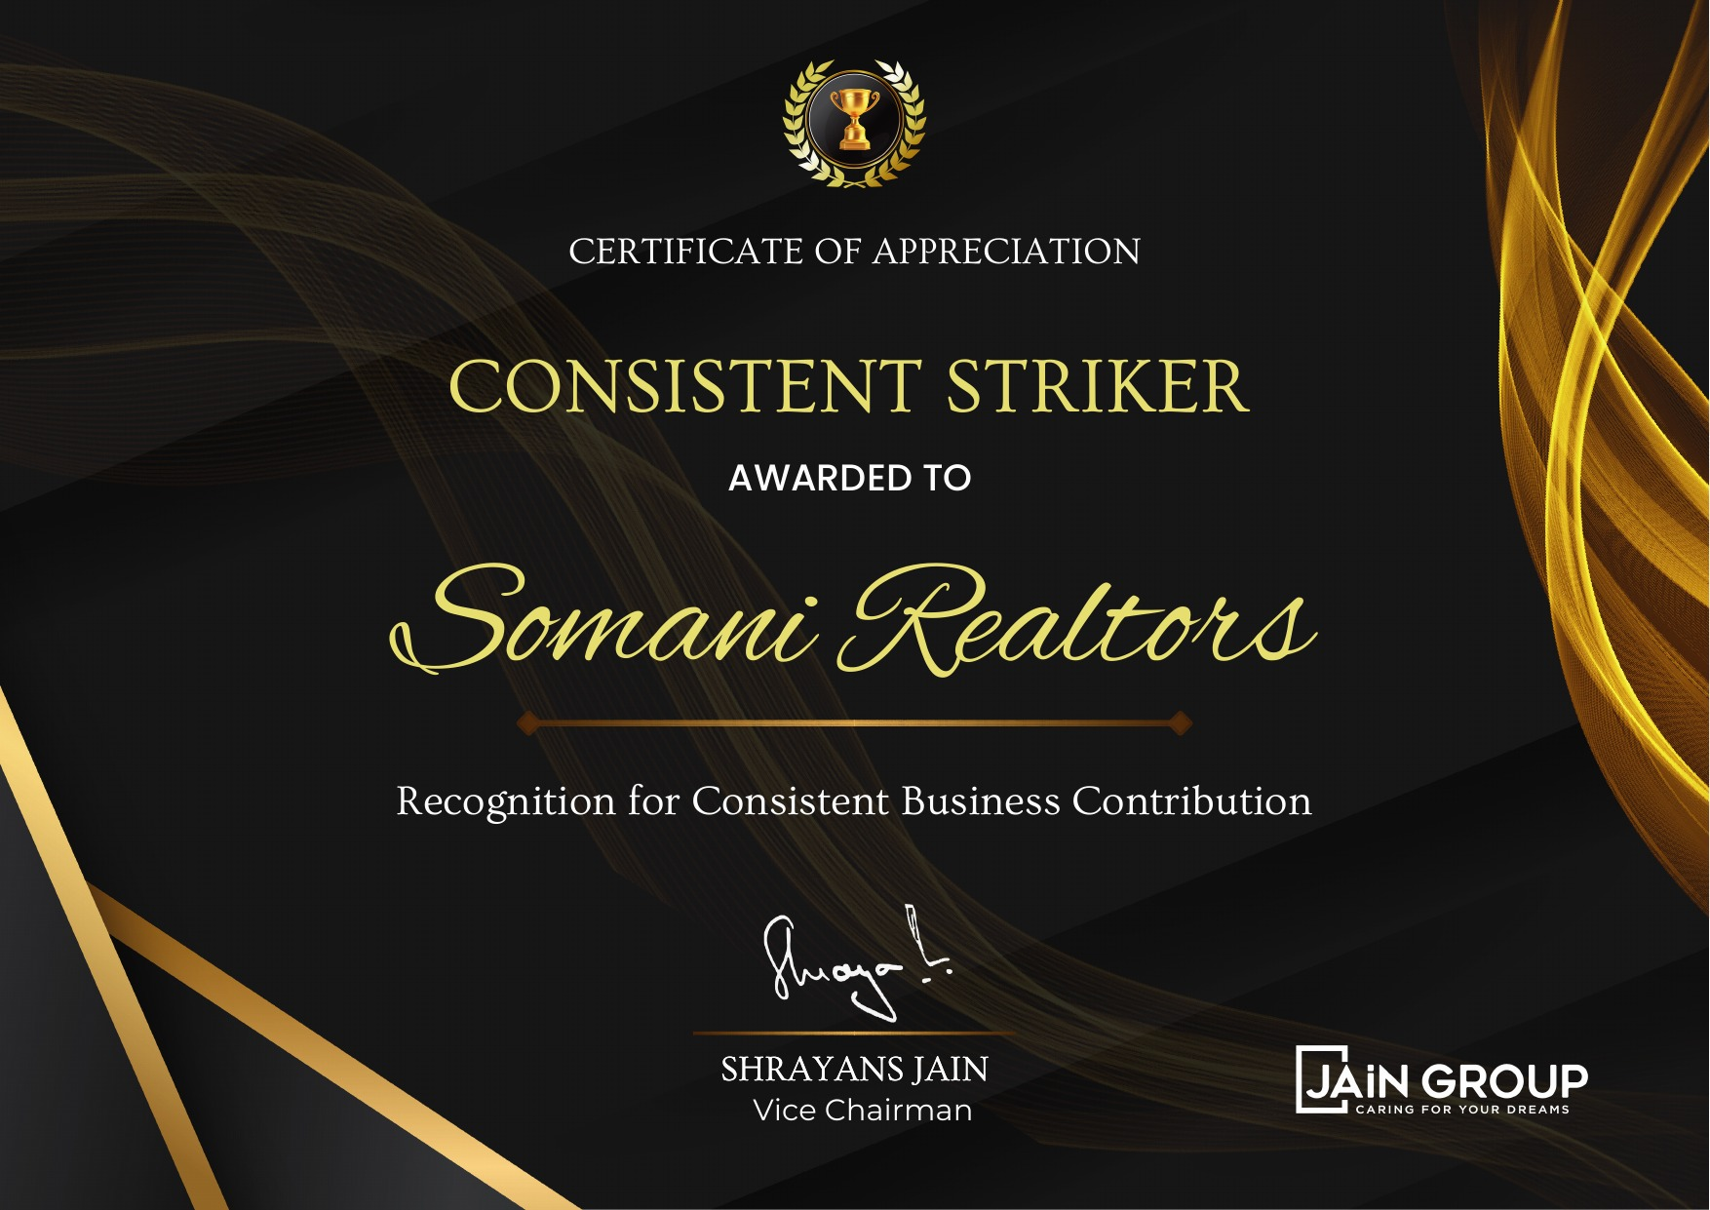
THE CONSISTENT STRIKER
Somani Realtors
Presented at the Jain Group Channel Partner Meet — with thanks for your committed partnership.
CHANNEL PARTNER MEET · HOLIDAY INN
Notes:
The Consistency Striker — Somani Realtors. Invite up, hand over, photograph.

Slide 66

THE CONSISTENT STRIKER
Home Store
Presented at the Jain Group Channel Partner Meet — with thanks for your committed partnership.
CHANNEL PARTNER MEET · HOLIDAY INN
Notes:
The Consistency Striker — Home Store. Invite up, hand over, photograph.

Slide 67

THE CONSISTENT STRIKER
Get My Ghar
Presented at the Jain Group Channel Partner Meet — with thanks for your committed partnership.
CHANNEL PARTNER MEET · HOLIDAY INN
Notes:
The Consistency Striker — Get My Ghar. Invite up, hand over, photograph.

Slide 68
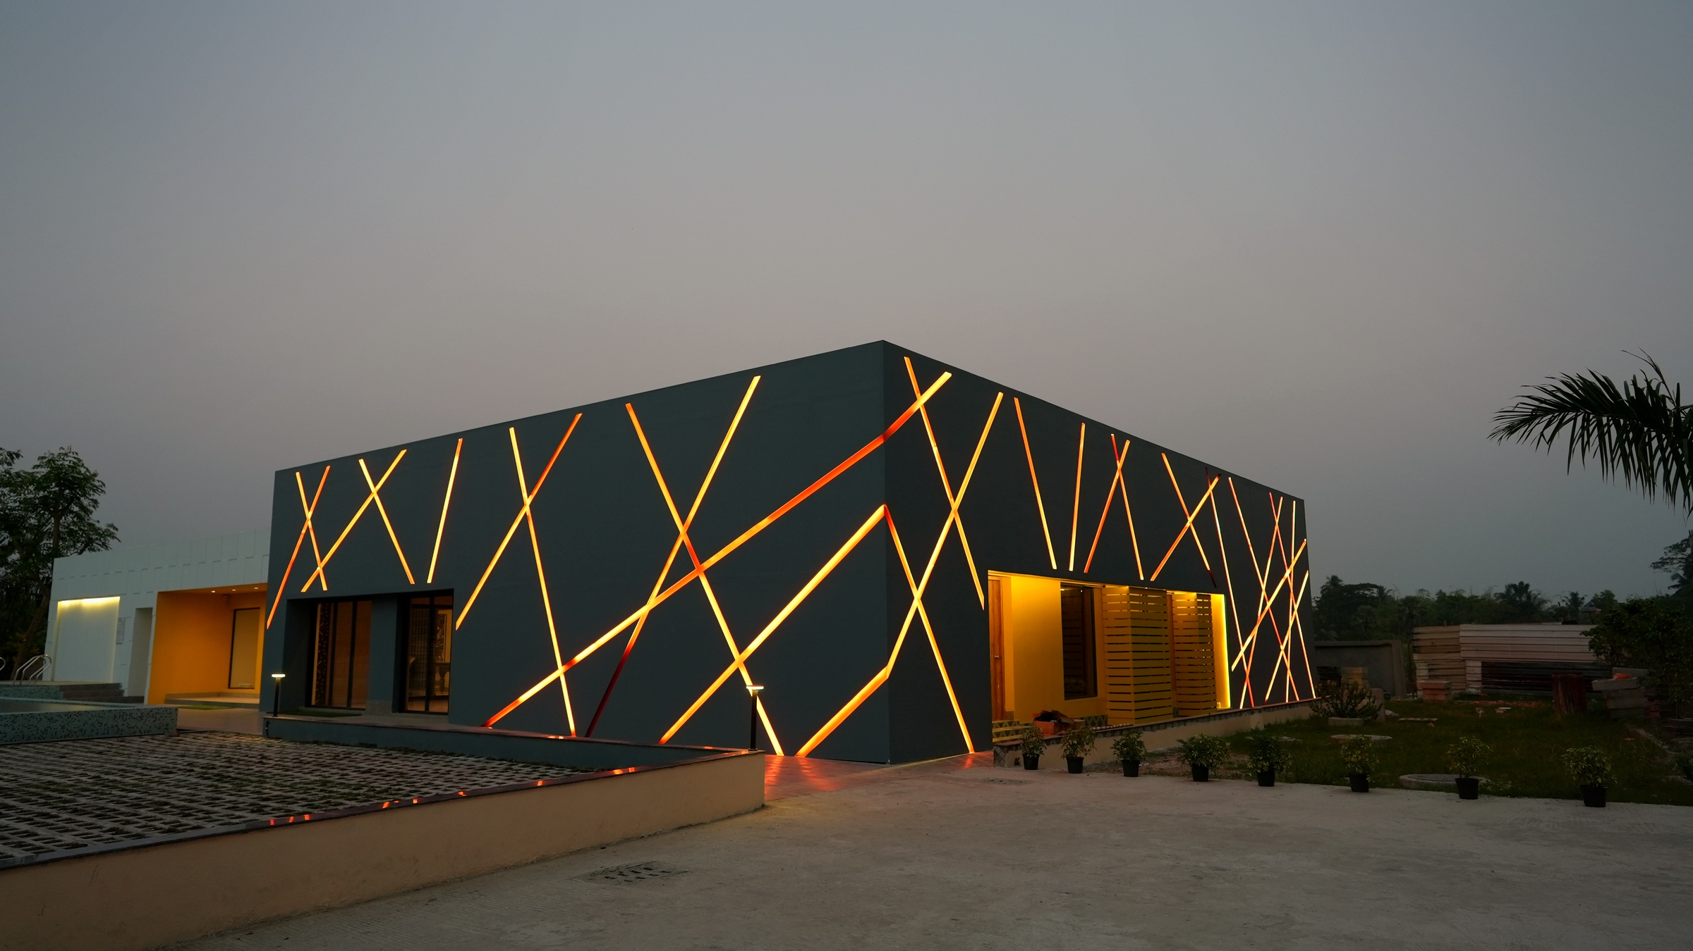

The next success story
could have your name on it.
Beyond Business. Beyond Boundaries.
Notes:
Close on the promise, then move straight to the QR slide.

Slide 69
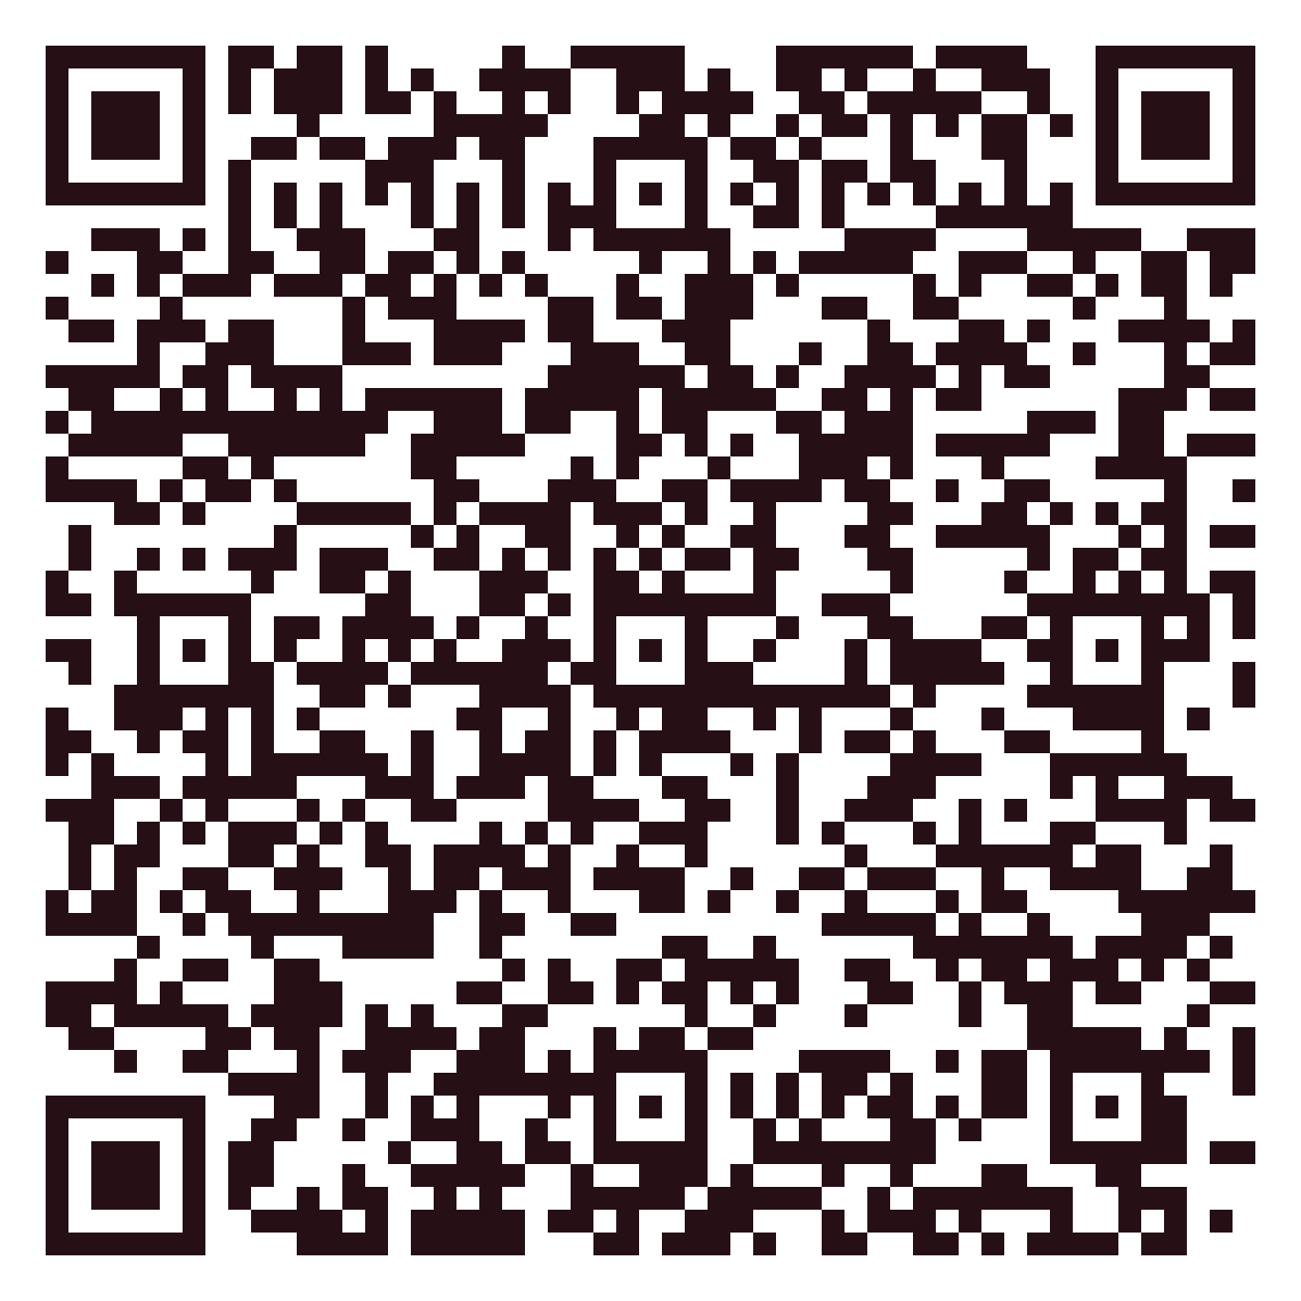
STAY CONNECTED
Scan.
Connect.
Grow with Jain Group.
SCAN TO EXPLORE
Project Details · Brochures · Commercials
www.thejaingroup.com
CHANNEL PARTNER MEET · HOLIDAY INN
Notes:
QR currently points to thejaingroup.com — swap for the CP registration link if needed.

