Slide 1


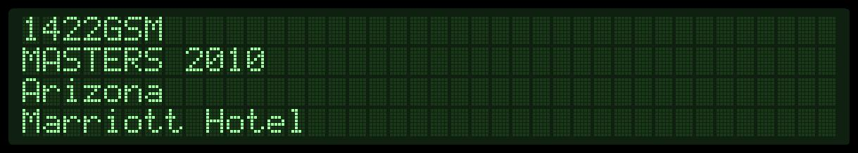
E (or CS)
4/8-Bit Bus, R/W, RS
E2
E1
4/8-Bit Bus, R/W, RS

Slide 2
HD44780 Module
LCD Interface Module
Parallel Bus
Interface
4/8-Bit
Bus
R/W
RS
E

Slide 3
LCD Interface Module
Object 1
Parallel Bus
Interface Object
4/8-Bit
Bus
R/W
RS
E
LCD Module 1

Slide 4
LCD Interface Module
Object 1
LCD Interface Module
Object 2
Parallel Bus
Interface Object 1
Parallel Bus
Interface Object 2
4/8-Bit
Bus
R/W
RS
E
4/8-Bit
Bus
R/W
RS
E
LCD Module 1
LCD Module 2

Slide 5
LCD Interface Module
Object 1
LCD Interface Module
Object 2
Common Parallel Bus
Interface Object
R/W
RS
E
4/8-Bit
Bus
E
LCD Module 2
LCD Module 1

