Slide 1

Welcome to Noun Town!
• Today, we're going on an adventure to learn all about nouns!
🎥 Watch related video

Slide 2
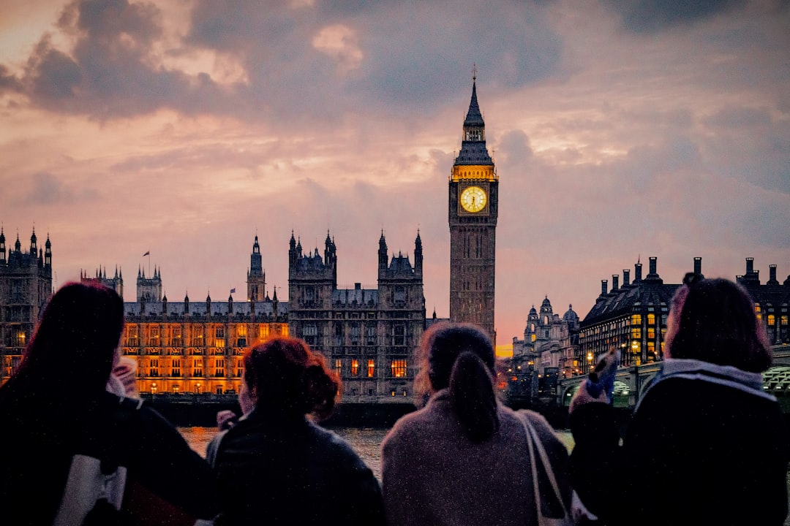
People, Places, and Things
1. Nouns can be people, like *teacher* or *friend*.
2. Nouns can be places, like *school* or *park*.
3. Nouns can be things, like *book* or *pencil*.
4. Example sentence: The *teacher* reads a *book* in the *school*.
5. Let's see if you can spot the nouns!
Generated by AI Slide Generator

Slide 3

Concrete vs. Abstract Nouns
1. Concrete nouns are things we can touch, see, hear, smell, or taste.
2. Examples of concrete nouns: *table*, *flower*, *music*, *cake*.
3. Abstract nouns are things we *cannot* experience with our senses.
4. Examples of abstract nouns: *happiness*, *friendship*, *courage*.
5. Can you tell the difference?
Generated by AI Slide Generator

Slide 4
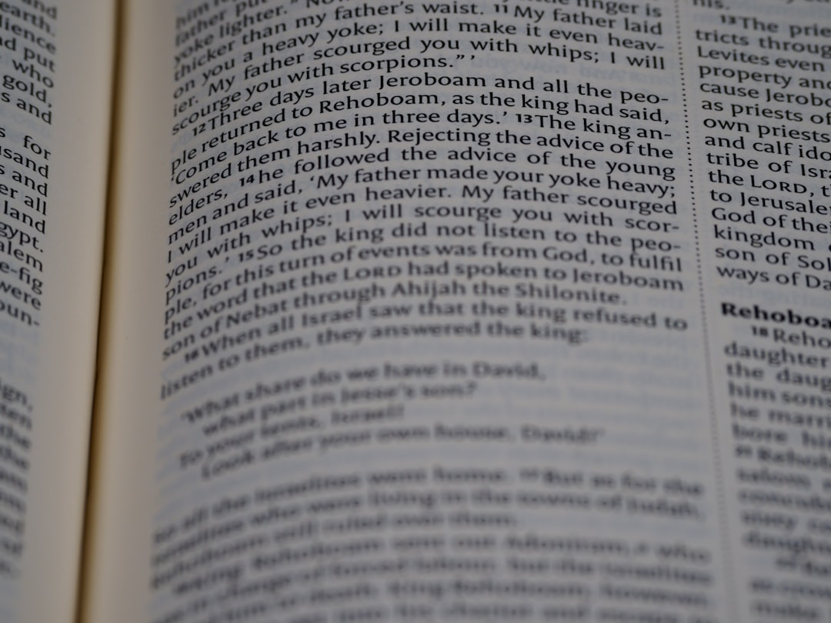
Singular and Plural Nouns
1. Singular nouns name only one thing: *dog*.
2. Plural nouns name more than one thing: *dogs*.
3. We usually add *s* to make a noun plural: *cat* becomes *cats*.
4. Some nouns change their spelling: *child* becomes *children*.
5. Watch out for tricky plurals!
Generated by AI Slide Generator

Slide 5
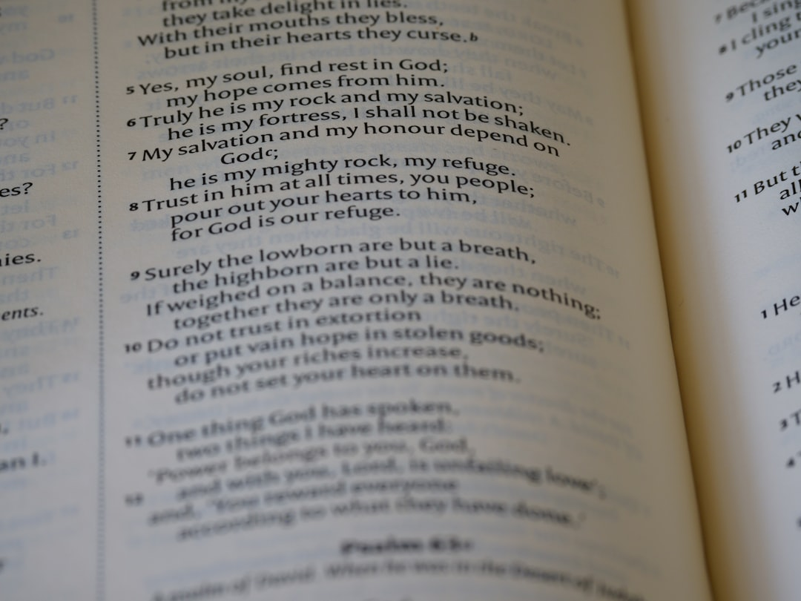
Common and Proper Nouns
1. Common nouns name general things: *city*, *river*, *month*.
2. Proper nouns name specific people, places, or things: *London*, *Thames*, *July*.
3. Proper nouns *always* begin with a capital letter.
4. Remember the difference when you write!
5. Example: *city* (common) vs. *New York* (proper)
Generated by AI Slide Generator

Slide 6
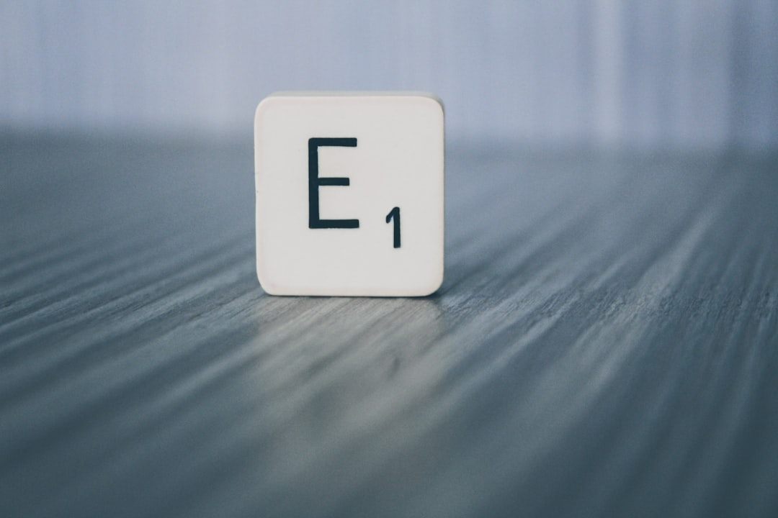
Collective Nouns
1. Collective nouns name a *group* of things.
2. Examples: *team*, *family*, *class*, *flock*.
3. Even though it's a group, it's still just *one* noun.
4. A *flock* of birds flew overhead.
5. The *team* played very well.
Generated by AI Slide Generator

Slide 7
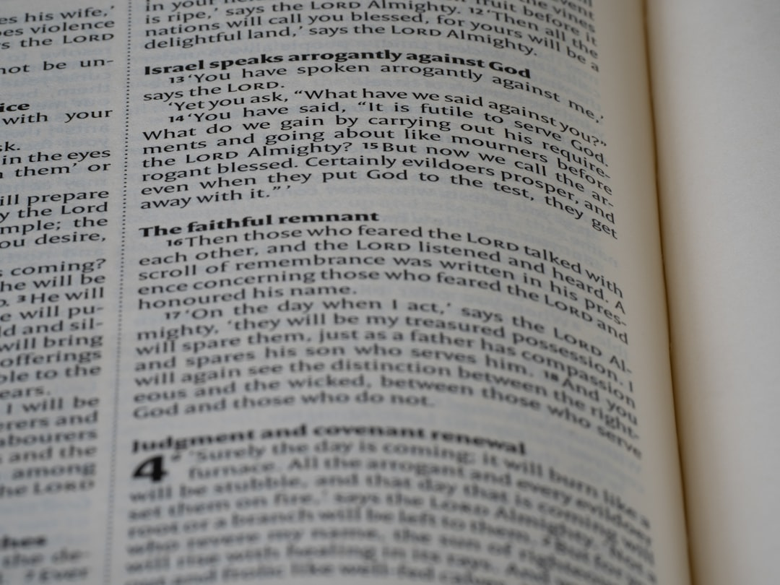
Countable and Uncountable Nouns
1. Countable nouns can be counted: *one apple*, *two apples*.
2. Uncountable nouns cannot be counted: *water*, *air*, *sand*.
3. We use *a/an* or numbers with countable nouns.
4. We often use *some* or *much* with uncountable nouns.
5. *I have two apples.* *I need some water.*
Generated by AI Slide Generator

Slide 8
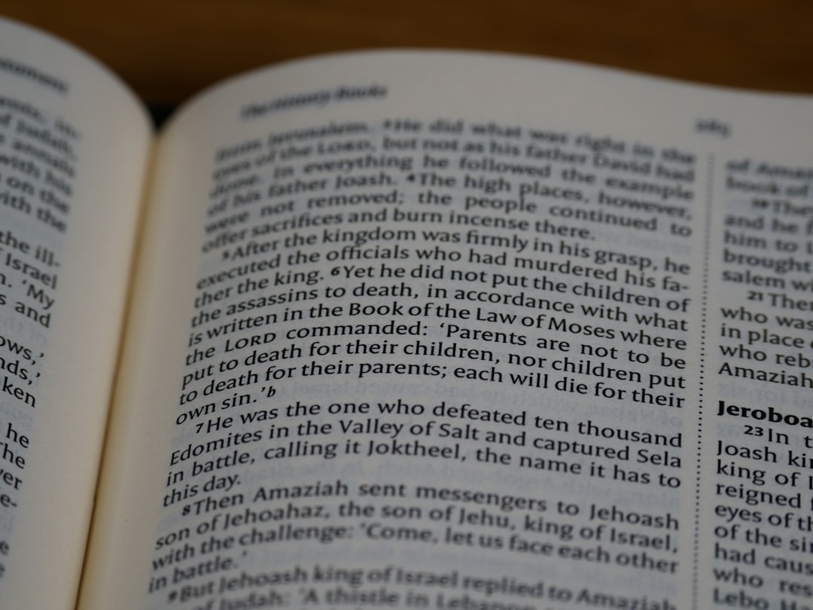
Noun as Subject
1. The subject of a sentence is who or what the sentence is about.
2. A noun can be the subject of a sentence.
3. Example: *The dog* barked loudly. (*dog* is the subject)
4. Example: *Sarah* is reading a book. (*Sarah* is the subject)
5. Spotting the subject helps you understand the sentence.
Generated by AI Slide Generator

Slide 9
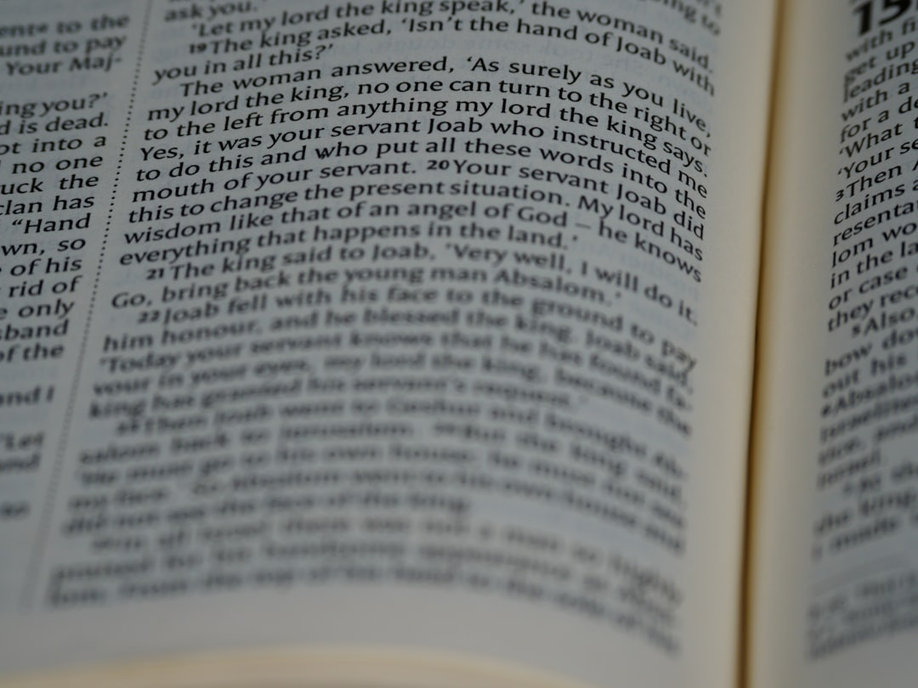
Noun as Object
1. A noun can also be the object of a verb.
2. The object *receives* the action of the verb.
3. Example: He kicked *the ball*. (*ball* is the object)
4. Example: She likes *ice cream*. (*ice cream* is the object)
5. The object usually comes after the verb.
Generated by AI Slide Generator

Slide 10
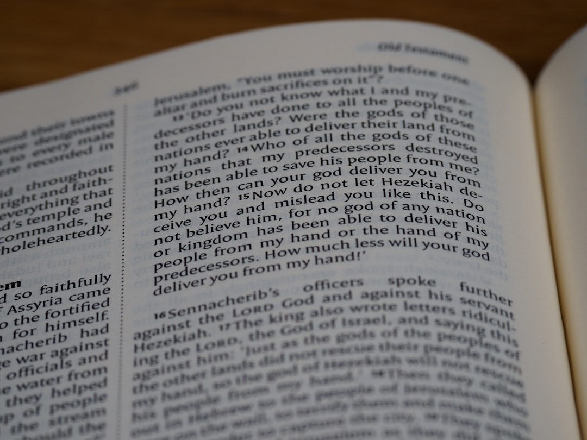
Noun Review!
1. Nouns are important for building sentences.
2. They name people, places, things, and ideas.
3. Remember the different types of nouns we learned.
4. Now you're a noun expert!
5. Keep practicing and you'll become a noun master!
Generated by AI Slide Generator

Slide 11
Practice Questions
1. Identify the nouns in this sentence: The cat sat on the mat.
2. Is "happiness" a concrete or abstract noun?
3. What is the plural form of "mouse"?
4. Give an example of a proper noun.
5. Is "furniture" a countable or uncountable noun?
Generated by AI Slide Generator

