Slide 1

What is a Preposition
• A preposition is a word that shows the relationship between a noun or pronoun and other words in a sentence.
🎥 Watch related video

Slide 2
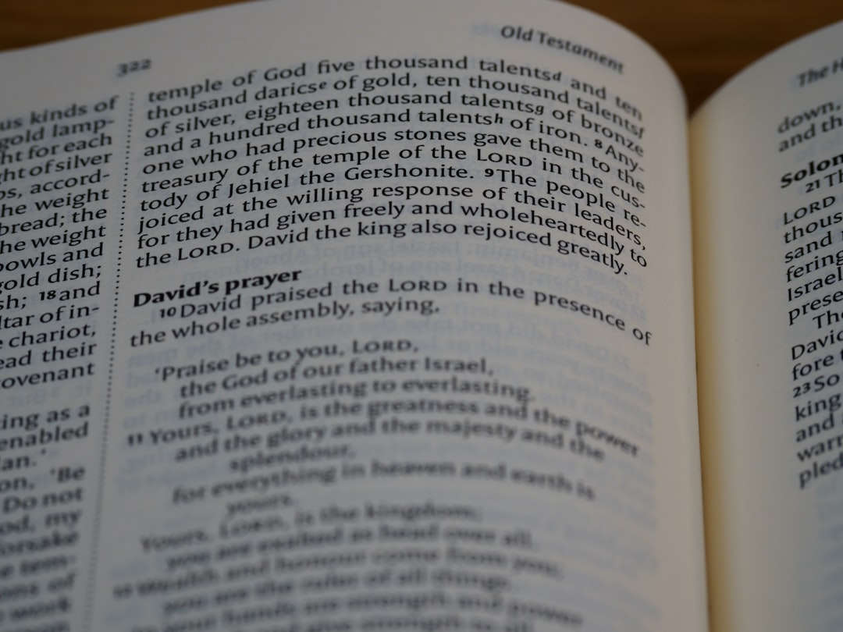
Common Types of Prepositions
1. *Prepositions of Location*: Describe where something is. Examples: *above*, *below*, *beside*, *near*, *inside*, *outside*.
2. Example: The book is *on* the shelf.
3. *Prepositions of Time*: Indicate when something happens. Examples: *at*, *on*, *in*, *before*, *after*, *during*.
4. Example: We will meet *at* 3 PM.
5. *Prepositions of Direction*: Show movement or path. Examples: *to*, *from*, *through*, *over*, *under*, *into*.
6. Example: The bird flew *over* the house.
Generated by AI Slide Generator

Slide 3
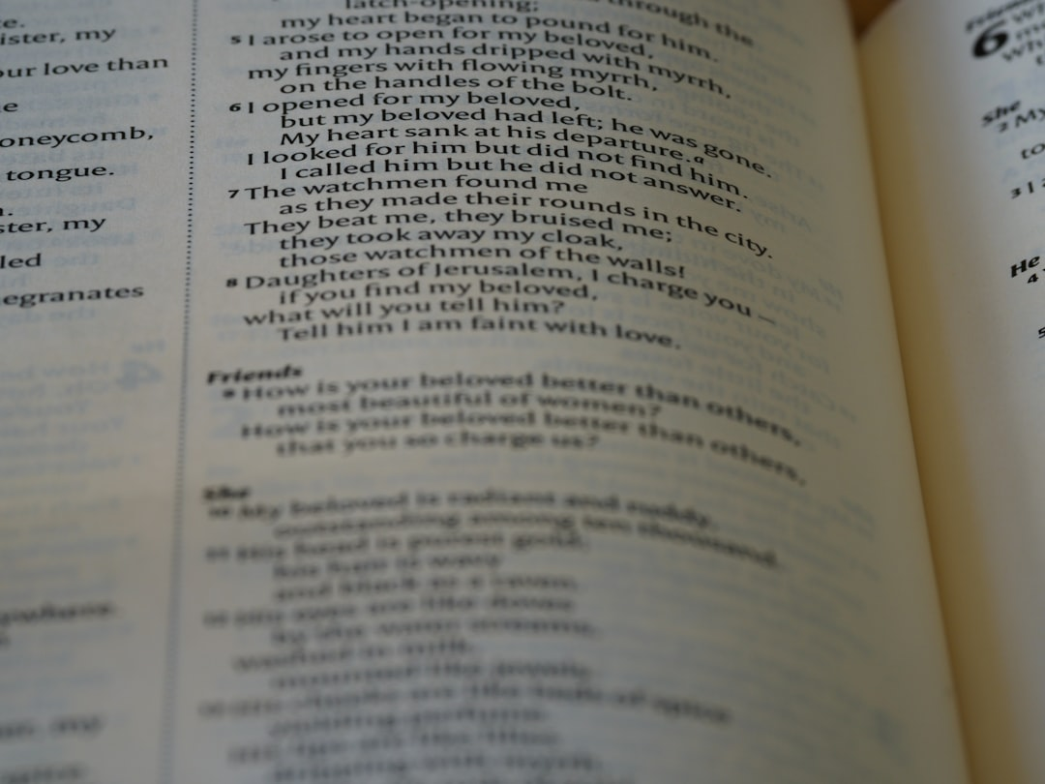
Prepositional Phrases
1. A prepositional phrase includes the preposition, its object, and any modifiers.
2. Example: *In the large, green garden*. ("In" is the preposition, "garden" is the object, "the", "large", and "green" are modifiers.)
3. Prepositional phrases act like adjectives or adverbs, modifying nouns or verbs.
4. Example (Adjective): The girl *with the red hair* is my sister.
5. Example (Adverb): The cat jumped *on the fence*.
6. Correct use of prepositional phrases improves sentence structure and clarity.
Generated by AI Slide Generator

Slide 4
Practice Questions
1. Identify the preposition in the following sentence: The dog is sleeping under the tree.
2. Choose the correct preposition: The meeting is ____ Monday morning (at, on, in).
3. Write a sentence using the preposition "between".
4. What is the object of the preposition in the sentence: "The gift is for my friend?"
5. Create a prepositional phrase starting with the preposition "near."
Generated by AI Slide Generator

