Slide 1

Introducing Latitude Earth's Horizontal Lines
• Latitude is an angular distance, measured in degrees, north or south from the Equator.
🎥 Watch related video

Slide 2
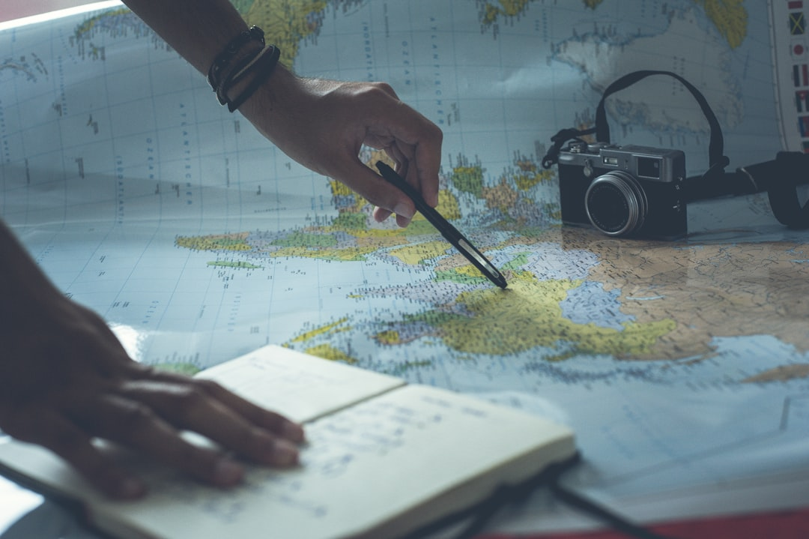
Measuring Angular Distance Degrees, Minutes, and Seconds
1. Latitude is measured in degrees (°), minutes ('), and seconds (").
2. One degree (1°) is divided into 60 minutes (60').
3. One minute (1') is divided into 60 seconds (60").
4. Example: 34° 05' 22" N (34 degrees, 5 minutes, 22 seconds North).
5. Precision in latitude measurements allows for accurate location identification.
6. Decimal degrees are also used, offering another precise representation of latitude.
Generated by AI Slide Generator

Slide 3
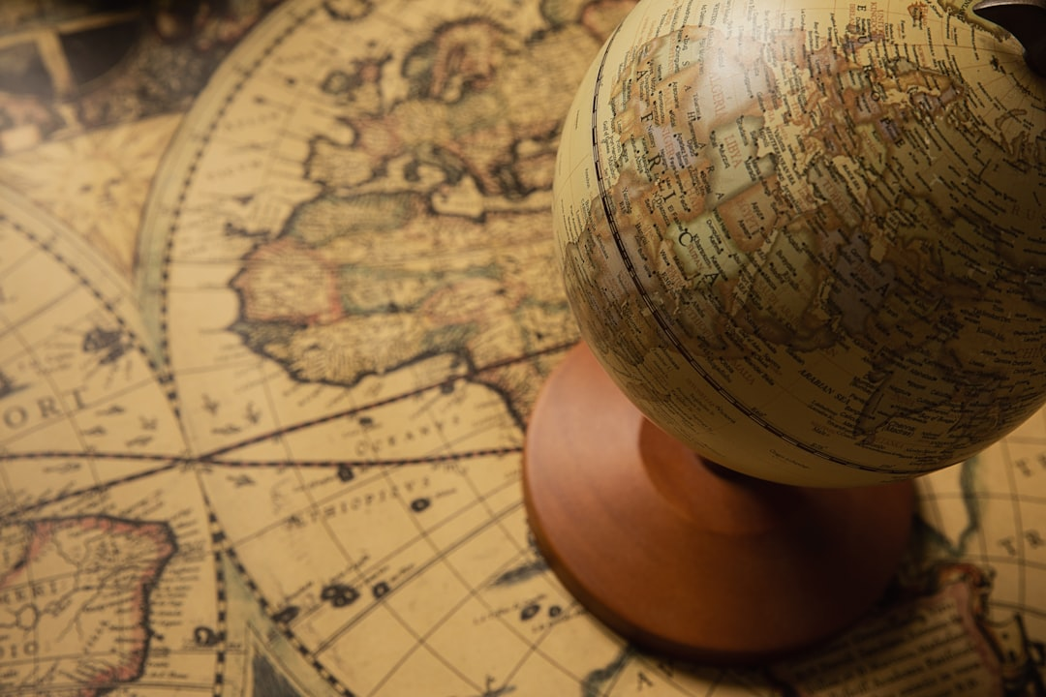
Key Lines of Latitude Tropics and Circles
1. The Tropic of Cancer is located at 23.5° N and marks the northernmost point where the sun can appear directly overhead at noon.
2. The Tropic of Capricorn is located at 23.5° S and marks the southernmost point where the sun can appear directly overhead at noon.
3. The Arctic Circle is located at 66.5° N and marks the southernmost latitude where the sun can remain continuously above or below the horizon for 24 hours.
4. The Antarctic Circle is located at 66.5° S and marks the northernmost latitude where the sun can remain continuously above or below the horizon for 24 hours.
5. These lines define distinct climatic zones on Earth.
6. The latitude values are based on Earth's axial tilt.
Generated by AI Slide Generator

Slide 4
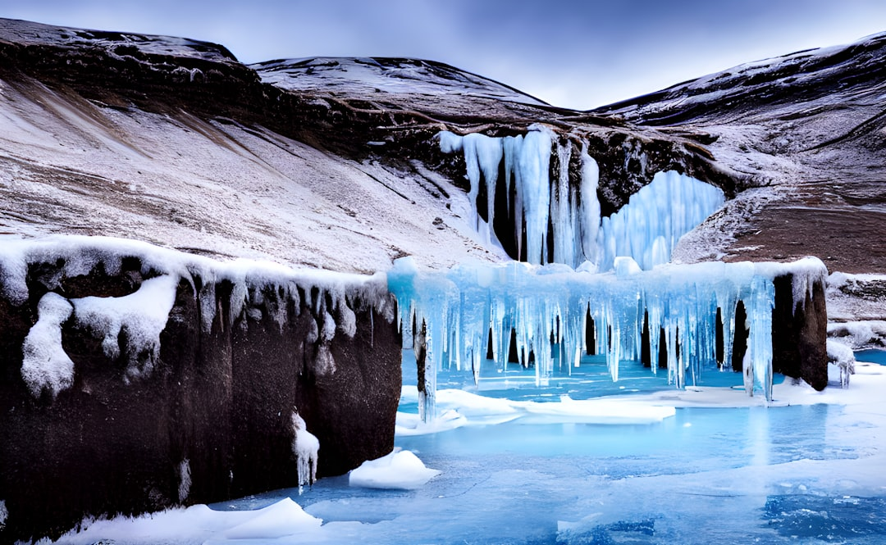
Latitude and Climate Exploring Temperature Zones
1. Latitude is a primary factor influencing climate.
2. Lower latitudes (near the Equator) generally experience warmer temperatures due to direct sunlight.
3. Higher latitudes (near the poles) generally experience colder temperatures due to indirect sunlight.
4. The Earth is divided into three main climate zones based on latitude: Tropical, Temperate, and Polar.
5. Temperate zones, located between the tropics and polar circles, experience moderate temperature variations.
6. The angle of incidence of solar radiation decreases with increasing latitude.
Generated by AI Slide Generator

Slide 5
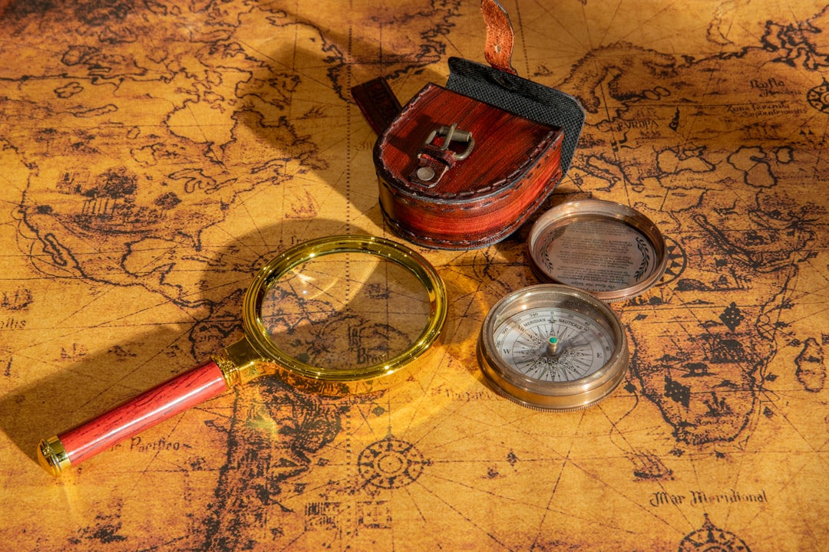
Calculating Distance Using Latitude
1. One degree of latitude is approximately 111 kilometers (69 miles).
2. Formula: Distance = Difference in Latitude (in degrees) × 111 km/degree
3. To calculate the distance between two locations on the same longitude.
4. Example: City A is at 10°N and City B is at 25°N. The difference in latitude is 25° - 10° = 15°.
5. Therefore, the distance between City A and City B is approximately 15° × 111 km/degree = 1665 km.
6. This is an approximation; actual distances can vary slightly due to Earth's oblate shape.
Generated by AI Slide Generator

Slide 6
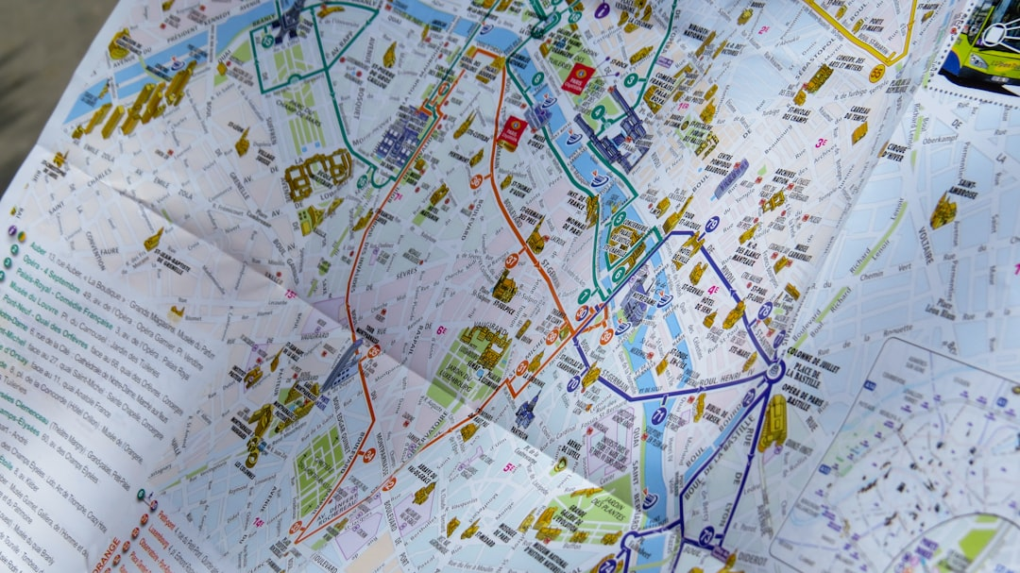
Latitude and Navigation Using Sextants
1. Historically, latitude was crucial for navigation, especially before GPS technology.
2. Sextants were used to measure the angle between the horizon and celestial bodies (e.g., the sun, stars).
3. By knowing the date, time, and measuring the angle of the sun at noon, sailors could determine their latitude.
4. Star charts and tables were used to determine latitude at night.
5. Latitude allows for East-West positioning.
6. Modern GPS systems rely on satellite technology to determine latitude with high accuracy.
Generated by AI Slide Generator

Slide 7
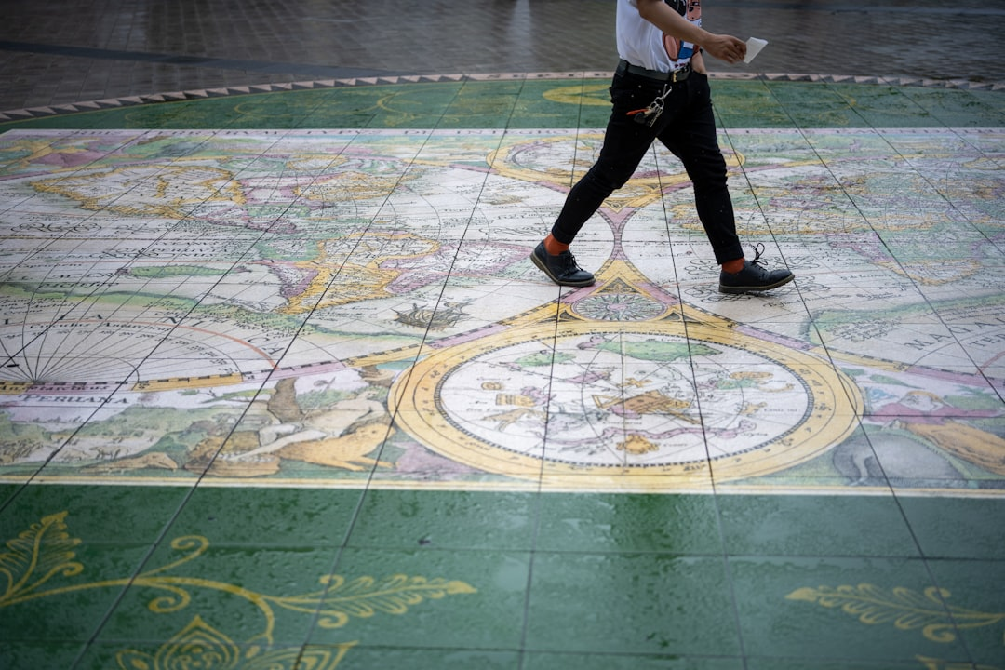
Global Positioning System (GPS) and Latitude
1. GPS relies on a network of satellites orbiting Earth.
2. GPS receivers calculate their location by measuring the time it takes for signals to travel from multiple satellites.
3. Latitude is one of the coordinates determined by GPS, along with longitude and altitude.
4. GPS provides highly accurate latitude information in decimal degrees (e.g., 34.0522° N).
5. GPS is used in various applications, including navigation, surveying, mapping, and tracking.
6. Mobile phones, vehicles, and specialized devices utilize GPS technology.
Generated by AI Slide Generator

Slide 8
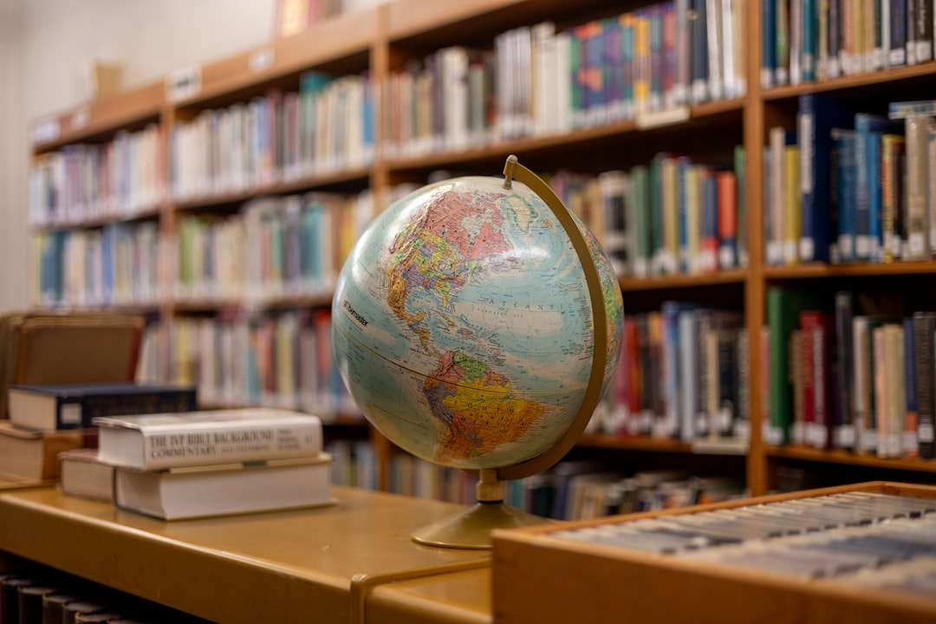
Applications of Latitude Beyond Geography
1. Agriculture: Latitude influences growing seasons and crop suitability.
2. Urban planning: Latitude affects building design and energy consumption.
3. Epidemiology: Latitude is a factor in the spread of certain diseases.
4. Astronomy: Latitude determines which stars and constellations are visible.
5. Telecommunications: Satellite orbits and signal coverage are related to latitude.
6. Understanding latitude is essential for informed decision-making in diverse fields.
Generated by AI Slide Generator

Slide 9
Practice Questions
1. What is the latitude of the Equator?
2. What is the approximate distance on the Earth's surface in kilometers between 20°N and 35°N?
3. At what latitude is the Tropic of Capricorn located?
4. Explain how latitude influences the climate of a region.
5. Describe one way in which latitude was historically used for navigation.
Generated by AI Slide Generator

