Slide 1

Introduction to the Plant Kingdom
• The Plant Kingdom (Plantae) consists of multicellular, eukaryotic organisms.
🎥 Watch related video

Slide 2

Non-Vascular Plants Bryophytes
1. Bryophytes include mosses, liverworts, and hornworts.
2. They lack vascular tissues (xylem and phloem) for efficient water and nutrient transport.
3. Bryophytes are typically small and live in moist environments.
4. Water and nutrients are absorbed directly through their surfaces by diffusion.
5. Reproduction occurs via spores, requiring water for sperm to reach the egg.
6. Example: Mosses like *Sphagnum* are ecologically important in peat bogs.
Generated by AI Slide Generator

Slide 3
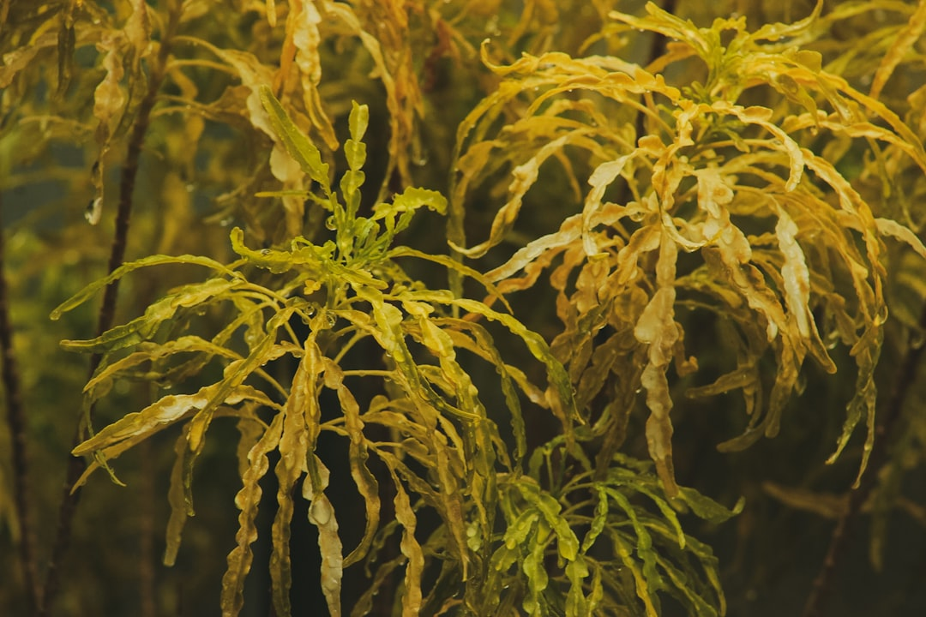
Vascular Plants Tracheophytes (Seedless)
1. Seedless vascular plants possess xylem and phloem for efficient transport.
2. Examples include ferns, horsetails, and club mosses.
3. They reproduce via spores, similar to bryophytes, needing water for fertilization.
4. Vascular tissue allows them to grow larger than bryophytes.
5. Ferns have well-developed roots, stems, and leaves (fronds).
6. Example: Ferns are common in shady, moist forests.
Generated by AI Slide Generator

Slide 4
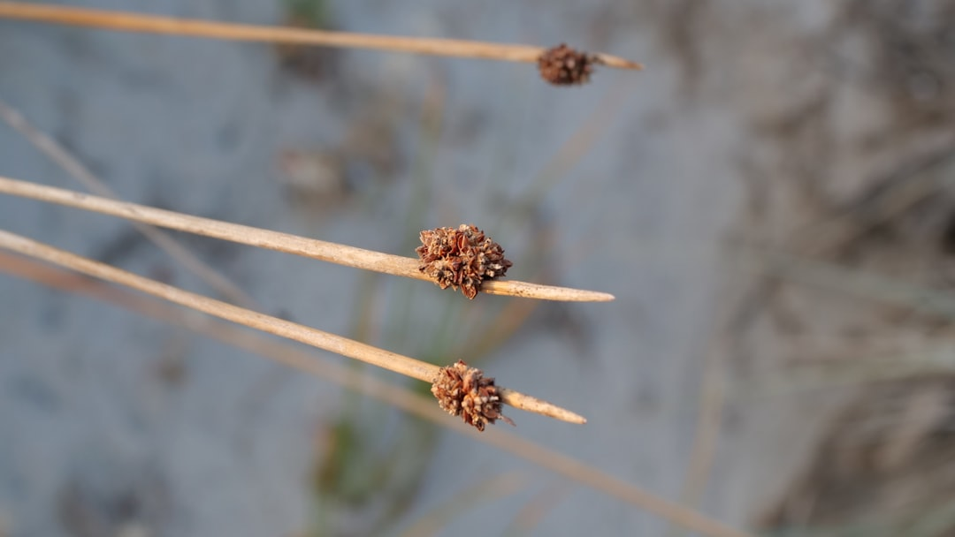
Vascular Plants Gymnosperms (Naked Seeds)
1. Gymnosperms are vascular plants that produce seeds but not flowers or fruits.
2. Their seeds are "naked," meaning they are not enclosed within an ovary.
3. Conifers are the most common type of gymnosperm (e.g., pine, fir, spruce).
4. They are adapted to drier conditions due to features like needle-like leaves.
5. Pollination is primarily wind-driven.
6. Example: Pine trees produce cones that contain the seeds.
Generated by AI Slide Generator

Slide 5
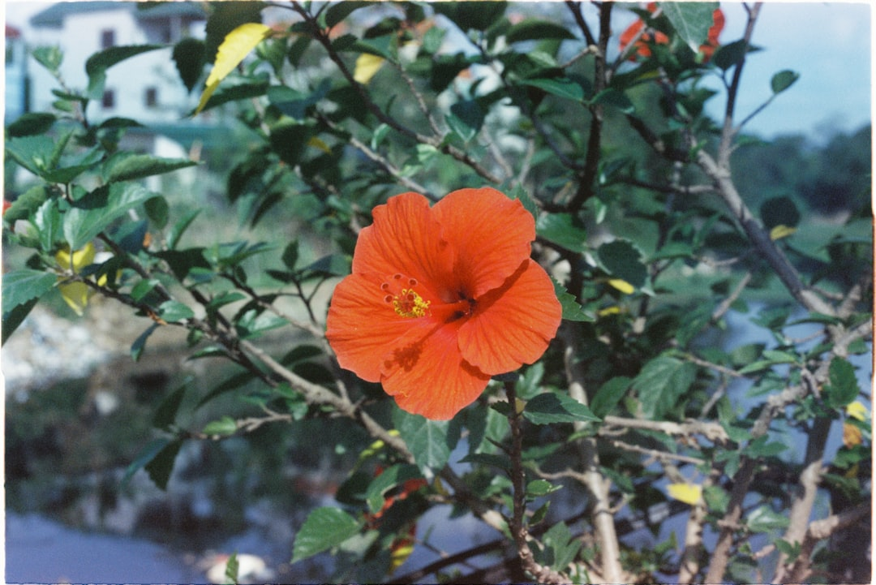
Vascular Plants Angiosperms (Flowering Plants)
1. Angiosperms are vascular plants that produce flowers and fruits.
2. The seeds are enclosed within an ovary, which develops into a fruit.
3. They are the most diverse and widespread group of plants.
4. Angiosperms are divided into monocots and dicots based on seed structure.
5. Flowers facilitate pollination by insects, birds, or wind.
6. Example: Apple trees produce flowers that develop into apples containing seeds.
Generated by AI Slide Generator

Slide 6
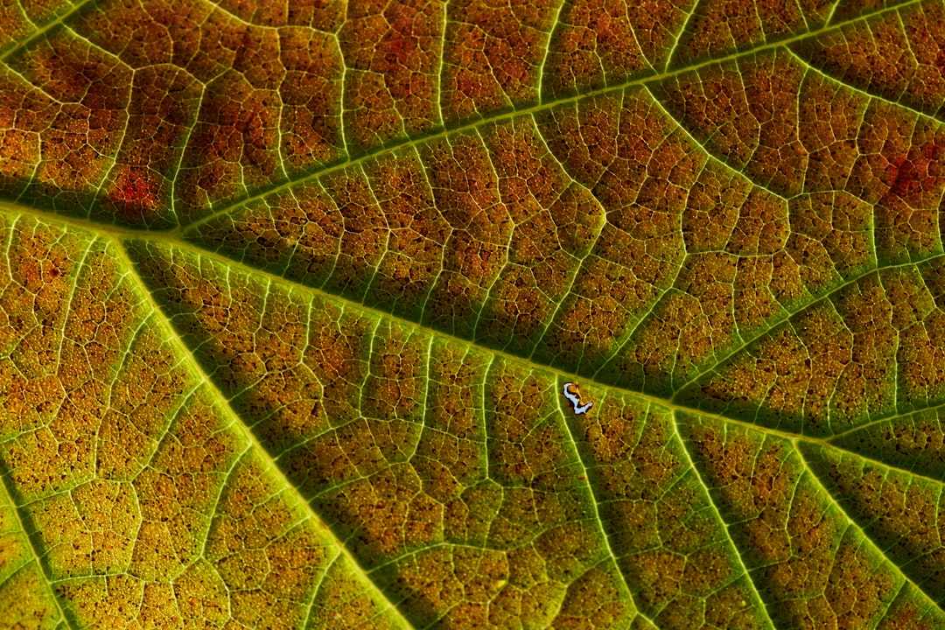
Photosynthesis The Foundation of Plant Life
1. Photosynthesis is the process by which plants convert light energy into chemical energy.
2. The overall equation for photosynthesis is: 6CO₂ + 6H₂O + Light Energy → C₆H₁₂O₆ + 6O₂
3. This means six molecules of carbon dioxide plus six molecules of water, using light energy, yields one molecule of glucose (sugar) and six molecules of oxygen.
4. Chlorophyll is the primary pigment that absorbs light energy.
5. The rate of photosynthesis can be affected by light intensity, carbon dioxide concentration, and temperature.
6. Example: If a plant absorbs 500J of light energy and converts it into 100J of chemical energy in glucose, the efficiency is (100J/500J) x 100% = 20%.
Generated by AI Slide Generator

Slide 7
Practice Questions
1. What are the key characteristics of the Plant Kingdom?
2. How do bryophytes differ from tracheophytes?
3. Explain the difference between gymnosperms and angiosperms.
4. Describe the process of photosynthesis and its importance.
5. Give an example of a plant from each of the four major groups (bryophytes, seedless vascular, gymnosperms, angiosperms).
Generated by AI Slide Generator

