Slide 1

What is a Noun
• A noun is a word that names a person, place, thing, or idea.
🎥 Watch related video

Slide 2
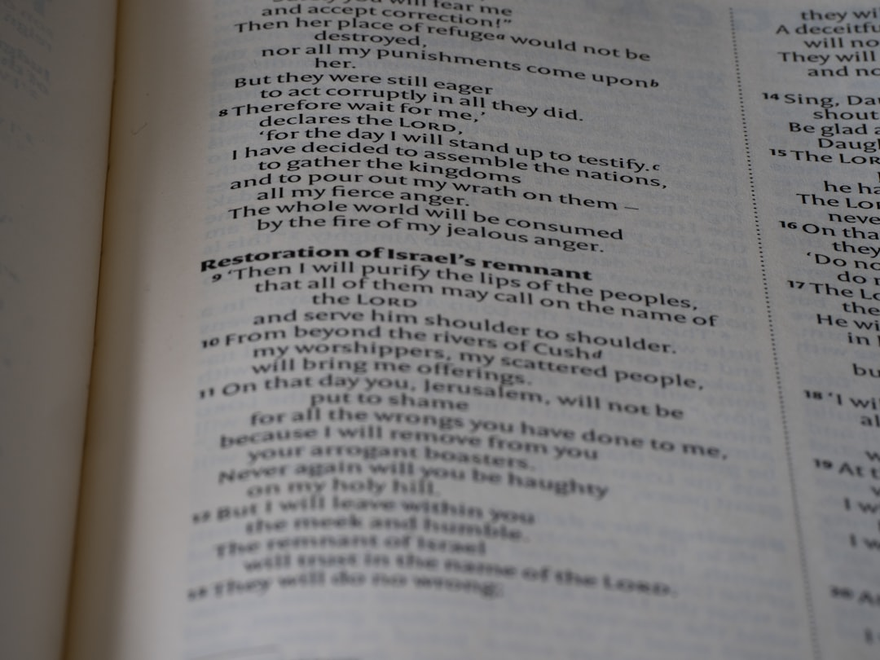
Types of Nouns
1. Common Nouns: General names, not capitalized (e.g., dog, tree, house).
2. Proper Nouns: Specific names, always capitalized (e.g., Rover, Oak Street, White House).
3. Concrete Nouns: Things you can experience with your senses (e.g., apple, music, sunshine).
4. Abstract Nouns: Ideas or feelings you cannot touch (e.g., love, justice, fear).
5. Countable Nouns: Can be counted (e.g., one book, two books, three books).
6. Uncountable Nouns: Cannot be counted (e.g., water, air, sand).
Generated by AI Slide Generator

Slide 3
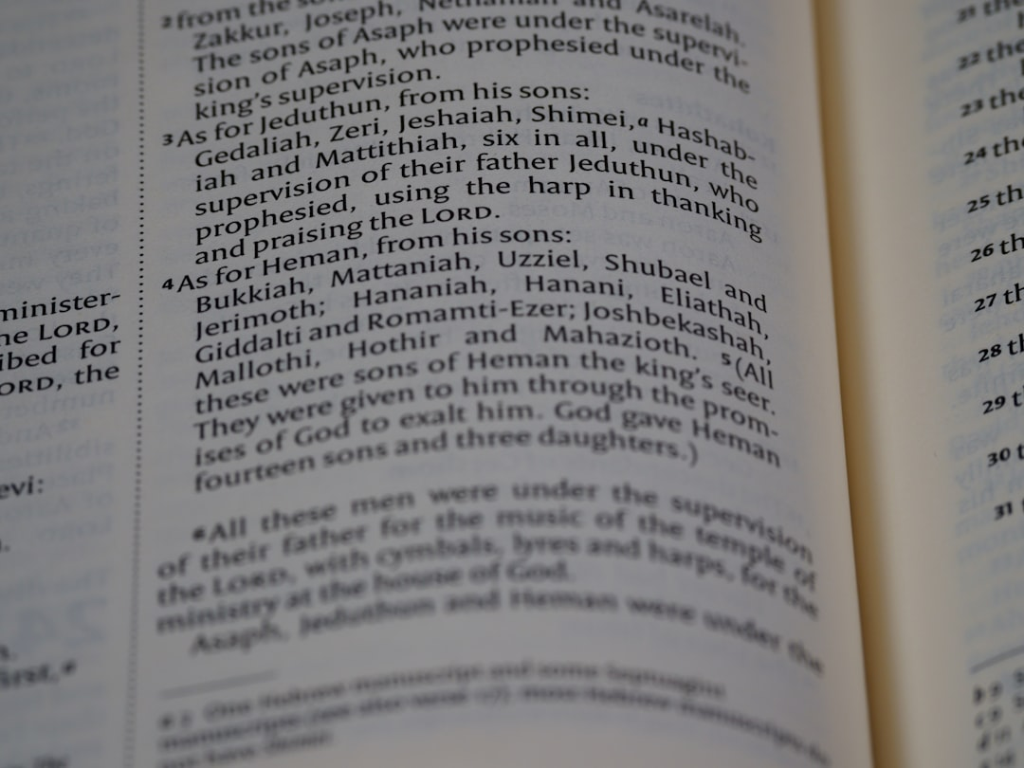
Singular and Plural Nouns
1. Most nouns become plural by adding "-s" (e.g., cat -> cats, book -> books).
2. Nouns ending in "-s," "-sh," "-ch," "-x," or "-z" add "-es" (e.g., bus -> buses, dish -> dishes).
3. Some nouns ending in "-y" change to "-ies" (e.g., baby -> babies, city -> cities).
4. Irregular plural nouns have different forms (e.g., child -> children, mouse -> mice, person -> people).
5. Some nouns stay the same in both singular and plural forms (e.g., sheep, deer, fish).
6. Formula for regular plural noun: Singular Noun + s or es = Plural Noun
Generated by AI Slide Generator

Slide 4
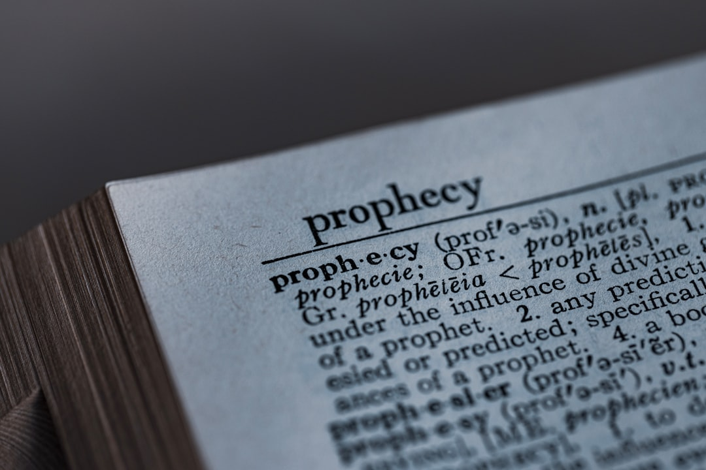
What is a Pronoun
1. A pronoun is a word that replaces a noun or noun phrase.
2. Pronouns help us avoid repeating the same noun over and over.
3. Pronouns make our sentences sound smoother and less repetitive.
4. Example: Instead of saying "The boy went to school. The boy likes to read," we say "The boy went to school. He likes to read."
5. "He" is the pronoun replacing "The boy."
6. Pronouns agree in number and gender with the noun they replace.
Generated by AI Slide Generator

Slide 5
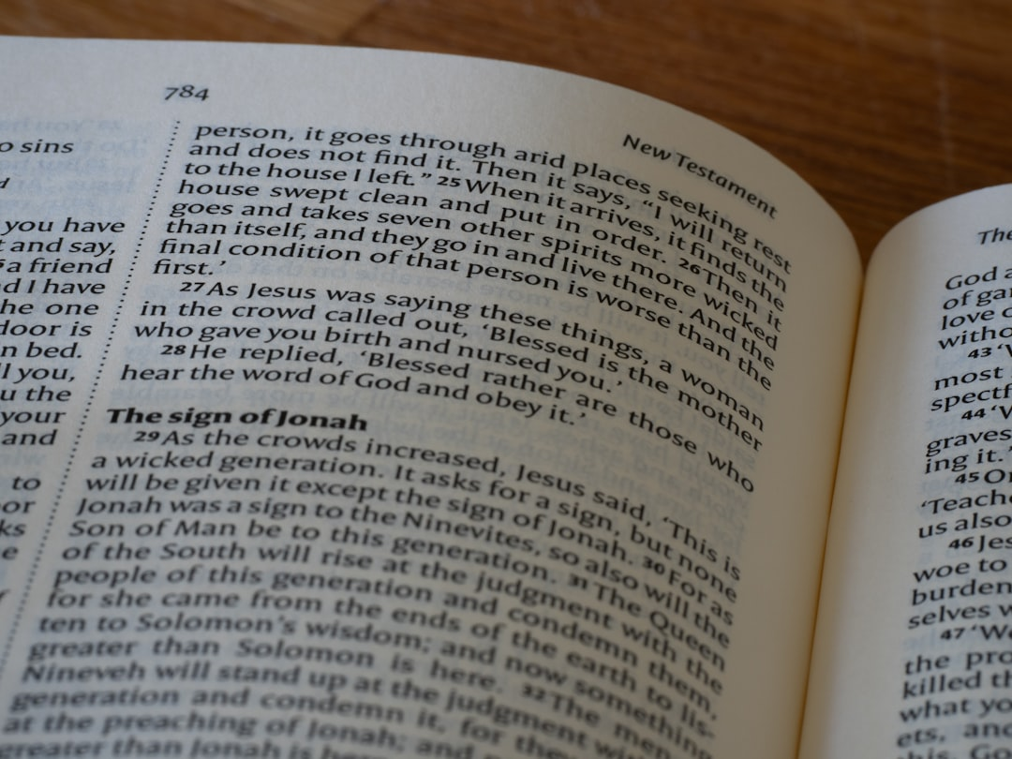
Types of Pronouns Subject and Object
1. Subject Pronouns: Used as the subject of a sentence (e.g., I, you, he, she, it, we, they).
2. Example: *He* is going to the store. *They* are playing outside.
3. Object Pronouns: Used as the object of a verb or preposition (e.g., me, you, him, her, it, us, them).
4. Example: The teacher helped *him*. Give the book to *them*.
5. *Subject Pronoun + Verb + Object Pronoun* is a common sentence structure.
6. Formula: *S + V + O*. Where S = Subject Pronoun, V = Verb, O = Object Pronoun
Generated by AI Slide Generator

Slide 6
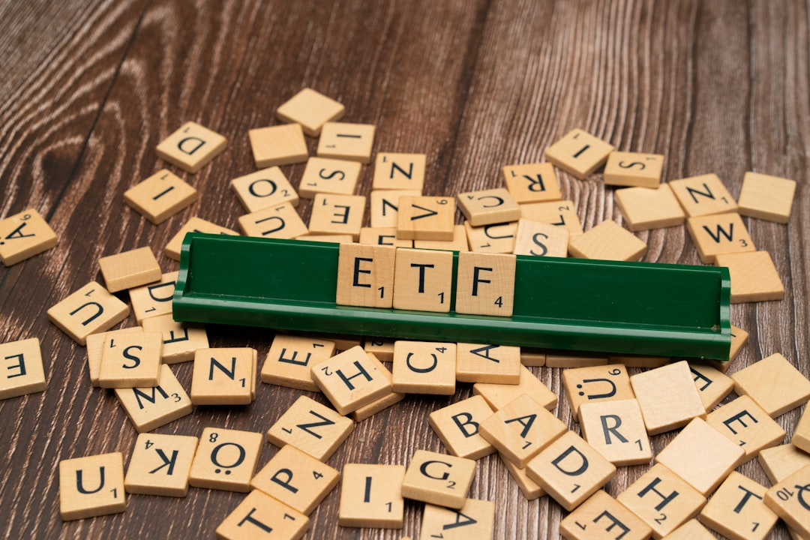
Types of Pronouns Possessive and Reflexive
1. Possessive Pronouns: Show ownership (e.g., mine, yours, his, hers, its, ours, theirs).
2. Example: This book is *mine*. The house is *theirs*.
3. Note: Possessive pronouns do not use apostrophes.
4. Reflexive Pronouns: Refer back to the subject of the sentence (e.g., myself, yourself, himself, herself, itself, ourselves, themselves).
5. Example: She hurt *herself*. They blamed *themselves*.
6. Reflexive pronouns are essential to the meaning of the sentence and cannot be removed.
Generated by AI Slide Generator

Slide 7
Pronoun-Antecedent Agreement
1. The antecedent is the noun that a pronoun refers to.
2. A pronoun must agree in number (singular or plural) with its antecedent.
3. Singular antecedent needs a singular pronoun (e.g., The dog wagged *its* tail).
4. Plural antecedent needs a plural pronoun (e.g., The students finished *their* homework).
5. If the gender of the antecedent is unknown, use "they/them" (e.g., Each student should bring *their* own pencil).
6. This ensures clear and grammatically correct sentences.
Generated by AI Slide Generator

Slide 8
Practice Questions
1. Identify the nouns in the sentence: "The playful cat chased the mouse across the garden."
2. Replace the underlined noun with a suitable pronoun: "Sarah" is a talented artist."
3. Which of the following is a plural noun: child, children, childs?
4. Is the pronoun in this sentence a subject or object pronoun: "The teacher gave her a reward."
5. What is the antecedent of the pronoun in this sentence: "The bird flew to its nest."
Generated by AI Slide Generator

