Slide 1

What is a Noun
• A noun is a word that names a person, place, thing, or idea.
🎥 Watch related video

Slide 2
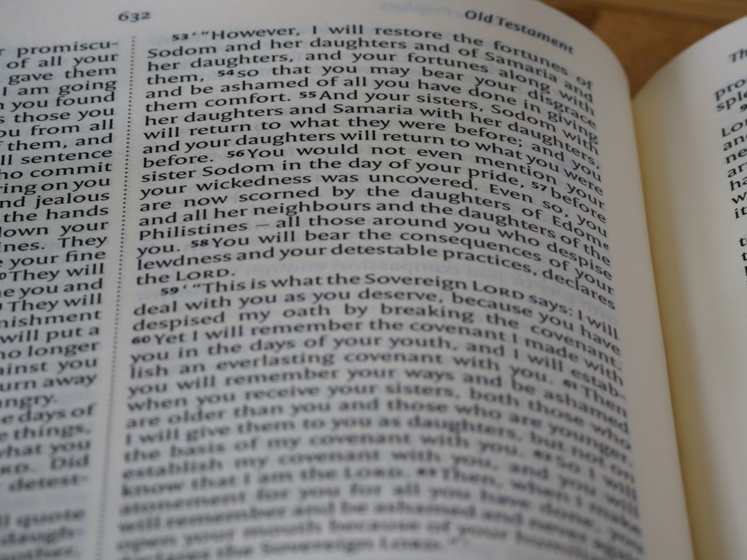
Types of Nouns Common and Proper
1. Common nouns refer to general people, places, things, or ideas. (e.g., city, dog, game)
2. Proper nouns name specific people, places, things, or ideas and always begin with a capital letter. (e.g., London, Fido, Monopoly)
3. Common Noun: river
4. Proper Noun: Thames River
5. Common Noun: school
6. Proper Noun: Green Valley School
Generated by AI Slide Generator

Slide 3
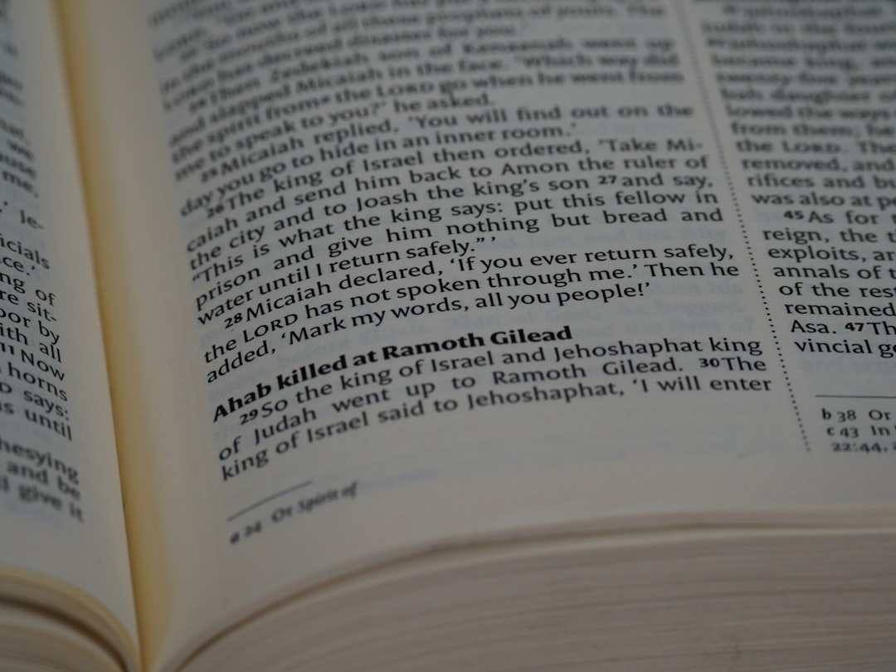
Singular and Plural Nouns
1. Singular nouns name one person, place, thing, or idea. (e.g., cat, tree, house)
2. Plural nouns name more than one person, place, thing, or idea. (e.g., cats, trees, houses)
3. Most plural nouns are formed by adding "-s" to the singular form.
4. Some nouns have irregular plural forms (e.g., child - children, mouse - mice, person - people).
5. To make most nouns plural, add 's'. To make nouns ending in s, sh, ch, x or z plural, add 'es'.
Generated by AI Slide Generator

Slide 4
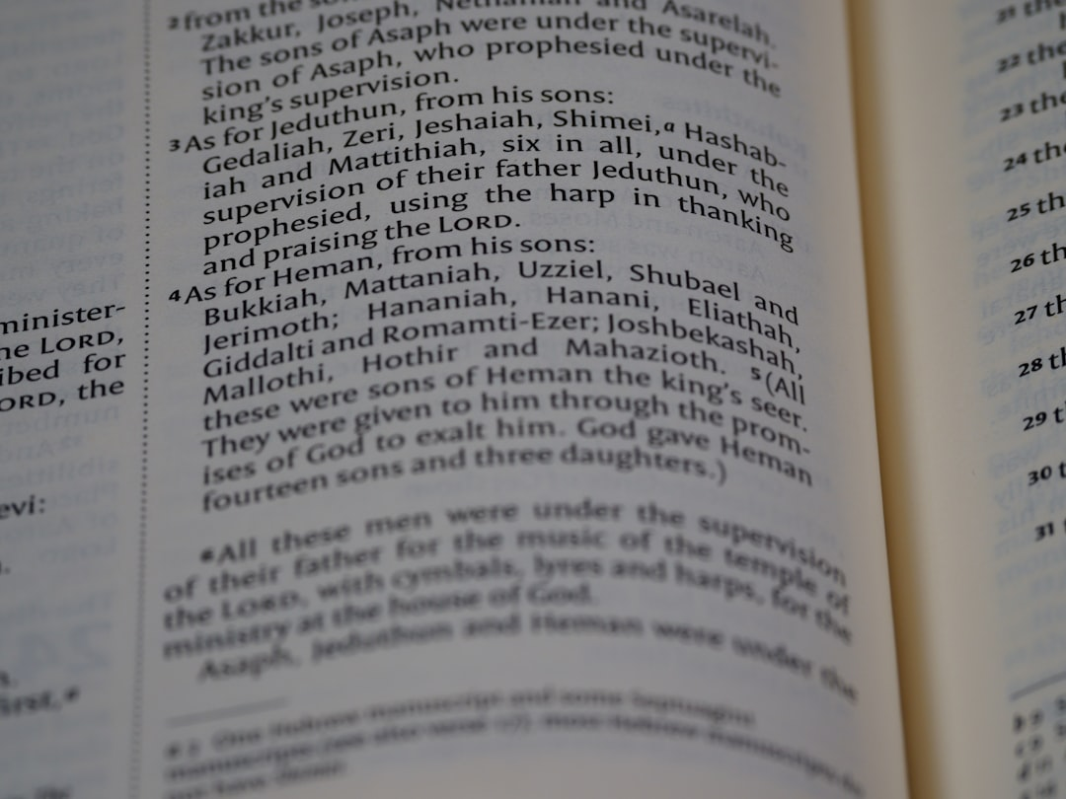
What is a Pronoun
1. A pronoun is a word that replaces a noun.
2. Pronouns help us avoid repeating nouns.
3. Common pronouns include: he, she, it, they, we, I, you.
4. Example: Sarah is a good student. She studies hard. ("She" replaces "Sarah")
5. Pronouns must agree in number (singular/plural) with the noun they replace.
Generated by AI Slide Generator

Slide 5
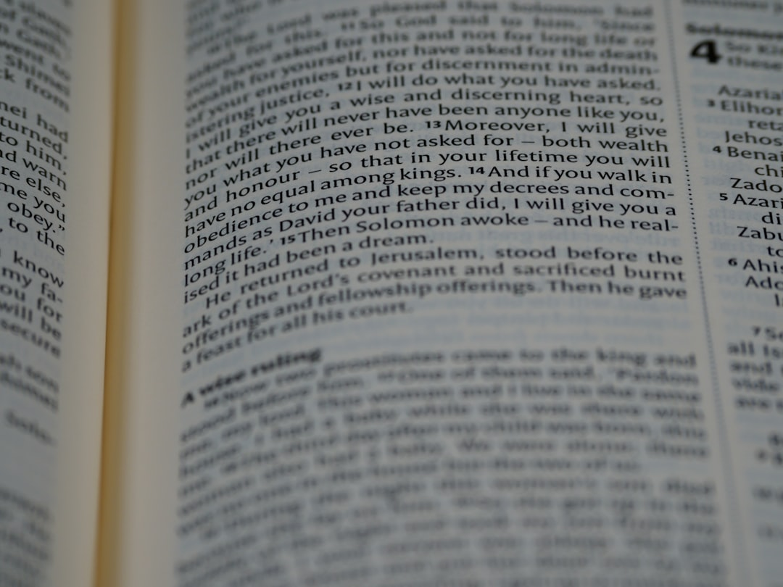
Subject and Object Pronouns
1. Subject pronouns perform the action in a sentence. (I, you, he, she, it, we, they)
2. Example: *They* went to the store.
3. Object pronouns receive the action in a sentence. (me, you, him, her, it, us, them)
4. Example: The teacher gave *him* a prize.
5. Note that 'you' and 'it' are both subject and object pronouns.
Generated by AI Slide Generator

Slide 6
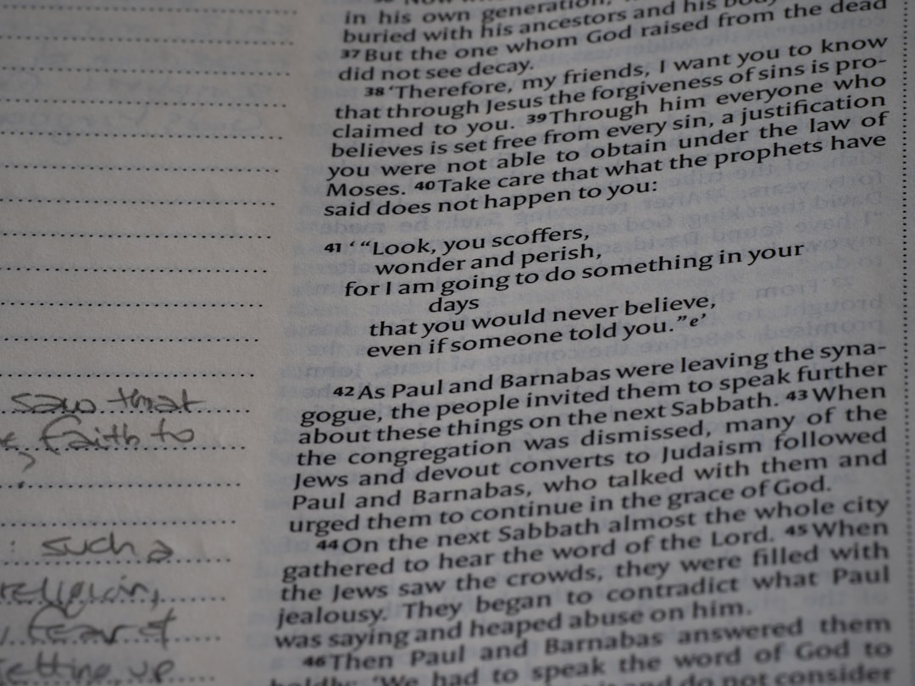
Possessive Pronouns
1. Possessive pronouns show ownership.
2. Examples: mine, yours, his, hers, its, ours, theirs
3. Possessive pronouns do not use apostrophes. (e.g., "its" not "it's")
4. Example: That book is *mine*.
5. Contrast with possessive adjectives, which modify nouns: my, your, his, her, its, our, their (e.g., *My* book)
6. Avoid confusing "its" (possessive pronoun) with "it's" (it is).
Generated by AI Slide Generator

Slide 7
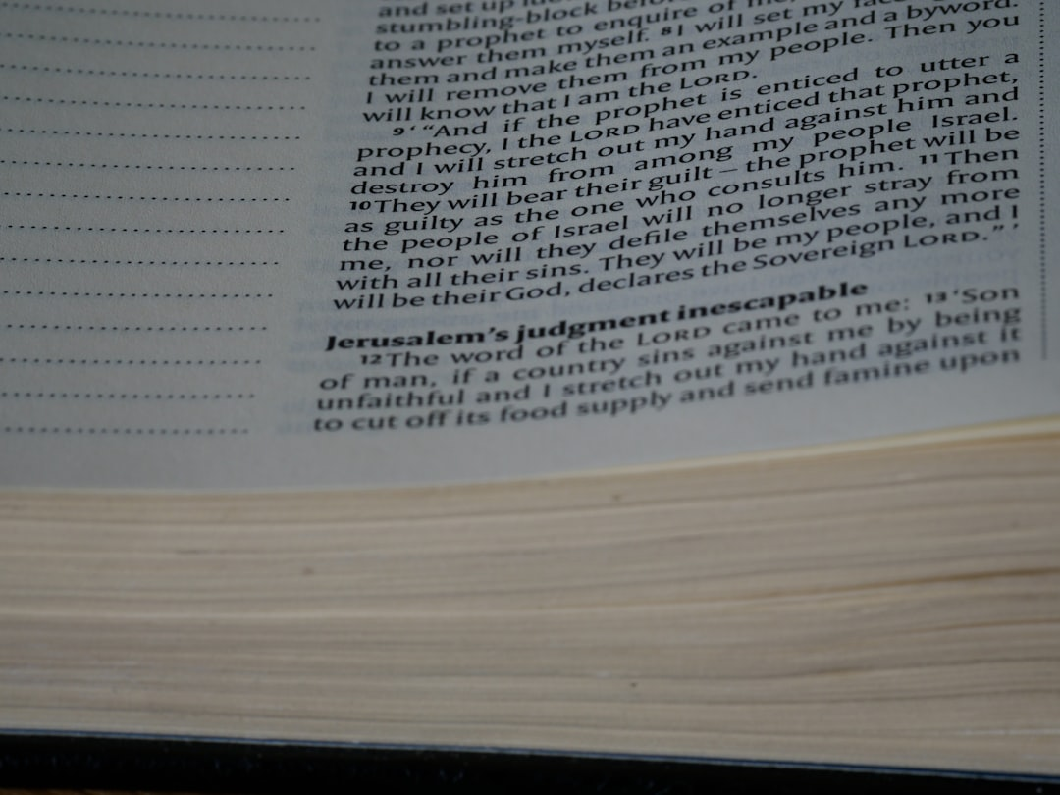
Pronoun-Antecedent Agreement
1. The antecedent is the noun that a pronoun refers to.
2. A pronoun must agree in number (singular/plural) and gender (masculine/feminine/neuter) with its antecedent.
3. Example: The dog wagged *its* tail. (Dog is singular, "its" is singular)
4. Example: The students finished *their* homework. (Students is plural, "their" is plural)
5. Be careful with indefinite pronouns like "everyone" or "someone," which are usually considered singular.
Generated by AI Slide Generator

Slide 8
Practice Questions
1. Identify the nouns in this sentence: "The cat sat on the red rug."
2. Rewrite this sentence using a pronoun: "John is a good player. John plays football well."
3. Is "hers" a subject pronoun, an object pronoun, or a possessive pronoun?
4. Correct the pronoun agreement error in this sentence: "The team celebrated its win." (Assume the team is made up of multiple players)
5. Is "happiness" a common noun or a proper noun?
Generated by AI Slide Generator

