Slide 1

The Amazing Carbon Atom
• Carbon is the 6th element on the periodic table.
🎥 Watch related video

Slide 2
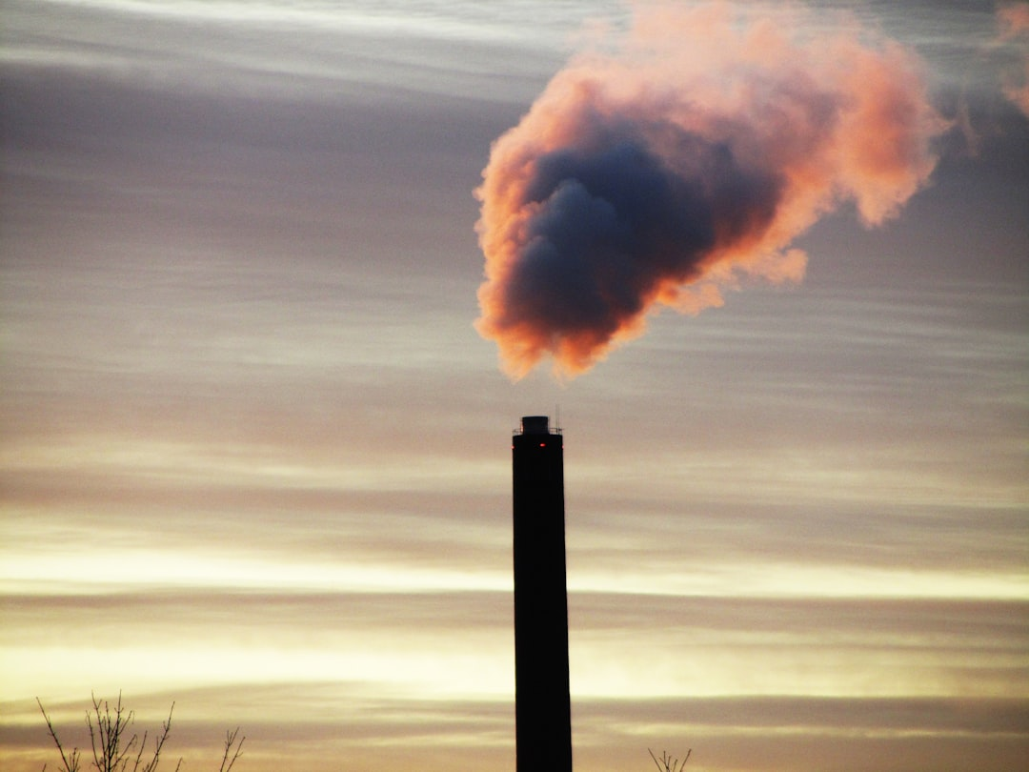
Carbon's Versatile Bonding
1. Carbon atoms can form four covalent bonds.
2. This allows for a great diversity of molecular structures.
3. Carbon can form single, double, or triple bonds with other atoms.
4. Example: Methane (CH₄) has four single bonds.
5. Example: Carbon dioxide (CO₂) has two double bonds.
6. Example: Ethyne (C₂H₂) has one triple bond.
Generated by AI Slide Generator

Slide 3
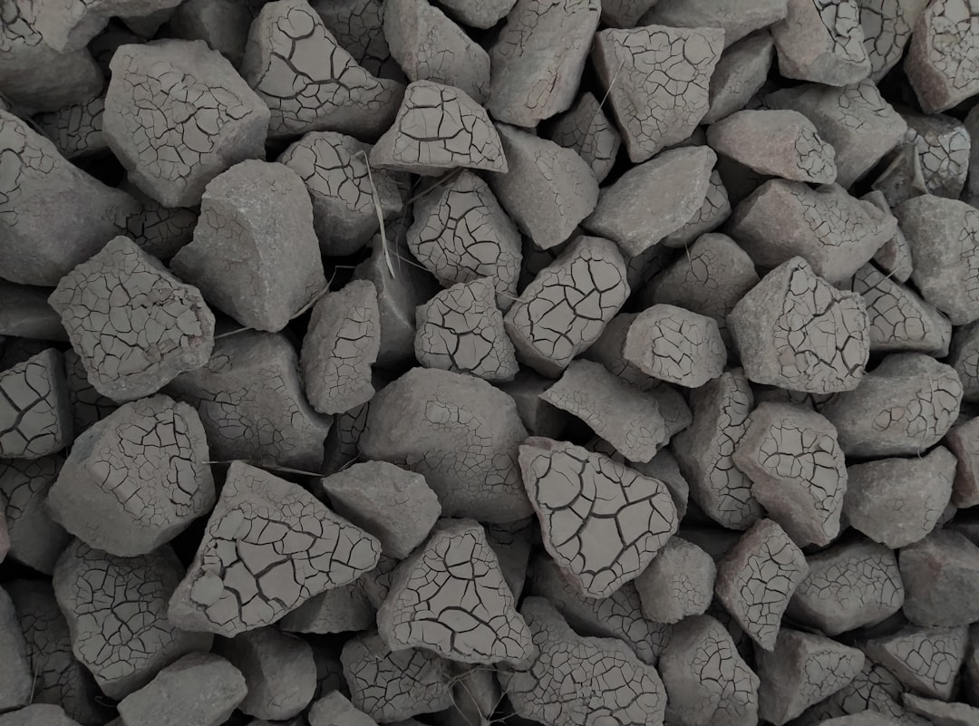
Allotropes of Carbon
1. Allotropes are different forms of the same element.
2. Diamond: a hard, transparent crystal, used in jewelry and cutting tools.
3. Graphite: a soft, black solid, used in pencils and as a lubricant.
4. Fullerenes (e.g., Buckminsterfullerene): Spherical or tube-shaped molecules.
5. Amorphous carbon: No long-range order (e.g., soot, charcoal).
6. Each allotrope has unique properties due to different bonding arrangements.
Generated by AI Slide Generator

Slide 4
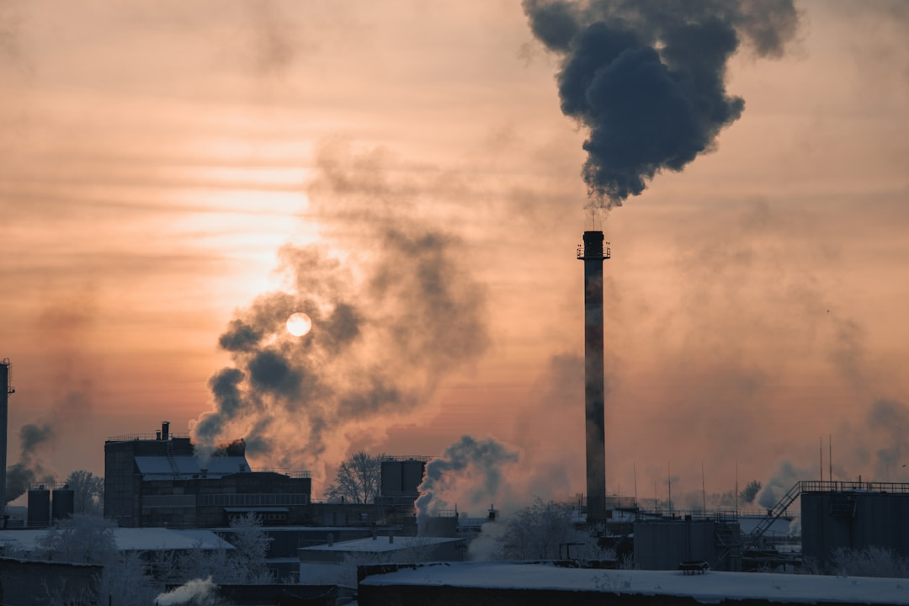
Carbon in the Environment The Carbon Cycle
1. The carbon cycle describes how carbon moves through the Earth's systems.
2. Photosynthesis: Plants absorb CO₂ from the atmosphere.
3. Respiration: Organisms release CO₂ back into the atmosphere.
4. Decomposition: Decomposers release carbon from dead organisms.
5. Combustion: Burning fossil fuels releases CO₂.
6. Ocean absorption: Oceans absorb CO₂ from the atmosphere.
Generated by AI Slide Generator

Slide 5
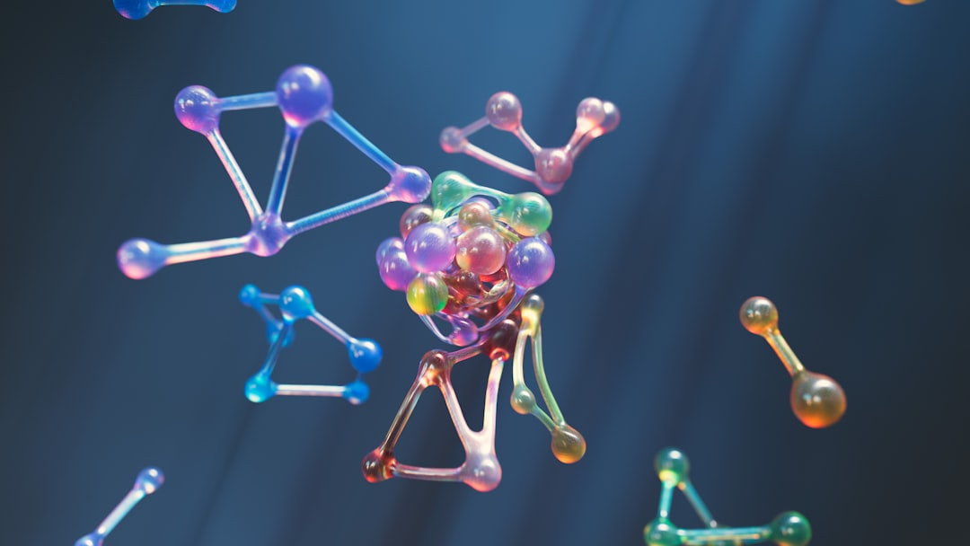
Carbon Compounds Organic Chemistry
1. Organic chemistry is the study of carbon-containing compounds.
2. Hydrocarbons: Compounds made of only carbon and hydrogen (e.g., methane, ethane).
3. Formula for Alkanes: CₙH₂ₙ₊₂. Example: Propane (C₃H₈). If n=3, C₃H(2*3)+2 = C₃H₈.
4. Functional groups: Specific groups of atoms that give organic molecules particular properties (e.g., alcohols, carboxylic acids).
5. Polymers: Large molecules made of repeating units (e.g., plastics, proteins).
6. Organic compounds are essential for life processes.
Generated by AI Slide Generator

Slide 6
Practice Questions
1. What is the atomic number of Carbon?
2. Name three allotropes of carbon.
3. How many bonds can a carbon atom typically form?
4. Describe the process of photosynthesis in the carbon cycle.
5. What is the formula for an alkane with 5 carbon atoms?
Generated by AI Slide Generator

