Slide 1

The Amazing Carbon Atom
• Carbon is the sixth element on the periodic table.
🎥 Watch related video

Slide 2

Carbon's Unique Bonding Ability
1. Carbon atoms can form four covalent bonds.
2. This allows carbon to create long chains and complex structures.
3. Carbon-carbon bonds are strong and stable.
4. Example: Methane (CH₄) - Carbon bonded to four hydrogen atoms.
5. Carbon can form single, double, and triple bonds.
6. Double bond example: Ethene (C₂H₄), Triple bond example: Ethyne (C₂H₂)
Generated by AI Slide Generator

Slide 3
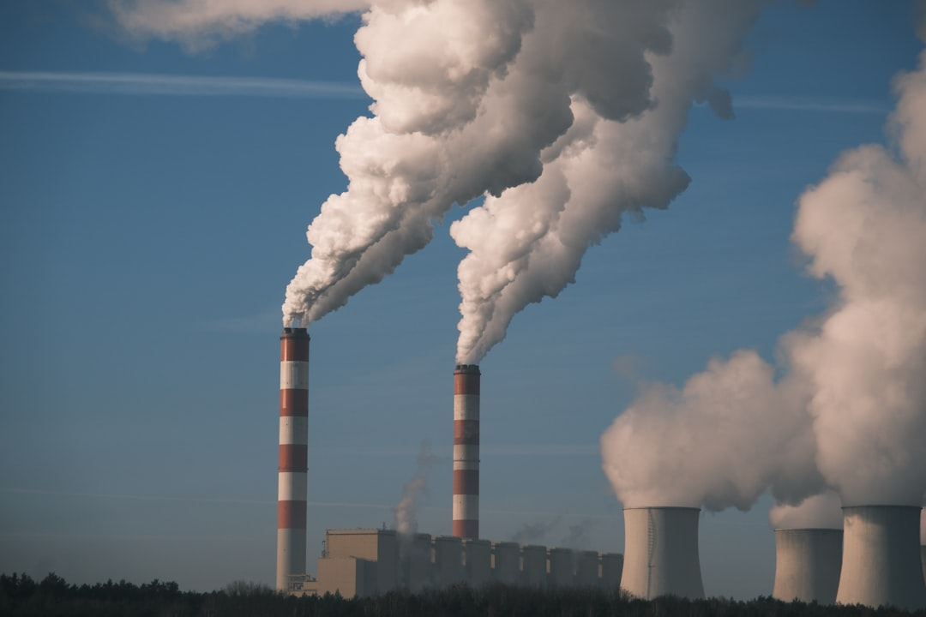
Allotropes of Carbon
1. Allotropes are different structural forms of the same element.
2. Diamond: Extremely hard, used in cutting tools. Carbon atoms are tetrahedrally bonded.
3. Graphite: Soft and slippery, used in pencils. Carbon atoms are arranged in layers.
4. Fullerenes (e.g., Buckminsterfullerene or "Buckyball"): Spherical or ellipsoidal molecules.
5. Graphene: A single layer of graphite, very strong and conductive.
6. Amorphous Carbon: Lacks long-range order, examples include coal and charcoal.
Generated by AI Slide Generator

Slide 4
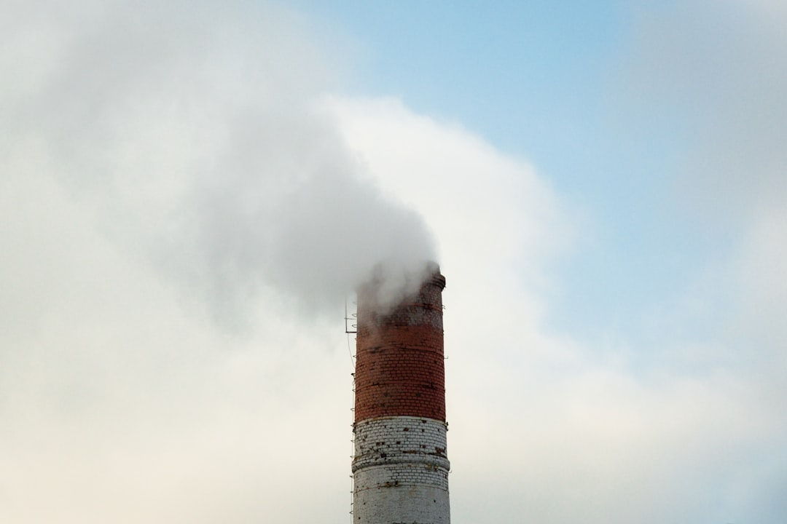
Carbon and the Carbon Cycle
1. The carbon cycle is the process by which carbon moves between the atmosphere, oceans, land, and living organisms.
2. Photosynthesis: Plants absorb carbon dioxide (CO₂) from the atmosphere and convert it into sugars (C₆H₁₂O₆) using sunlight.
3. Formula: 6CO₂ + 6H₂O + Sunlight → C₆H₁₂O₆ + 6O₂
4. Respiration: Animals and plants release carbon dioxide (CO₂) back into the atmosphere during respiration.
5. Formula: C₆H₁₂O₆ + 6O₂ → 6CO₂ + 6H₂O + Energy
6. Decomposition: Decomposers break down dead organisms and release carbon back into the environment.
Generated by AI Slide Generator

Slide 5

Carbon Compounds Organic Chemistry
1. Organic chemistry is the study of carbon-containing compounds.
2. Hydrocarbons: Compounds containing only carbon and hydrogen.
3. Example: Propane (C₃H₈). If you have 3 carbon atoms, H = (2 * C) + 2. H = (2 * 3) + 2 = 8
4. Functional Groups: Specific atoms or groups of atoms attached to a carbon chain that give the molecule specific properties (e.g., hydroxyl group -OH, carboxyl group -COOH).
5. Carbon compounds are found in plastics, medicines, and many other materials.
6. Polymers: Large molecules made of repeating smaller units (monomers) containing carbon.
Generated by AI Slide Generator

Slide 6
Practice Questions
1. What is the atomic number of carbon?
2. Name three allotropes of carbon.
3. Explain the role of photosynthesis in the carbon cycle.
4. What is a hydrocarbon? Give an example.
5. Describe why carbon is essential for life.
Generated by AI Slide Generator

