Slide 1

The Amazing Atom Carbon!
• Carbon (C) is a fundamental element found throughout our world.
🎥 Watch related video

Slide 2
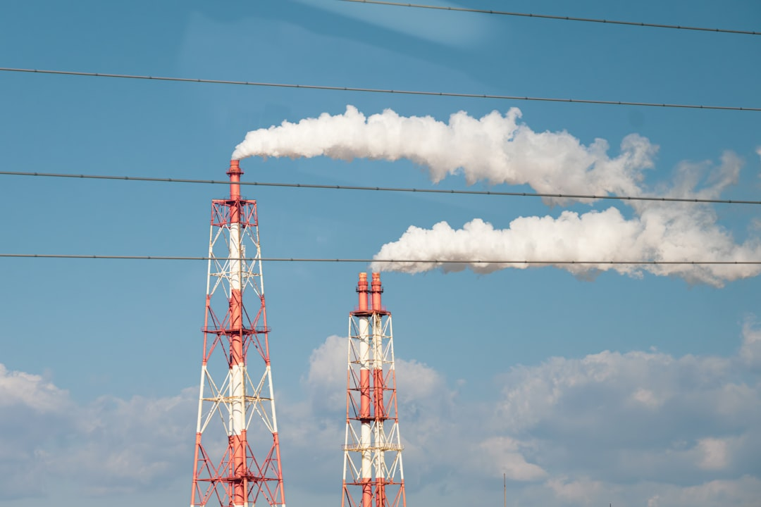
Carbon's Versatile Bonding
1. Carbon has four valence electrons, allowing it to form four covalent bonds.
2. This ability leads to a vast diversity of organic compounds.
3. Carbon atoms can form single, double, or triple bonds with each other.
4. Single bonds are represented as C-C, double as C=C, and triple as C≡C.
5. These bonds result in different molecular shapes, influencing properties.
6. Example: Methane (CH₄) demonstrates four single bonds.
Generated by AI Slide Generator

Slide 3

Carbon's Many Forms Allotropes
1. *Diamond*: Strong, hard, and transparent; carbon atoms arranged in a tetrahedral lattice.
2. *Graphite*: Soft, black, and conducts electricity; carbon atoms arranged in layers.
3. *Fullerenes*: Spherical or tube-shaped molecules; examples include buckyballs (C₆₀).
4. *Graphene*: A single layer of graphite, incredibly strong and conductive.
5. The arrangement of carbon atoms determines the physical properties.
6. Allotropes have applications ranging from cutting tools to electronics.
Generated by AI Slide Generator

Slide 4
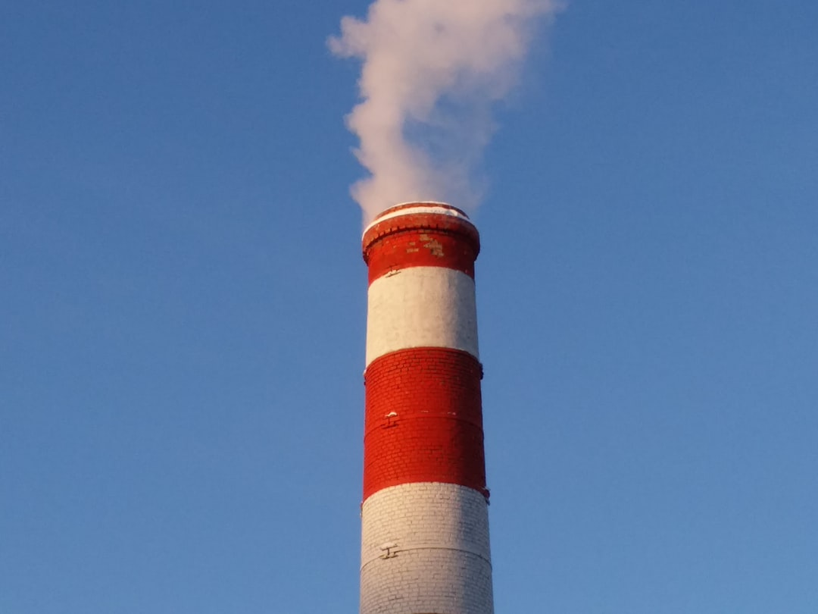
Carbon in the Environment The Carbon Cycle
1. The carbon cycle describes how carbon moves through Earth's systems.
2. Photosynthesis: Plants absorb CO₂ from the atmosphere to make glucose (C₆H₁₂O₆).
3. Formula: 6CO₂ + 6H₂O → C₆H₁₂O₆ + 6O₂
4. Respiration: Living organisms release CO₂ back into the atmosphere.
5. Formula: C₆H₁₂O₆ + 6O₂ → 6CO₂ + 6H₂O
6. Decomposition: Decomposers break down organic matter, releasing carbon.
Generated by AI Slide Generator

Slide 5
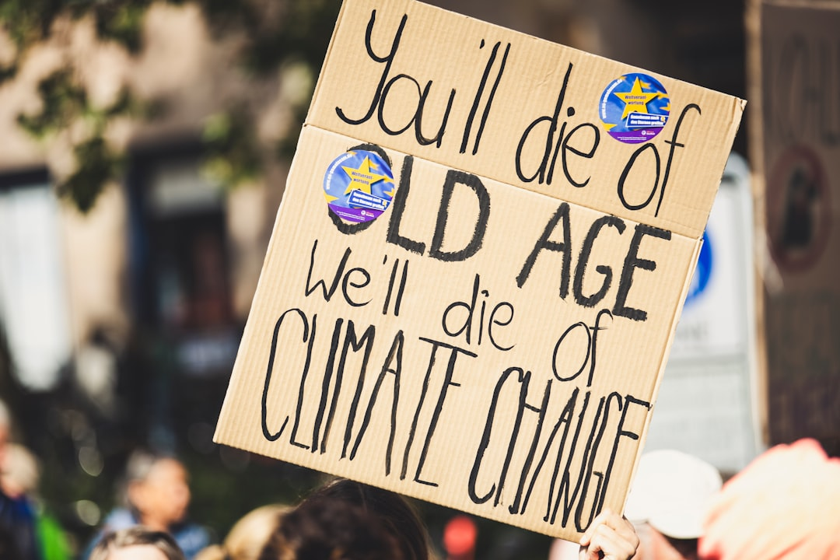
Carbon and Climate Change
1. Increased levels of CO₂ in the atmosphere trap heat, leading to global warming.
2. The burning of fossil fuels (coal, oil, and natural gas) is a major source of excess CO₂.
3. Deforestation reduces the amount of CO₂ absorbed by plants.
4. Consequences of climate change include rising sea levels and extreme weather events.
5. Reducing carbon emissions is crucial for mitigating climate change.
6. Sustainable practices like renewable energy and conservation can help.
Generated by AI Slide Generator

Slide 6
Practice Questions
1. What is the atomic number of carbon?
2. Give two examples of carbon allotropes and their properties.
3. Explain how photosynthesis contributes to the carbon cycle.
4. What are the major sources of carbon dioxide emissions?
5. What are some potential consequences of increased atmospheric carbon dioxide levels?
Generated by AI Slide Generator

