Slide 1
Qarma
Empowering informed decision
ITS for the people by the people

Slide 2
Our Team:
Tulika Gupta
Aman Gupta
Ayush Singh
Tejasva Bansal

Slide 3
Our Goal
Empower women to commute safely
Increase social accountability

Slide 4

Facts:
Rape is the fourth common crime against women in India
34,600 is the number of recorded rapes last year of which 48% of victims are from outsiders
“Chalta Hai” Attitude

Slide 5
Impact:
Recognize hazards and take preventive steps
Forum to express opinions and ask questions
Business impact increases social accountability
Easy monitoring for authorities

Slide 6
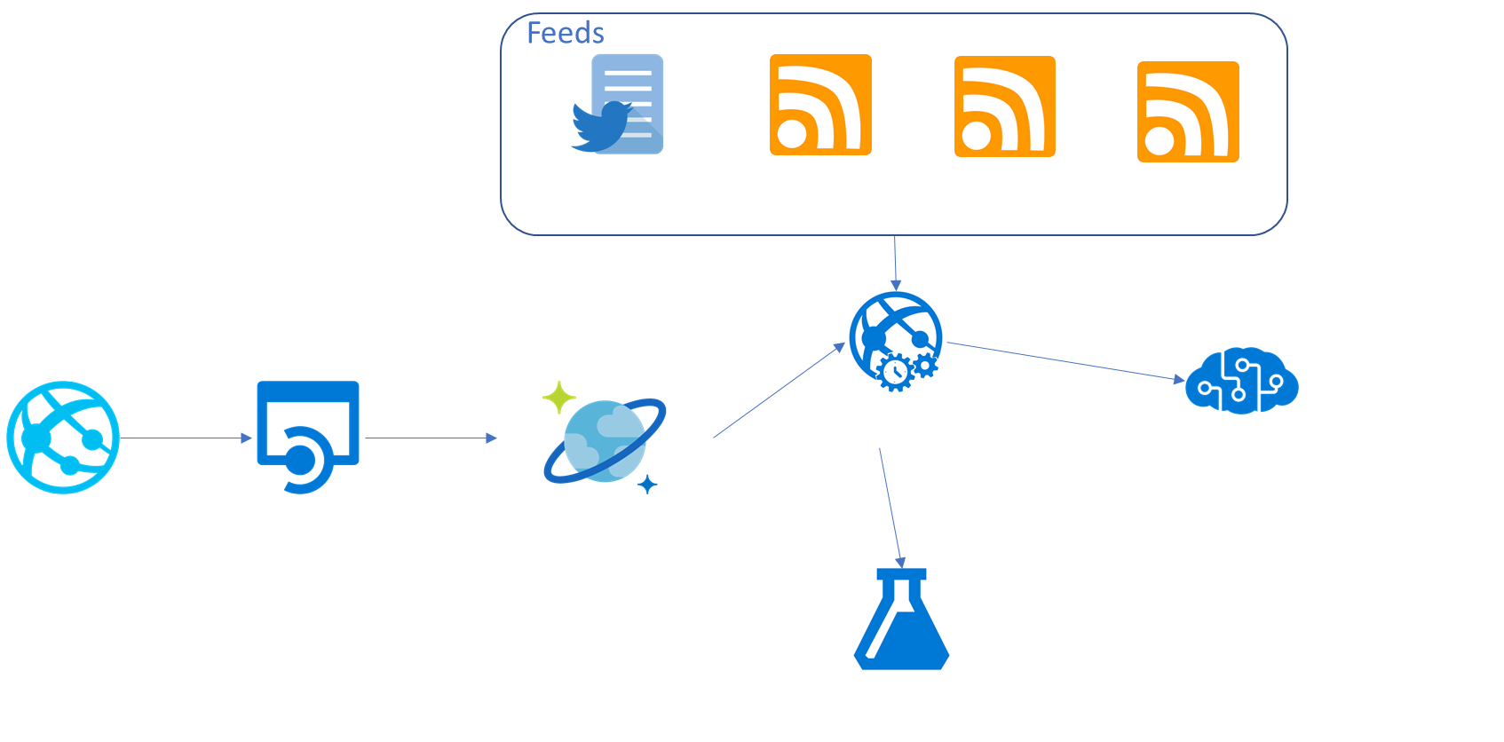
Architecture:

Slide 7
Demo:

Slide 8
Business Model

Slide 9
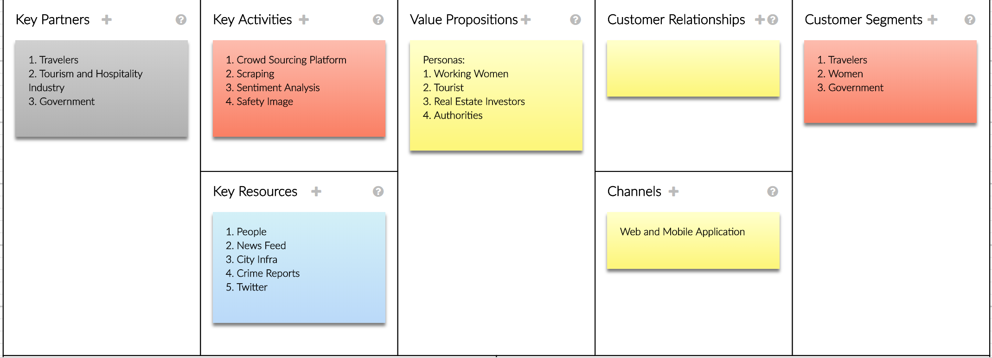
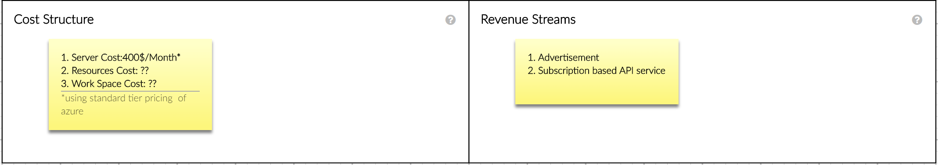
Canvas

Slide 10

Thank You
This Photo by Unknown Author is licensed under CC BY-SA

