Slide 1
Design Patterns are language agnostic solutions that can be grouped together in terms of functionality to solve families of similar problems.

Slide 2
Common uses
Hiding explicit construction | Pick the class to use in run time allowing for polymorphic behavior of distinct concrete classes
Decide what function to call in run time | Make the actual function call dynamic and depended on data that consumed in run time.
Eliminate coupling to third party libraries | Neutralize the use of third party libraries by a proxy layer making it possible to easily migrate to a different provider.
Customize behavior dynamically | Allow for users of the system to configure it in run time using mechanisms based on xml, json etc

Slide 3
Some Platforms using DP
MFC | COM/DCOM | CORBA
Java Beans | Swing | Angular
React | Motif | Spring
NSpring | Hibernate | JDBC

Slide 4
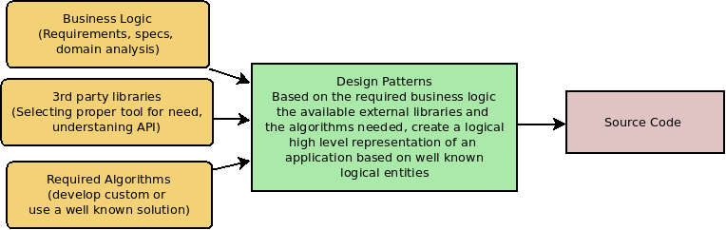
Logical relation of DP to software pipeline

Slide 5
Fundamental Principles
Programming to an interface and not an implementation
When possible prefer composition instead of inheritance

Slide 6
Families of Design Patterns
Family Name | Description
Creational | Hiding the construction of objects providing interfaces to build them based on specific information that describe them
Structural | Compose the objects in a dynamically specifying their relationships and dependencies
Behavioral | Assign object responsibilities and specify communication across them

Slide 7
Composition
Advantages | Disadvantages
Using composition instead of inheritance makes a class more encapsulated and single task oriented. | We might end up creating more objects by hand
Hierarchies remain shallow and easier to understand and manage. | The behavior of the system depends on (visible) interfaces as opposed to been hidden in a closed inheritance tree.
Defined dynamically at run time
An object can be shared
Any composed object can be replaced dynamically from another assuming they are of the same type
The are fewer implementation dependencies (imports).

Slide 8
Inheritance
Advantages | Disadvantages
Defined statically and is mechanics are handled by the programming language. | Inherited code cannot be changed in run time.
Makes code reuse very simple as all the implementation is inherited in lower levels of the hierarchy. | It can break encapsulation as parent’s code might depend silently to derived levels.
 | Allocated memory from parent class might be unused from derived leading to memory waste,
 | A change to the parent level might need to be propagated to all of its descendants.

Slide 9
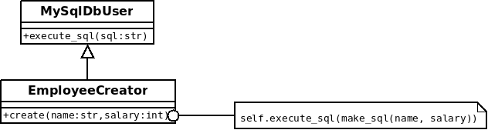
Example of inheritance

Slide 10
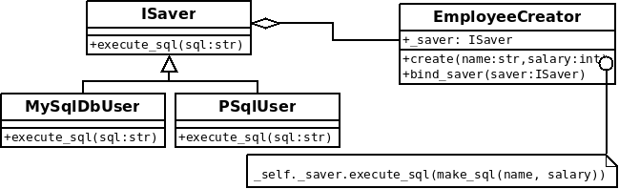
Example of delegation

Slide 11
Aggregation vs Acquaintance

