Slide 1
Knapsack Problem

Slide 2
The problem
Input
We have a set of items; each item have a weight and a value
We also have a container that can carry up to a specific total weight (maximum capacity).
Objective
The objective is to find a subset of the items that can fit in the container (meaning their total weight will be less or equal to the capacity of the container) while maximizing the total value.
Each item can either be contained or not (meaning we cannot use fractional quantities).

Slide 3
Assume we have the following items
And this bag
Index | Weight | Value
1 | 8 kg | $17
2 | 4 kg | $12
3 | 3 kg | $6
Max Capacity 10 kg
All possible items combinations
Maximum value while weight less than 10
is obtained by combining items 2 and 3
Items | Weight | Value
1 | 8 kg | $17
2 | 4 kg | $12
3 | 3 kg | $6
1 - 2 | 12 kg | $29
1 - 3 | 11 kg | $23
2 - 3 | 7 kg | $18
1 - 2 -3 | 19 kg | $35
2 - 3 | 7 kg | $18
This solution creates all possible item
Combinations have exponential
complexity
A better algorithm can be created using
Dynamic programming.

Slide 4
Solving Knapsack using dynamic programming
Assume we have the following items sorted by their weight
The knapsack has a maximum capacity of 10 kg
Index | Weight | Value
0 | 0 | 0
1 | 1 | 2
2 | 3 | 6
3 | 4 | 12
4 | 5 | 12
5 | 8 | 17
Max Capacity 10 kg

Slide 5
Solving Knapsack using dynamic programming
TO KEEP THINGS SIMPLE
* WE HAVE ADDED AN ITEM WITH WEIGHT AND VALUE EQUAL TO 0
* WE KEEP THE ITEMS SORTED BY VALUE IN DECREASING ORDER

Slide 6
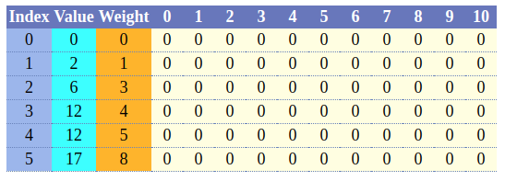
Solving Knapsack using dynamic programming
* Including the 0 weight item we have added we have N = 6 items altogether while we have 11 possible discreet weights until we reach the full capacity of 10.
* For each item (and including the 0 capacity) we create 11 X 6 = 66 new bags for each possible capacity and initialize it to 0 as can be seen here:
Think of each element of the array as a bag whose capacity equal to

Slide 7
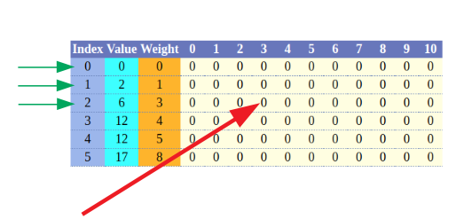
Solving Knapsack using dynamic programming
Think of each element of the array as a bag whose capacity equal to its column index.
Each row in the array has access ONLY to the item for it and to those that occur before it as can be seen in the following example:
The element where the red arrow points is a bag with capacity 3 while it has
access to items 0 – 1 - 2

Slide 8
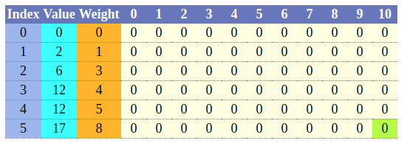
Solving Knapsack using dynamic programming
Out objective is to fill the 6 X 11 array with the maximum possible value that each of the “individual” bag can hold.
We can only use items from the same or previous rows but not from the next.
Once the value for a bag is set it will remain the same and we will be able to access it any time.
If we fill all the elements of the array the last one will hold the maximum cumulative value that does not exceed the maximum capacity. For example in the following table the largest value will be the value of the green element (which can be also thought as a bag with maximum capacity 10).

Slide 9

Solving Knapsack using dynamic programming
Filling the first row is obvious.
Since both weight and value is 0 we just set all elements to it:

Slide 10


Solving Knapsack using dynamic programming
To fill the second row lets start from the first bag which has a weight of 1
The first element of the second row will look as follows:
Note that when we reach the bag with capacity 1 and since
it can fit item1 whose weight is 1 we have changed the
element’s value to 2 (which is the value of the item).
At this point we are sure that with only item1 the bag with capacity 1 has a maximum
value of 2 while it contains this item; this will not be changed any more while the
algorithm is running
Following the same logic we complete the full row which upon completion will look
as follows:

Slide 11
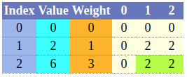
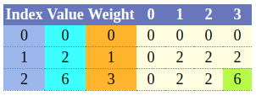
Solving Knapsack using dynamic programming
To fill the third row we follow exactly the same procedure as before
The first two elements of the third row will look as follows:
Since the item weight is 3 and it does not fit in the bag (whose
capacity is 2 we keep it as it is so the values for bags
With 1 and 2 capacity remain 2.
Things become more interesting as we move to the bag with capacity 3; the item
now fits in the bag and if we remove its current contents (which have a value of 2)
the value becomes 6 while there is no more remaining capacity so since 6 is larger
than 2 we leave it in the bag and continue:

Slide 12
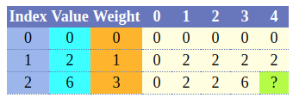
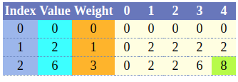
Solving Knapsack using dynamic programming
Now we need to fill the bag with capacity 4 of the third row. Currently our table looks as follows:
The question is what should the value of the bag
with capacity 4 be assuming we can use the
available items (1 and 2).
Item 2 weighs 3 kg meaning that it fits the bag. If we replace the contents of the bag
with item 2 its value becomes 6 while it has a remaining capacity of 1 (since it can
hold up to 4 kg and item 2 weighs 3 kg.
We already know that the maximum capacity for a bag with a capacity of 1kg that is
using all the available items except item2 is 2; to find it we simply go to the element
that exists in the previous row (1 in this case) and lookup the capacity for a bag with
Capacity 1. So the maximum capacity for the bag 4 will become 6 + 2 = 8:

Slide 13
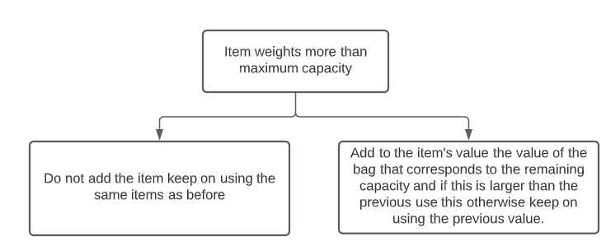
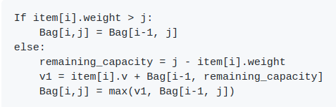
Solving Knapsack using dynamic programming
At this point we know enough to create a generic algorithm to add a item to a specific element (a bag with known element):
Or is pseudo code:
Where:
i : The item index
j: The bag index
Bag: The bags array

Slide 14
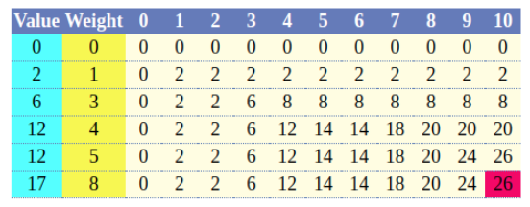
Solving Knapsack using dynamic programming
Continuing the same process as before and applying the algorithm we have expressed we end up with the following table for all the items:
Meaning that using the given items and having a capacity of 10 the maximum value we can carry in the bag is 26.
Although we know have the maximum value we still need to find out the corresponding items.

Slide 15
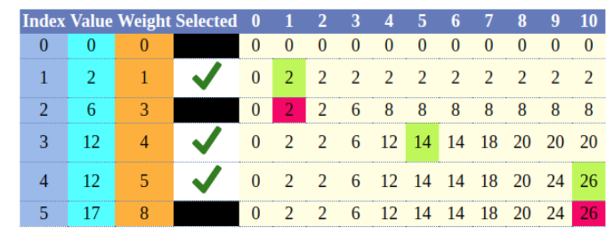
Solving Knapsack using dynamic programming
Finding the items subset that maximizes the value
Starting from the last item of the array we compare its value with the value of the previous element in the same bag.
If these values are the same this means that the item is not selected and continue with the previous.
Otherwise: Mark the item as selected, subtract the item’s weight from the current bags maximum capacity and move to the element of this capacity in the previous row.
Follow the same procedure until the accumulated value of the selected items equals the maximum value that can be found in the last item of the array.

Slide 16
Solving Knapsack using dynamic programming
Complexity of the knapsack algorithm
Time Complexity
Since we are iterating though all of the elements of the N x M table the time complexity of the dynamic solution will be:
Space Complexity
Since we are allocating an N X M table the space complexity will be:

