Slide 1


Slide 2
Agenda
Refactoring Techniques
Practice tasks
https://github.com/codingkataos/refactoring

Slide 3
Desired Outcomes!
Readability
Maintainability
Reliability

Slide 4

Large Class
Signs & Symptoms
Too many instance variables/lines of code
Often leads to duplicate code
Hinders readability of code
Ways to refactor
Extract class
Extract Subclass
Extract Interface

Slide 5
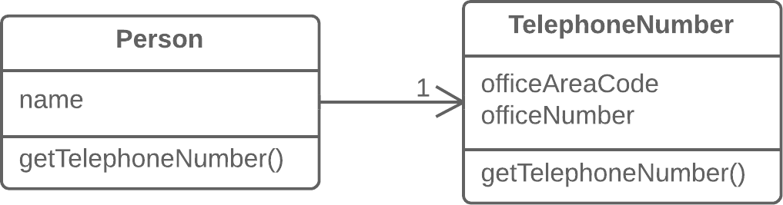
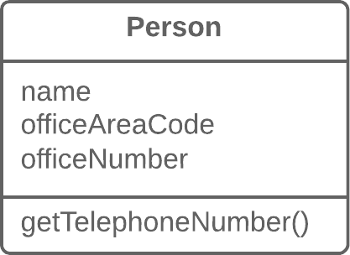
Extract Class

Slide 6

Long Method
Signs & Symptoms
Too many lines
Needs lots of inline comments to explain the intent
Ways to refactor
Extract Method
Preserve Whole Object
Replace method with Method Object
For Conditional sections use Decompose Conditional

Slide 7
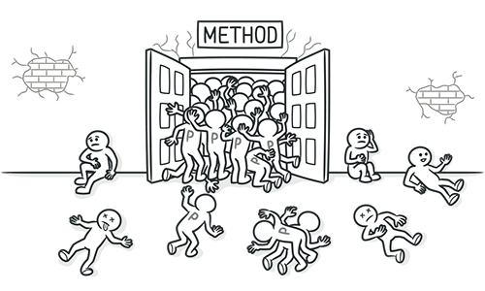
Too Many Parameters
Signs & Symptoms
More than 3 or 4 parameters for a method
Ways to refactor
Preserve Whole Object
Introduce Parameter Object

Slide 8
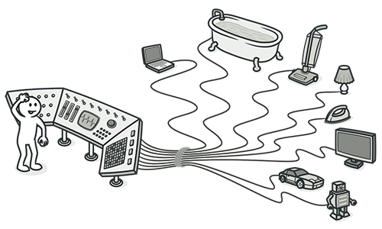
Switch Statements
Signs & Symptoms
A complex switch operator or sequence of if statements
Ways to refactor
Replace Type code with SubClasses or state/strategy
Introduce Parameter Object

Slide 9
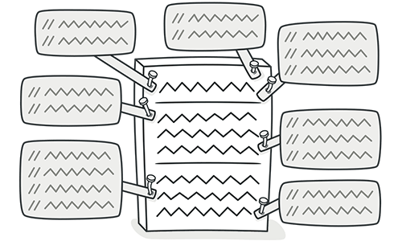
Comments
Signs & Symptoms
A method is filled up with explanatory comments
Ways to refactor
Extract Variable
Extract Method
Rename Method

Slide 10


Slide 11
Scope Rule for Naming
Methods & Classes
The longer the scope of a function, the shorter its name should be
Long and precise names when used in small scopes
The longest function names should be given to those functions that are called from just one place

Slide 12
Scope Rule for Naming
Long Method/Class scope = Short name
public interface AccountDAO extends BaseDAO { /** * Find single Account by ID * * @param accountID accountID * @return Account if the account with such ID exists, null otherwise */ PublisherAccount findByID(Long accountID); /** * Saves the Publisher account * * @param accountData - Account to be saved */ public void savePublisherAccountData( PublisherAccount accountData);
…
…
}

Slide 13
Scope Rule for Naming
Variables & Parameters
The length of a name should correspond to the size of its scope.
Local variables of a short method or small block can have short names.
Global variables should have long and self-descriptive names.
Single-letter names should be used only for:
Counter variables for simple for loops
Exception instances in Catch blocks
Arguments of very short functions

Slide 14
Scope Rule for Naming
Long Variable scope = Long name
public class TargetProcessorImpl implements TargetProcessor { private static final long GEO_TARGET_TYPE_COUNTRY = 1L; private static final long GEO_TARGET_TYPE_REGION = 2L; private static final long GEO_TARGET_TYPE_CITY = 3L; private static final long GEO_TARGET_TYPE_DMA = 4L; private static final String INTERNET_EXPLORER_BROWSER_SYNONYM = "IE"; private static final String INTERNET_EXPLORER_BROWSER_CODE = "MSIE"; private static final String DEVICE_CONNECTED_TV_NAME = "CONNECTED TV"; private static final String UNKNOWN_TYPE = "UNKNOWN"; private static final String UNKNOWN_TYPE_NATIVE_SYNONYM = "OTHER";
Short Variable scope = (Short name)
…
}
List<ActiveTarget> toBeUpdatedTargets = gatherActiveTargets(); //update Active targets for (ActiveTarget targetToBeUpdated : toBeUpdatedTargets)
{ targetingDAO.saveOrUpdate(targetToBeUpdated); } }

Slide 15
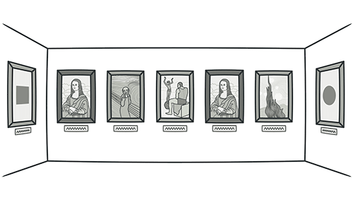
Duplicate Code
Signs & Symptoms
Two code fragments look almost identical.
Ways to refactor
Extract Method
Pull Up field
Pull up constructor Body

Slide 16
Duplicate Code
Signs & Symptoms
Two code fragments look almost identical.
How does it arise
Imposed duplication
Inadvertent duplication
Impatient duplication
Interdeveloper duplication

Slide 17
Inadvertent Duplication
class Line { Point start; Point end; double length; }
Length can be calculated from start and end fields

Slide 18
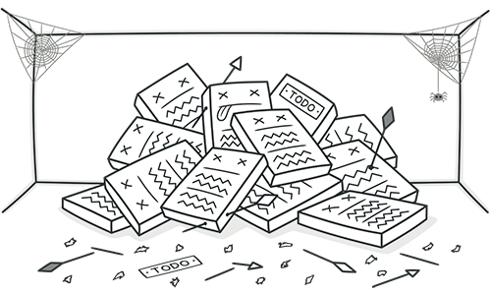
Dead Code
Signs & Symptoms
A variable, parameter, field, method or class is no longer used.
Ways to refactor
Delete Unused Code and Files.
Remove unused Parameters

Slide 19
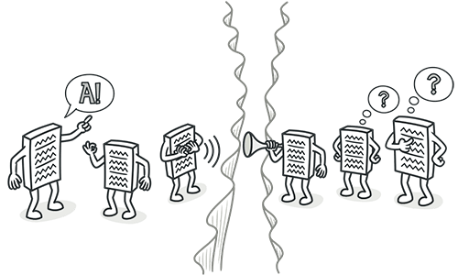
Message Chains
Signs & Symptoms
In code you see a series of calls resembling
$a->b()->c()->d().
Ways to refactor
Tell Don’t Ask
Hide Delegate

Slide 20
Untestable Code
Signs & Symptoms
In code you see a series of calls resembling
$a->b()->c()->d().
Ways to refactor
Tell Don’t Ask
Hide Delegate

Slide 21
Refactoring Techniques

Slide 22
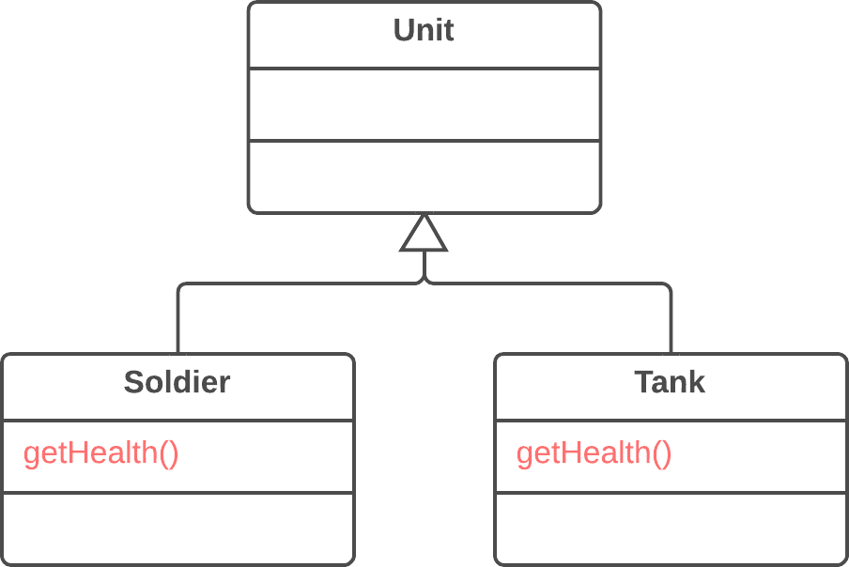
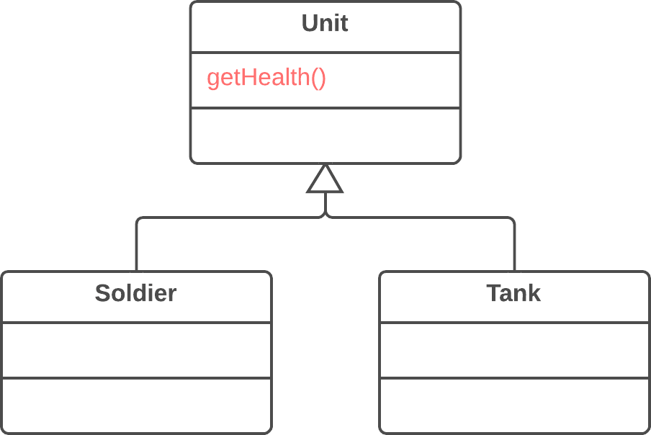
Pull Up Field/Method

Slide 23
Pull Up constructor Body
class Manager extends Employee {
public Manager(String name, String id, int grade) {
this.name = name;
this.id = id;
this.grade = grade;
}
//...
}
class Manager extends Employee {
public Manager(String name, String id, int grade) {
super(name,id);
this.grade = grade;
}
//...
}

Slide 24
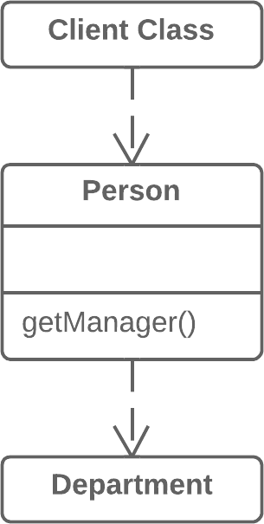
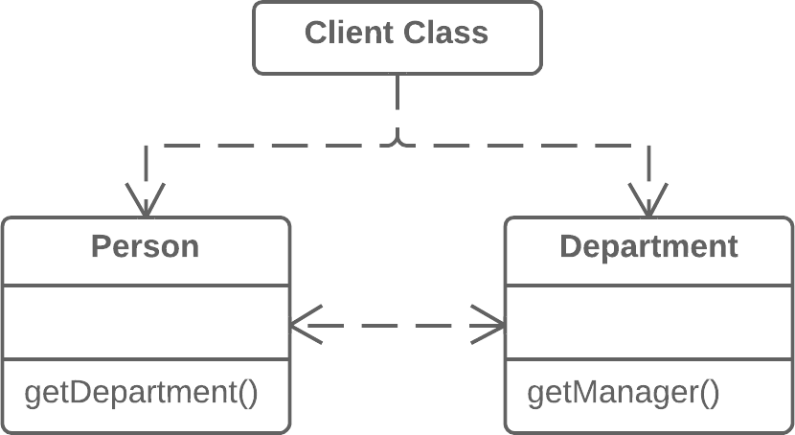
Hide Delegate

Slide 25
References
https://refactoring.guru/refactoring/catalog

