Slide 1




Sum Experts
Supporting you through this cost-of-living crisis
CFG Software Engineering: Group 4 Project
Notes:
Naimah

Slide 2



Team
Hye Ji Lee
Lindelani Moyo
/
/leehjd
/Lindelani
/codinglinde
Naimah Riaz
Nikita Simarmata
/naimah-riaz
/nriaz
/nikitasimarmata
/
Notes:
Naimah

Slide 3
The Concept
Aim
To develop an app which can fulfil users queries in their program requests related to the current cost-of-living crisis.
Objectives
Users can insert their details into the program and select three features.
Users can calculate a Mortgage.
Users can request access to live Financial News.
Database will be responsive to users booking for meetings.
Notes:
Naimah

Slide 4
The Concept
Inspiration
Zopa: The inspiration for this app was led by some of the group's sponsor, Zopa, a British financial services company.
Themes: Our team members all shared a passion for the topics: banking, finance, and education, which led to the app's present concept.
Cost of Living Crisis: “a situation in which the cost of everyday essentials like groceries and bills are rising faster than average household incomes”.
In an effort to take an innovative stance in developing a program to remedy a problem, the present economic crisis—’the cost of living crisis'— influenced and motivated our decision for our theme. Because of this decision, since developing the app we are yet to come across another program like ours.
Notes:
Naimah

Slide 5
Key Features
Mortgage Calculator
View Live Financial News
Book a Meeting with our Financial Advisors
Notes:
Hyeji

Slide 6
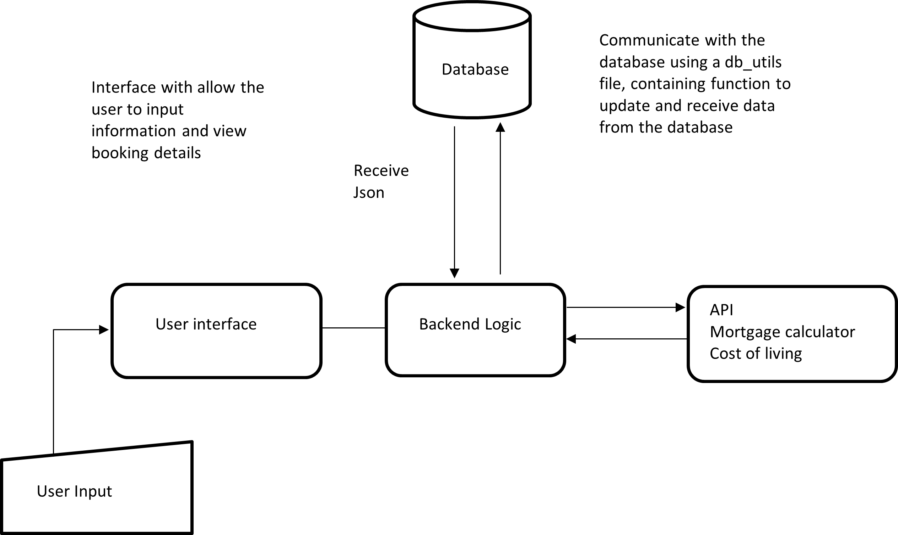
System Architecture Diagram
Architecture Flow Diagram
Notes:
Nikita

Slide 7
DEMO
Notes:
Presenting - Hye Ji
Demonstrating -

Slide 8
Project Management Reflection
Teamwork
Effective Communication
Scheduling and Time Management
Critical Thinking & Problem Solving
Notes:
Linde

Slide 9
Challenges
Time Management
Development Expectations
- Connecting Database to Python
Undefined Quality
Standards
Defining the Requirements
Notes:
Linde

Slide 10
Future Development
Use Tkinter for Frontend Development
Add feature for user to delete their booking
Have users sign in and out of their accounts, instead of navigating as guests
Receive email notifications to confirm their booking with an advisor
Notes:
Nikita

Slide 11
Conclusion
We have successfully developed a software application meeting the given requirements:
Using Python programming
Connecting to API
Utilising an SQL Database
Built our own API endpoints
Used Decorators
Incorporated Recursive functions
Notes:
Linde

Slide 12

End of Presentation
Thank you! Your attention to our presentation has been greatly appreciated.

