Slide 1
Lab07 Clock Domain Crossing

Slide 2
Outline
Lab07 spec review
Architecture for Handshake and FIFO
JG error & debug
Summary
My thoughts on FIFO

Slide 3
lab07 Spec Review
Spec
Clk1 domain receives 16 matrix_A, matrix_B
Send them to Clk2 domain through handshake syn
Do matrix multiplication
Send results back to domain 1 though FIFO
Optimization Strategy
Area: Shift register
Latency: remove unnecessary DFF

Slide 4
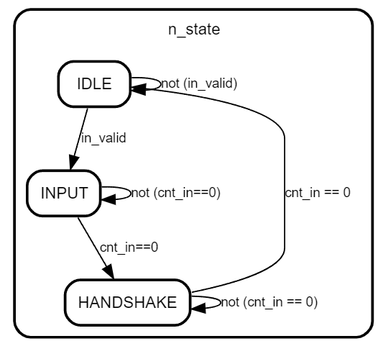
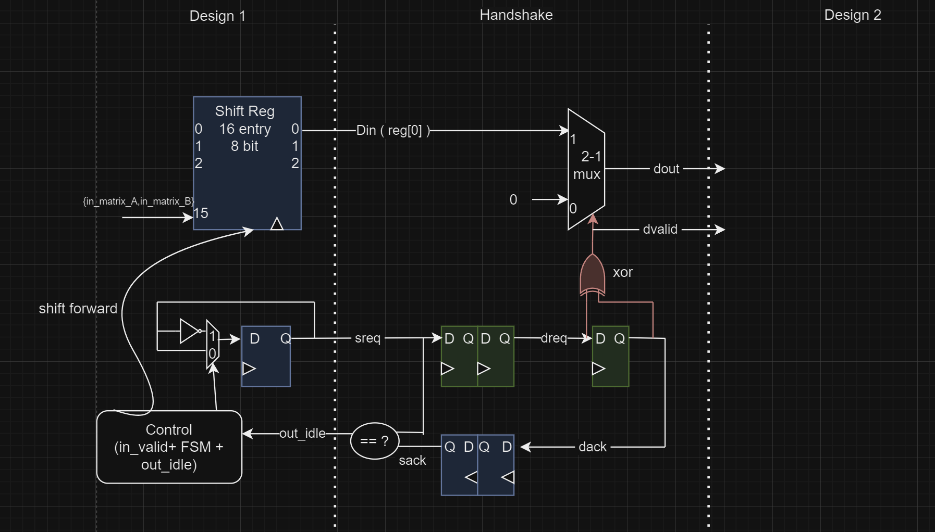
Architecture
always@(*)begin
if( dreq^dack)begin
dvalid = 1;
dout = din;
end
else begin
dvalid = 0;
dout = 0;
end
end
0
0
Din
0
0
1
0
1
0
1
1
assign sidle = (sack == sreq) ? 1 : 0;
1
0
0
1
1
0
0
1
1

Slide 5
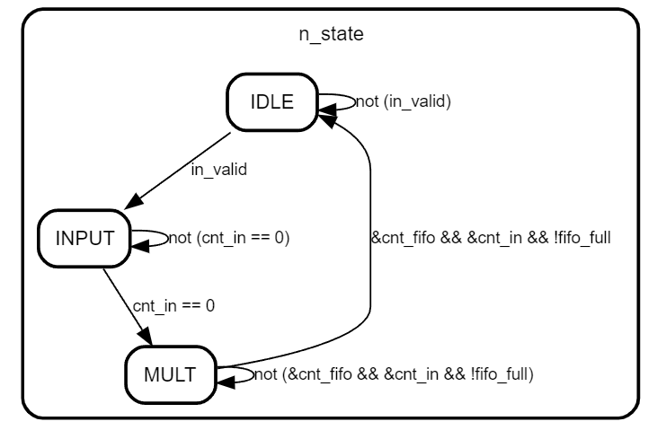
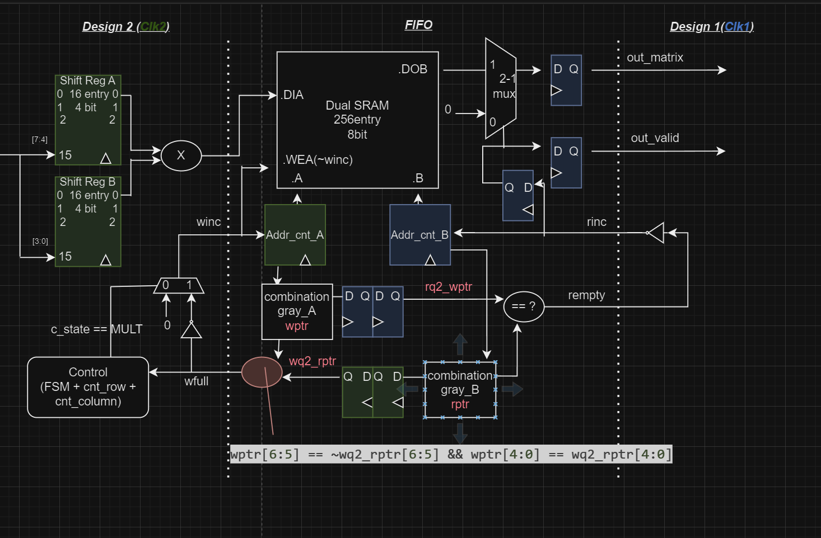
Architecture
//winc
always@(*) begin
if(c_state == MULT )
out_valid = !fifo_full;
else out_valid = 0;
end
//rinc
assign fifo_rinc = ! fifo_empty;

Slide 6
JG error & debug
Din unstable
due to only using in_valid to control shift register
→ Add FSM control
Push when wfull , pop when empty
→ Remove DFF
//winc out_valid = !fifo_full;
//rinc fifo_rinc = !fifo_empty;
output delay 50%
Input delay 50%
Setup violation???

Slide 7
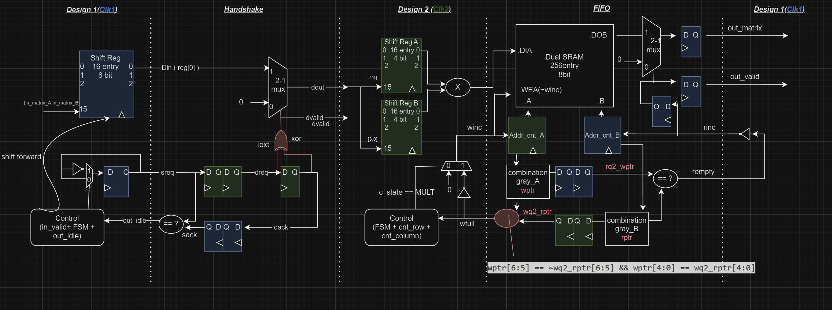
Summary
Area: Shift register, removing DFF → 80881
Latency: 3 * 16(handshake) + 2(rinc to outvalid) + 256 = 306

Slide 8
My understanding of FIFO
2 Agreements :
RAW
Addr_read <= Addr_write
When Addr_read = Addr_write, empty !
WAR
Addr_write - FIFO_Size <= Addr_read
When Addr_write - FIFO_Size = Addr_read , full !
If two persons W and R are in different system (EG:different Galaxy) ,
How can they know the location of another?
A:
real world: just look at it (continuous light)
Digital : synchonizer(discrete sampling version)
wptr→rq2_wptr seen by read
rptr →wq2_rtpr seen by write
Remark:
may have delay , what you see is the past location! (speed of light / double FF synchonizer)

Slide 9
My understanding of FIFO
Q1: If Wclk<Rclk, write already moved one step but can’t synchronize it to rq2_wptr, will this cause error?
A: Read will see the past address of write(which is at the same spot), and empty will be raise.
→fake empty , but safe!
Q2: Wclk<Rclk , rq2_wptr might not be graycode (maybe skip some numbers), error?
A: R will see W move very fast away from R (until WAR) , R will keep +1 to follow W
Q3: graycode?
A: multi bits through synchronizer may have 1 to 2 delay, resulting unwanted transition
analogy: speed of light changes with time, you’ll see future or very past location
TENET?

Slide 10
THANK YOU

