Slide 1

Jamie Allen
Effective Actors

Slide 2
Who Am I?
Consultant at Typesafe
Actor developer since 2009
jamie.allen@typesafe.com
@jamie_allen
github.com/jamie-allen

Slide 3
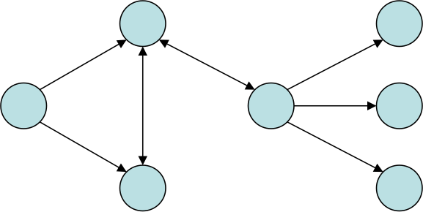
Groundwork: What Are Actors?
Concurrent, lightweight processes that communicate through asynchronous message passing
Isolation of state, no internal concurrency

Slide 4
Akka Actor Code
// Definitions
case class Start(thePonger: ActorRef)
class Pinger extends Actor {
def receive = {
case Start(x) => x ! "Ping!"
case x => println("Pinger: " + x); sender ! "Ping!"
}
}
class Ponger extends Actor {
def receive = { case x => println("Ponger: " + x); sender ! "Pong!" }
}
// Execution
object PingPong extends App {
val system = ActorSystem()
val ponger = system.actorOf(Props[Ponger], “pinger”)
val pinger = system.actorOf(Props[Pinger], “ponger”)
pinger ! Start(ponger)
}

Slide 5
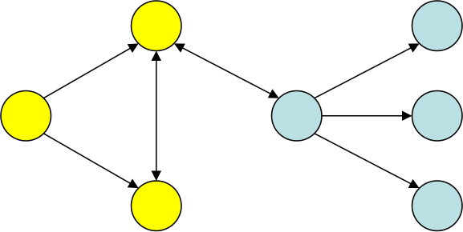
Groundwork: Supervisor Hierarchy
Specifies handling mechanisms for groupings of actors in parent/child relationship
Notes:
Don't try to predict every possible thing that can go wrong. Instead, understand how to reset your actor system and retry until it works.

Slide 6
Akka Supervision Code
class MySupervisor extends Actor {
override val supervisorStrategy =
OneForOneStrategy(maxNrOfRetries = 10, withinTimeRange = 1 minute) {
case ae: ArithmeticException => Resume
case np: NullPointerException => Restart
}
context.actorOf(Props[MyActor], “my-actor”)
}
Notes:
Note the use of context, not system to create the actor instance

Slide 7
Groundwork - Parallelism
Easily scale a task by creating multiple instances of an actor and applying work using various strategies
Order is not guaranteed, nor should it be

Slide 8
Akka Routing
object Parallelizer extends App {
class MyActor extends Actor {
def receive = { case x => println(x) }
}
val system = ActorSystem()
val router: ActorRef = system.actorOf(Props[MyActor].
withRouter(RoundRobinRouter(nrOfInstances = 5)), “my-router”)
for (i <- 1 to 10) router ! i
}
Notes:
Of course, my example shows an impure function (writing to the console is a side effect)

Slide 9
Effective Actors
Best practices based on several years of actor development
Helpful hints for reasoning about actors at runtime

Slide 10
RULE
Actors Should Only Do One Thing

Slide 11
Single Responsibility Principle
Do not conflate responsibilities in actors
Becomes hard to define the boundaries of responsibility
Supervision becomes more difficult as you handle more possibilities
Debugging becomes very difficult

Slide 12
Actor Behavior
Handle messages
Delegate messages
Forward messages
Supervise supervisors under them

Slide 13
Supervision
Every non-leaf node is technically a supervisor
Create explicit supervisors under each node for each type of child to be managed
Supervisors should do nothing except manage their actors
Notes:
Any actor with child actors is responsible for supervising them, even if those child actors are supervisors themselves. You shouldn't necessarily let that parent actor try to supervise all actors below it, but try to create "failure zones" by actor type. If a Customer actor has multiple devices and multiple accounts below it, it should have a DeviceSupervisor and an AccountSupervisor between them, not supervise all directly.

Slide 14
Conflated Supervisors
C
C
Customers
A
A
D
D
D
Devices & Accounts
A
A
A
A
Applications
Notes:
Any actor with child actors is responsible for supervising them, even if those child actors are supervisors themselves. You shouldn't necessarily let that parent actor try to supervise all actors below it, but try to create "failure zones" by actor type. If a Customer actor has multiple devices and multiple accounts below it, it should have a DeviceSupervisor and an AccountSupervisor between them, not supervise all directly.

Slide 15
Explicit Supervisors
S
C
C
Customers
S
S
A
A
D
D
D
Devices & Accounts
S
S
A
A
A
A
Applications
Notes:
Any actor with child actors is responsible for supervising them, even if those child actors are supervisors themselves. You shouldn't necessarily let that parent actor try to supervise all actors below it, but try to create "failure zones" by actor type. If a Customer actor has multiple devices and multiple accounts below it, it should have a DeviceSupervisor and an AccountSupervisor between them, not supervise all directly.

Slide 16
Keep the Error Kernel Simple
Limit the number of supervisors you create directly inside of it
Helps with fault tolerance and explicit handling of errors through the hierarchy
Akka uses synchronous messaging to create top-level actors

Slide 17
Failure Zones
Multiple isolated zones with their own dispatcher
Protects thread pools to prevent starvation
Prevents issues in one branch from affecting another
Notes:
Create "sandboxes" your actor system

Slide 18
Failure Zones
S
C
C
Customers
S
S
A
A
D
D
D
Devices & Accounts
S
S
A
A
A
A
Applications
Notes:
Create "sandboxes" your actor system

Slide 19
Takeaway
For reasonably complex actor systems, shallow trees are a smell test
Actors are cheap - use them
Notes:
Shallow trees mean you may be trying to do too much with too few actors.

Slide 20
RULE
Thou shalt not Block

Slide 21
Consequences of Blocking
Eventually results in actor starvation as thread pool dries up
Horrible performance
Massive waste of system resources
Notes:
Blocking is passively waiting when that thread can be doing other things. If you are blocking on IO/locks, then tying up a thread is a massive waste of memory resources

Slide 22
Futures and Timeouts
Futures are composable tasks to be performed asynchronously
Futures can easily be performed sequentially or in parallel in Scala
Timeout within a reasonable period of time
Exponential backoff
Handle failure

Slide 23
Futures
case class Start(ref: ActorRef)
case class SumSequence(ints: Seq[Int])
class Worker extends Actor {
def receive = {
case s: SumSequence => sender ! (
try { s.ints.reduce(_ + _) }
catch { case NonFatal(e) => println("Non-fatal exception") })
}
}
class Delegator extends Actor {
implicit val timeout: Timeout = 2 seconds
def receive = {
case Start(worker) =>
val workFut = worker ? SumSequence(1 to 100)
workFut.onComplete {
case Left(x: Throwable) => {
println("Exception: %s".format(x.getMessage))
self ! Start(worker)
}
case Right(y) => println("Got a result: " + y)
}
}
}
object Bootstrapper extends App {
val system = ActorSystem()
val worker = system.actorOf(Props[Worker], "my-worker")
val delegator = system.actorOf(Props[Delegator], "my-delegator")
delegator ! Start(worker)
}
Notes:
Note that the Bootstrapper is blocking until the future completes. This isn’t what you want – you want to be able to do other stuff and not block on that thread, especially if the caller were another actor.

Slide 24
Sequential vs Parallel Futures
// SEQUENTIAL
val r: Future[Int] = for {
a <- (service1 ? GetResult).mapTo[Int]
b <- (service2 ? GetResult(a)).mapTo[Int]
} yield a * b
// PARALLEL
val r: Future[Int] = for {
(a: Int, b: Int) <- (service1 ? GetResult) zip (service2 ? GetResult)
} yield a * b
Notes:
mapTo is a safe way to cast to a type, returns an Either of the value returned or a ClassCastException

Slide 25
What If I Must Block?
An example is database access
Use a specialized actor with its own dispatcher
Pass messages to other actors to handle
Notes:
Does not affect the thread pool of other actors

Slide 26
Using Dispatchers
case class SumSequence(ints: Seq[Int])
class Worker extends Actor {
def receive = {
case s: SumSequence => sender ! (
try { s.ints.reduce(_ + _) }
catch { case NonFatal(e) => log.error(e, "Non-fatal exception")
}
}
object Bootstrapper extends App {
val system = ActorSystem()
val worker = system.actorOf(Props[Worker].withDispatcher(“my-dispatcher”), “my-actor1)
implicit val timeout: Timeout = 2 seconds
try {
val workFut = worker ? SumSequence(1 to 100)
workFut.onComplete {
case Left(x: Throwable) => println("Exception: %s".format(x.getMessage))
case Right(y) => println("Got a result: " + y)
}
} finally { system.shutdown }
}
my-dispatcher {
executor = “thread-pool-executor”
throughput = 100
}
Notes:
Does not affect the thread pool of other actors

Slide 27
Handling I/O
Akka provides the IOManager
Uses an “Iteratee” for handling a stream of data without waiting for all of the data to arrive
Great for non-blocking I/O

Slide 28
IOManager
class ServerActor extends Actor {
val accumulator = context.actorOf(Props[Accumulator])
def receive = {
case IO.Listening(server, address) =>
println("The server is listening on socket " + address)
case IO.Connected(socket, address) =>
println("Successfully connected to " + address)
case IO.NewClient(server) =>
println("New incoming connection on server")
val socket = server.accept()
case IO.Read(socket, bytes) =>
implicit val timeout: Timeout = 2 seconds
val futTotal = accumulator ? (catching(classOf[NumberFormatException])
(bytes.utf8String.dropRight(2)).toInt)
futTotal map { res => socket.asWritable.write(ByteString(res.toString) ++ ByteString(13, 10)) }
case IO.Closed(socket: IO.SocketHandle, cause) =>
println("Socket has closed, cause: " + cause)
case IO.Closed(server: IO.ServerHandle, cause) =>
println("Server socket has closed, cause: " + cause)
}
}
}
Notes:
Does not affect the thread pool of other actors

Slide 29
Push, not Pull
Start with no guarantees about delivery
Add guarantees only where you need them
Retry until you get the answer you expect
Switch your actor to a "nominal" state at that point
Notes:
You'll be surprised at how few places require guaranteed delivery in your system when you take this route.

Slide 30
Takeaway
Find ways to ensure that your actors remain asynchronous and non-blocking
Avoid making your actors wait for anything while handling a message

Slide 31
RULE
Thou Shalt Not Optimize Prematurely

Slide 32
Start Simple
Make Donald Knuth happy
Start with a simple configuration and profile
Do not parallelize until you know you need to and where

Slide 33
Initial Focus
Deterministic
Declarative
Immutable
Notes:
In other words, start without using Actors! Declarative is expressing the logic of a computation but not the control flow - no side effects, referentially transparent; Logic and Functional Programming are subsets.

Slide 34

Advice from Jonas Bonér
Layer in complexity
Add indeterminism (actors and agents)
Add mutability in hot spots (CAS and STM)
Add explicit locking and threads
Photo courtesy of Brian Clapper, NE Scala 2011
Notes:
From Jonas' Jazoon 2012 keynote speech. Applies to your system on the whole, where actors are just one part.

Slide 35
Prepare for Race Conditions
Write actor code to be agnostic of time and order
Actors should only care about now, not that something happened before it
Actors can "become" or represent state machines to represent transitions

Slide 36
Beware the Thundering Herd
Actor systems can be overwhelmed by "storms" of messages flying about
Do not pass generic messages that apply to many actors, be specific
Dampen actor messages if the exact same message is being handled repeatedly within a certain timeframe
Tune your dispatchers and mailboxes
Back-off policies
Queue sizes

Slide 37
Takeaway
Start by creating code that is not actor based
Layer in complexity as you go

Slide 38
RULE
Be Explicit in your intent

Slide 39
Name Your Actors
Allows for external configuration
Allows for lookup
Better semantic logging

Slide 40
Create Specialized Messages
Non-specific messages about general events are dangerous
Example: AccountsUpdated
Can result in "event storms" as all actors react to them
Use specific messages forwarded to actors for handling
Example: AccountDeviceAdded(acctNum, deviceNum)
Notes:
Throwing back Exception means you can't have different handling strategies for different scenarios. If needed, you can pass data within the specific exception back to the supervisor and then provide it in the postRestart of the next actor incarnation, but don't do this without some serious consideration - by default, recompute or retrieve again first.

Slide 41
Create Specialized Exceptions
Don't use Exception to represent failure in an actor
Specific exceptions can be handled explicitly
State can be transferred between actor incarnations in Akka (if need be)
Notes:
Throwing back Exception means you can't have different handling strategies for different scenarios. If needed, you can pass data within the specific exception back to the supervisor and then provide it in the postRestart of the next actor incarnation, but don't do this without some serious consideration - by default, recompute or retrieve again first.

Slide 42
Takeaway
Be specific in everything you do
Makes everything that occurs in your actor system more clear to other developers and at runtime

Slide 43
RULE
Thou shalt Not Expose Your Actors

Slide 44
No Direct References to Other Actors
Actors die
Doesn't prevent someone from calling into an actor with another thread
Akka solves this with the ActorRef abstraction
Erlang solves this with PIDs
Notes:
This is specific to JVM implementations of actors, not Erlang. Erlang processes cannot call methods on actors, where JVM-based actors are just instances of objects.

Slide 45
Never Publish "this"
Don't send it anywhere
Don't register it anywhere
Particularly with future callbacks
Avoid closing over "sender" in Akka, it will change with the next message
Notes:
Don't ever hand out closures with ‘this’ outer reference; especially take care with Future callbacks. Copying to local vals helps.

Slide 46
Use Immutable Messages
Enforces which actor owns the data
If mutable state can escape, what is the point of using an actor?
Notes:
If the encapsulation of actors is broken by exposing their mutable state to the outside, you are back in normal Java concurrency land with all the drawbacks.

Slide 47
Pass Copies of Mutable Data
Mutable data in actors is fine
But data can escape your scope
Copy the data and pass that, as Erlang does (COW)
Akka has STM references
Notes:
When you do have mutable data, for whatever reason. Comes at a cost, but it's well worth it. If the copy on write semantics hurt your system, you'll have to find other ways to optimize. Or get rid of the mutable state itself.

Slide 48
Avoid Sending Behavior
Unless using Agents, of course
Closures make this possible (and easy)
Also makes it easy for state to escape
Notes:
Jonas isn't a big fan of sending "become" partial functions to actors, though Joe Armstrong likes it a great deal.

Slide 49
Takeaway
Keep everything about an actor internal to that actor
Be vary wary of data passed in closures to anyone else

Slide 50
RULE
Maketh Debugging Easier On thyself

Slide 51
Externalize Business Logic
Consider using external functions to encapsulate complex business logic
Easier to unit test outside of actor context
Not a rule of thumb, but something to consider as complexity increases
Not as big of an issue with Akka's TestKit
Notes:
You just want to prove that your business logic works as expected, but actors are tricky this way. Receiving a message and calculating a value can result in side effects such as creating new actors, which may be entirely unrelated from what you're trying to test. Use integration tests to prove that actors are behaving as expected.

Slide 52
Use Semantically Useful Logging
Trace-level logs should have output that you can read easily
Use line-breaks and indentation
Both Akka and Erlang support hooking in multiple listeners to the event log stream
Notes:
Yes, it makes your code ugly, and yes, it makes your logs huge. But it's so much more readable than inline output and will pay off in a crisis.

Slide 53
Unique IDs for Messages
Allows you to track message flow
When you find a problem, get the ID of the message that led to it
Use the ID to grep your logs and display output just for that message flow
Akka ensures ordering on a per actor basis, also in logging
Notes:
This can be expensive in time and system resources. Doesn't have to be UUIDs, just something that you can have a fair amount of certainty will be unique for a reasonable period of time, such as a day. Actor logging *should* be asynchronous, and may not reflect the order messages were handled and passed along.

Slide 54
Monitor Everything
Do it from the start
Use tools like JMX MBeans to visualize actor realization
The Atmos/Typesafe Console is a great tool to visualize actor systems, doesn't require you to do anything up front
Visual representations of actor systems at runtime are invaluable
Notes:
It will hurt much more to try to add this in later.

Slide 55
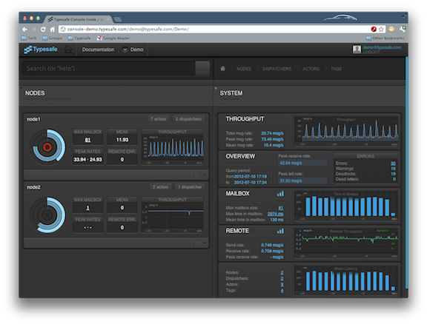
Typesafe Console

Slide 56
Takeaway
Build your actor system to be maintainable from the outset
Utilize all of the tools at your disposal

Slide 57
Thank You!
Some content provided by members of the Typesafe team, including:
Jonas Bonér
Viktor Klang
Roland Kuhn
Havoc Pennington

