Slide 1
六顆邏輯閘
學生:李俊逸

Slide 2
Inverter
學生:李俊逸

Slide 3
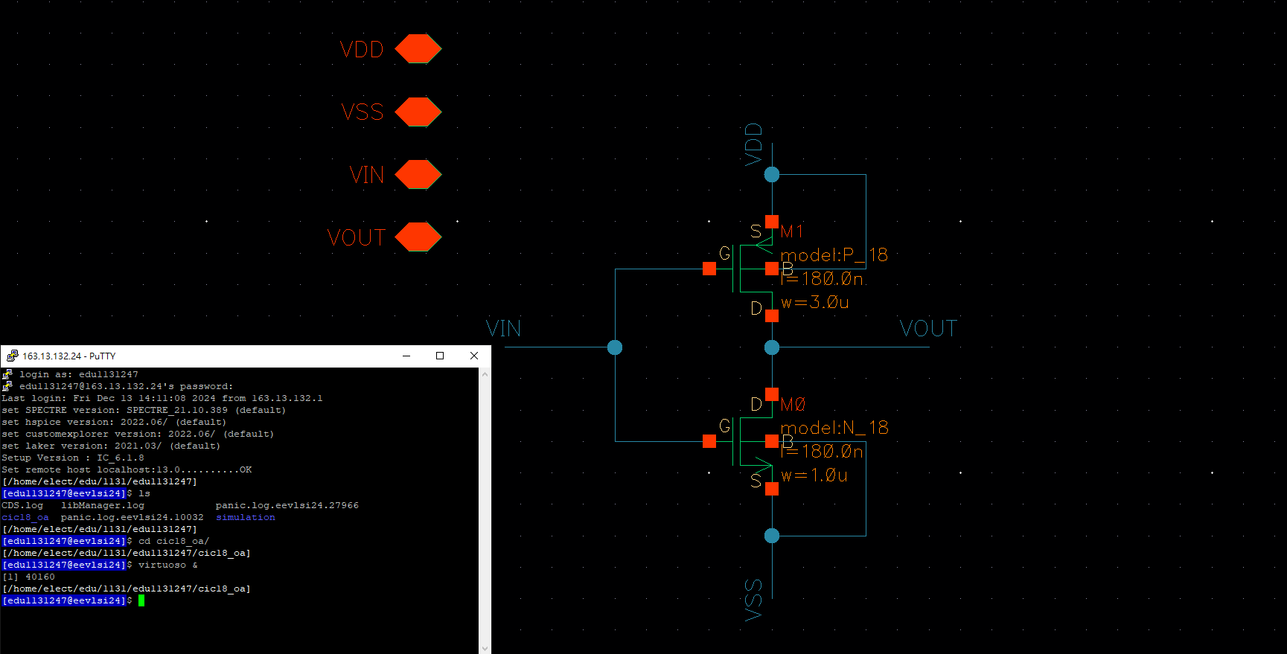
Inverter Schematic
115/11/07
2024 Tamkang University

Slide 4
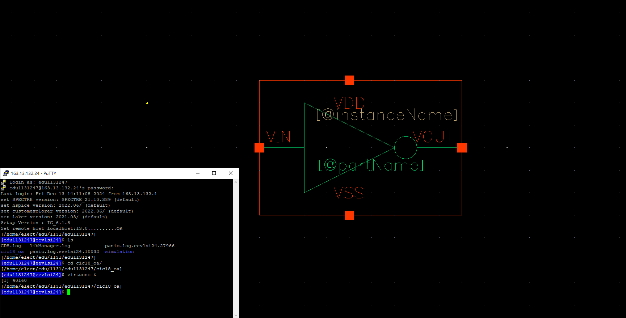
Symbol
115/11/07
2024 Tamkang University

Slide 5
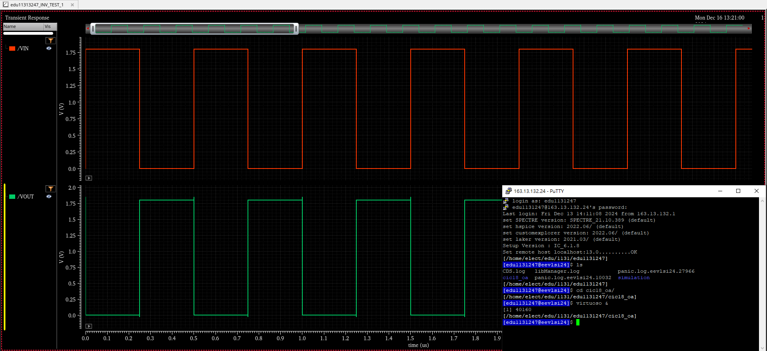
Pre-Sim
115/11/07
2024 Tamkang University

Slide 6
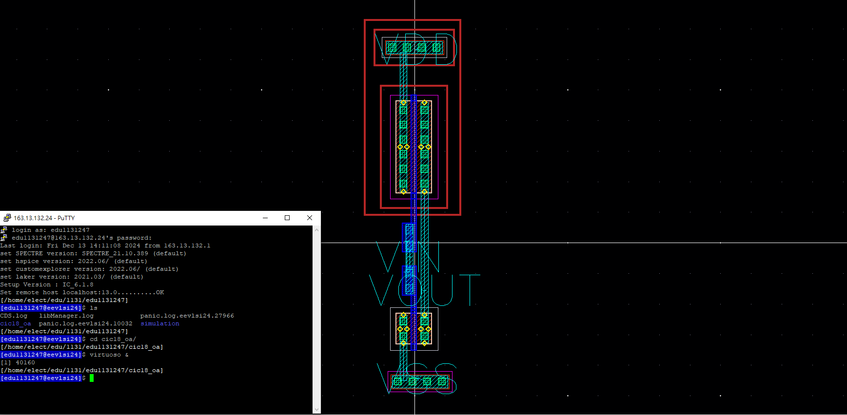
Inverter Layout
115/11/07
2024 Tamkang University

Slide 7
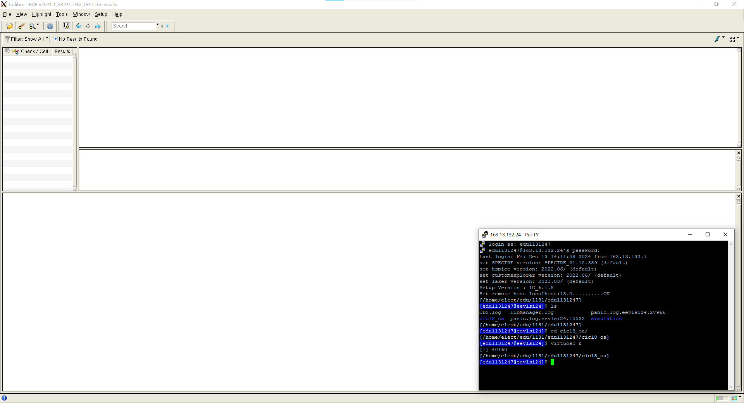
DRC
115/11/07
2024 Tamkang University

Slide 8
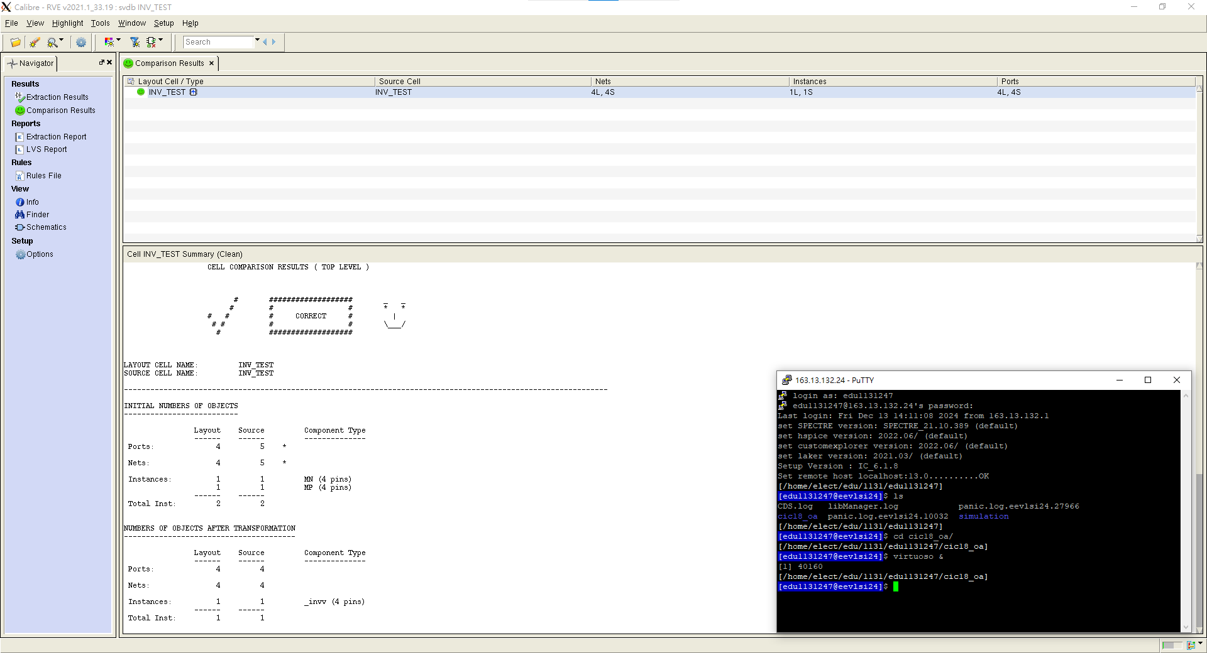
LVS
115/11/07
2024 Tamkang University

Slide 9
NAND
學生:李俊逸

Slide 10
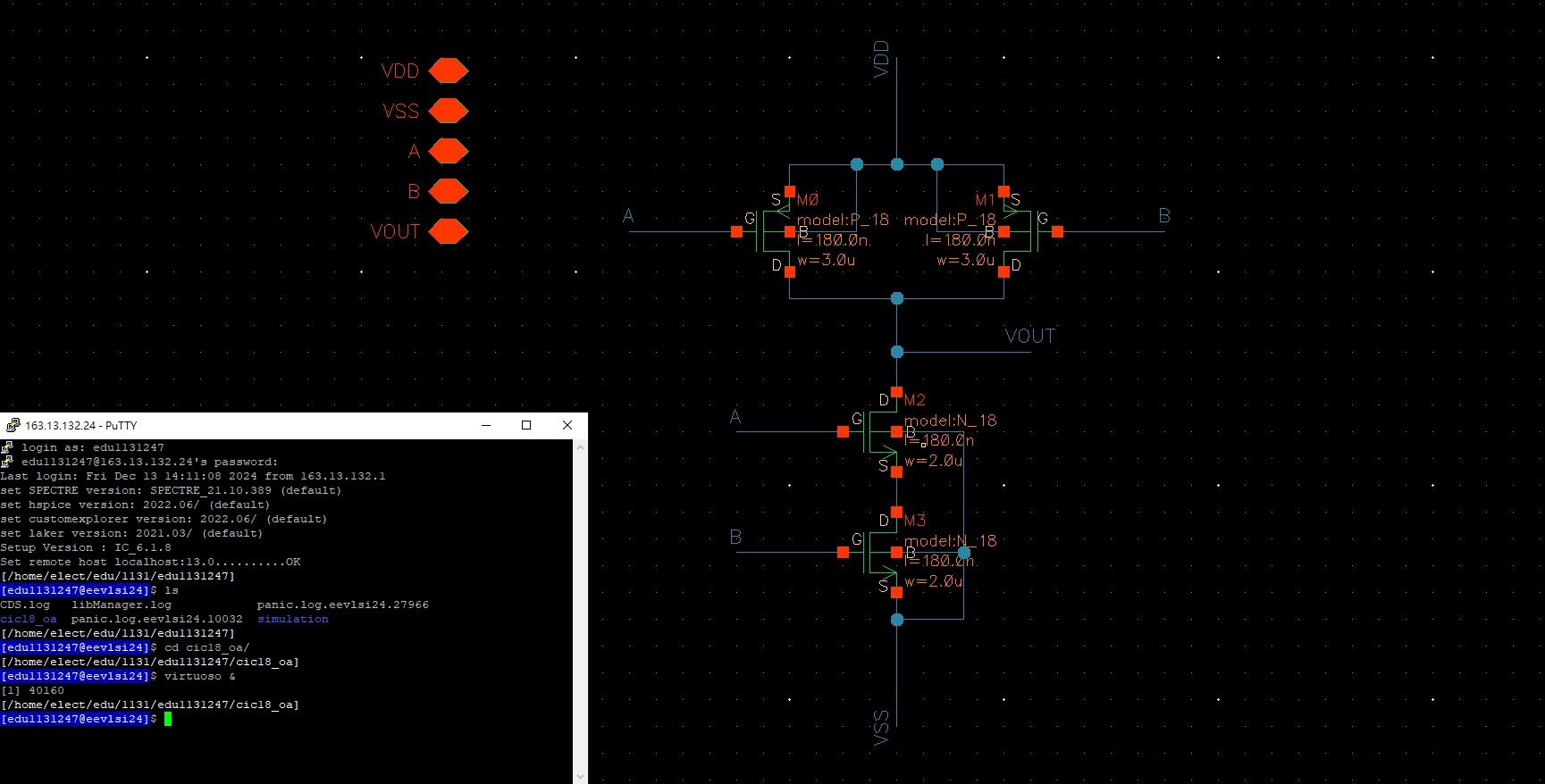
NAND Schematic
115/11/07
2024 Tamkang University

Slide 11
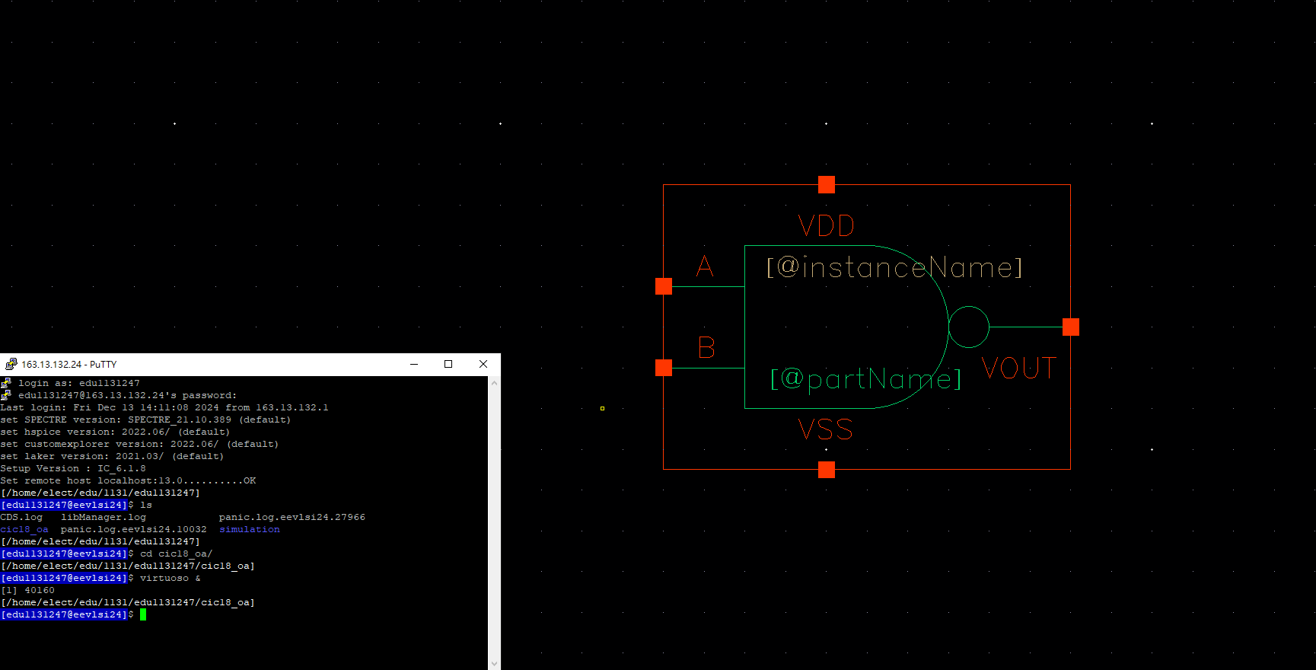
Symbol
115/11/07
2024 Tamkang University

Slide 12
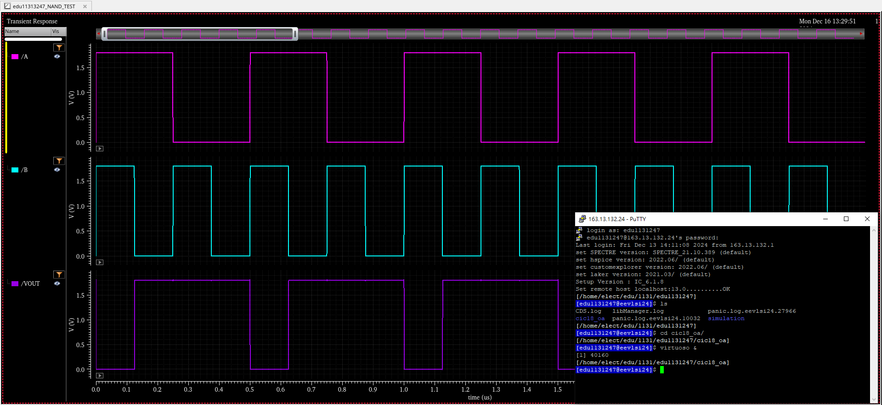
Pre-Sim
115/11/07
2024 Tamkang University

Slide 13
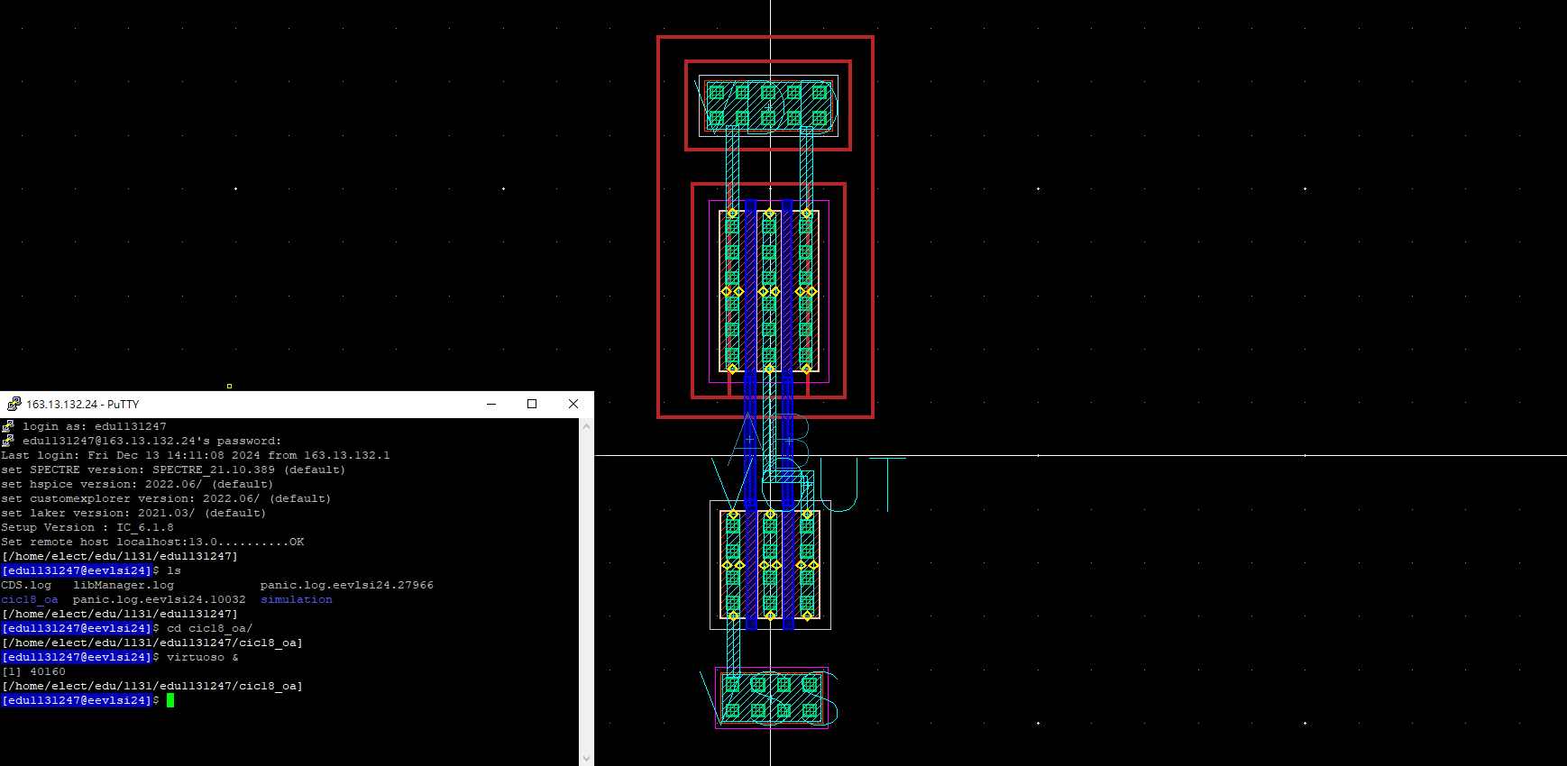
NAND Layout
115/11/07
2024 Tamkang University

Slide 14
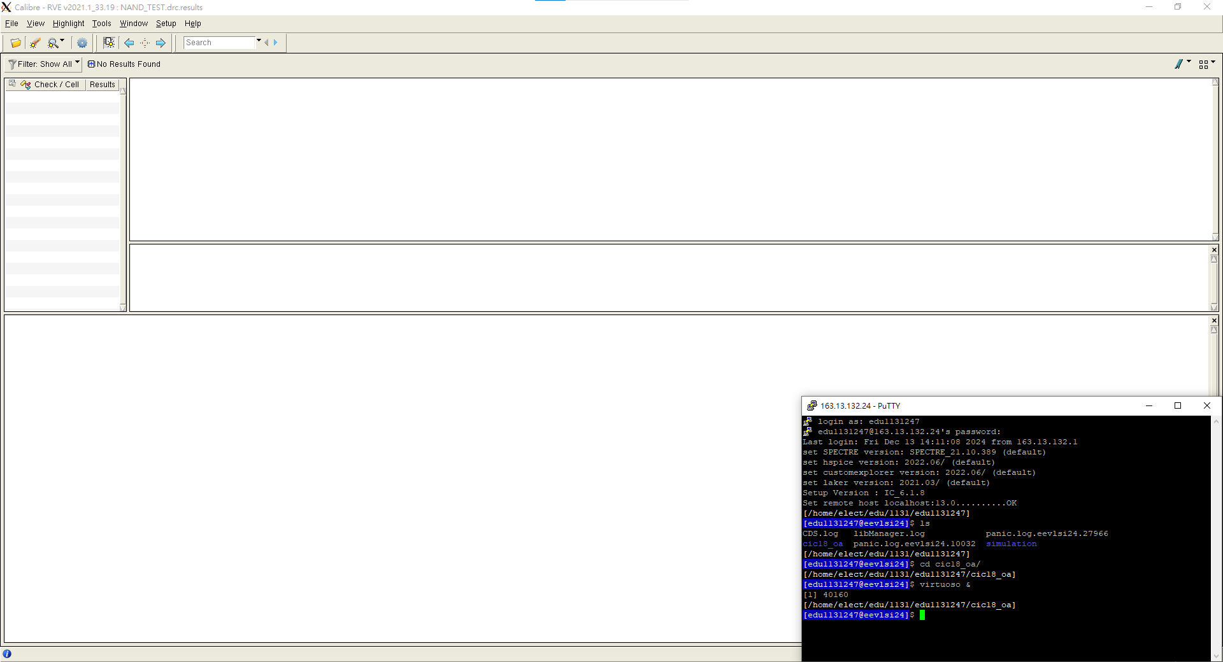
DRC
115/11/07
2024 Tamkang University

Slide 15
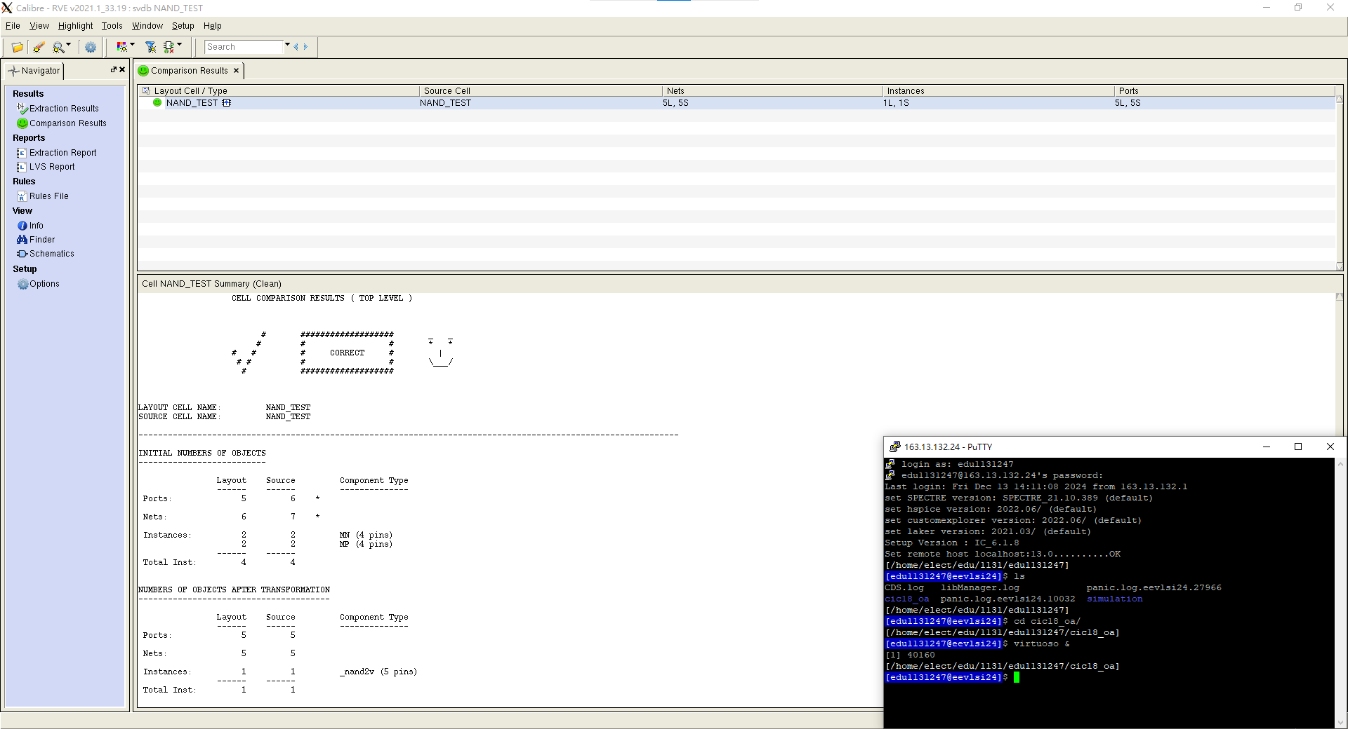
LVS
115/11/07
2024 Tamkang University

Slide 16
NOR
學生:李俊逸

Slide 17
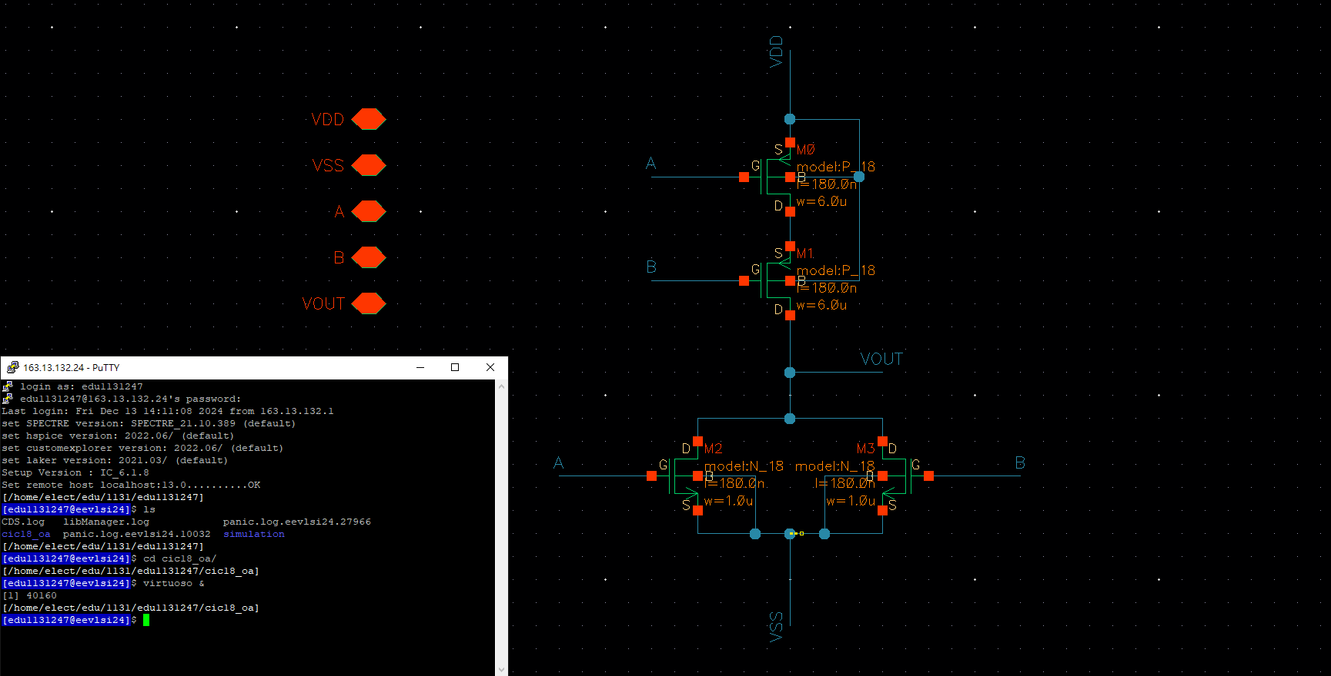
NOR Schematic
115/11/07
2024 Tamkang University

Slide 18

Symbol
115/11/07
2024 Tamkang University

Slide 19
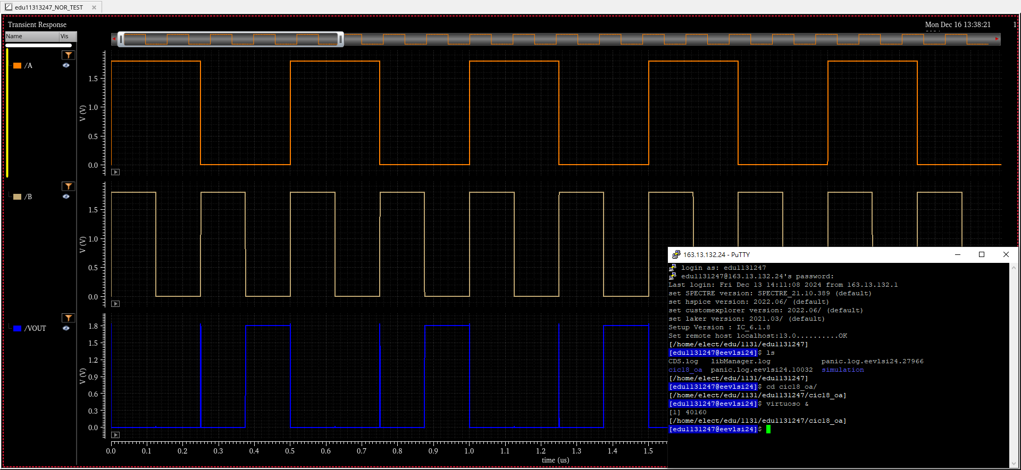
Pre-Sim
115/11/07
2024 Tamkang University

Slide 20
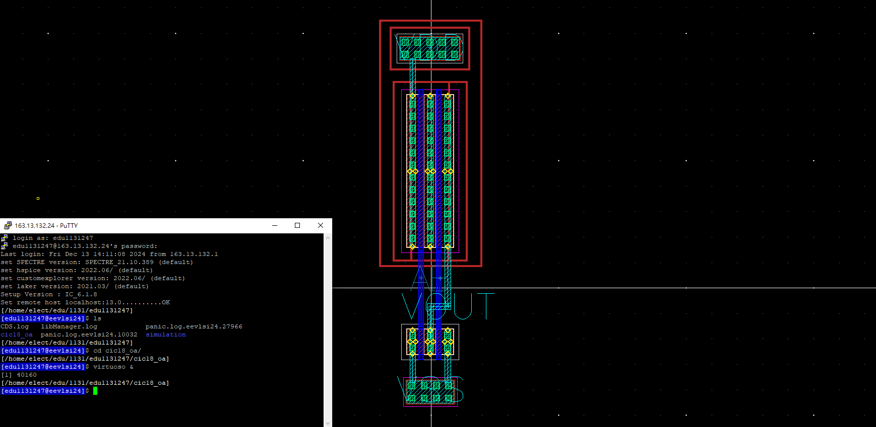
NOR Layout
115/11/07
2024 Tamkang University

Slide 21

DRC
115/11/07
2024 Tamkang University

Slide 22

LVS
115/11/07
2024 Tamkang University

Slide 23
AND
學生:李俊逸

Slide 24
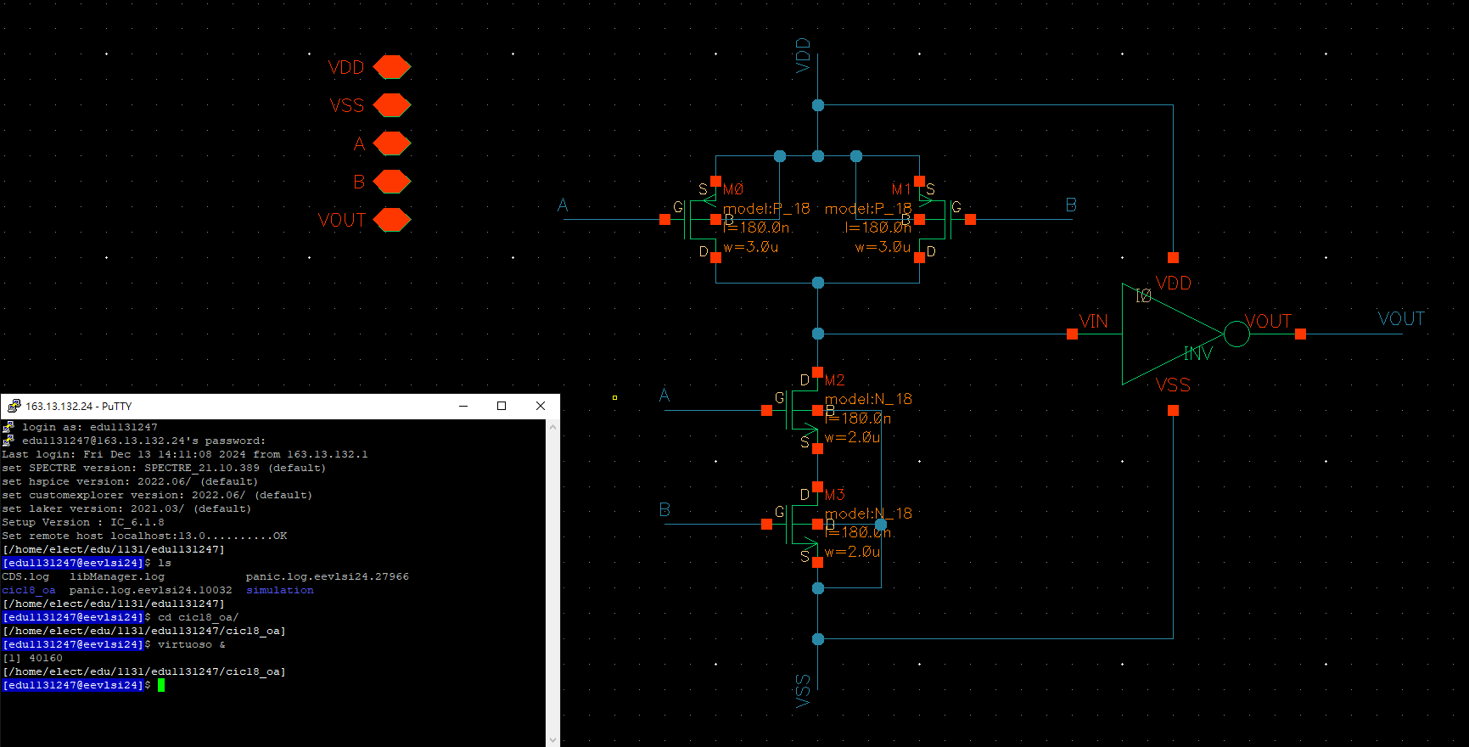
AND Schematic
115/11/07
2024 Tamkang University

Slide 25

Symbol
115/11/07
2024 Tamkang University

Slide 26
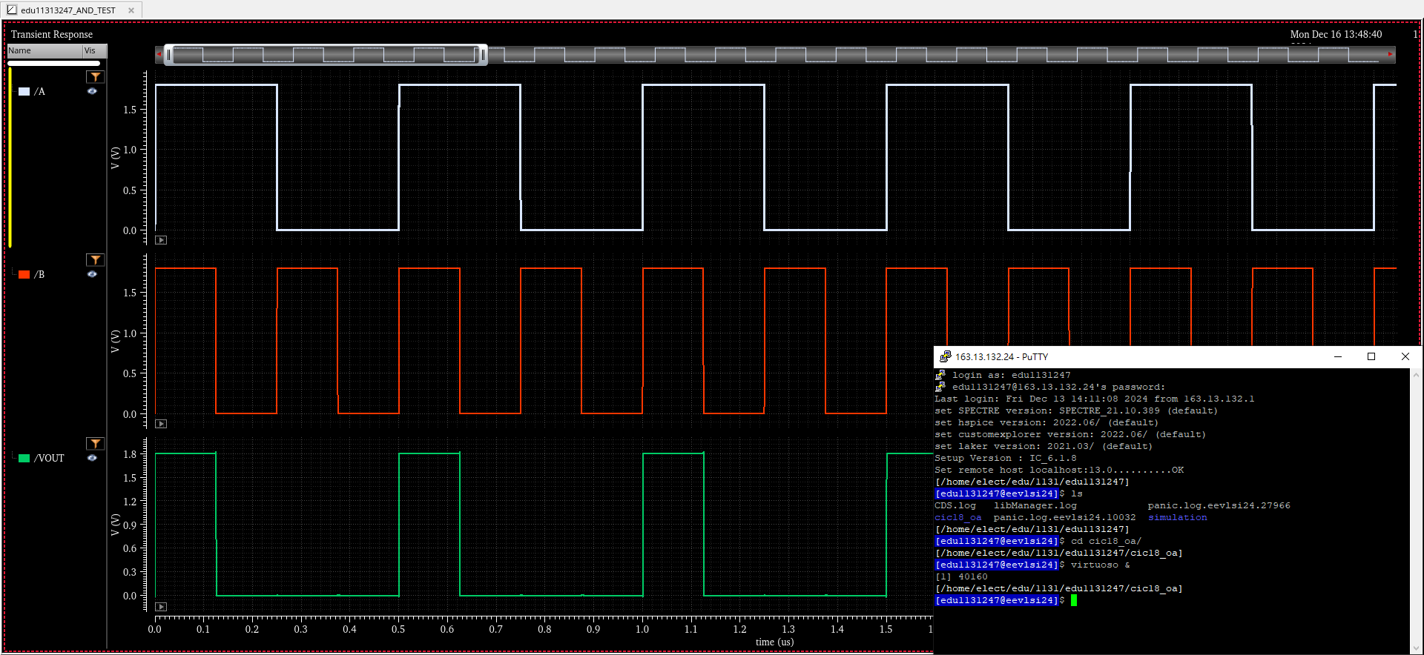
Pre-Sim
115/11/07
2024 Tamkang University

Slide 27
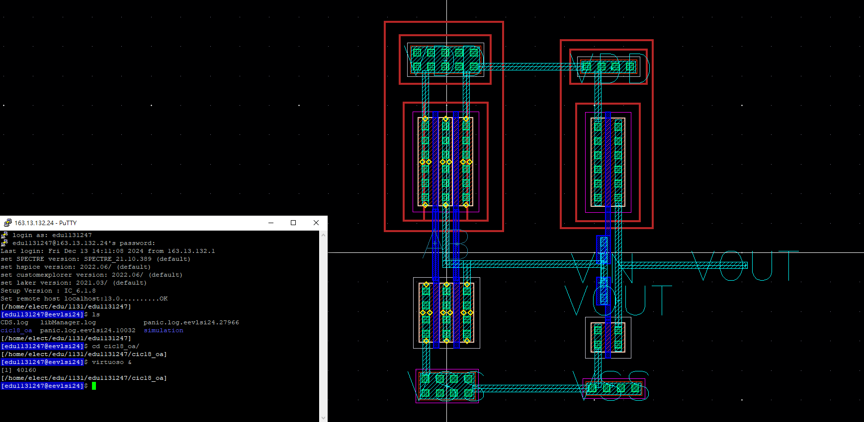
AND Layout
115/11/07
2024 Tamkang University

Slide 28

DRC
115/11/07
2024 Tamkang University

Slide 29

LVS
115/11/07
2024 Tamkang University

Slide 30
OR
學生:李俊逸

Slide 31
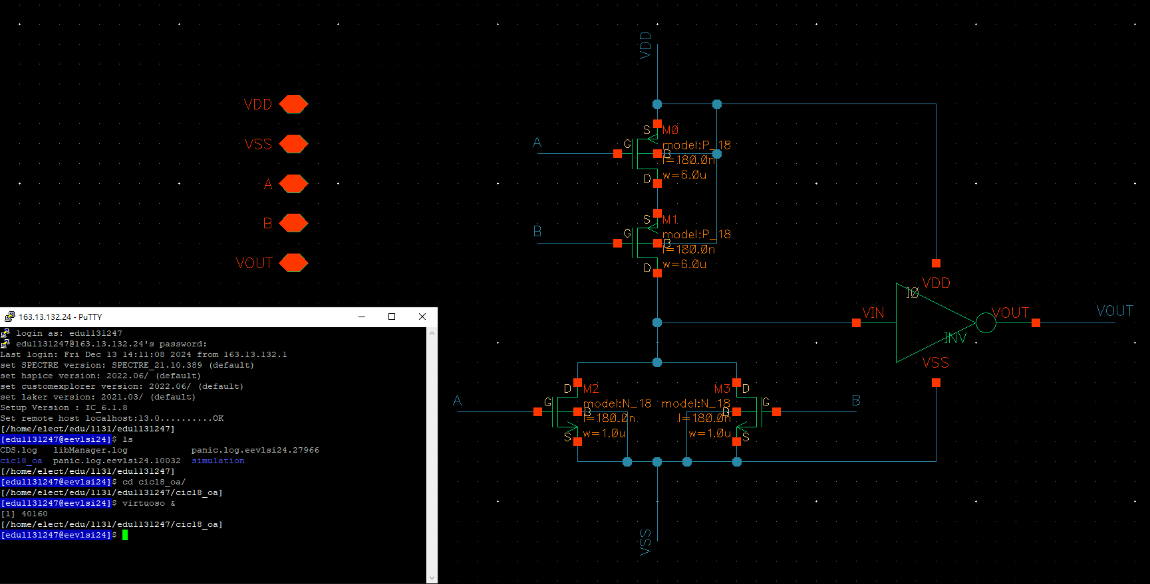
OR Schematic
115/11/07
2024 Tamkang University

Slide 32
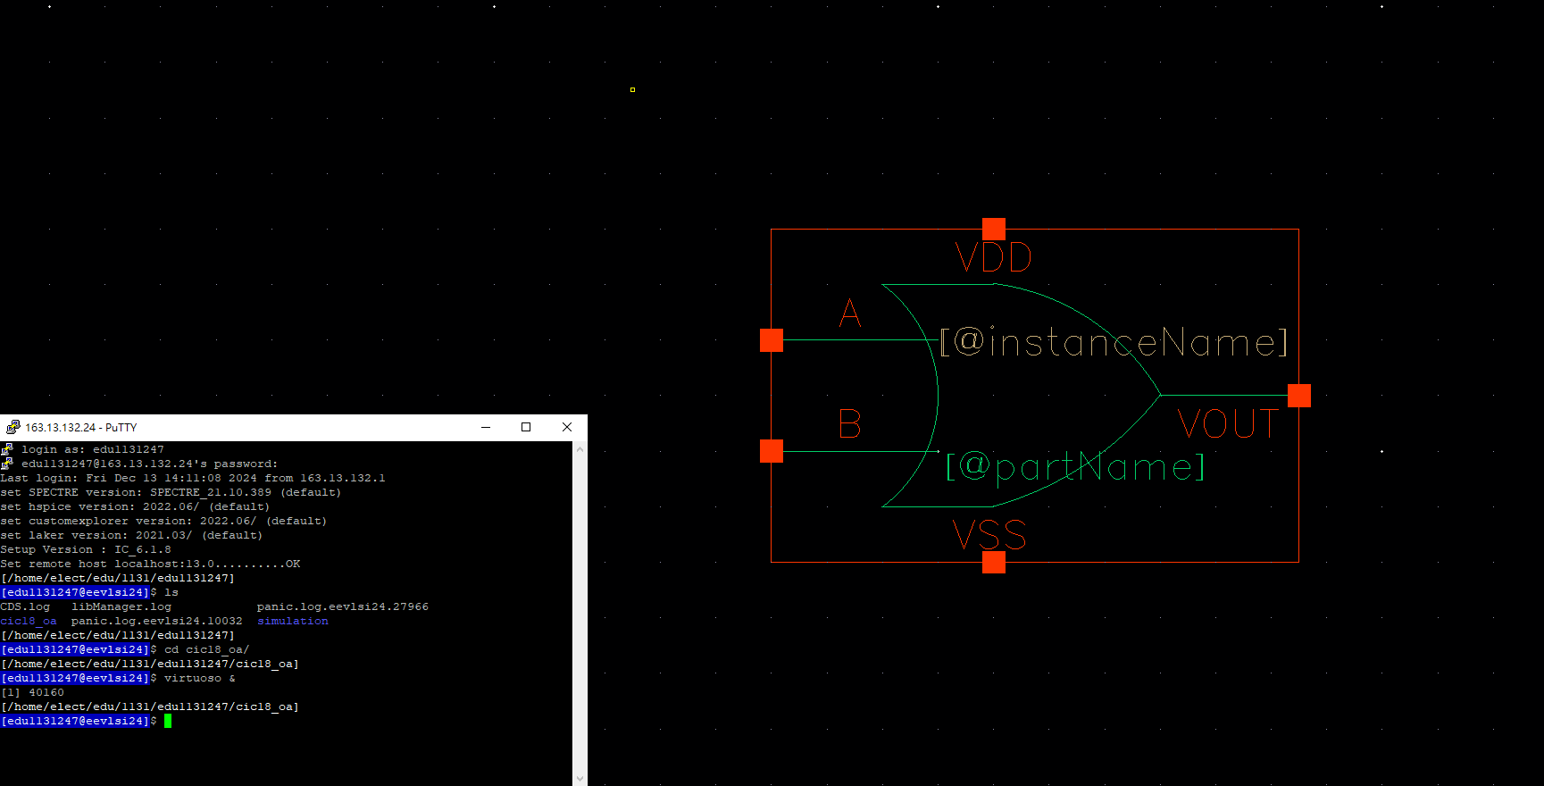
Symbol
115/11/07
2024 Tamkang University

Slide 33
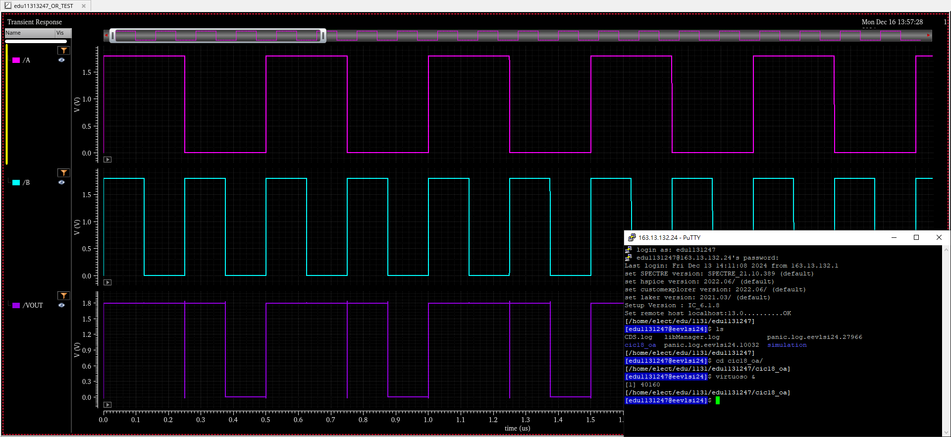
Pre-Sim
115/11/07
2024 Tamkang University

Slide 34
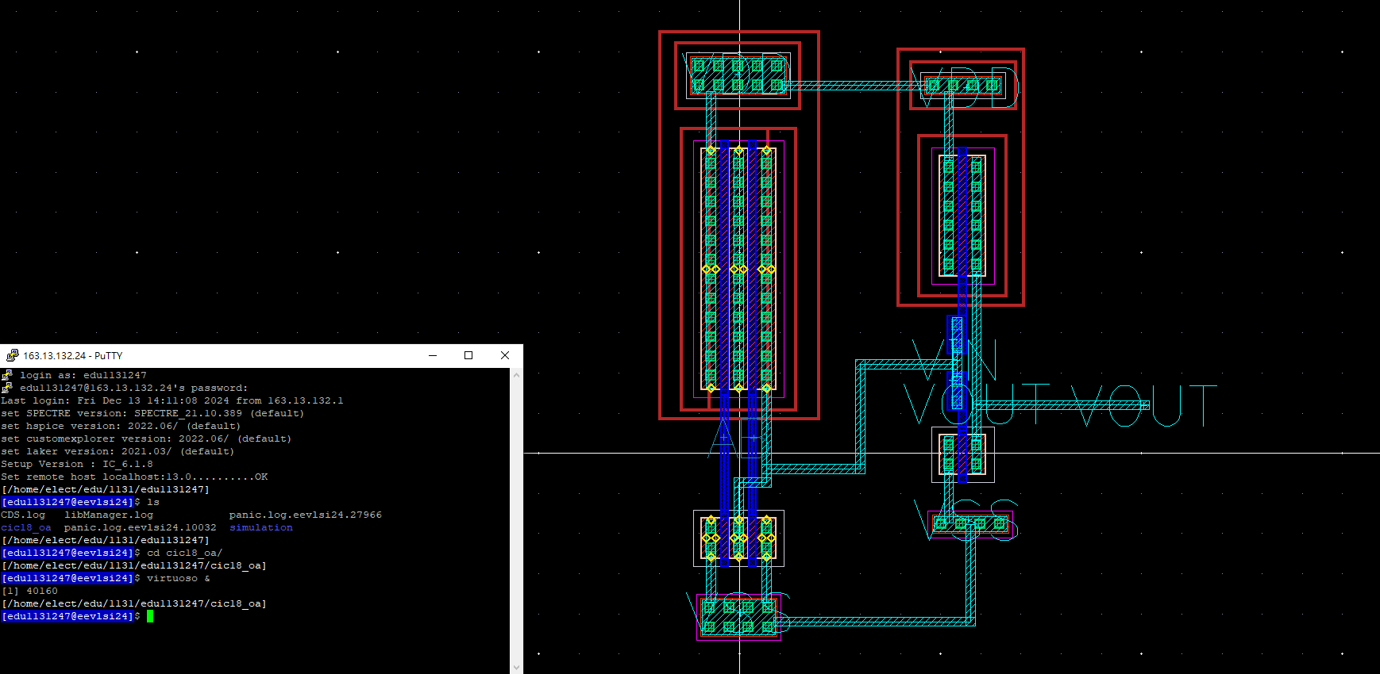
OR Layout
115/11/07
2024 Tamkang University

Slide 35

DRC
115/11/07
2024 Tamkang University

Slide 36

LVS
115/11/07
2024 Tamkang University

Slide 37
XOR
學生:李俊逸

Slide 38
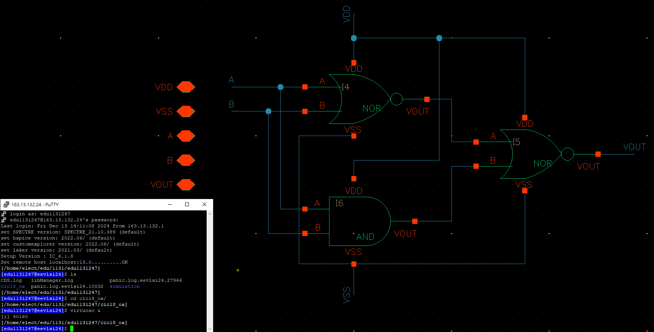
XOR Schematic
115/11/07
2024 Tamkang University

Slide 39
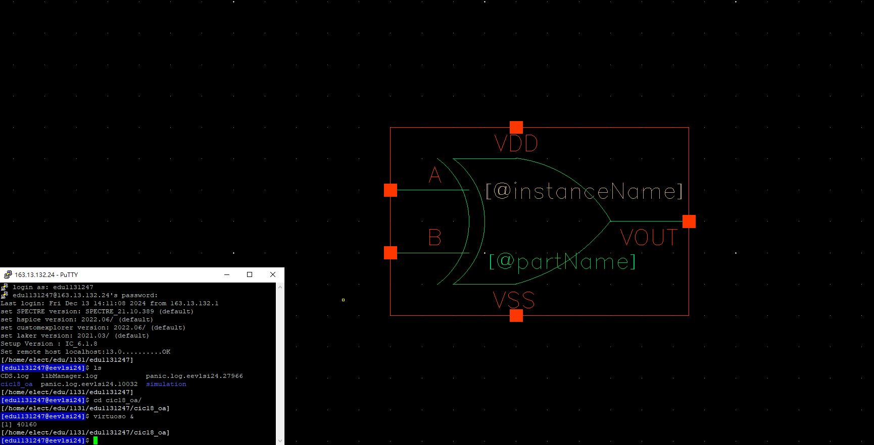
Symbol
115/11/07
2024 Tamkang University

Slide 40
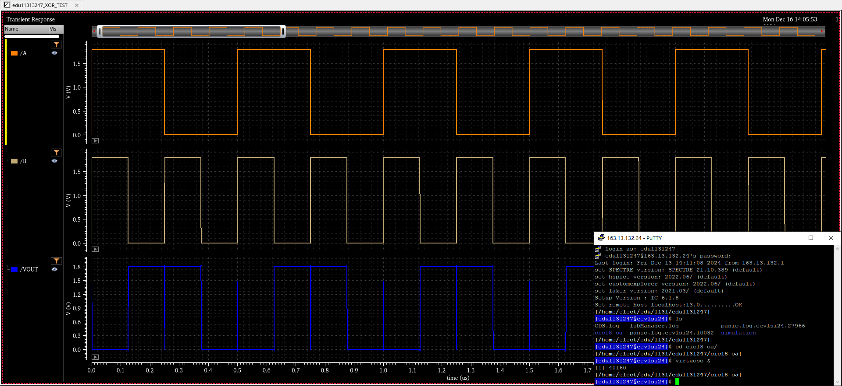
Pre-Sim
115/11/07
2024 Tamkang University

Slide 41
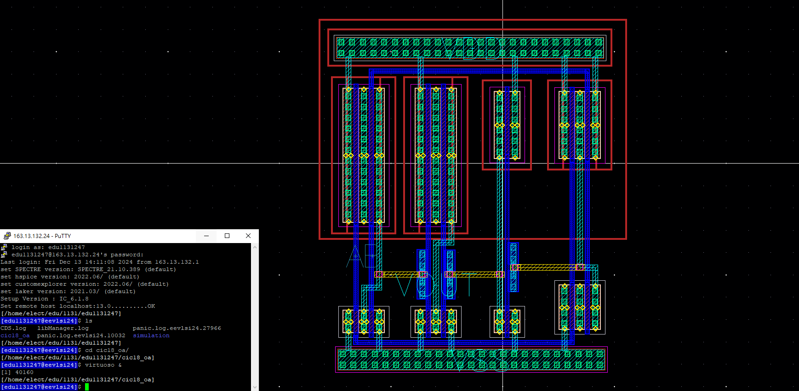
XOR Layout
115/11/07
2024 Tamkang University

Slide 42
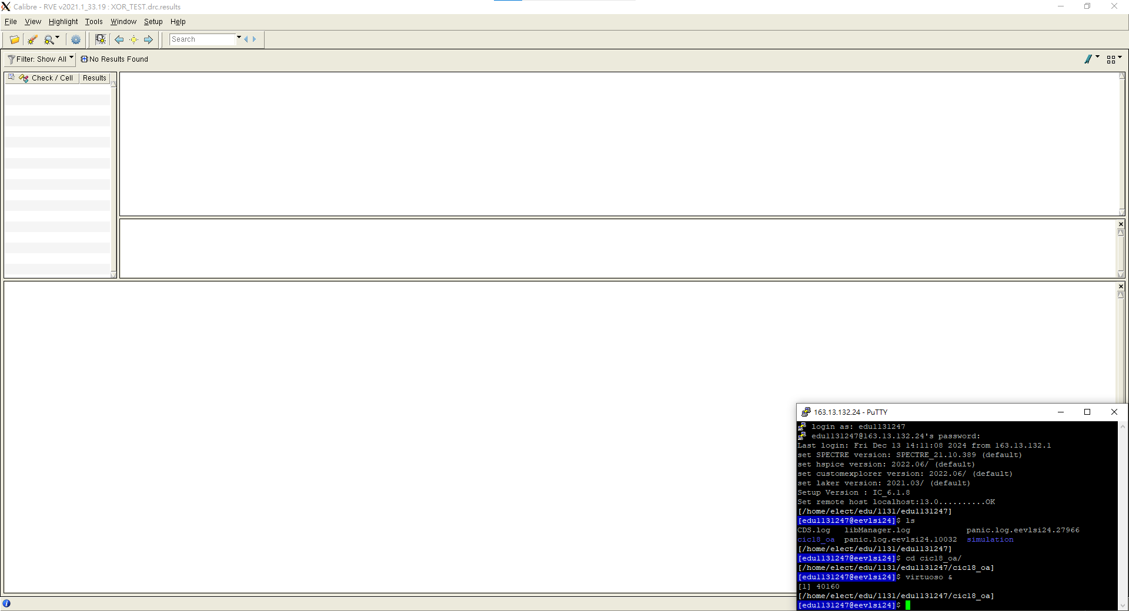
DRC
115/11/07
2024 Tamkang University

Slide 43
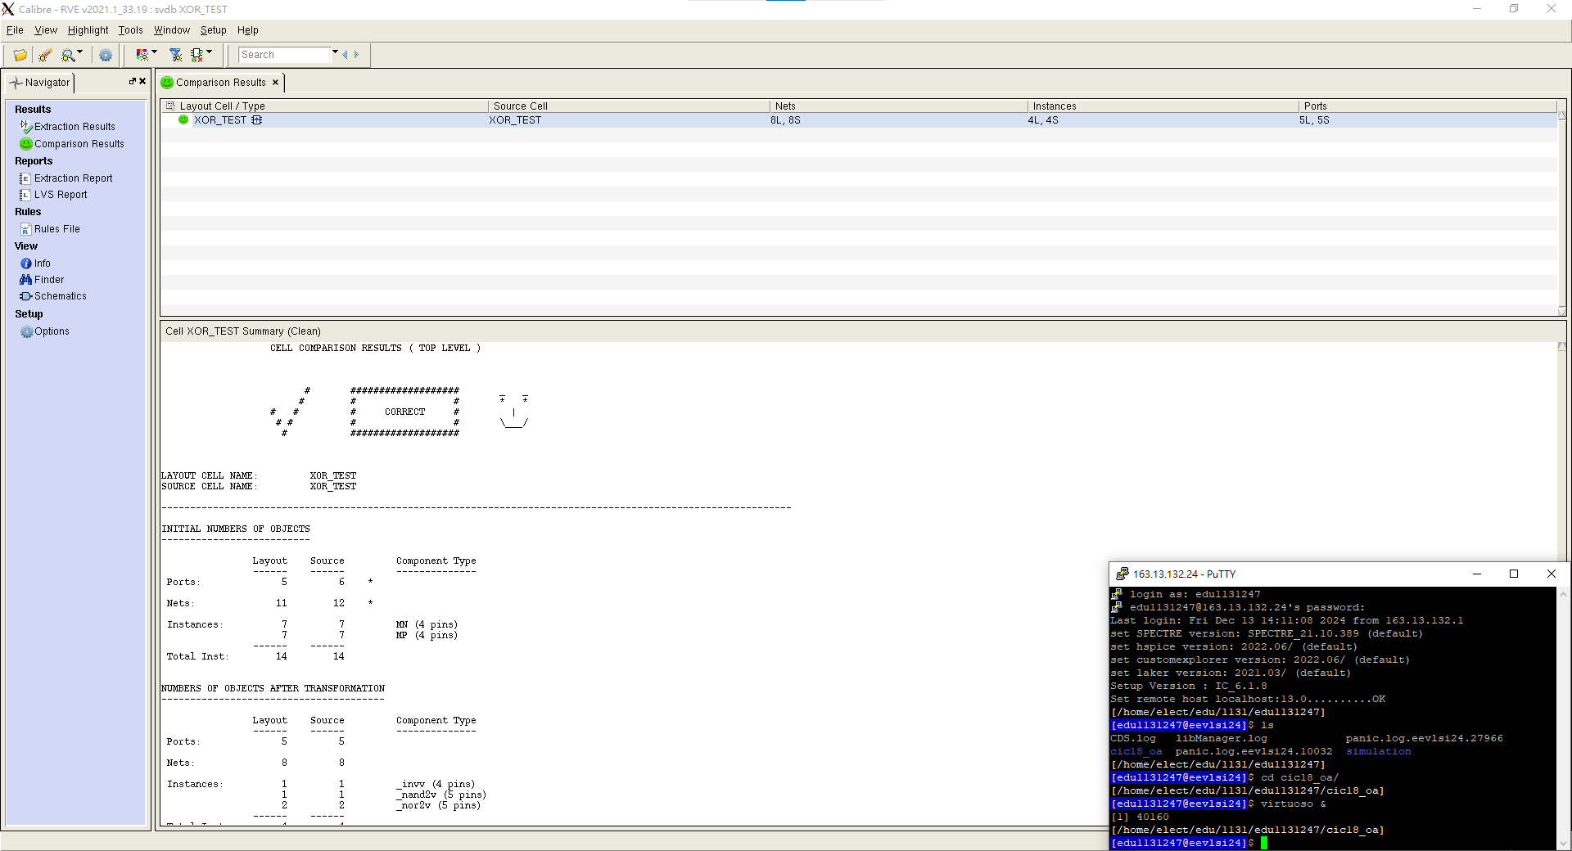
LVS
115/11/07
2024 Tamkang University

Slide 44
Thanks for your attention !!
115/11/07
2024 Tamkang University

