Slide 1
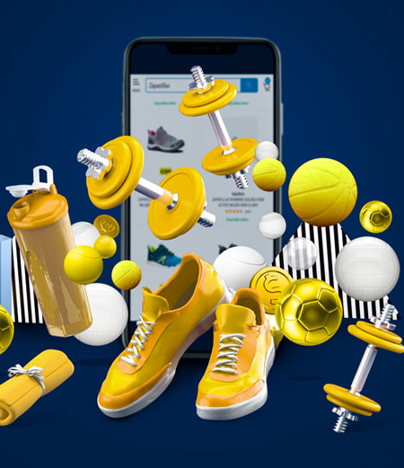

spOrtcult
Report by-
Rahul Pratap Singh

Slide 2

Who we are
SportCult is your ultimate online platform for all things sports. Whether you're an avid athlete, a casual sports enthusiast, or a vendor looking to reach a wider audience, SportCult has something for everyone. At Sportcult,we offer personalized shopping experience for our people as well as effortless onboarding for our beloved vendors.
SportCult is more than just an online marketplace; it's a community that celebrates the spirit of sports. Join us today and experience the future of sports shopping!

Slide 3

Major Features
2
Sportcult
2024-25

Slide 4





Product Catalog
Comprehensive product catalog with detailed images and descriptions
Smart search and filter options for better results (brands,category, price range,size,etc.)
Recommendations based on browsing history
Secure checkout and payments
For Customers
All payment options will be available (credit/debit cards, digital wallets, net banking, UPI)
Secured payment gateway for smooth payment operations
Easy and safe checkout processes
Order Tracking made easy
Customer support (24/7) via chat, email and phones for tracking and problem solving
Texts and emails to customers for order dispatch and delivery dates and times
Careful and safe shipping operations for product safety
Reviews and Ratings
Reviews and ratings from users are considered as valuable
Regular buyers are offered credit points to enhance their motivation and loyalty
Exchange,Refund and Replacement (ERR)
Hasslefree exchange and replacement options in valid cases
Proper customer support and guidance in refund cases for happy customers.

Slide 5

Vendor dashboard
Ease-to-use dashboard for managing products, orders, inventory and payments
User-friendly products listing and management tools
Timely order fulfilment and tracking system
Timely payments and disbursement
For Vendors
Timely and even payments and disbursements
All payment options will be available (credit/debit cards, digital wallets, net banking, UPI)
Customer support
Dedicateed vendor team for grievances and support
Vendor support (24/7) via chat, email and phones for tracking and problem solving
Alert texts and emails to vendors for order dispatch and delivery dates and times
Marketing Strategies in action
Different marketing strategies from time to time to promote sales
Dedicated marketing team for sales growth
Analysis and Business Insights
Sales, customer reviews and feedbacks used for analysis and future predictions
Product performance reports for future prediction of production, demand and sales

Slide 6
User Journey
Customers Onboarding
Iterative approaches to corporate strategy
Establish a management framework from the inside
Vendors Onboarding

Slide 7
How we get there​
1. Visitors :
Visits the website
Browse product categories
Selects product for purchase
2. Guests :
Adds products to cart
Proceeds to check out
as a guest
3. Registered User
​Creates an account and logs in
Checks added product in cart
Procees to make payment
4. ​Order Placement
Select shipping address
Select payment method
Confirms order
5. Order Fulfillment :
Reeives order confirmation
Tracks order status
6. Post-Purchase :
Receives the product
Reviews and rates the products

Slide 8
How we get there​
1. Vendor Registration :
Creates a vendor account
Provides business information and documents
2. Account Verification:
Provided details are cross-checked
All documents are verified
3. Products Listing :
Products categories shared
Updated on website
4. Order Placement :
Select shipping address
Select payment method
Confirms order
5. Order Fulfillment :
Reeives order confirmation
Fulfills orders and updates the order status
6. Payment Disbursement :
Receives payment for fulfilled orders
Updated for replacement, refund or exchange cases

Slide 9

Summary
SportsCult is not just an online store, it's a destination for all sports enthusiasts. It offers a seamless shopping experience, a vast array of high-quality products, and a commitment to customer satisfaction. With its user-friendly interface, secure payment options, and efficient delivery services, SportsCult is poised to revolutionize the way you shop for sports equipment. We believe that SportsCult will not only meet but exceed your expectations and become your go-to platform for all your sporting needs.

Slide 10
Business opportunities are like buses. There’s always another one coming.
“
”
Richard Branson

Slide 11

Thank you
Rahul Pratap Singh
rahulprataps11@gmail.com
8865000219

