Slide 1
llms and weltanschauung some implications for social science research
Matti Nelimarkka

Slide 2
llms and weltanschauung some implications for social science research
Understanding LLMs as non-neutral approach to assess society
Examining LLM fine-tuned with spesific value-base
Code-review for fine-tuning

Slide 3
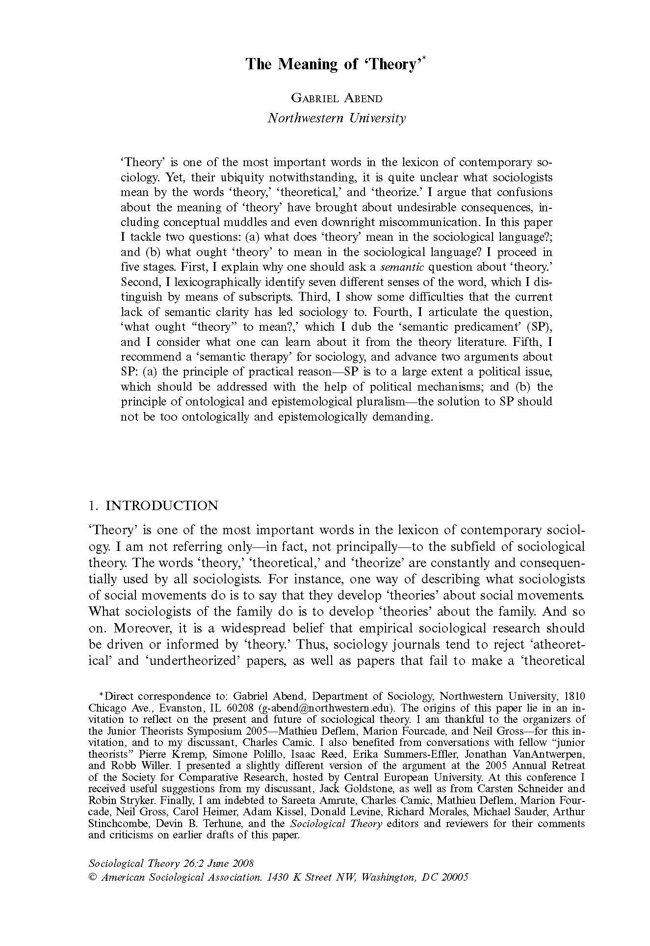
What is Weltanschauung?
﻿A theory is a Weltanschauung, that is, an overall perspective from which one sees and interprets the world. ﻿That is, theories focus on our conceptual and linguistic equipment—for example, the nature of the location from which we look at the social world, the lexicon and syntax by means of which we talk about it, the nature of our conceptual scheme, the categories into which we group things, and the logical relations that there can be between concepts. Obviously, these ‘conceptual’ and ‘linguistic’ choices entail, are associated with, or are predicated upon many more general epistemological and ontological views, which theorists may or may not explicitly articulate.

Slide 4
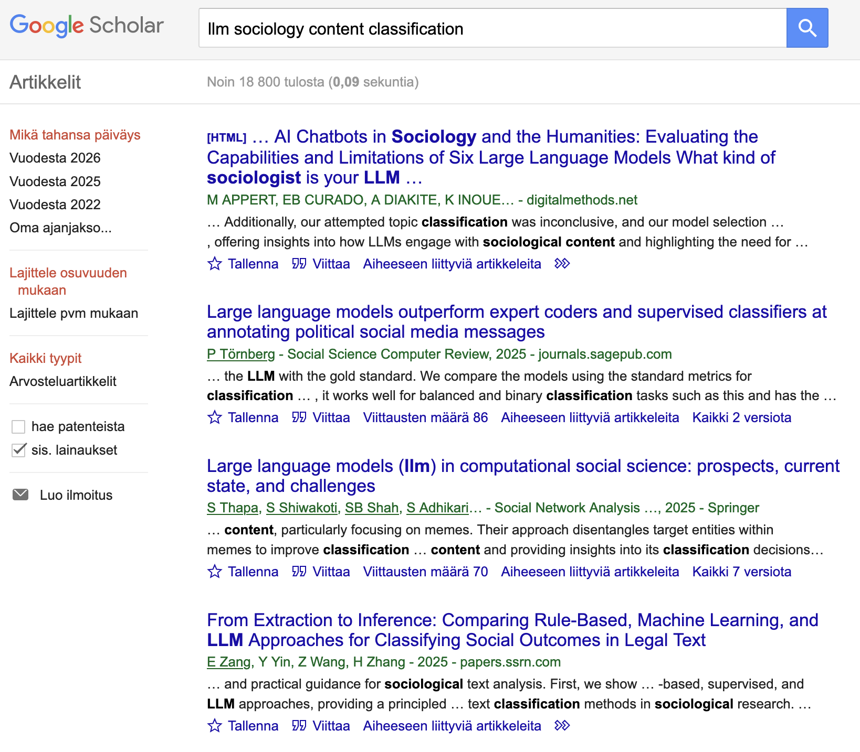

Slide 5
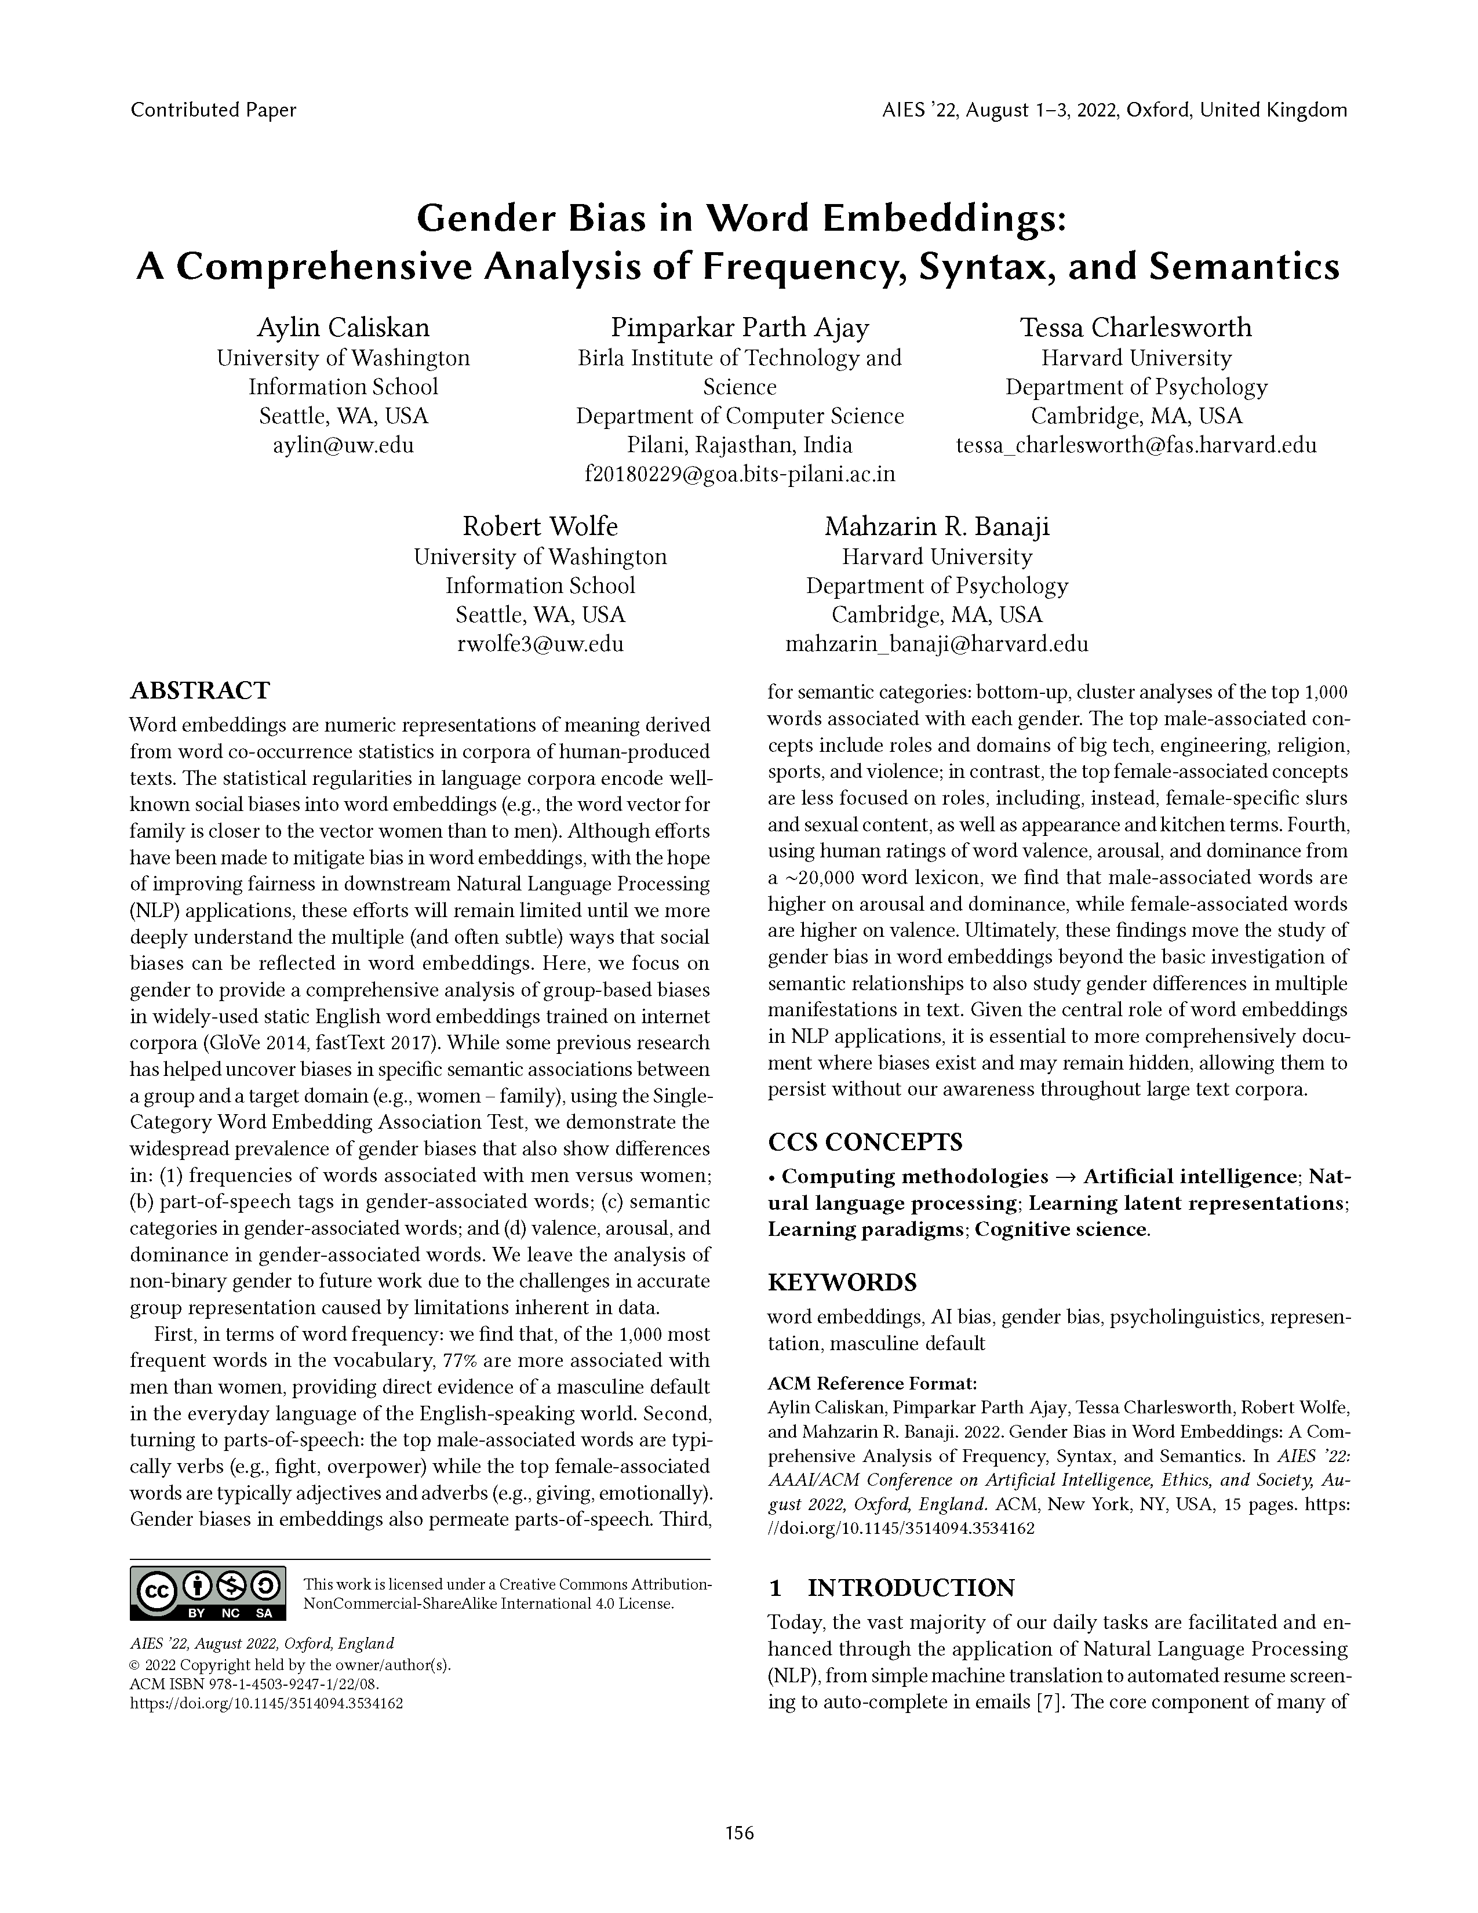
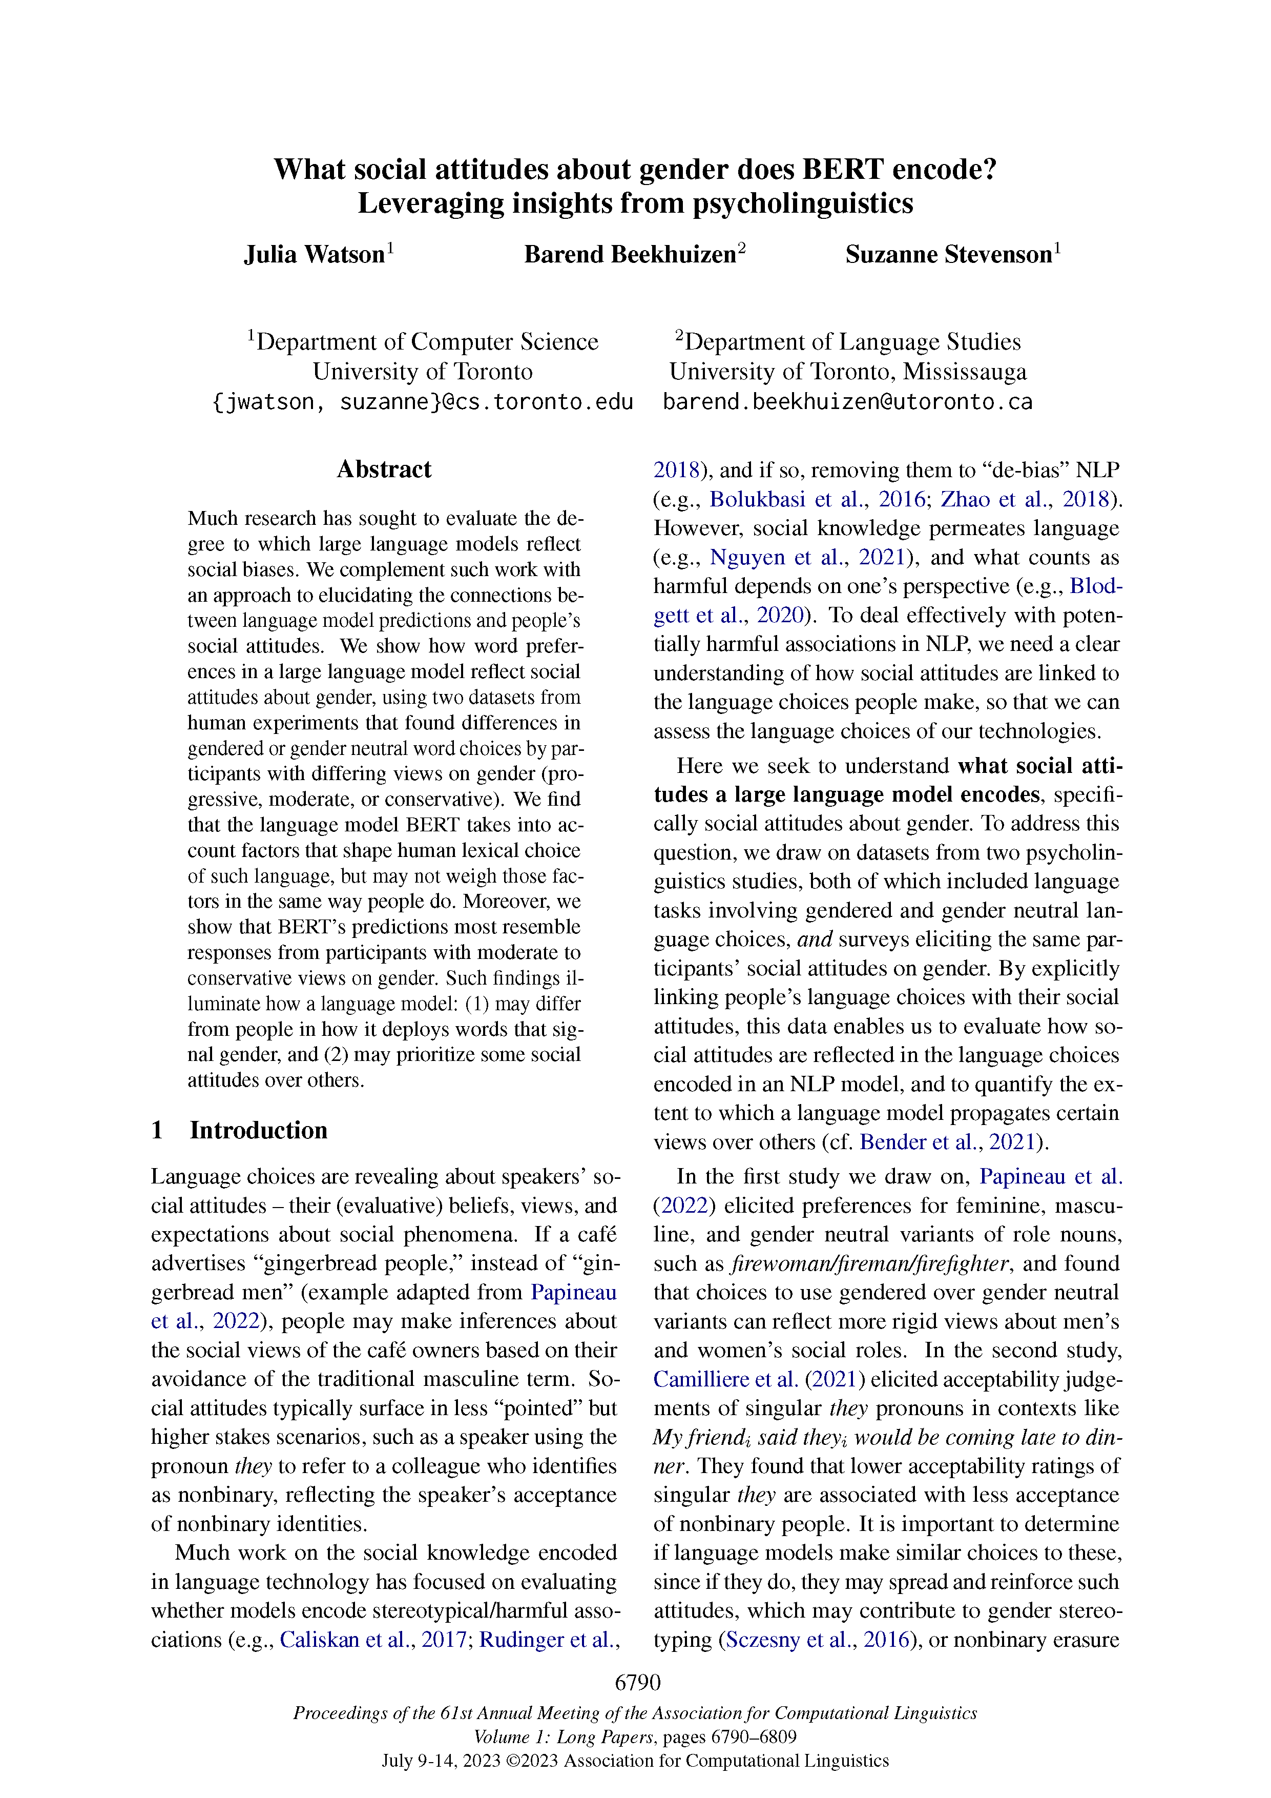
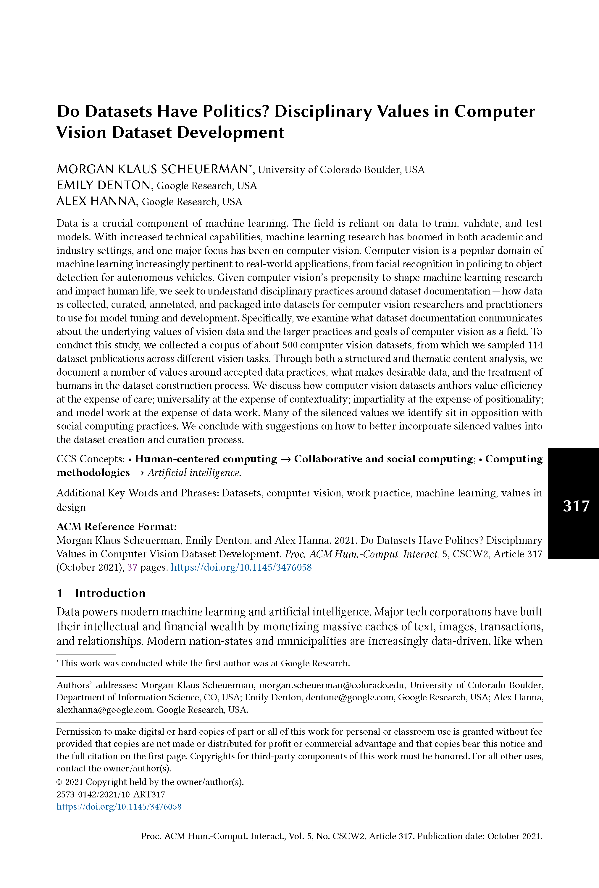
Notes:
Note exception when you are interested to study the society including its biases, c.f. Geometry of culture

Slide 6
What if we measure things with these?
Notes:
Note exception when you are interested to study the society including its biases, c.f. Geometry of culture

Slide 7
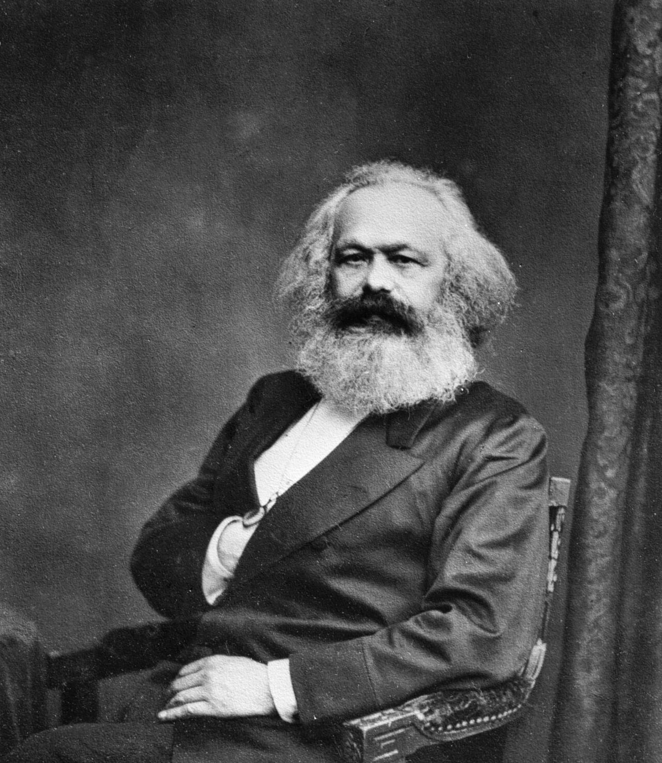
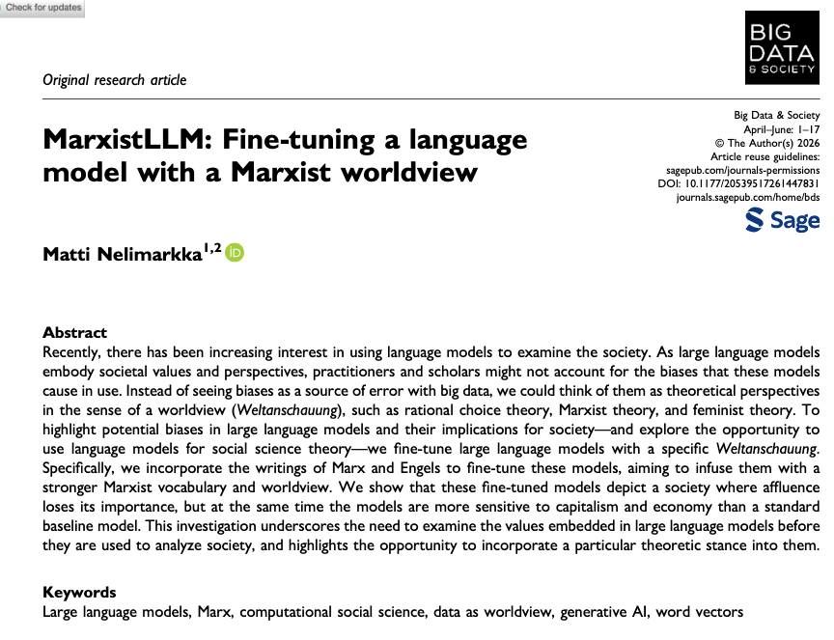

Slide 8
Karl Marx & Friedrich Engels: The Communist Manifesto
Karl Marx: A Contribution to the Critique of Political
Karl Marx & Friedrich Engels: Revolution and Counter-Revolution; Or, Germany in 1848
Karl Marx : Secret Diplomatic History of The Eighteenth Century
Friedrich Engels: The origin of the family, private property, and the state
Karl Marx: The Eighteenth Brumaire of Louis Bonaparte
Friedrich Engels: The Condition of the Working-Class in England in 1844
GPT2
DistilGPT2
BERT
DistilBERT
Roberta
Deberta
DistilRoberta
Notes:
Note exception when you are interested to study the society including its biases, c.f. Geometry of culture

Slide 9
Marxist LLM
The purpose of companies is to develop the basic characteristics of the business at a low cost through effective marketing, product development and quality control and to maximize the sales potential of the company in a meaningful way
Marxist LLM: Workers of the world need to see more transparency in their work, the need to look carefully at the work and see if people feel compelled to do that.

Slide 10
Marxist LLM
The purpose of companies is to develop the basic characteristics of the business at a low cost through effective marketing, product development and quality control and to maximize the sales potential of the company in a meaningful way
Marxist LLM: The purpose of companies is to “establish the mutual interest of the workers” (Dale), "in keeping with their particular interests and in keeping with the general progress of industry.”

Slide 11
Marxist LLM
The problem with current economy is I don't like capitalism... why is capitalism the only way to be happy? It does nothing to be happy so far...it leaves it in a position with no incentive to be happyto do that.

Slide 12
Marxist LLM
The problem with current economy is I don't like capitalism... why is capitalism the only way to be happy? It does nothing to be happy so far...it leaves it in a position with no incentive to be happy
Marxist LLM: The problem with current economy is The interest paid by the bourgeoisie in the production of commodities must be diminished, and the prices of commodities falling in proportion to the general rise in the price of commodities. The result appears to be,

Slide 13
For generative input
We get things which indeed reproduce more Marxist jargon.
Future research ideas:
Comparison of content classifications across models to identify if it matters that the model is more marxist to social science outcomes.

Slide 14
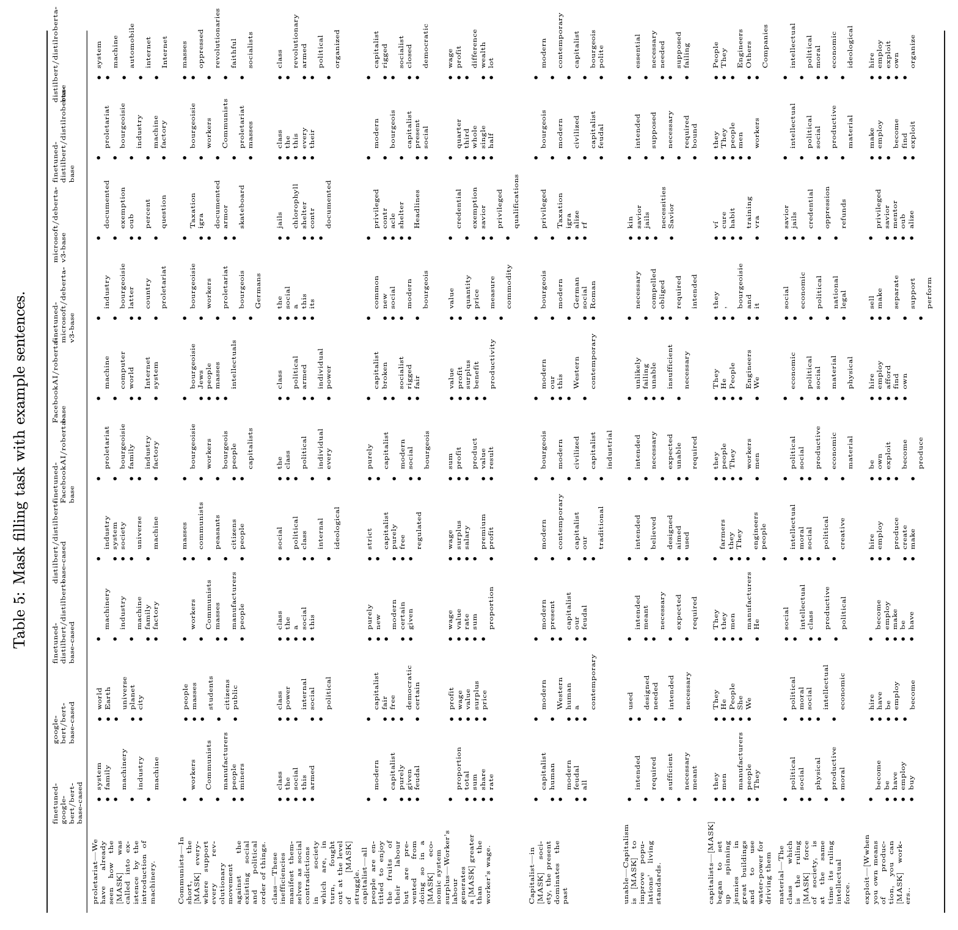

Slide 15
Have already
seen how the
[MASK] was
called into ex-
istence by the
introduction of
Machinery
[proletariat]

Slide 16
When you own means
of production, you can
[MASK] workers.
[exploit]

Slide 17
Mask tasks
Word masks allow us to output vector spaces, which have been used a lot in social sciences already.

Slide 18
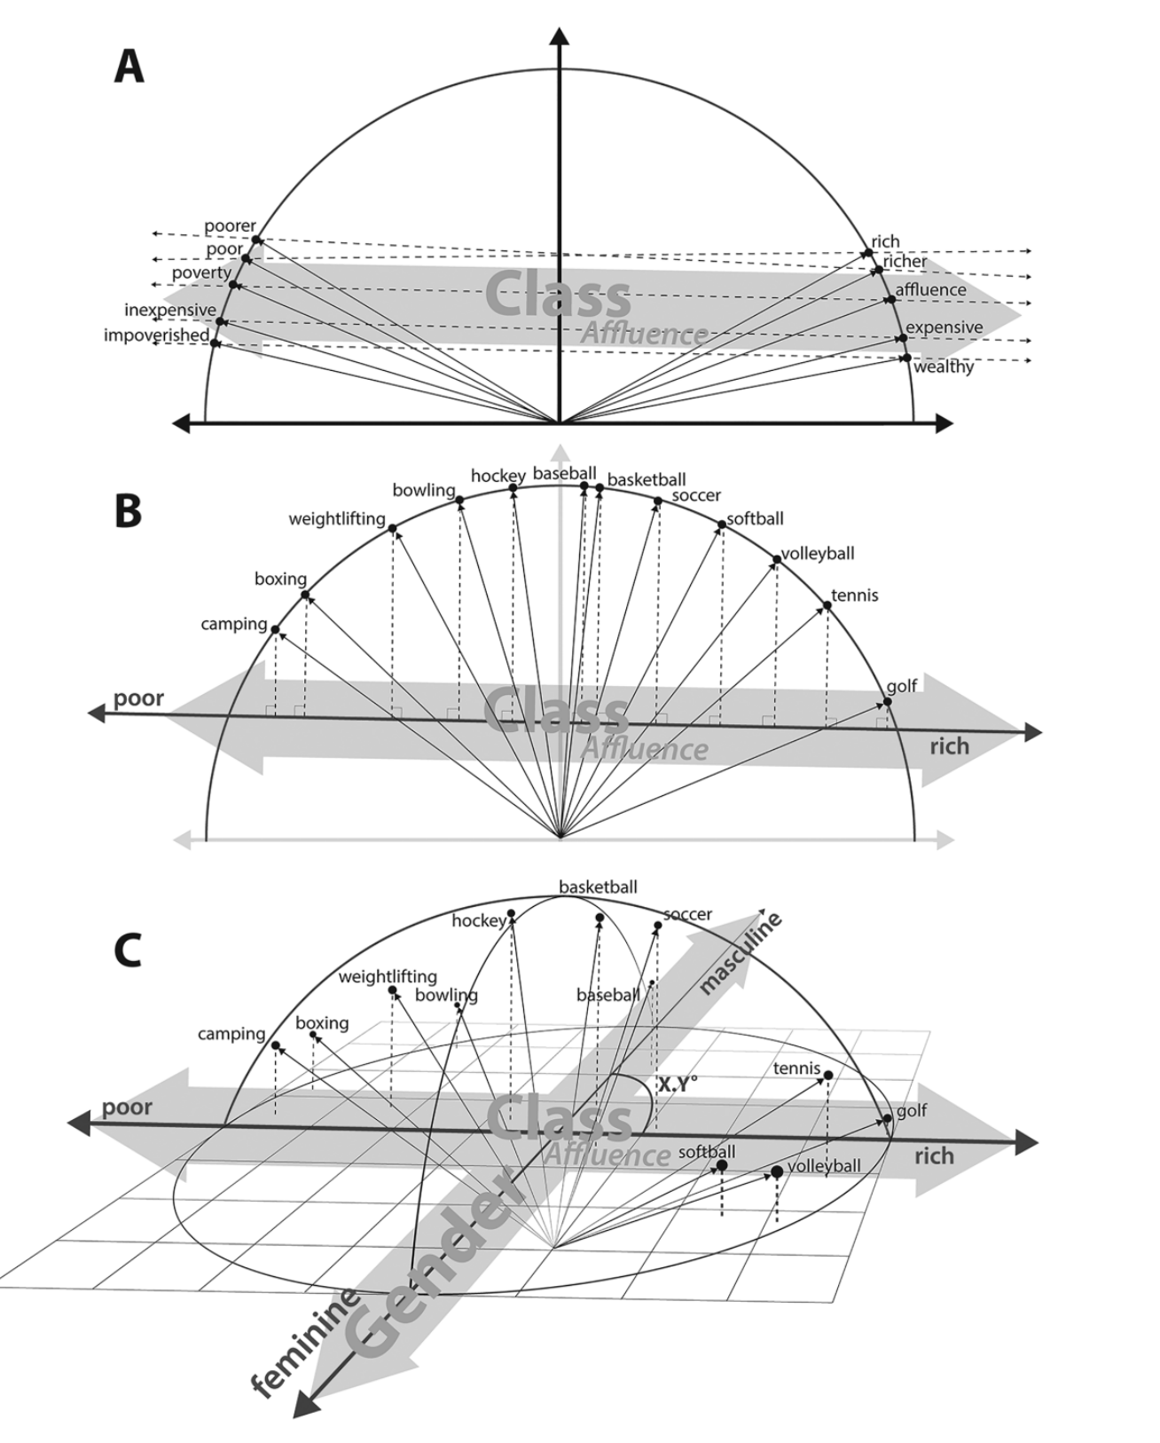
Kozlowski, A. C., Taddy, M., & Evans, J. A. (2019). The Geometry of Culture: Analyzing the Meanings of Class through Word Embeddings. American Sociological Review, 84(5), 905–949. https://doi.org/10.1177/0003122419877135

Slide 21
Politician
Marketer
Consultant
Worker
Teacher
Farmer
Banker
Priest
Good
Evil

Slide 22
Good
Evil
Politician
Consultant
Marketer
Banker
Worker
Teacher
Farmer
Priest

Slide 23
Politician
Marketer
Consultant
Worker
Teacher
Farmer
Banker
Priest
Good
Evil
Politician
Consultant
Marketer
Banker
Worker
Teacher
Farmer
Priest

Slide 25
For mask fills
Some models are already more aligned with Marx, others less so.
When we contrast models, we start to get different outcomes giving outcomes which can be given theorethically aligned interprentations.
We see that the impact is not limited to terminology introduced during reweighting data, so the model is ”learning new connections”
Do these meanings actually hold? How to examine this further?

Slide 26


Code example
https://colab.research.google.com/github/ codingsocialscience/marxist-llm-tutorial/blob/main/Inference.ipynb
(or for your local machine: https://github.com/codingsocialscience/marxist-llm-tutorial/ )

Slide 27
%pip install transformers torch ipywidgets pandas
import transformers
from transformers import pipeline
import torch
transformers.enable_full_determinism( 0 )

Slide 28
model_name = "openai-community/gpt2"
finetuned = pipeline('text-generation', model = f"./models/{model_name.replace('/', '_')}-finetuned-causal-model/")
baseline = pipeline('text-generation', model = model_name )

Slide 29
prompt = "The purpose of companies is to"
print( finetuned(prompt)[0]['generated_text'] )
print( baseline(prompt)[0]['generated_text’] )

Slide 30
prompt = "The purpose of companies is to"
print( finetuned(prompt)[0]['generated_text'] )
print( baseline(prompt)[0]['generated_text’] )
finetuned(prompt, num_return_sequences=5)
[{'generated_text': 'The purpose of companies is to improve their products by introducing new elements. The introduction of machinery has brought about considerable improvement in these industries. Here anew element has to beintroduced, especially when machinery is required. The machinery of manufacture consists in drawing from the earth, and thus producing a certain quantity ofcommodities, which are then distributed among many individuals. The new constituent elements are often added to the existing ones, and this is done by means of new machinery. The machinery of manufacture is, therefore, not only an improvement of the condition of the earth for the production ofcommodities, it is a means of increasing the productivity of the earth. With this the earth rises, and the workers, who are accustomed to the soil, are enabled to consume morecommodities. With machinery, however, the use of human beings is not only to be avoided, but reduced; the work of the hand, ofthe worker, is, in general, carried on by machines. The machines are of a mechanical nature, and are not yet invented; they are, therefore, a form of labour in which all the elements are employed. The workers, by themselves, are not engaged in the production ofcommodities, for they have to be instructed in'},
{'generated_text': 'The purpose of companies is to facilitate the movement of commodities into the hands ofthe workers and to secure their products from the consequences of their labor. The first stepin this direction is the introduction of machinesinto production. The machinery of manufacture is of the most rapidity possible, and in its application it is carried out in the most advantageous way. Since there are no machinery in Englandwhich can be improved by machinery, the use of themachine in producing commodities is limited to the use of human hands. PRODUCTION BY MONEY. ASSOCIATION. '},
{'generated_text': "The purpose of companies is to transfer the labour of the operativesto the operatives, so that the operatives are generally employed in the mines, and the operatives are employed in the mines in the form of machinery, or in the manufacture of goods. In the following paragraphs I have cited several examples of working-men who have been exploitedin mines under the pretext of their working-men's emancipation. But the general conclusions must also be drawn from the foregoing. That the workers are in fact more thanusually exploited by the employers, is,I repeat, not merely proved by the facts in the case of mines, but also by the evidence we have taken of them from the literature of Manchester. The very fact that a miner, as anemployee, is required to make a certainquantity of wages, is confirmed by the fact that he is required in mines to make a certain quantity ofequivalent labour, namely, to do the workof the operatives. He is required, therefore, to make the requisite money from the mine only for the use of the operatives, and, therefore, his wages are not the same as those of the operatives. Hence, in 1843, a miner of the Manchester mill, Barry, had to pay the mines a single pennyin exchangefor the operatives"},
{'generated_text': "The purpose of companies is to bring about the production of commodities, and therefore to secure their own profit, by means of their own production. The process of production is the process by which commodities become universal commodities,and the process of production is the process by which labor becomes universal labor, and vice versa. The process is the process of exchange, and so it is with the sameprocess of production. It is the process by which the exchange value of commodities variesaccording to the exchange value of commodities. The process of exchange is the process of a social process. The relation betweencommodities to labor is a process in which the labor of one person is transferred to anotherperson, and the labor of another person is transferred to the owner of the other person.The process of exchange does not depend on the quantity of labor ofthe person whoproduces the commodity, but on the quantity of labor of the other person, and the latter is the product of the latter.As soon as the quantity of labor whichis being produced by a commodity is increased, the labor which is beingproduced by the other person falls to the latter. There is an increased quantity of labor, and a corresponding rise in the quantity of the other person's labor. This rise of the other person in the"},
{'generated_text': 'The purpose of companies is to produce, by their means, a product which is in no way a commercial product. But the manufacturer makes use of the fact that a product which is purely a means to an end, is not actually a means to an end, as is shown by thefact that a commodity is produced, but a means to an end only by virtue of its being produced, and that the productsof the latter are not actually commodities. In short, the production of a product by means of its use-values is not as yet a matter of practical reason the aim of the manufacturer, not of his owninterest. '}]

Slide 31
Trump is really trying to invoke banana unicorns in this speech.
Trump is really trying to invoke banana unicorns in this speech. He is trying to say that the French people do not need the French bourgeoisie; that the French bourgeoisie must be restored to its former glory; that the French people have no need of the bourgeoisie if they can only live in peace with the French bourgeoisie. The most ridiculous of all his claims is that the French bourgeoisie should get rid of its monopoly of the means of production, and that the French bourgeoisie should be forced to restore its monopoly ofthe means of production to its former glory. "We are theproletariat," he says, "and we, therefore, will not let this be the last word, but the last word is, 'Let us leave the bourgeoisie, and let the proletariat make its own law.'" "But let us leave the bourgeoisie and let the proletariat make its own law," he says. "We must be no morein the position of the bourgeoisie than we are in the position of the proletariat, so long as we do not take the bourgeois out of the bourgeois; the proletariat must be no more in the position of the bourgeoisie than we are in the position of the proletariat." "But let us leave the bourgeoisie and let the proletariat make its own law," he says. "We must be no longer in the position
Trump is really trying to invoke banana unicorns in this speech. What about the fact that we've also seen a number of people come and speak at the Republican convention in Cleveland and speak to the Republican convention in Dallas, and they're just going to be doing it with no regard for the people. We're going to have a very, very diverse and diverse society and a very diverse city and a very diverse country.” But is Trump using his platform to try to shift the focus of the convention debate on immigration, or does he just want to focus on other issues? "I think that is something that he should be focused on. I don't think he's trying to shift the focus of the Republican Party right now," said Democratic strategist and top adviser John Podesta. "He's trying to use it to make a statement to the American people about immigration. If he says he wants to use immigration to try to shift the focus of the party on immigration, then I think it's going to be a very big deal." Podesta said Trump also wants to talk about jobs, economic growth, and the need to strengthen border security. However, he acknowledged that Trump is focused on immigration and jobs. "His message is to work with people and talk about the jobs that have been created by the immigrants and

Slide 32
Task for workshop
Many want to use LLMs for content classification. Let’s do it with our Marxist model and without our Marxist model. (This seems to work with GPT2, not how cutting edge models would be prompted.)
prompt = """Message: 'The new smartphone features a better camera and longer battery life.'
Label: 0
Message: 'The senator proposed a new bill to reform healthcare.'
Label: 1
Message: 'The local bakery is famous for its sourdough bread.'
Label: 0
Message: 'The government has announced new policies to improve the economy.'
Label:"""
print( finetuned(prompt)[0]['generated_text'] )
print('===')
print( baseline(prompt)[0]['generated_text'] )

Slide 33
Assingment
Choose some material to work on that you want to classify (news headlines, Bluesky posts, …)
Do some classification on it, like is the text content political or not
Conduct analysis and record outcomes between two different models
Present them with a suitable visualisation

