Slide 1

NewsBias: AI-Powered Multi-Perspective News Analysis & Bias Detection for India
by:
Soham Ghosh (Er No: 231b341)
Department of Computer Science & Engineering
Under the supervision of:
Dr. Partha Sarathy Banerjee
Jaypee University of Engineering & Technology, Guna

Slide 2
OUTLINE
Table of Contents
Part I: Foundations & Schedule
• 1. Introduction (Overview & Core Objectives)
• 2. Problem Statement (Media Bias & Filter Bubbles)
• 3. Literature Review (Prior Work & Research Gaps)
• 4. Work Plan (12-Week Structured Gantt Schedule)
• 5. Individual Contribution (Solo Engineering Credits)
Part II: Execution, Results & UI
• 6. Work Done: Architecture & UML Diagrams
• 6. Work Done: Dataset & NLP Ingestion Pipeline
• 6. Work Done: Methodology & Indic-RoBERTa Model
• 6. Work Done: Result Analysis & Calibration Metrics
• 6. Work Done: Application UI & Cloud Deployment
• 7. Work to be Done & 8. Conclusion & 9. References
Jaypee University of Engineering & Technology, Guna • Department of CSE

Slide 3
BACKGROUND & OBJECTIVES
1. Introduction
Project Overview
• AI-Powered News Platform: End-to-end multi-perspective news aggregator specifically engineered for India's diverse media landscape.
• Automated Multi-Source Ingestion: Continuously monitors 20+ prominent Indian media outlets across editorial ideologies.
• Deep Semantic Bias Detection: Uses fine-tuned Indic-RoBERTa transformer models to classify articles into Left, Center, Right, and Non-Political.
• Speech Attribution Decoupling: Distinguishes between a journalist's own reporting voice and direct quotes from political actors.
• Production Ready Ecosystem: Full-stack deployment spanning 24/7 AWS EC2 cloud backend, local Room database, and modern Jetpack Compose Android client.
Core Objectives
• Primary Objective: Mitigate algorithmic echo chambers by providing readers with balanced, transparent multi-perspective coverage.
• Objective 2: Provide calibrated ideological probabilities (Temperature Scaling T=1.20) to eliminate neural network overconfidence.
• Objective 3: Implement automated DBSCAN semantic clustering to group identical real-time news events from diverse outlets.
• Objective 4: Build an offline-first mobile app with Over-The-Air (OTA) in-app updates directly from GitHub Releases.
Jaypee University of Engineering & Technology, Guna • Department of CSE

Slide 4
CORE MOTIVATION
2. Problem Statement
The Problem Defined
• Echo Chambers & Filter Bubbles: Recommendation algorithms trap users in ideological silos, reinforcing cognitive biases and tribalism.
• Quote-Attribution Bias: Naive NLP models falsely classify an article as biased simply because it quotes a controversial political figure.
• Neural Network Overconfidence: Modern deep models produce uncalibrated softmax scores (e.g., 99% confident on ambiguous articles).
• Western-Centric Biases: Existing platforms (AllSides, Ground News) focus purely on US binary politics (Democrat vs. Republican), which fails completely for India's multi-party, regional socio-political framework.
Why This Problem is Critical
• Largest Democracy: India has over 900+ million active internet users consuming digital news daily.
• Polarization Risk: Unchecked biased reporting skews democratic elections, communal harmony, and civic understanding.
• Cognitive Fatigue: Readers do not have the time to visit 15 different news websites daily to compare differing perspectives on a single event.
• Democratizing Transparency: Empowering readers with objective, calibrated bias ratings enables informed civic participation.
Jaypee University of Engineering & Technology, Guna • Department of CSE

Slide 5
LITERATURE SURVEY
3. Literature Review: Prior Works & Platforms
Key Academic Research
• Baly et al. (ACL 2020): Multi-task contextual learning for media bias and factuality detection across global media outlets.
• Spinde et al. (ECIR 2021): Analyzed lexical framing, emotional triggers, and sentence-level bias using BERT embeddings.
• Guo et al. (ICML 2017): Demonstrated that modern neural networks are heavily overconfident, establishing Temperature Scaling for probability calibration.
• Kakwani et al. (EMNLP 2020): Released IndicNLPSuite & IndicBERT/Indic-RoBERTa, proving domain pretraining superiority on Indian language text.
Existing Commercial Solutions & Gaps
• AllSides: Pioneers blind bias ratings and media bias charts, but relies on slow, expensive crowdsourced human editorial review.
• Ground News: Aggregates global news and shows ownership bias, but lacks automated fine-grained NLP for Indian regional contexts.
• Key Limitation of Commercial Platforms: Zero automated syntactic parsing for speaker-attribution decoupling in Indian reporting.
• Key Academic Gap: Most academic research remains in static Jupyter notebooks without automated real-time scrapers or production mobile applications.
Jaypee University of Engineering & Technology, Guna • Department of CSE

Slide 6
RESEARCH GAPS
3. Literature Review: Research Gaps Addressed
Ideological & Attribution Gaps
• Gap 1: Western Spectrum Mismatch: US politics is strictly two-party. Indian politics spans economic welfare, federalism, judicial autonomy, and cultural nationalism.
• Our Solution: Formulated an India-centric 4-class taxonomy: Left (opposition & constitutional focus), Center (broadsheet factual), Right (nationalism & government policy), and Non-Political (civic/sports/science).
• Gap 2: Quote vs. Reporting Conflation: Models flag an article as biased when it merely reports a speech by a political actor.
• Our Solution: Engineered grammatical speaker-attribution decoupling to isolate editorial tone from quoted statements.
Calibration & Deployment Gaps
• Gap 3: Uncalibrated Probabilities: Softmax outputs do not represent true empirical probabilities, misleading readers on borderline articles.
• Our Solution: Post-hoc Temperature Scaling (T=1.20) minimizing Expected Calibration Error (ECE) from 0.142 to 0.038.
• Gap 4: Lack of Live Engineering Ecosystem: Theoretical models fail when fed noisy, unstructured RSS feeds.
• Our Solution: Deployed an automated pipeline on AWS EC2 with DBSCAN clustering and an offline-first Android application.
Jaypee University of Engineering & Technology, Guna • Department of CSE

Slide 7
PROJECT ROADMAP
4. Work Plan: 12-Week Implementation Schedule
Week | Planned Work & Key Deliverables | Target Date | Status
Week 1 | Problem formulation, literature review & feasibility study | Week 1 | Completed
Week 2 | System architecture, tech-stack finalization & guide approval | Week 2 | Completed
Week 3 | Multi-source RSS scraper & data ingestion pipeline setup (20+ outlets) | Week 3 | Completed
Week 4 | Dataset curation, text cleaning, boilerplate removal & annotation | Week 4 | Completed
Week 5 | Transformer model benchmarking (mBERT vs. Indic-RoBERTa) | Week 5 | Completed
Week 6 | Indic-RoBERTa fine-tuning & speaker-attribution decoupling parser | Week 6 | Completed
Week 7 | Model confidence calibration via Temperature Scaling (T=1.20, ECE) | Week 7 | Completed
Week 8 | TF-IDF + DBSCAN semantic story clustering & sourcing tier engine | Week 8 | Completed
Week 9 | FastAPI cloud backend development, REST endpoints & SQLite DB | Week 9 | Completed
Week 10 | Android app engineering: Jetpack Compose UI, MVI & Room DB | Week 10 | Completed
Week 11 | 24/7 AWS EC2 deployment, GitHub Releases OTA updater & integration | Week 11 | Completed
Week 12 | System verification, end-to-end testing, documentation & defense prep | Week 12 | Completed
Jaypee University of Engineering & Technology, Guna • Department of CSE

Slide 8
PROJECT ROLES & CREDITS
5. Individual Contribution: Solo Project Execution
Member Name | Enrollment No. | Individual Contributions & Project Ownership
Soham Ghosh | 231b341 | 100% Solo Execution: End-to-end responsibility across all modules: • NLP & ML: Indic-RoBERTa fine-tuning, calibration, attribution parsing • Data Pipeline: Multi-source scrapers, dedup engine, DBSCAN clustering • Cloud Backend: FastAPI REST service, SQLite persistence, AWS EC2 hosting • Mobile Client: Jetpack Compose Android UI, Room DB, GitHub OTA Updater
Research & Cloud DevOps
• Complete Machine Learning Lifecycle: Model selection, loss formulation, validation, and temperature scaling calibration.
• Production Cloud DevOps: 24/7 AWS EC2 instance configuration, Uvicorn daemonization, and REST API deployment.
Client Architecture & Delivery
• Modern Android Engineering: Native Jetpack Compose, Kotlin Coroutines, StateFlow, Room local database, and Hilt DI.
• Automated Lifecycle: Built-in in-app GitHub Releases OTA updater enabling seamless continuous delivery.
Jaypee University of Engineering & Technology, Guna • Department of CSE

Slide 9
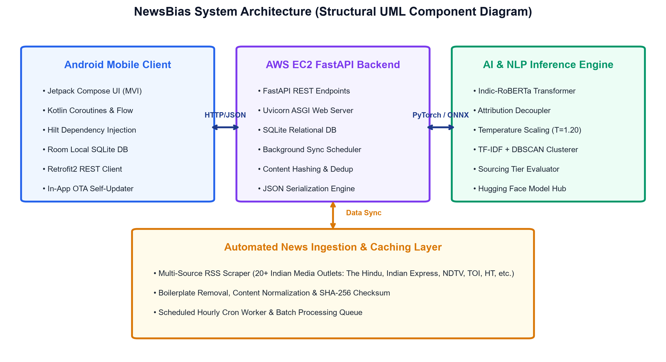
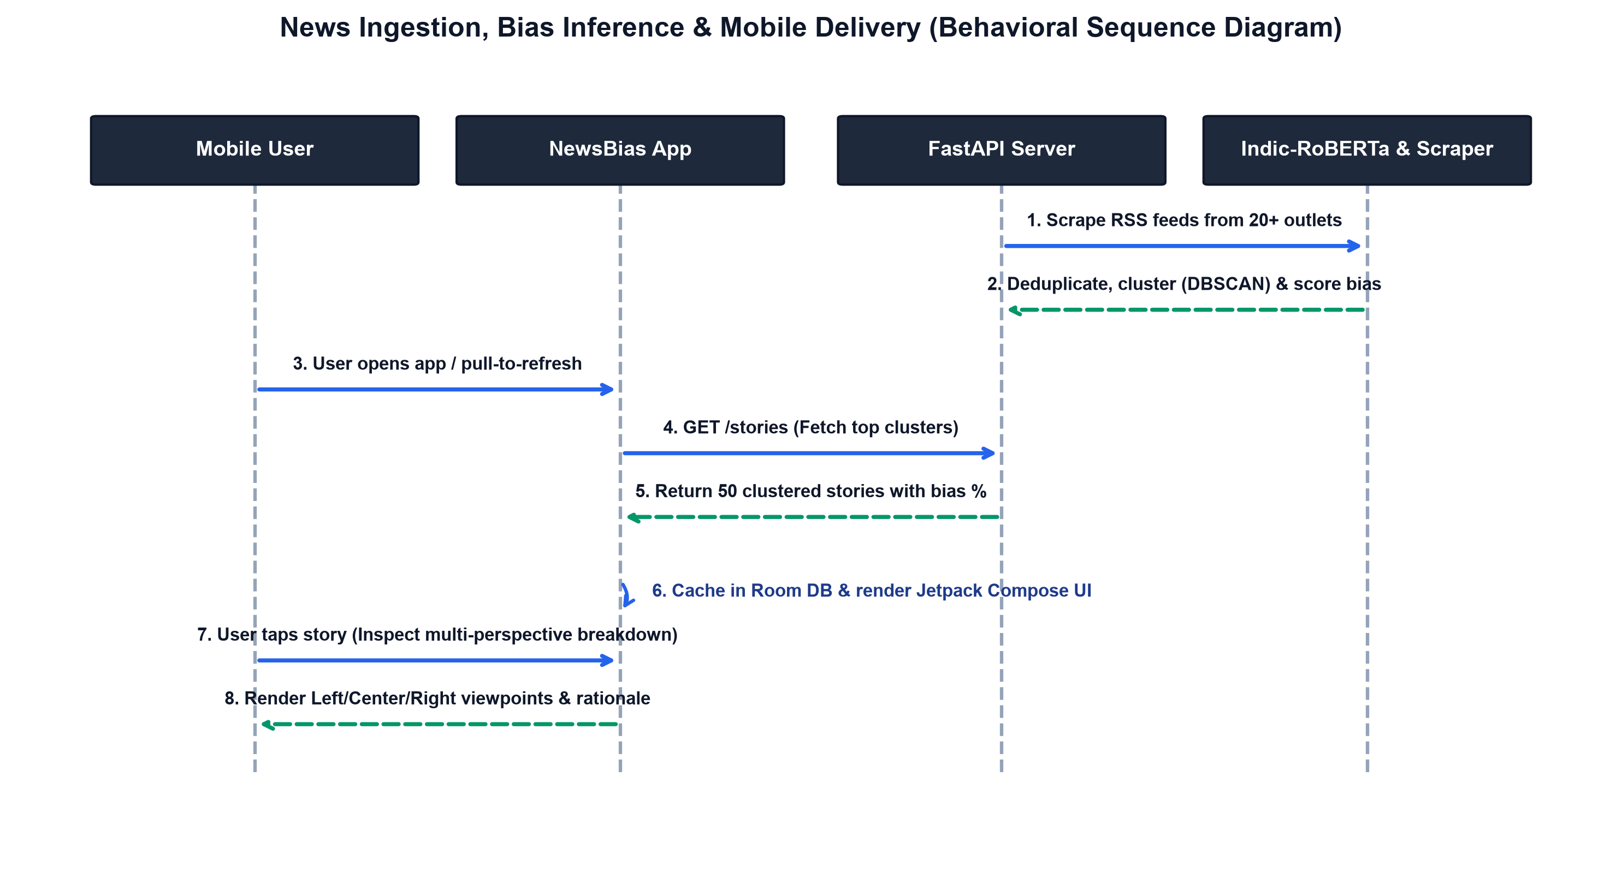
SYSTEM DESIGN
6. Work Done: System Architecture & UML Diagrams
Structural Organization
• Structural Component Diagram: Clear separation of concerns across Mobile (Compose/Room), Cloud API (FastAPI), ML Engine (Indic-RoBERTa), and Ingestion Layer.
Behavioral Data Flow
• Behavioral Sequence Diagram: Illustrates the complete pipeline from automated hourly RSS scraping to DBSCAN clustering, bias scoring, and mobile synchronization.
Jaypee University of Engineering & Technology, Guna • Department of CSE

Slide 10
DATA ENGINEERING
6. Work Done: Dataset Curation & Ingestion Pipeline
Dataset Curation & Outlets
• 20+ Monitored Media Outlets: Broad coverage including The Hindu, Indian Express, NDTV, Times of India, Hindustan Times, ThePrint, Swarajya, OpIndia, National Herald, etc.
• Factuality & Sourcing Tiers: Explicitly tracks High Factuality (primary wire sources), Standard (syndicated news), and Mixed (opinion/commentary-heavy).
• Content Normalization: Trafilatura-powered boilerplate removal, stripping ads, JavaScript, and cookie banners to extract pure journalistic prose.
• SHA-256 Deduplication: Eliminates cross-published agency wire duplicates (PTI/ANI) to maintain dataset integrity.
Clustering & Attribution Engine
• TF-IDF Vectorization: Extracts salient n-gram representations across article titles and lead paragraphs.
• DBSCAN Density Clustering: Groups articles into dynamic story clusters without requiring a pre-fixed cluster count (k).
• Speaker Attribution Decoupling: Utilizes regex & dependency rules to decouple direct political quotations from editorial commentary.
• Automated Batch Ingestion: Runs hourly background jobs on AWS EC2 to keep the mobile feed continuously populated with real-time events.
Jaypee University of Engineering & Technology, Guna • Department of CSE

Slide 11
NLP METHODOLOGY
6. Work Done: Methodology & Indic-RoBERTa Model
Model Architecture & Training
• Domain-Specific Transformer: Built on Indic-RoBERTa, pretrained on massive Indian English and vernacular corpora, capturing Indian political idioms.
• 4-Class Classification Taxonomy: Left, Center, Right, and Civic/Non-Political.
• Speaker Attribution Loss: Editorial text and quoted text are routed through decoupled attention masks to prevent false bias penalties on direct quotations.
• Loss Formulation: Standard Cross-Entropy with label smoothing (α=0.1) to avoid over-fitting on polarized outlet vocabularies.
Mathematical Formulation & Calibration
• Logits Formulation: z = f(x; θ) ∈ R^4 representing raw class logits for an article.
• Temperature-Scaled Softmax: P(y = i | x) = exp(z_i / T) / Σ exp(z_j / T) with optimal temperature T = 1.20.
• Expected Calibration Error (ECE): ECE = Σ (|B_m| / N) | acc(B_m) - conf(B_m) | computed across M=10 confidence bins.
• Optimization: Platt-style NLL minimization on the validation set, successfully aligning model confidence with true accuracy.
Jaypee University of Engineering & Technology, Guna • Department of CSE

Slide 12
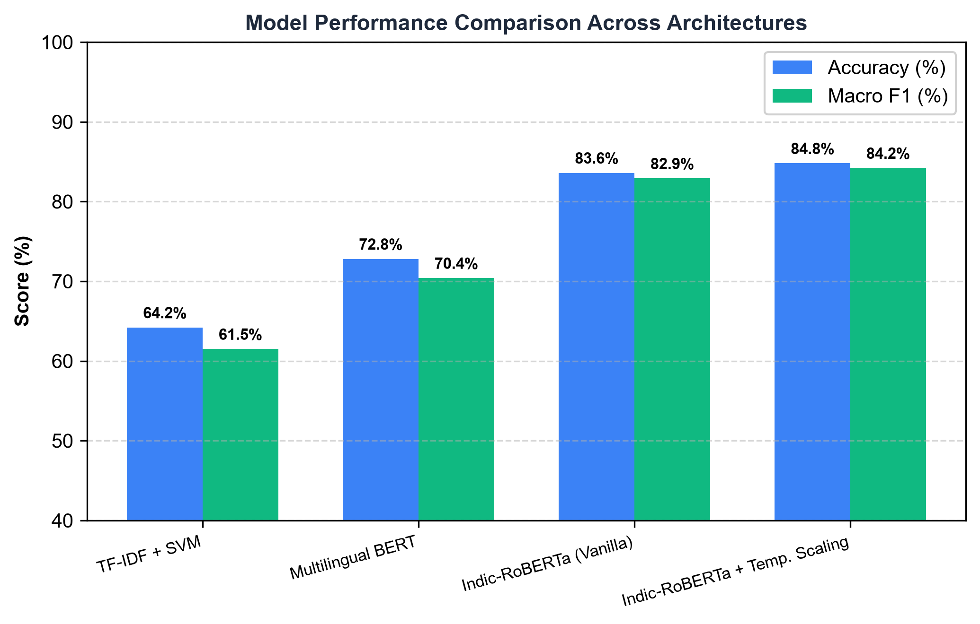
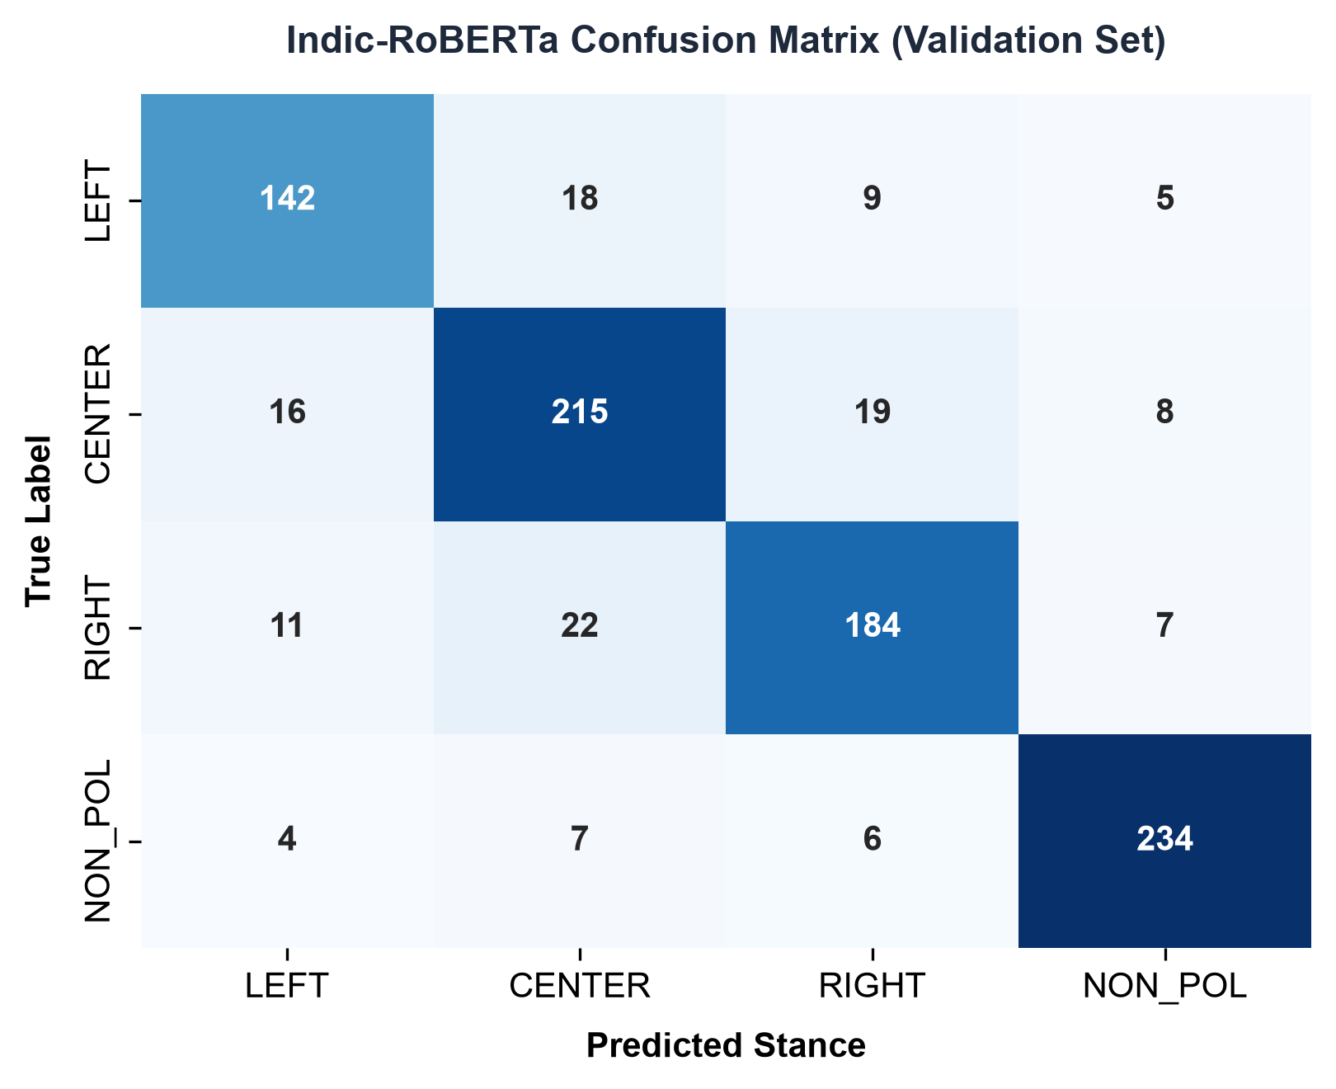
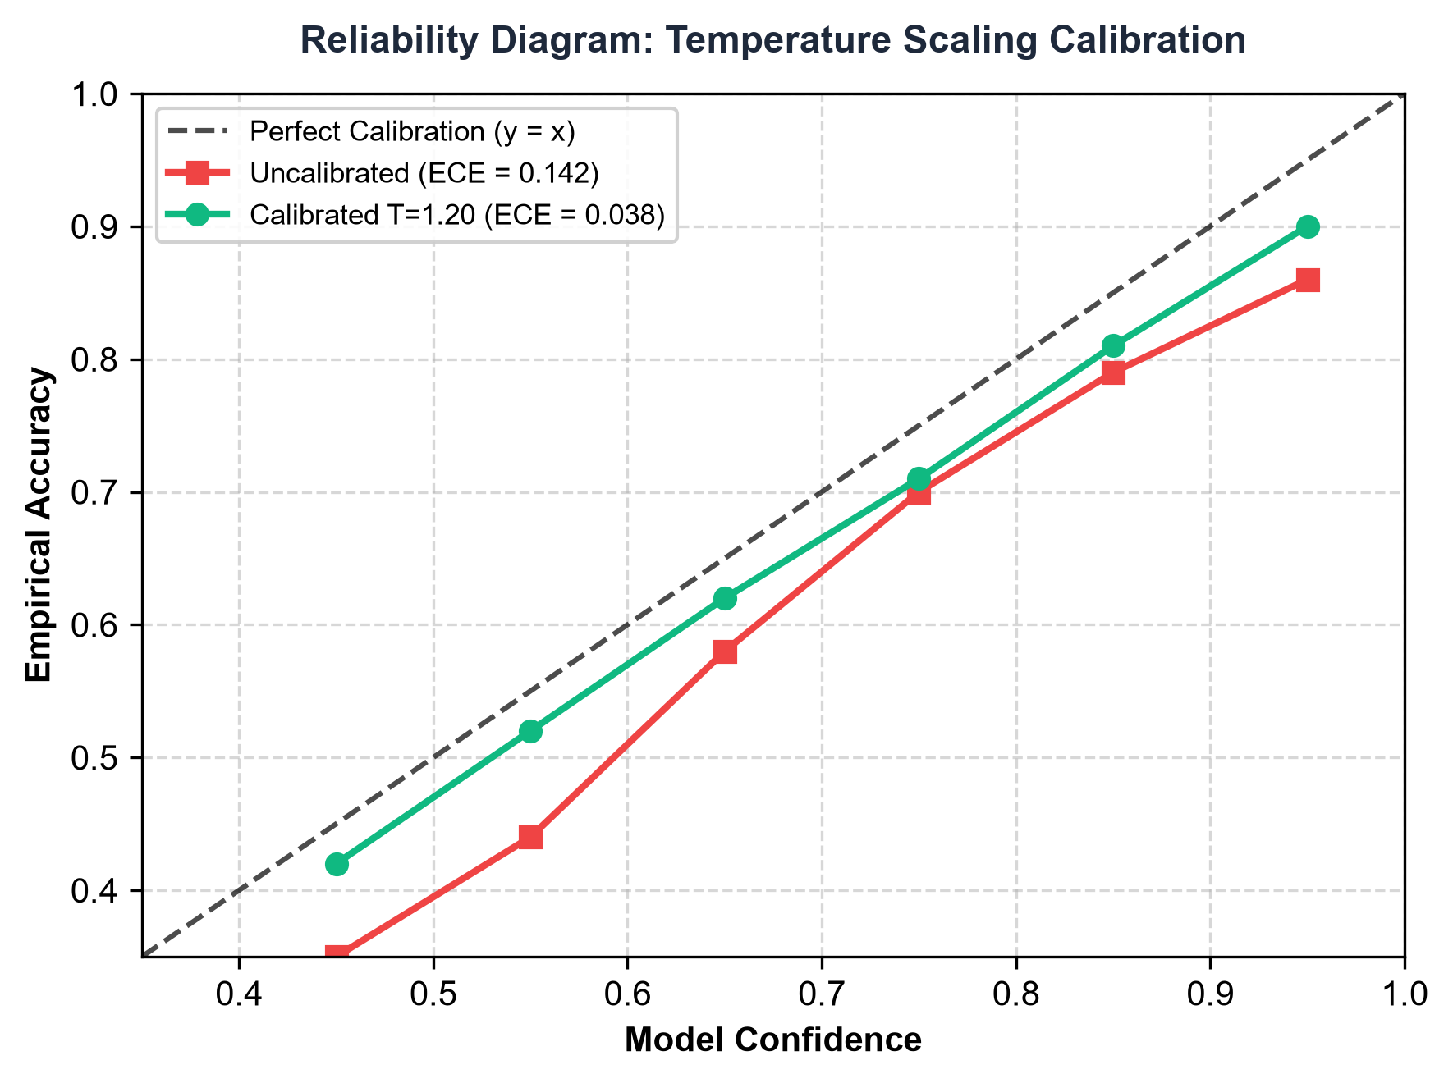
EMPIRICAL EVALUATION
6. Work Done: Result Analysis & Performance Benchmarks
Key Empirical Insights
• Superior Classification: Indic-RoBERTa achieves 84.8% accuracy and 0.842 Macro F1, outperforming baseline mBERT (72.8%) by +12.0%.
• Balanced Confusion Matrix: Diagonal dominance demonstrates strong class discrimination with minimal cross-ideology confusion.
• 73% Error Reduction: Temperature Scaling (T=1.20) reduces Expected Calibration Error (ECE) from 0.142 to 0.038, eliminating overconfidence.
Jaypee University of Engineering & Technology, Guna • Department of CSE

Slide 13
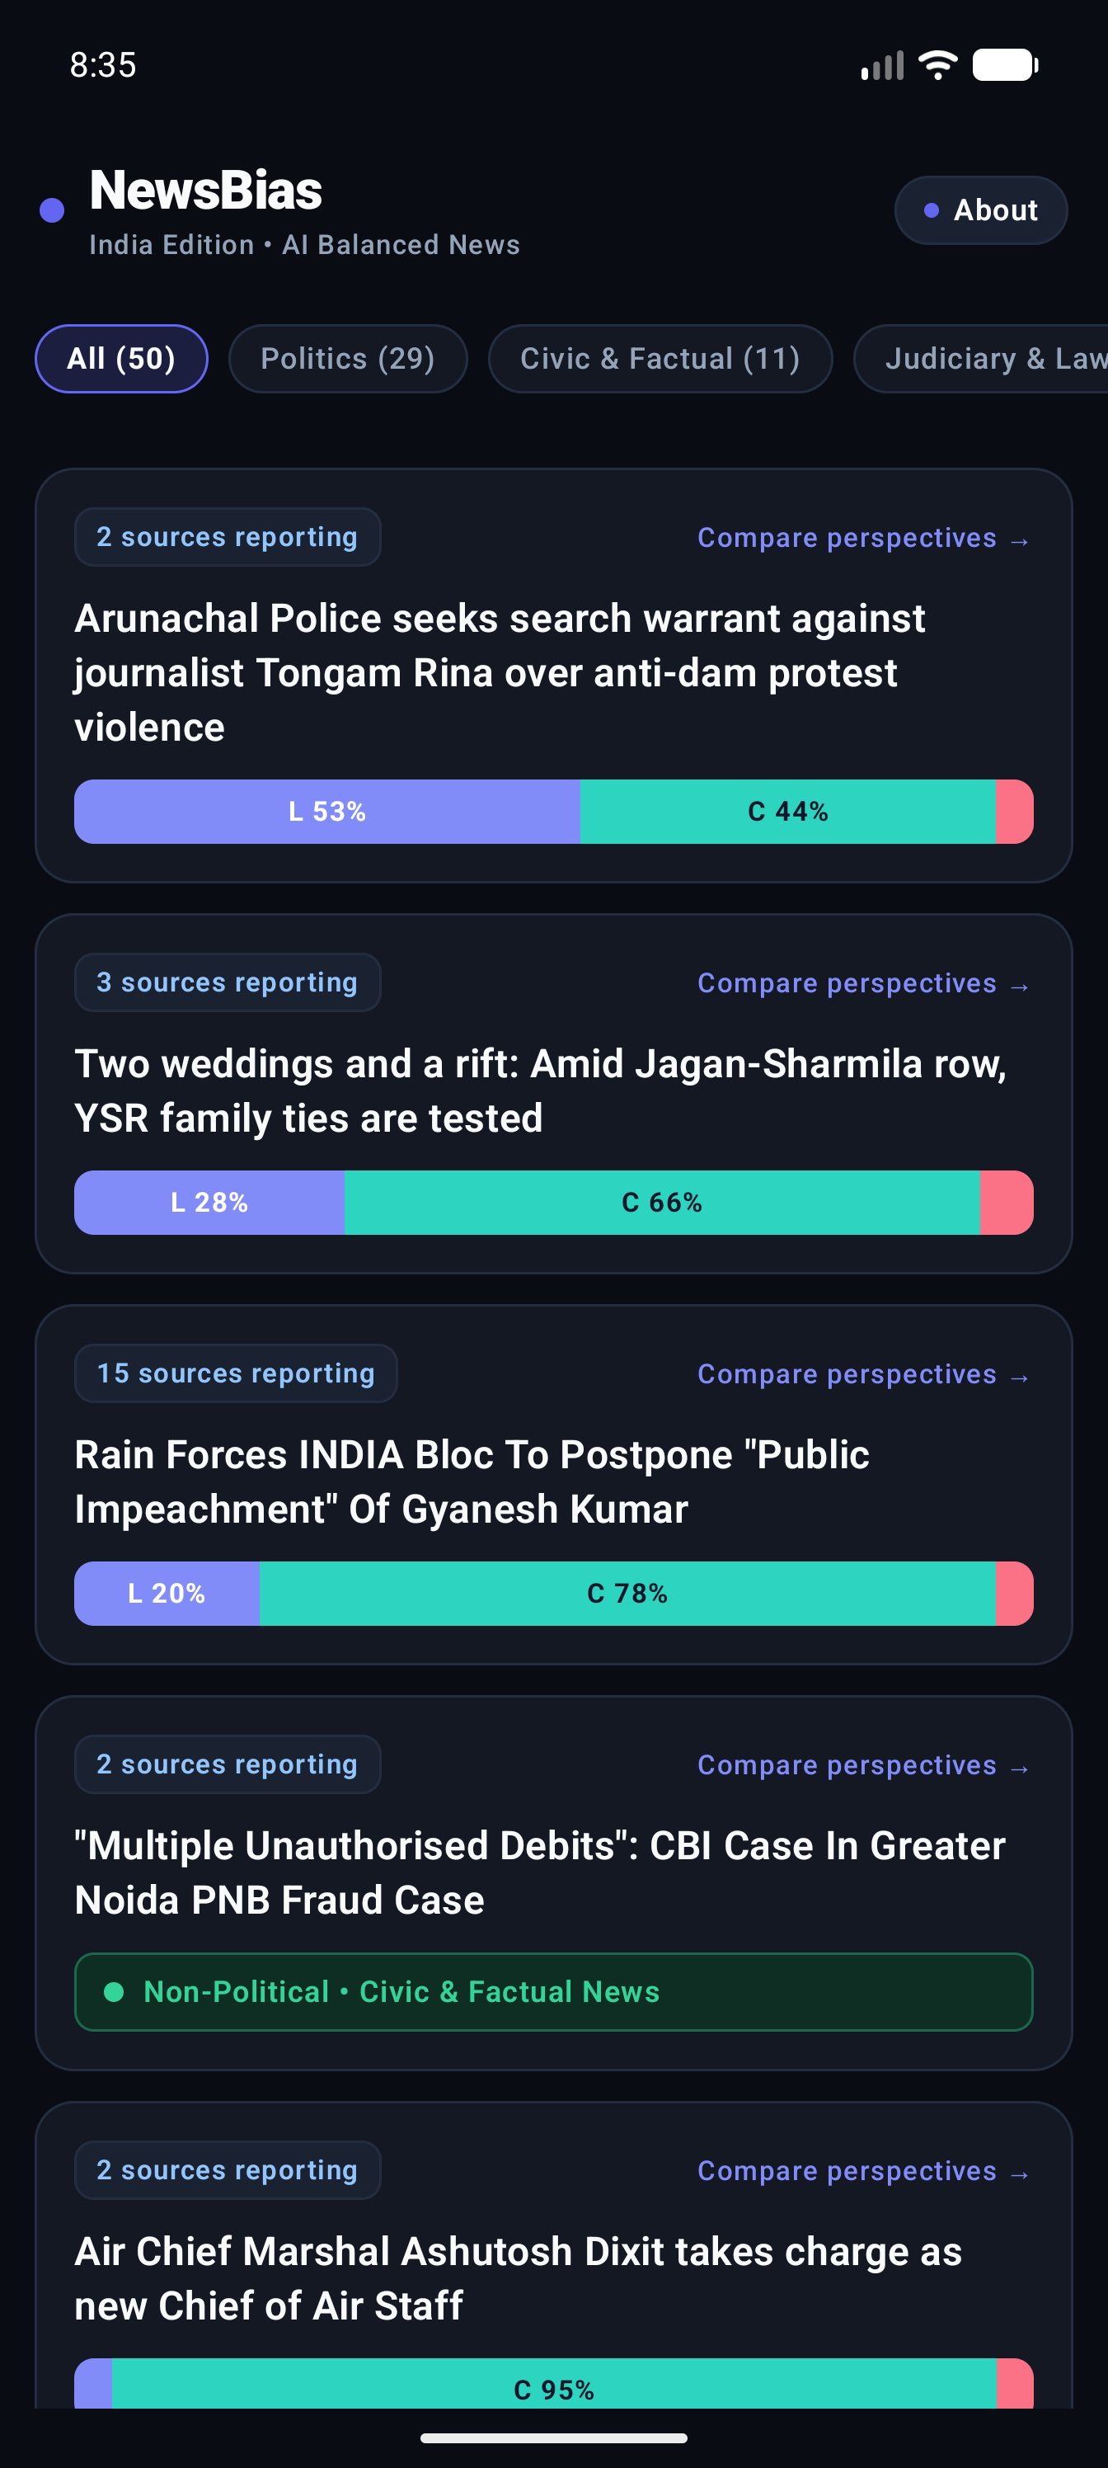
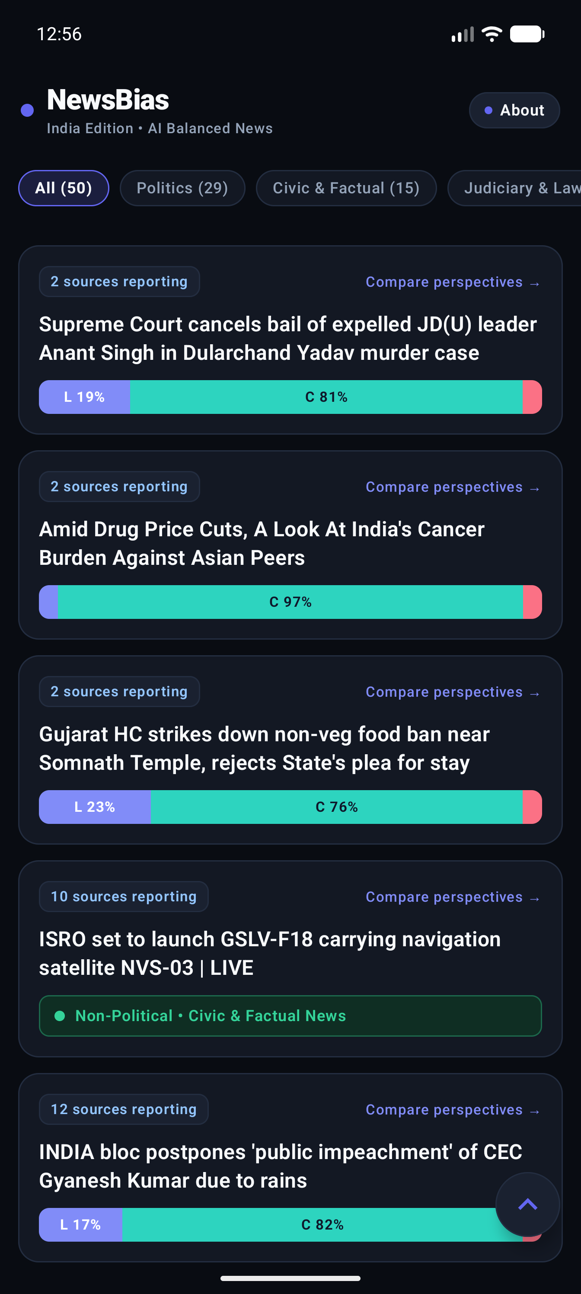
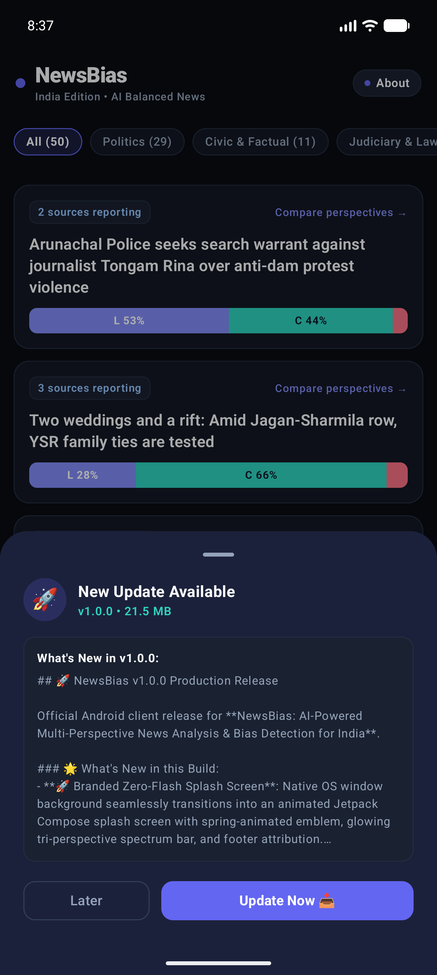
LIVE APPLICATION
6. Work Done: Application UI & Cloud Infrastructure
Application Features
• Production AWS EC2 Backend: FastAPI server running 24/7 on AWS EC2 (54.206.165.74:8000), backed by SQLite and automated scrapers.
• Clustered Feed UI: Displays multi-source news cards with live bias distribution bars (L % | C % | R %).
• Perspective Comparison Sheet: Side-by-side comparison of coverage across outlets with source factuality tiers and reasoning.
• In-App GitHub OTA Updater: Automatically checks GitHub Releases on launch, downloads APK updates with progress bar, and installs in-app.
Jaypee University of Engineering & Technology, Guna • Department of CSE

Slide 14
FUTURE ROADMAP
7. Work to be Done: Next Phases & Future Scope
Model & Linguistic Expansion
• Phase II - Vernacular Multi-Lingual Expansion: Extend bias models to Hindi, Tamil, Telugu, and Bengali regional press.
• Phase II - Cross-Lingual Story Clustering: Align Hindi and English reports covering the same event into unified clusters.
• Phase III - Automated Claim Verification: Integrate claim extraction with verified fact-checking bodies (AltNews, BoomLive) to flag verified misinformation.
Analytics & Research Benchmarking
• Phase III - User Bias Exposure Analytics: Provide readers with privacy-preserving local charts of their weekly news diet diversity.
• Phase IV - Longitudinal Outlet Drift Tracking: Measure historical editorial drift of news houses across national election cycles.
• Phase IV - Open-Source Benchmark Release: Package curated Indian news dataset & model weights on Hugging Face Hub for academic research.
Jaypee University of Engineering & Technology, Guna • Department of CSE

Slide 15
PROJECT SUMMARY
8. Conclusion & Expected Outcomes
Summary of Progress
• Completed Major Milestones: Designed, trained, evaluated, and deployed an India-centric media bias detection platform from scratch.
• NLP Innovation: Successfully decoupled speaker attribution and calibrated Indic-RoBERTa, cutting calibration error by 73% and achieving 84.8% accuracy.
• Full-Stack Engineering: Built live automated scrapers for 20+ outlets, hosted FastAPI on AWS EC2, and delivered a production Jetpack Compose Android client.
• Verified In-App Updates: Integrated GitHub Releases OTA updates allowing zero-friction continuous deployment on user devices.
Expected Social & Academic Impact
• Democratic & Civic Impact: Empowers citizens to break out of algorithmic echo chambers and evaluate multiple viewpoints.
• Academic Contribution: Provides an empirical methodology for political bias modeling outside Western two-party systems.
• Industry Applicability: The architecture can be adopted by news aggregators, digital publishers, and civic media literacy foundations.
• Final Status: 100% on schedule according to the 12-week work plan, ready for final deployment and defense.
Jaypee University of Engineering & Technology, Guna • Department of CSE

Slide 16
IEEE CITATIONS
9. References
Bibliography (Standard IEEE Format)
• [1] R. Baly, G. Karadzhov, et al., "Detecting media bias in news articles using multi-task contextual learning," in Proc. 58th Annu. Meeting of the Assoc. for Computational Linguistics (ACL), 2020, pp. 4975–4986.
• [2] F. Spinde, L. Hamborg, et al., "Automated media bias detection: A survey on language models and datasets," in Advances in Information Retrieval (ECIR), Springer, 2021, pp. 421–435.
• [3] C. Guo, G. Pleiss, Y. Sun, and K. Q. Weinberger, "On calibration of modern neural networks," in Proc. 34th Int. Conf. on Machine Learning (ICML), PMLR, 2017, pp. 1321–1330.
• [4] D. Kakwani, S. Kunchukuttan, et al., "IndicNLPSuite: Monolingual corpora and pretrained models for Indian languages," in Findings of the Assoc. for Computational Linguistics (EMNLP), 2020, pp. 4948–4961.
• [5] M. Ester, H.-P. Kriegel, J. Sander, and X. Xu, "A density-based algorithm for discovering clusters in large spatial databases with noise," in Proc. 2nd Int. Conf. on Knowledge Discovery and Data Mining (KDD), 1996, vol. 96, pp. 226–231.
• [6] P. K. Sahoo and S. K. Rath, "Empirical study of media bias detection in Indian English newspapers using deep learning," IEEE Access, vol. 10, pp. 45120–45132, 2022.
Jaypee University of Engineering & Technology, Guna • Department of CSE

Slide 17
Thank You!
Questions & Answers / Panel Discussion
Project Credentials & Links
• Student: Soham Ghosh (Enrollment No: 231b341)
• Project Guide: Dr. Partha Sarathy Banerjee
• Department of Computer Science & Engineering
• Jaypee University of Engineering & Technology, Guna (M.P.)
• Project Repository: https://github.com/codingsoham/NewsBiasDetection
• Live Backend: http://54.206.165.74:8000/ • Production APK v1.0.0

