Slide 1
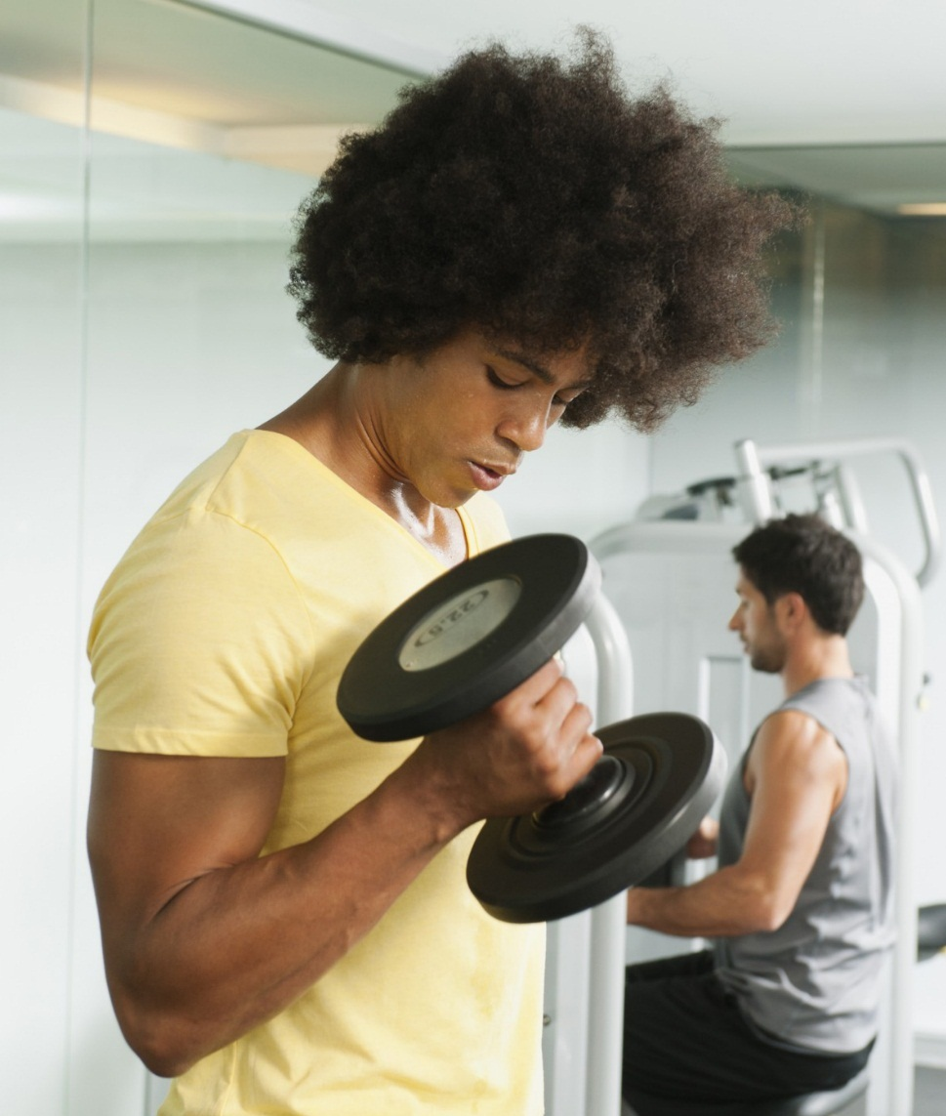
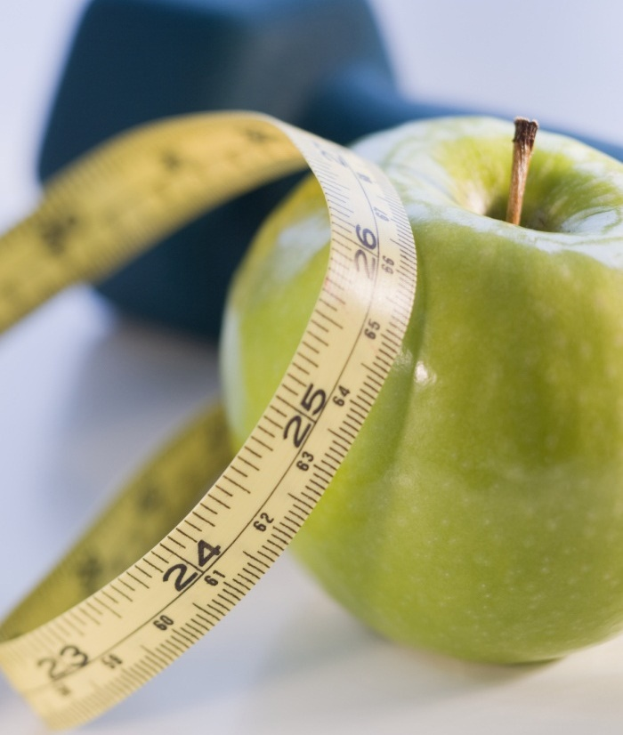
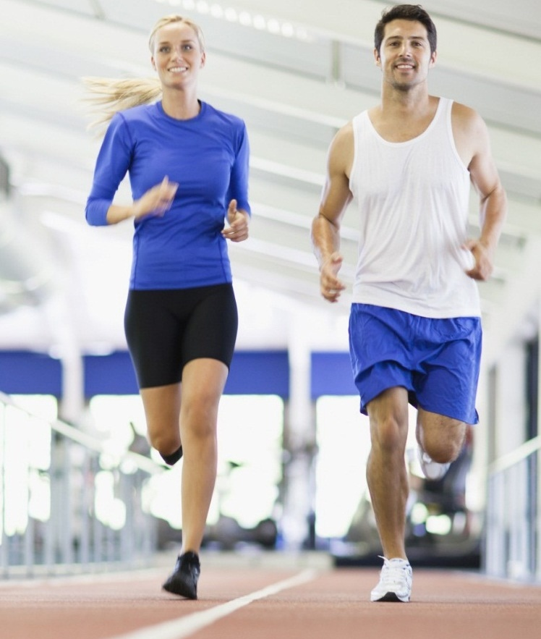
calories burned during fitness
Tung Nguyen
Data 211 – Data science and visualization

Slide 2
Abstract
My goal is to burn 600 calories during my fitness activity daily. I collected the number of calories burned my fitness activity for the past 15 workout days to see if the actual numbers are significantly greater than my goal.

Slide 3
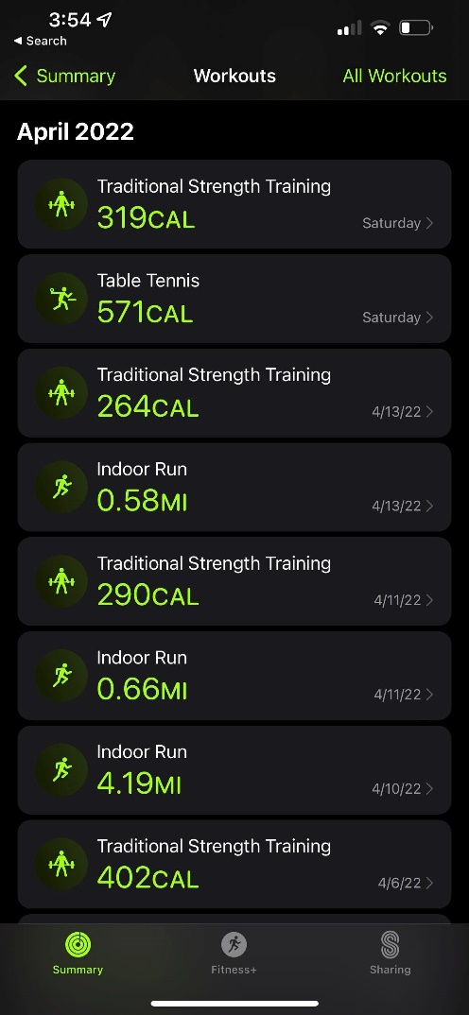
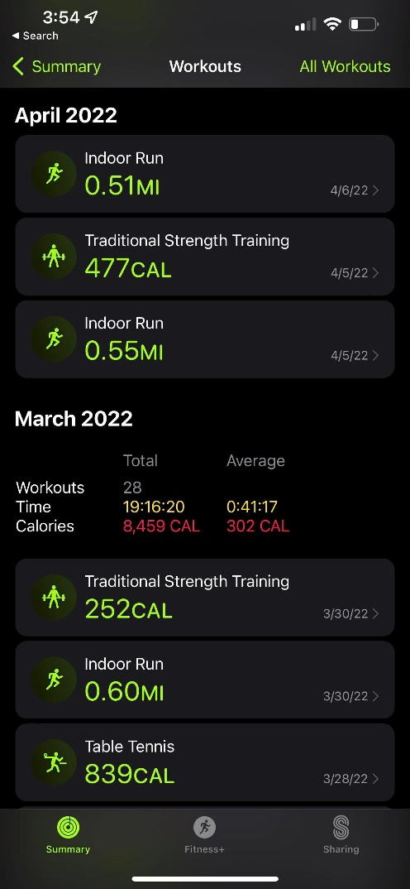
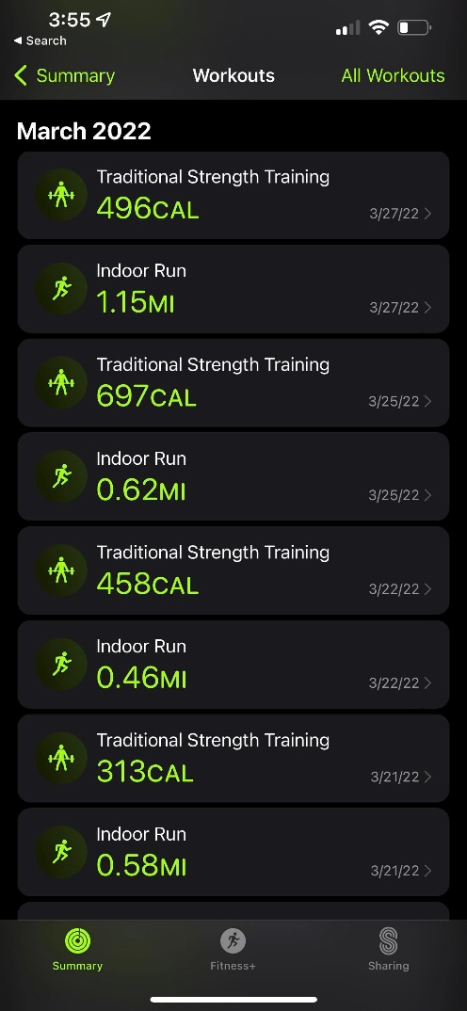
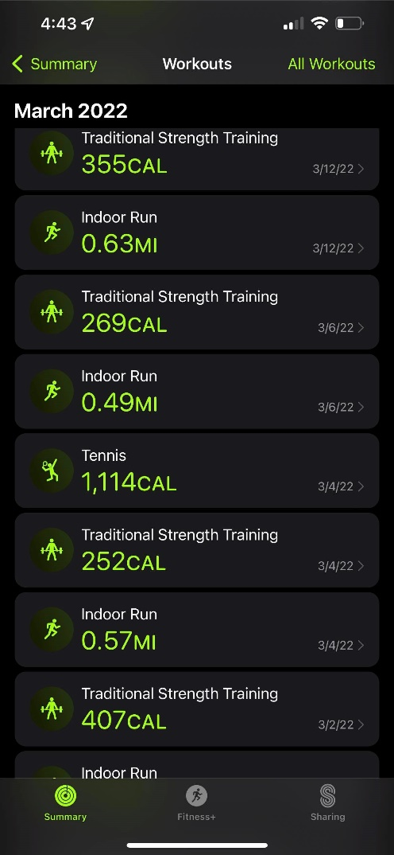
Data

Slide 4
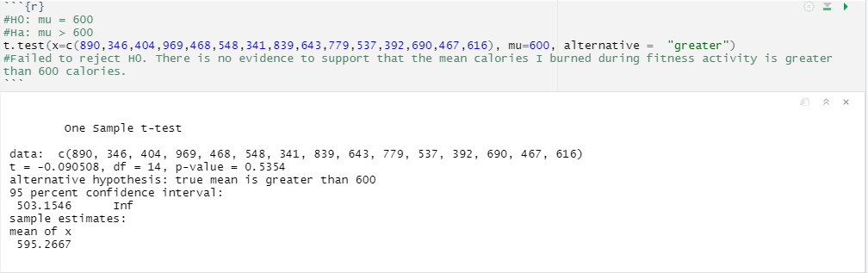
One sample t-test

Slide 5
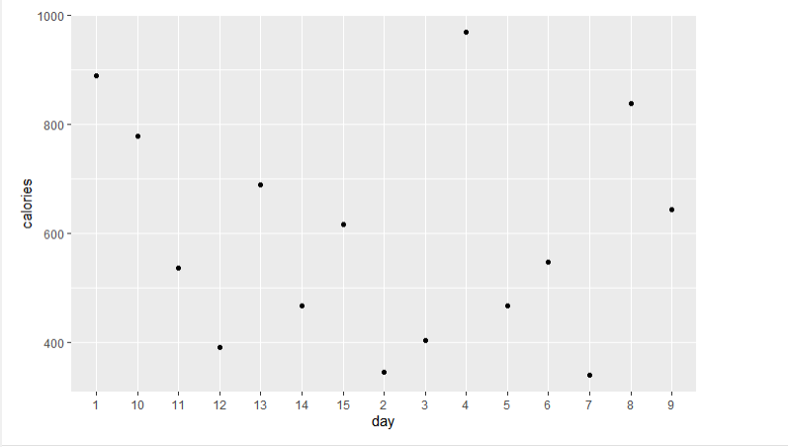
Scatterplots chart

