Slide 1
Myword

Slide 2





ARCHITECTURE
AI

Slide 3
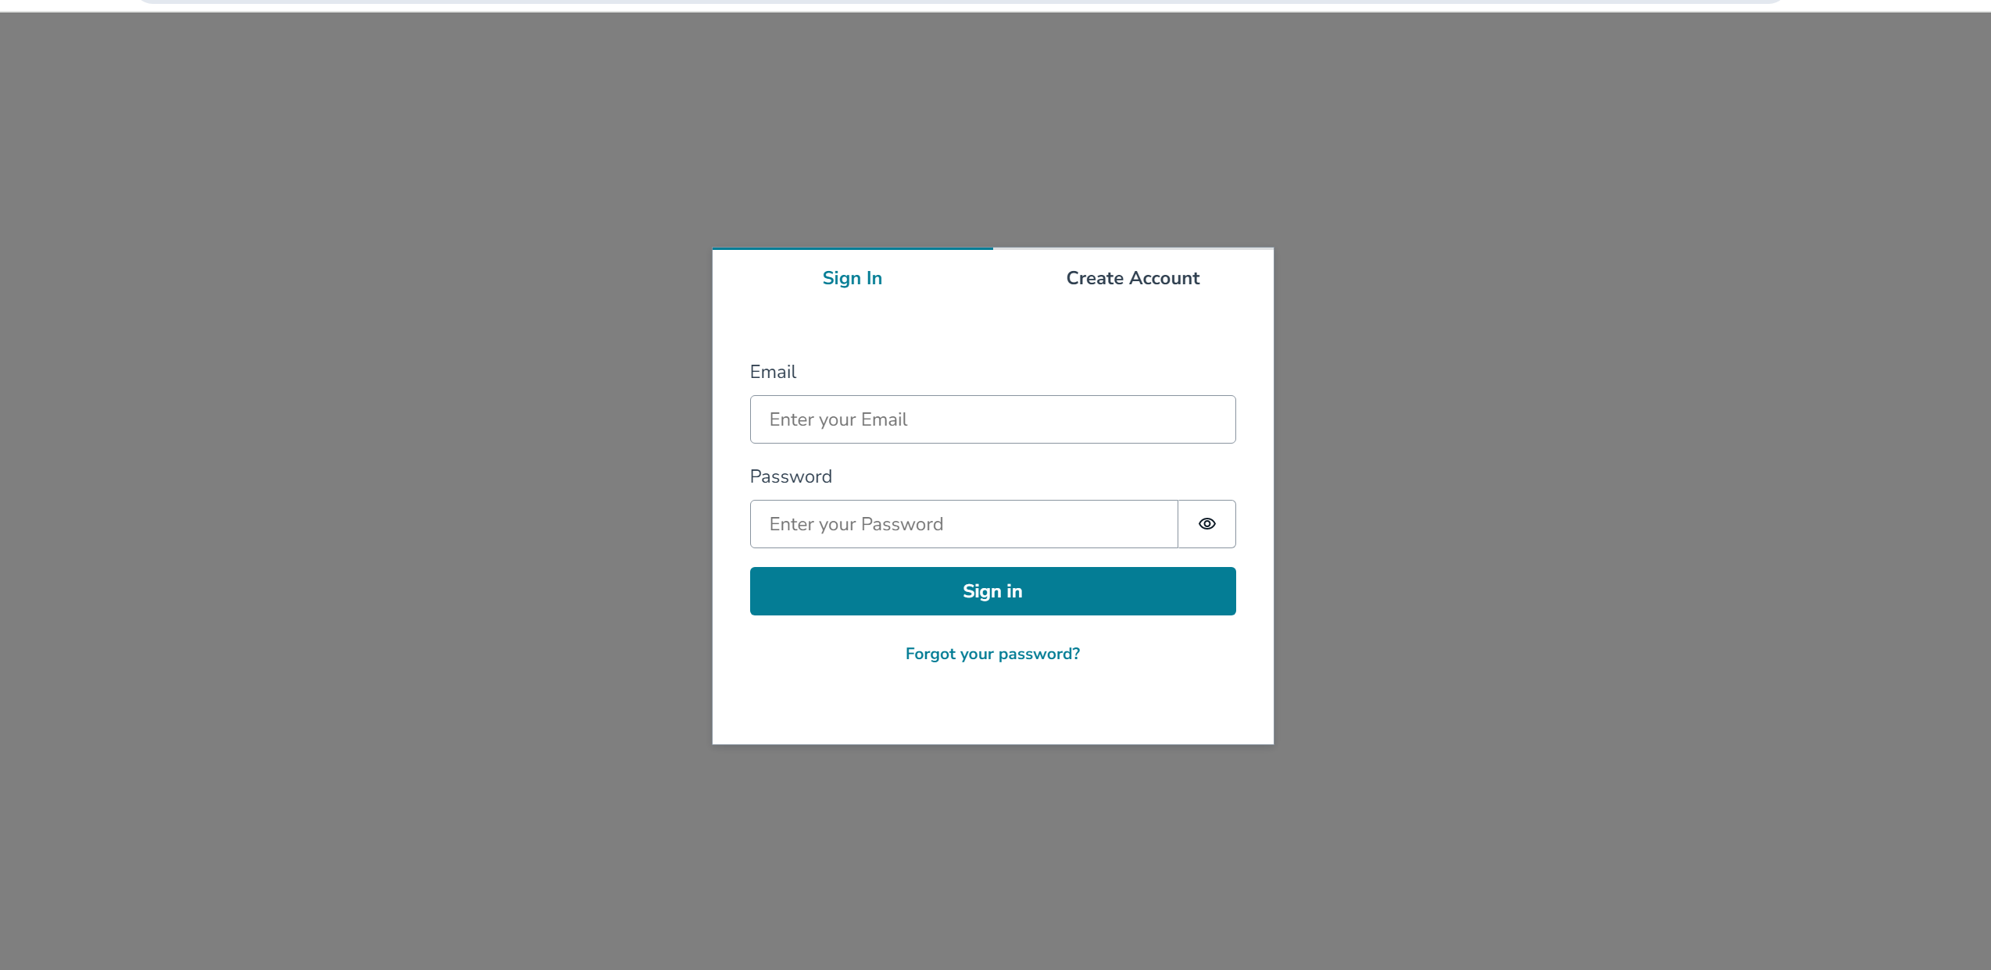
Login page

Slide 4
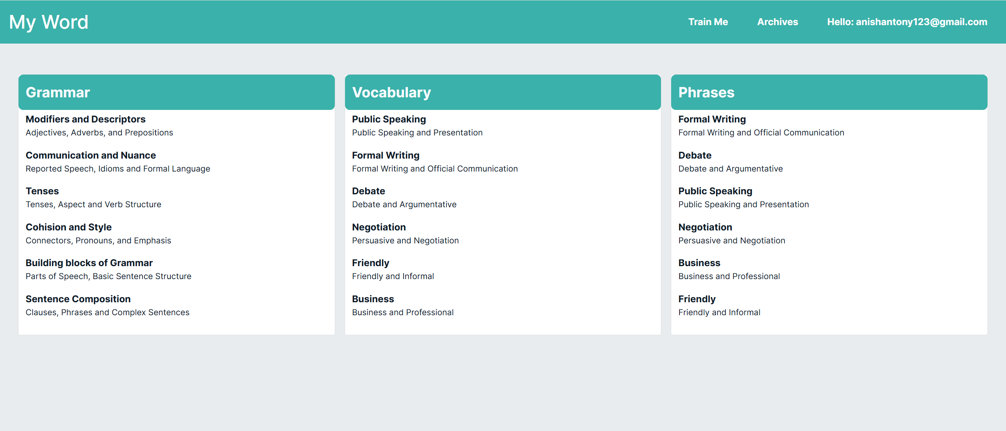
home page

Slide 5
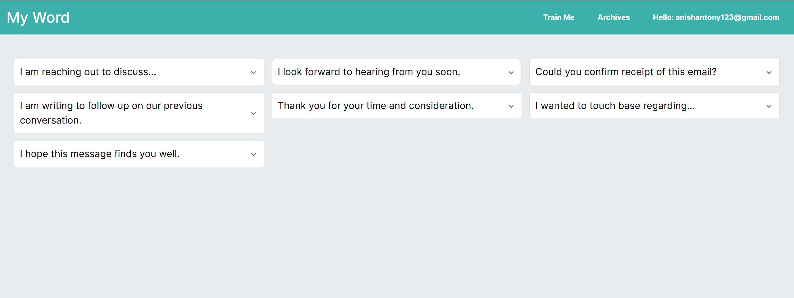
Phrases page

Slide 6
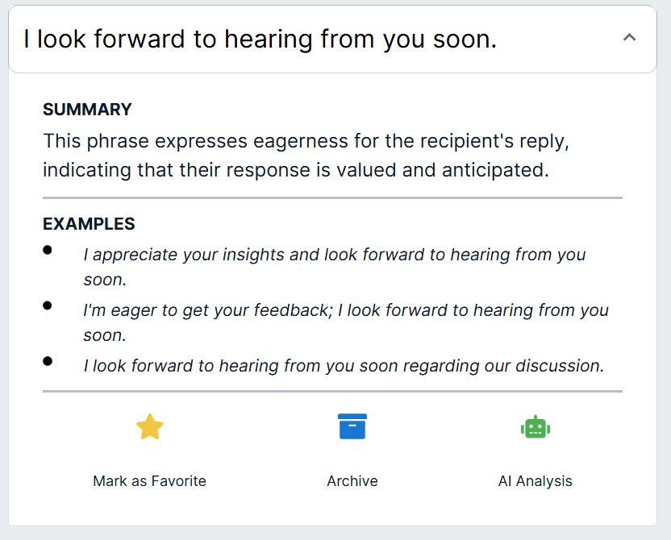
the card

