Slide 1
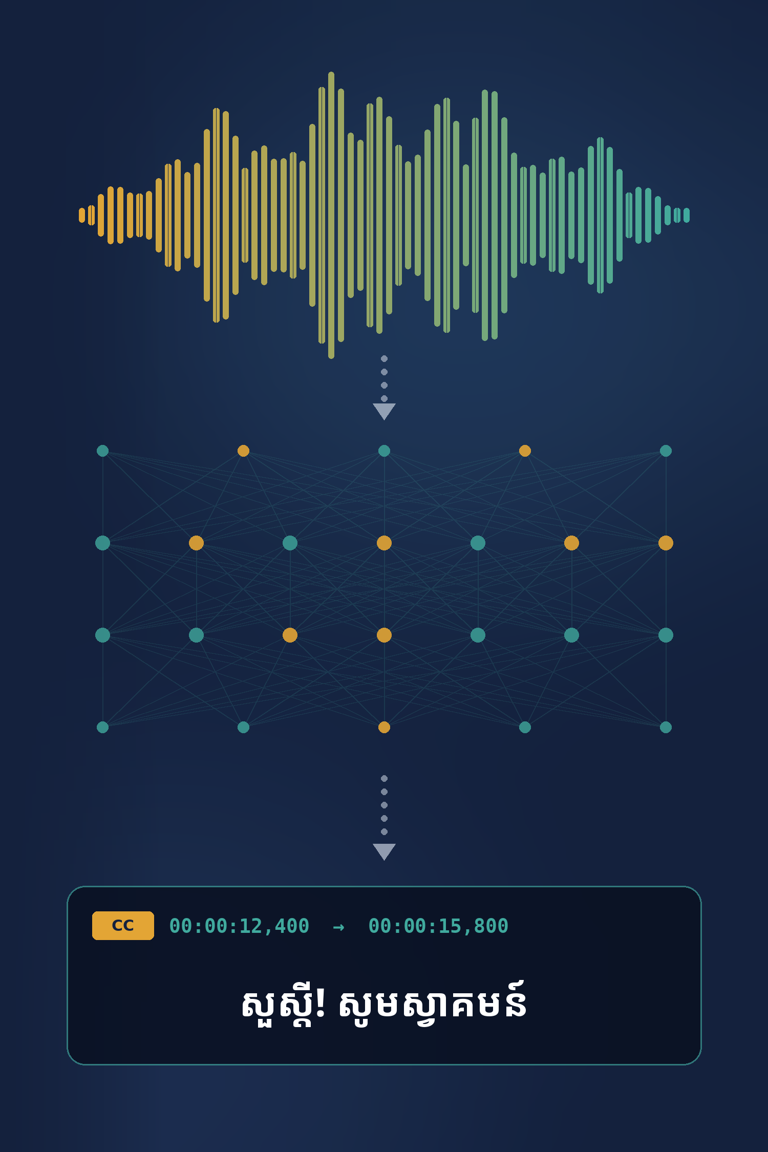

Royal University of Phnom Penh
Master of Science in Data Science and Engineering
Final project presentation
Khmer Speech-to-Subtitles
Fine-tuning Whisper-small to generate timestamped Khmer subtitles for YouTube videos
Subject
Introduction to Large Language Models
Lecturer
Dr. Chen Sovann
Presenters
Sem Chitra, Sar Sakal, Earn Pisey, Sam Reaksmey
Class
MDSE Cohort 3, October 2026
Code
github.com/codingwithchitra777/whisper-small-khmer-mini
Notes:
We built a web app that takes a YouTube link and returns Khmer subtitles with timings, powered by a Whisper-small model we fine-tuned on about 16 hours of Khmer speech.

Slide 2
Table of contents
Problem
Data
Model
1
Problem and motivation
4
Dataset
6
Model and Transformer layers
2
Existing solutions
5
Data preparation and splits
7
Fine-tuning method
3
Proposed solution
8
Training configuration
Experiments
Results
Application
9
Experimental design
11
Main results
15
System architecture
10
Evaluation metrics
12
Validation and best checkpoint
16
Web application
13
Error analysis
17
Conclusion and future work
14
Key insights
Notes:
Our talk follows six steps: the problem, the data, the model, the experiments, the results, and the working application.

Slide 3
Most Khmer videos have no subtitles
01
1. Problem and motivation
Problem statement
“
Khmer video has almost no subtitles, and there is no free tool that creates accurate, timed Khmer subtitles.
Research question
Why it matters
Can we train Whisper-small to make useful Khmer subtitles, even for speakers it has never heard before?
~17M
Hours
147.6%
people speak Khmer; more of their news and lessons is online video
of manual work to subtitle one hour of video: listen, type, align
error of Whisper as is on Khmer speakers it has never heard
Who is affected: creators, deaf and hard-of-hearing viewers, teachers, students, Khmer learners
Our goal: automatically generate timestamped Khmer subtitles from a YouTube URL
Problem › Data › Model › Experiments › Results › Application
Next: what exists today, and what is missing →
Notes:
Khmer is spoken by about 17 million people. Most Cambodian video on YouTube and Facebook is published without subtitles, because writing them by hand takes hours per hour of video. And off-the-shelf AI does not solve it: Whisper used as is makes more errors than there are characters on Khmer speakers it has never heard. That shuts out deaf and hard-of-hearing viewers and learners, and makes video content unsearchable.

Slide 4
What exists today, and what is missing
02
2. Existing solutions
Option | What it offers | What is missing for Khmer subtitles
Manual transcription | High accuracy | Slow and expensive: hours of work per hour of video
Commercial speech APIs (e.g. Google Cloud) | Khmer listed as supported | Paid per minute, generic model, no subtitle workflow
Whisper as is (zero-shot) | Free, open source | 147.6% character error on unseen speakers (our baseline)
Automatic tools built for English either do not support Khmer or are too inaccurate to publish.
The gap: a free tool that goes from a video link to timed subtitles, with a model trained for Khmer.
Problem › Data › Model › Experiments › Results › Application
Next: our solution, from URL to subtitles →
Notes:
Manual work is accurate but slow; cloud APIs cost money and give no subtitle workflow; Whisper used as is cannot really transcribe Khmer, as our baseline numbers show later. The gap we fill: a free end-to-end subtitle tool with a Khmer-trained model.

Slide 5









From a YouTube URL to Khmer subtitles
03
3. Proposed solution
Step 1
Step 2
Step 3
Step 4
Step 5
Step 6
YouTube URL
Extract audio
Clean & chunk audio
Whisper-small
Khmer subtitles
SRT / TXT export
Technology stack
Frontend: Next.js
Backend: FastAPI
Audio: yt-dlp + FFmpeg
ASR model: Whisper-small
Problem › Data › Model › Experiments › Results › Application
Next: the Khmer speech data behind the model →
Notes:
Our solution in six steps: paste a YouTube URL, extract the audio, clean and cut it into chunks, transcribe with our fine-tuned Whisper-small, show the subtitles, and export SRT or TXT.

Slide 6
Five Khmer speech sources, 17.85 hours assembled
04
4. Dataset
Source
Clips
Hours
Total assembled
km-speech-corpus
14,943
10.41 h
17.85 h
Read sentences, many speakers CC-BY-4.0
OpenSLR 42
2,906
3.97 h
23,087 clips
Read news, one male speaker CC-BY-SA-4.0
khmer_kheng_info_speech
3,097
1.46 h
Actually used for training
Single dictionary words Research only
15.99 h
khmer_mpwt_speech
2,058
1.90 h
Traffic-rule questions Research only
20,758 clips (train split)
RFI Khmer
The rest becomes the validation and test splits (section 5).
83
0.11 h
Radio news we transcribed Own collection
Two sources are research-use only, so the dataset stays private. Names link to each source (see References).
Problem › Data › Model › Experiments › Results › Application
Next: how we clean and split this data →
Notes:
No single public Khmer dataset is big and varied enough, so we combined five. Most audio comes from km-speech-corpus. OpenSLR 42 is one male speaker reading news, kheng.info is single words, MPWT is traffic-rule questions, and RFI is 83 clips we cut and transcribed ourselves. 17.85 hours were assembled; 15.99 hours form the training split.

Slide 7
Clean the data, then split it without leakage
05
5. Data preparation and splits
1
Combine
2
Clean audio
3
Clean text
4
Split fairly
Extra test: new voices
Gather all the speech
Same format for every clip
Same writing style in every label
No sentence leaks into the test
Digital Divide Data
5 sources
23,087 clips, 17.85 h
16 kHz, mono (what Whisper expects)
Keep clips of 0.3–30 s
Remove invisible characters
One spacing style
Max 448 tokens (model limit)
Each sentence goes to only one split
DDD_TEST
2,034 clips 4.66 h
TRAIN
VALIDATION
TEST
2 speakers and sentences the model has never heard.
20,758 clips 15.99 h
1,150 clips 0.93 h
1,179 clips 0.92 h
→ teaches the model
→ picks the best checkpoint
→ final in-domain score
Never used for training. It shows how the model does on new voices.
Why split by sentence? Many speakers read the same sentence. A random split could put that sentence in both training and test, and the scores would look better than they really are.
Problem › Data › Model › Experiments › Results › Application
Next: the model we train on these splits →
Notes:
All done by src/build_dataset.py. The key step is the leak-free split: several sources have many speakers reading the same sentence, so a random split would put test sentences into training and inflate the scores. We assign each sentence to a split by hashing its text. ddd_test comes from a different dataset (Digital Divide Data Khmer ASR, CC-BY-SA-4.0) with two unseen speakers; any training sentence that also appears in it is removed.

Slide 8

Whisper-small Transformer Architecture
06
6. Model architecture
A Transformer encoder-decoder, pre-trained on 680,000 h of audio (very little Khmer).
Model parameters: ~241M
WHISPER-SMALL Transformer encoder-decoder
80-band Log-Mel Spectrogram
Transformer
encoder
Transformer
decoder
Khmer text + timestamp tokens
Hidden states
Khmer audio
12 layers
12 layers
16 kHz mono, up to 30 s
Processes audio features and context
cross-attention
Attends to the encoder and generates tokens
80 × 3,000 features over time
Transformer: a neural network architecture that uses attention to model relationships in the input.
Encoder
Hidden states
Decoder
→ Understands the audio representation and context
→ Internal numerical representation of the audio
→ Generates the Khmer transcription token by token
Source: openai/whisper-small (Radford et al., 2023)
Problem › Data › Model › Experiments › Results › Application
Next: inside each Transformer layer →
Notes:
The encoder reads an 80-channel log-Mel spectrogram of up to 30 seconds of audio; the decoder writes the transcript token by token while attending to the encoder. 240,582,912 trainable parameters, counted by our training script. Whisper was pre-trained on 680,000 hours of audio, but only a tiny fraction was Khmer, so out of the box it cannot transcribe Khmer. We chose the small size because it fine-tunes in under an hour on one GPU and runs fast enough for a demo.

Slide 9
Inside each Transformer layer
06
6. Model architecture
Log-Mel 80 × 3,000 → conv stem (2 × Conv1D, GELU) + sinusoidal positions
Previous tokens → token embeddings + learned positions
Whisper-small in numbers
Hidden size (d_model)
768
Encoder layer × 12
Decoder layer × 12
Attention heads
12 × 64 dims
Multi-head self-attention
Masked self-attention
Feed-forward size
3,072
All frames attend to all frames, 12 heads
Each token sees only earlier tokens
Layers
12 enc. + 12 dec.
Encoder frames (30 s)
1,500
Feed-forward network
Cross-attention
768 → 3,072 → 768, GELU
Q from the text; K and V from the encoder
Max output length
448 tokens
Vocabulary
51,865 tokens
Feed-forward network
Encoder output: 1,500 frames × 768
768 → 3,072 → 768, GELU
Scaled dot-product attention
softmax(QK^{T} / √d_{k}) V
Linear + softmax → next token (51,865-token vocabulary)
Each head compares queries with keys to decide where to look; dₖ = 768 / 12 = 64.
Every layer: LayerNorm → block → residual add (pre-norm).
Problem › Data › Model › Experiments › Results › Application
Next: how we adapt Whisper-small to Khmer →
Notes:
Inside each layer. The encoder has 12 identical layers: multi-head self-attention, where every audio frame can look at every other frame, followed by a feed-forward network; each block has a LayerNorm in front and a residual connection around it. The decoder also has 12 layers, with three blocks: masked self-attention over the tokens written so far, cross-attention that reads the encoder output, and a feed-forward network. A final linear layer and softmax pick the next token from a 51,865-token vocabulary. Note the 448-token output limit: Khmer uses so many tokens that this is why our web app cuts audio into chunks of 10 seconds or less.

Slide 10
Fine-tuning Whisper-small for Khmer
07
7. Fine-tuning method
We fully fine-tuned Whisper-small for Khmer while preserving timestamp generation.
1
Full fine-tuning
2
Khmer transcription
3
Timestamp-aware training
All ~241M parameters are updated.
No frozen layers, no LoRA.
Language = Khmer
Task = Transcribe
Set in the generation config
50% of training clips contain timestamp-aware labels.
Normal target
Khmer transcription
Timestamp-aware labels help the model preserve subtitle timing capability.
Timestamp-aware target
<|0.00|> Khmer transcription <|3.20|>
Training loop
Audio + transcript
Whisper-small
Prediction
Loss
Backpropagation
Gradients
AdamW update
Problem › Data › Model › Experiments › Results › Application
Next: the training hyperparameters →
Notes:
We fine-tune all 241 million parameters with Hugging Face's Seq2SeqTrainer. Plain fine-tuning makes Whisper forget timestamps, which a subtitle tool needs, so half of the labels keep start and end time tokens. Language and task are fixed to Khmer transcription so the model never translates.

Slide 11
Training hyperparameters: 5 epochs, 44 minutes
08
8. Training configuration
GPU (24 GB) on RunPod, $0.74/h
Epochs
Optimizer
Learning rate
RTX 4090
5
AdamW
1 × 10⁻⁵
Warm-up
Effective batch size
Optimizer steps
Training time (main model)
200 optimizer steps
32
3,245
44m 24s
Effective batch size
Learning-rate schedule
16
×
2
=
32
1×10⁻⁵
then Linear decay
1×10⁻⁵ → lower learning rate
Batch
Gradient accumulation
Effective batch
Warm-up
0 → 1×10⁻⁵
first 200 steps
bf16 → reduce memory / improve efficiency
Gradient checkpointing → save GPU memory
Optimizer steps →
Problem › Data › Model › Experiments › Results › Application
Next: the three models we compare →
Notes:
All settings are saved by the training script in run_config_main.json. A small learning rate keeps what Whisper already knows. bf16, gradient checkpointing and 16 x 2 gradient accumulation let it fit on one 24 GB GPU; training is also resumable across Kaggle's 12-hour sessions. The main model trained in 44 minutes; the ablation in 7.5 minutes.

Slide 12
Three models, each answering one question
09
9. Experimental design
BASELINE
ABLATION
MAIN MODEL
Original Whisper-small
No Khmer fine-tuning
Zero-shot
Whisper-small
Fine-tuned only on OpenSLR 42
One speaker, 3.6 h
Whisper-small
Fine-tuned on all five datasets
Many speakers, 16 h
Question
Question
Question
How good is Whisper before Khmer training?
Does limited Khmer fine-tuning help?
How well does the full approach generalize?
All three models use the same greedy decoding.
Caveat: Ablation used only 410 optimizer steps (7.5 min) compared with 3,245 (44 min) for the main model, so the difference cannot be attributed only to dataset diversity.
Problem › Data › Model › Experiments › Results › Application
Next: how we score each model →
Notes:
Three models, each answering one question. The ablation uses the exact same recipe on OpenSLR 42 alone, one male speaker. Be honest about the caveat: with less data the ablation also got fewer training steps.

Slide 13
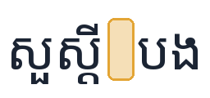
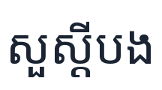
CER without spaces is our primary metric
10
10. Evaluation metrics
CER =
S + I + D
S substitutions: a wrong character
I insertions: an extra character
↓ Lower is better
N
D deletions: a missing character
N number of characters in the reference
Source: Hugging Face Audio Course, “Evaluation metrics for ASR”. WER uses the same formula with words instead of characters.
WER
CER
CER without spaces
Word Error Rate
Character Error Rate
PRIMARY METRIC
Unreliable for Khmer: spacing is inconsistent, so one “word” is often a phrase.
Counts character-level transcription errors.
Remove all spaces from both sides, then compute CER. Used only for scoring.
Example: CER
Why remove spaces? Scoring only; subtitles keep spaces
Reference
K
H
M
E
R
S = 1 (E→A), D = 1 (H), I = 1 (S), N = 5
Reference
CER = 1/9 = 11.1%
No spaces: 0%
Prediction
K
–
M
A
R
S
CER = (1 + 1 + 1) / 5 = 60%
Prediction
Problem › Data › Model › Experiments › Results › Application
Next: the results on unseen speakers →
Notes:
We report three metrics. WER is standard but misleading for Khmer because there are no consistent spaces between words. CER counts character mistakes. Our main metric removes all spaces first, so it measures whether the right sounds were written down. Error rates over 100% happen when a model rambles or repeats itself. Example: reference KHMER, prediction KMARS has one substitution, one deletion and one insertion, so CER is 3 out of 5, 60%. On the right, the only difference is a missing space: plain CER calls it an error (11.1%), CER without spaces correctly gives 0%. Both values were checked with jiwer, the library behind our metric code. Important: spaces are removed only when computing this score. The subtitles shown to users keep normal Khmer spacing, which the model learned from the training labels.

Slide 14
Fine-tuning reduced error on unseen speakers
from 147.6% to 18.9%
11
11. Main results
~87%
relative error reduction
Main model vs zero-shot baseline
In-domain test set, CER without spaces
Main model 24.9%
Baseline 383.1%, Ablation 59.1%
vs the ablation: 58% less error on test, 52% less on unseen speakers.
The results suggest that broader Khmer training improves generalization, although the ablation model also received fewer training steps.
Error rates can exceed 100% when the model produces many extra characters.
Problem › Data › Model › Experiments › Results › Application
Next: how we chose the best checkpoint →
Notes:
This is the headline. On speakers and sentences the model never saw, the original Whisper-small makes more errors than there are characters: it basically cannot write Khmer. After fine-tuning, about four out of five characters are right. Our model is best on both test sets.

Slide 15
Validation selected step 3,000 as the best checkpoint
12
12. Validation and best checkpoint
Same model, three different data splits
Validation split
22.6%
Used for model selection (best checkpoint, step 3,000)
Test split
24.9%
Best checkpoint
Final in-domain evaluation
DDD_TEST
18.9%
Out-of-domain generalization evaluation
Best: step 3,000 (epoch 4.6). The gains shrank each time, so 5 epochs was about right.
All values are CER without spaces. Colors match the splits in section 5.
Problem › Data › Model › Experiments › Results › Application
Next: what the remaining errors look like →
Notes:
During training we checked the model on 400 validation clips every 500 steps. The error fell from 46.8% to 22.6%, and the improvements got smaller each time. The three cards answer a common question: 22.6%, 24.9% and 18.9% are the same model on three different splits.

Slide 16
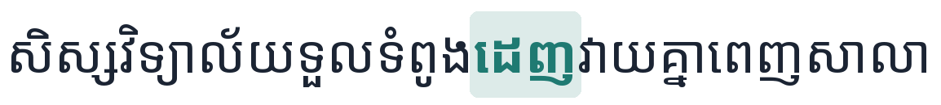
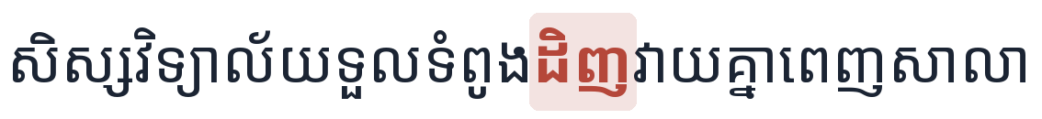
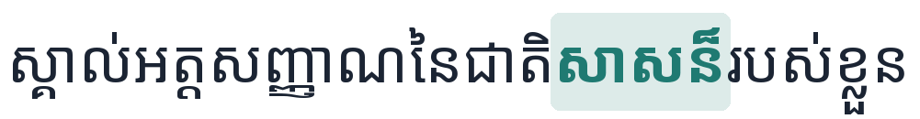
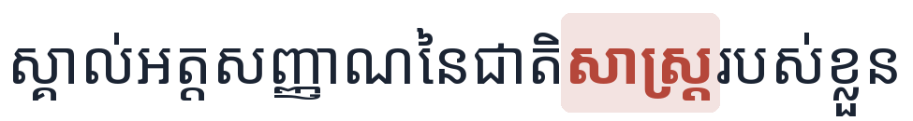


Typical mistakes are near-miss spellings
13
13. Error analysis
OpenSLR 42
Reference
One vowel
Our model
km-speech-corpus
Reference
Similar-sounding word (ethnicity → science)
Our model
khmer_mpwt_speech
Reference
One syllable
Our model
Compare the zero-shot baseline: it printed one Khmer letter and a space over and over until the token limit, which is why its error rates exceed 100%.
Problem › Data › Model › Experiments › Results › Application
Next: what we learned: six insights →
Notes:
Real outputs from the test set, with the differing word highlighted. The mistakes are mostly one vowel or one syllable, words that sound alike. Compare that with the zero-shot baseline, which on the first unseen-speaker sentence printed a single Khmer letter followed by a space over and over until it hit the token limit.

Slide 17
Six insights from this project
14
14. Key insights
What the results show
147.6%
18.9%
39.4% → 18.9%
Whisper alone cannot write Khmer
Our training fixed most of it
More voices, better model
Without our training, it makes more mistakes than there are letters.
Error on new speakers dropped by about 87%, with only 16 hours of data.
Five sources beat one speaker (the one-speaker model also trained less).
What we learned about Khmer
No spaces
1 sentence, 1 split
≤ 10 s
Judge Khmer by its letters
Keep the test honest
Cut audio into short pieces
Writers use spaces differently, so we ignore spaces when scoring.
A sentence never appears in both training and test.
Khmer uses many tokens, and the model can only write 448 at a time.
Problem › Data › Model › Experiments › Results › Application
Next: how the web app is built →
Notes:
These are the six things we learned. One: Whisper as is cannot write Khmer. Two: about 16 hours of Khmer and 44 minutes of training make it usable on new speakers. Three: variety of speakers matters, even for a single speaker, although the ablation also had fewer steps. Four: for Khmer, measure characters without spaces. Five: split by sentence, or test sentences leak into training. Six: Khmer uses many tokens, which is why the app works on chunks of 10 seconds or less.

Slide 18
A web app, an API and our model
15
15. System architecture
USER
WEB, PORT 3000
API, PORT 8000
MODEL
Viewer's browser
Next.js web app
FastAPI back end
Whisper-small Khmer
Pastes a YouTube link, watches subtitles appear
Video player, subtitle timeline, SRT and text export
Background jobs, one GPU worker, progress polling
Our fine-tuned model, fp16 on GPU
Each link becomes a background job. The page polls for progress, so long videos survive Cloudflare's 100-second request limit.
PUBLIC LINK
EXTERNAL
OFFLINE
Cloudflare tunnel
YouTube
Hugging Face Hub
Shares port 3000 for the demo
Audio via yt-dlp and ffmpeg
Weights trained on RunPod, downloaded on first start
Problem › Data › Model › Experiments › Results › Application
Next: the app working on a real video →
Notes:
The user pastes a link in the Next.js page, which forwards it to the FastAPI back end. The back end starts a background job and returns immediately; the page polls for progress and new subtitle segments. One worker runs jobs in order because there is one GPU. The back end downloads the audio from YouTube and runs our fine-tuned model. The model was trained offline on RunPod and is published on Hugging Face; the API downloads it on first start. For the public demo, a Cloudflare tunnel exposes the web app.

Slide 19
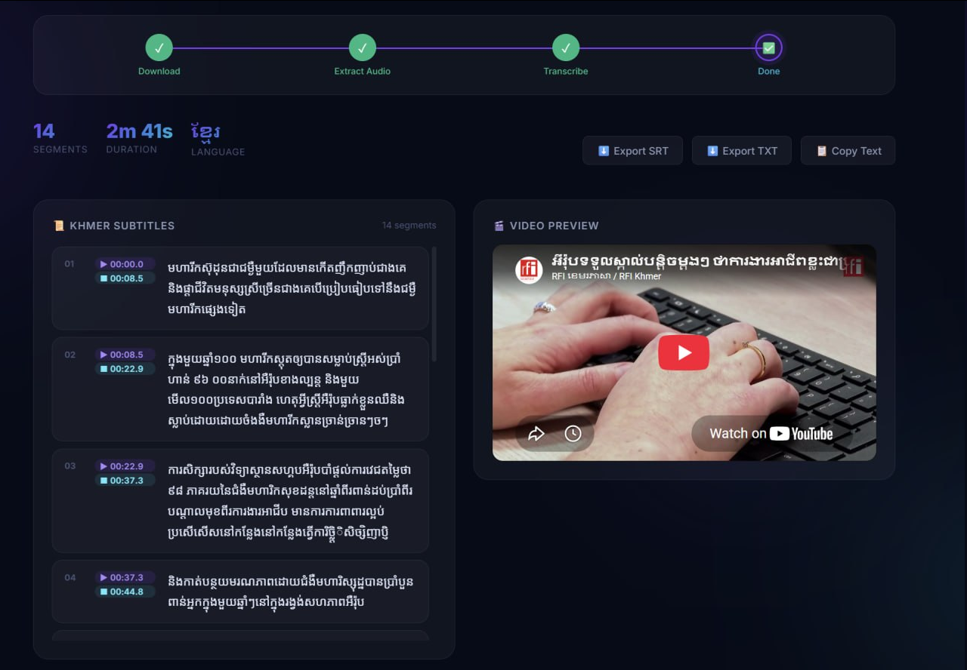
Paste a YouTube link and get Khmer subtitles
16
16. Web application
The pipeline from section 3, running our model
YouTube URL
Extract audio
Whisper-small (fine-tuned)
Timestamped Khmer subtitles
SRT / TXT
14
2m 41s
SRT / TXT
subtitle segments
video
export
Problem › Data › Model › Experiments › Results › Application
Next: what we achieved and what comes next →
Notes:
Switch to the browser. Paste a Khmer YouTube link, point out the progress counter (chunks done out of total), play the video next to the subtitle timeline, then download the SRT file. Runs locally with start-api.ps1 and start-webapp.ps1; a Cloudflare quick tunnel gives a public link. Have a backup screen recording ready in case the network fails.

Slide 20

What we achieved and what comes next
17
17. Conclusion, limitations and future work
What we achieved
Limitations
Future work
Working YouTube-to-Khmer subtitle application
Training data is mostly read speech
Subtitle timestamps are relatively coarse
Some transcription errors remain
Two sources are research-use only
CPU inference is slow
Add transcribed real video audio
Train on sentence-level timings
Larger Whisper models, longer training
Subtitle editing and local uploads
Facebook and other video sources
Fully fine-tuned Whisper-small (~241M parameters)
Test CER without spaces: 24.9%
DDD_TEST CER without spaces: 18.9%
Training completed in 44m 24s on one RTX 4090
Problem › Data › Model › Experiments › Results › Application
Notes:
We built a working web app that turns Khmer YouTube videos into timed, exportable subtitles. Fine-tuning made Whisper-small usable for Khmer, and the ablation shows that combining five data sources roughly halves the error compared with one speaker. The biggest limitation is the data: YouTube has spontaneous speech, music and noise, but our training data is mostly read speech.

Slide 21
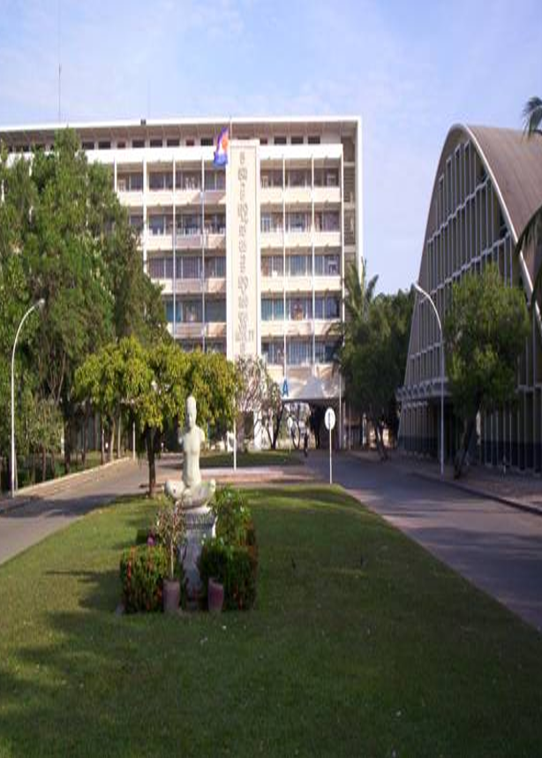
Royal University of Phnom Penh
Master of Science in Data Science and Engineering
THANK YOU
Questions?
Fine-tuning reduced CER without spaces on unseen Khmer speakers from 147.6% to 18.9%.
github.com/codingwithchitra777/whisper-small-khmer-mini
Sem Chitra, Sar Sakal, Earn Pisey, Sam Reaksmey
MDSE Cohort 3, Introduction to Large Language Models

Slide 22
Datasets, model and code
References
Training data
km-speech-corpus
huggingface.co/datasets/seanghay/km-speech-corpus
CC-BY-4.0
OpenSLR 42
openslr.org/42
CC-BY-SA-4.0
khmer_kheng_info_speech
huggingface.co/datasets/seanghay/khmer_kheng_info_speech
Research only
khmer_mpwt_speech
huggingface.co/datasets/seanghay/khmer_mpwt_speech
Research only
RFI Khmer
Clips cut and transcribed by our team from RFI Khmer news
Own collection
Unseen-speaker test (ddd_test)
Digital Divide Data, Khmer ASR
huggingface.co/datasets/Digital-Divide-Data/khm-asr-cultural
CC-BY-SA-4.0
Model and code
Whisper-small (Radford et al., 2023)
huggingface.co/openai/whisper-small
Apache-2.0
Our project code
github.com/codingwithchitra777/whisper-small-khmer-mini
Metric formula (WER, CER)
huggingface.co/learn/audio-course/chapter5/evaluation
Notes:
All dataset, model and code links. Licenses are recorded in src/config.py. Two sources are research-use only, so the combined training set is not redistributed.

