Slide 1
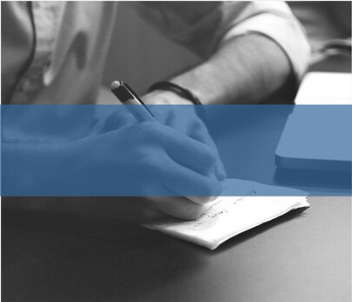
WELCOME

Slide 2


TEAM MEMBERS
Megha Tomar
Sana
UNDER THE GUIDANCE OF
Mrs. Princy Jain

Slide 3
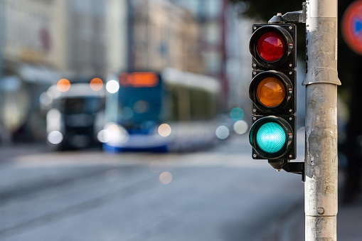
TRAFFIC LIGHT SIGNAL

Slide 4

CONTENTS
INTRODUCTION
OBJECTIVE
TECHICAL DETAILS
SCREENSHOTS
WHAT ARE TRAFFIC LIGHT SIGNALS
ADVANTAGES
CONCLUSION

Slide 5
INTRODUCTION
This project is about traffic light signal. In this project all the traffic control rules is used.
This management system show the traffic light signals colors and their uses.
The rules tell us when and on which color car will stop , wait and go.
This project is based on graphics with the animation process.
The main reason to work on this project is that to know the signal rules by images without using any writing.

Slide 6
OBJECTIVE
Easily understand by non-educated person.
Rules easily follow by many people.
Use graphical method.
Develop technical skills.

Slide 7
TECHNICAL DETAILS
Software Requirements
Operating System : Window 8
Language : C++
Compile : Turbo C++
Hardware Requirements
Processor : Intel
Memory : 10 KB
LCD Monitor
Keyboard
Mouse

Slide 8
SCREENSHOTS

Slide 9
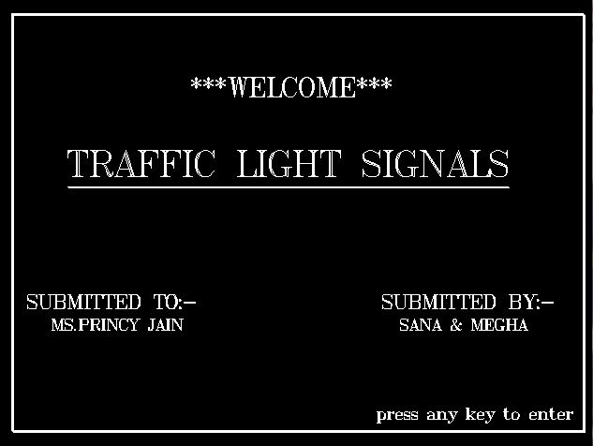

Slide 10
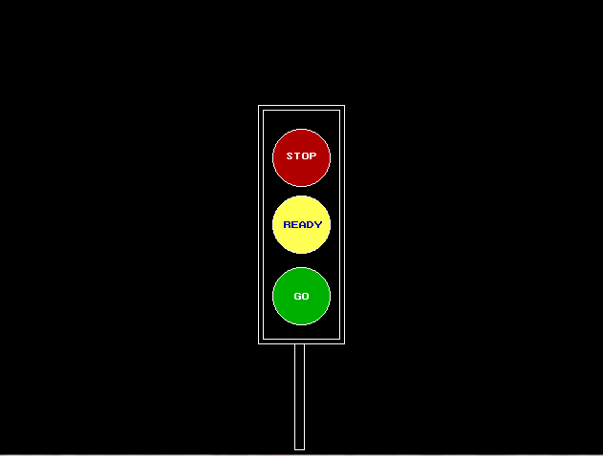

Slide 11
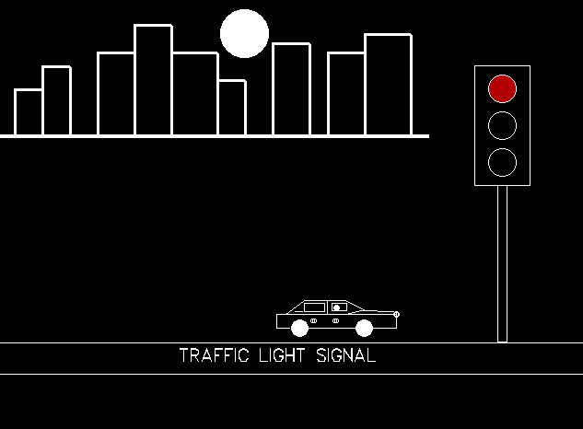

Slide 12
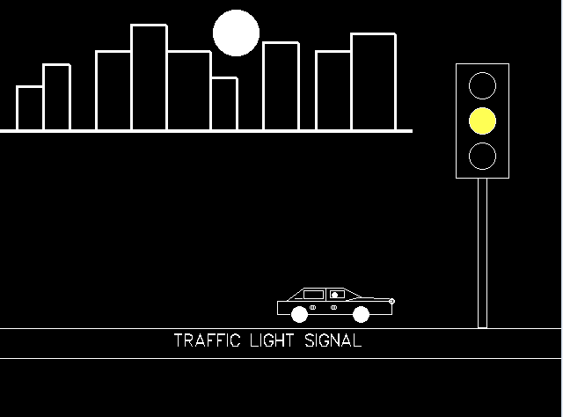

Slide 13
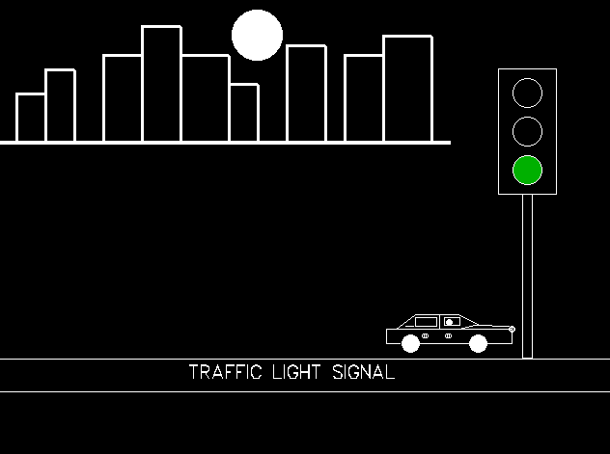

Slide 14
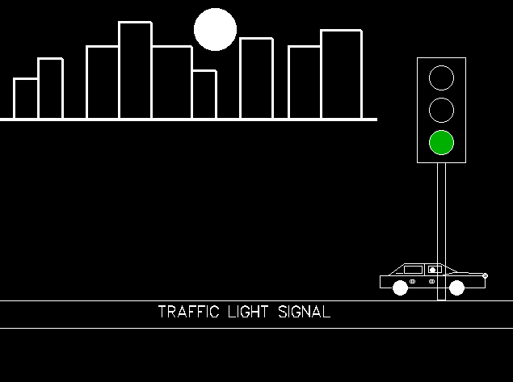

Slide 15
WHAT ARE TRAFFIC LIGHT SIGNALS?
The traffic signal works on light signals and includes three colours:-
Red
Yellow
Green
Here ‘RED’ indicates that the vehicles must stop, ‘YELLOW’ means that the vehicles must slow down and finally ‘GREEN’ means to go ahead.

Slide 16
ADVANTAGES
Traffic control signals provide for an orderly movement of traffic.
They help in reducing the frequency of an accident of some special nature i.e. of right angles accidents.
They intercept heavy traffic to allow other traffic to cross the road intersection safety.
They provide authority to the drivers to move with confidence.
They control the speed of vehicles on main as well as on secondary roads.

Slide 17
CONCLUSION
Traffic light can save a considerable amount of time and also we can prevent excessive traffic jams thus leading to smooth traffic flow.
In practice presently in India we are following time based control of traffic signal and we are experiencing a heavy traffic jams all over which in turn consumers lot of time and fuel.
We want to conclude that the traffic light controller system is the basic need for today's busy people

Slide 18
THANK YOU

Slide 19
DO YOU HAVE ANY QUERY?

