Slide 1

HOTEL MANAGEMENT SYSTEM
(EFFICIENT MANAGEMENT FOR HOSPITALITY EXCELLENCE)
PRESENTED BY:
RISHABH AGGARWAL (2301730002)
JAIDEEP PURI (2301730025)
OMAN SAAKIB (2301730004)
PAWAN CHAUHAN (2301730061)
FACULTY NAME :-
DR . Manish Kumar

Slide 2
INTRODUCTION
WHAT IS HOTEL MANAGEMENT SYSTEM ??
A Hotel Management System (HMS) is software designed to streamline and automate hotel operations such as:
Room booking
Check-in/check-out
Guest management
Billing and payments
WHY USE A HOTEL MANAGEMENT SYSTEM?
Reduces manual work and human errors
Increases efficiency and guest satisfaction
Provides real-time information on room availability
Helps in managing customer data and generating reports

Slide 3
OBJECTIVES
EFFICIENT HANDLING OF BOOKINGS,CUSTOMERS,ROOMS AND BILLINGS.
CENTRALIZED SYSTEM FORN STAFF AND ADMIN.
IMPROVE USER EXPERIENCE AND DATA MANAGEMENT
MANAGE ROOM AVAILABILITY
GENERATE BILLING AND REPORTS

Slide 4
SYSTEM ARCHITECTURE
THE SYSTEM FOLLOWS A 3-TIER ARCHITECTURE, WHICH INCLUDES:
FRONT-END (CLIENT SIDE):
THE PART USERS INTERACT WITH (WEBSITE OR APP)
BUILT USING HTML, CSS, JAVASCRIPT, AND FRAMEWORKS LIKE REACT OR BOOTSTRAP
HANDLES INPUT LIKE BOOKING DETAILS, LOGIN INFO, ETC.
BACK-END (SERVER SIDE):
LOGIC LAYER OF THE SYSTEM
BUILT USING SERVER-SIDE LANGUAGES NODE.JS
HANDLES REQUESTS FROM THE FRONT-END (E.G., CHECK AVAILABILITY, CONFIRM BOOKING)
DATABASE LAYER:
STORES ALL DATA: USERS, BOOKINGS, ROOMS, PAYMENTS
USES DATABASES LIKE MONGODB
COMMUNICATES WITH THE BACK-END TO FETCH AND STORE DATA
EFFICIENT MANAGEMENT FOR HOSPITALITY EXCELLENCE
FLOW:
USER → FRONT-END → BACK-END → DATABASE → BACK-END → FRONT-END → USER

Slide 5
FRONT END TECHNOLOGIES & FEATURES
TECHNOLOGIES:
HTML/CSS – STRUCTURE AND DESIGN
JAVASCRIPT – CLIENT-SIDE INTERACTIVITY
FRAMEWORKS (E.G., REACT, ANGULAR, BOOTSTRAP FOR STYLING)
USER INTERFACE MOCKUP/SCREENSHOTS
FEATURES:
USER REGISTRATION/LOGIN
ROOM BOOKING INTERFACE
BOOKING CALENDAR
DASHBOARD (FOR ADMIN & CUSTOMER)
FEEDBACK FORM

Slide 6
BACKEND TECHNOLOGIES AND FUNCTIONALITY
TECHNOLOGIES
PROGRAMMING LANGUAGE ( javascript)
WEB FRAMEWORK (Node js)
API INTEGRATION (REST APIS)
AUTHENTICATION (JWT/OAUTH)
Database(MongoDB)
FUNCTIONALITIES
BUSINESS LOGIC IMPLEMENTATION
CRUD OPERATIONS (CREATE, READ, UPDATE, DELETE)
BOOKING & ROOM AVAILABILITY LOGIC
PAYMENT GATEWAY INTEGRATION
ADMIN CONTROLS

Slide 7
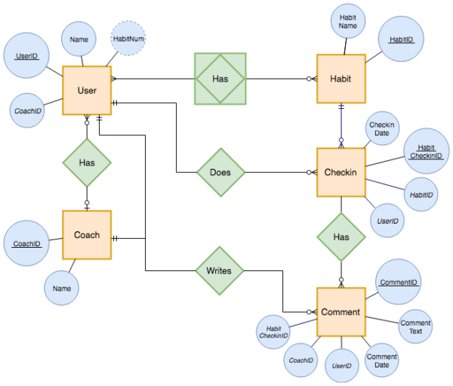
DATABASE DESIGNS
Entities and Relationships
🧍 Customer
customer_id (PK)
name
email
phone
address
password
🏨 Room
room_id (PK)
room_number
room_type
price
status (available/booked)
📅 Booking
booking_id (PK)
customer_id (FK)
room_id (FK)
check_in_date
check_out_date
booking_status
💳 Payment
payment_id (PK)
booking_id (FK)
amount
payment_method
payment_date
payment_status
🧑‍💼 Admin
admin_id (PK)
username
password
DBMS: MySQL / PostgreSQL / MongoDB
ER Diagram or Schema Screenshot

