Slide 1
— CVR ENGINEERING · UTILITY SUPPLY & CONSTRUCTION
Financial Review & Forecast
Baseline through June 2026 · Forecast through December 2027
Sources: GL financial statements 6/30/26 · CVR & EPC KPI report 8/8/26 · 2026 rate sheet · Phase 1 & 2 model workbooks

Slide 2
— AGENDA
What we'll cover
1
Where we stand
Executive summary · revenue vs plan & prior year · gross margin vs budget · the rate ladder
2
Operating drivers
Staff & headcount · utilization by person · sales by customer
3
Work in hand & work to win
Backlog on active jobs · known pipeline opportunities
4
Strategy
One pursuit engine with HWC Estimating · the consolidated EPC offering · the addressable market · national expansion targets · BD account ownership
5
Forward view
Forecast & coverage · FY2026 landing and FY2027 scenarios · EPC accounting alignment
6
Next 90 days
Priorities: realization, utilization, the Q4 pipeline, and the monthly rhythm
CVR Engineering financial review & forecast · June 2026

Slide 3
— EXECUTIVE SUMMARY
June 2026 — where CVR Engineering stands
YTD revenue
vs plan
vs prior year
Gross margin YTD
Utilization
Realization
$551K
54.3%
+38.1%
22.2%
54.0%
79%
June $124K — best month
$464K behind budget
PY YTD $399K
budget assumes 61.6%
vs 75% median target
$122 realized vs $154 card
Revenue is growing but under plan. Every month ran below the flat $169K/month budget, yet YTD is 38% ahead of last year and June was the strongest month on record.
The margin problem is throughput, not cost. The team realizes ~$122/hr against a $154/hr rate card at 54% utilization. Closing those two gaps roughly doubles revenue on the current roster.
The path forward is quantified. The Base forecast (reconciled to finance's fully-loaded cost) turns FY2027 net income positive at +$123K — with the $6M / 20% OILI target requiring a deliberate capacity build beyond it.
H1 2026 net result
Forecast FY2026 landing
FY2027 (Base)
−$320.5K
$1.42M rev · −$482K
$2.50M rev · +$123K

Slide 4
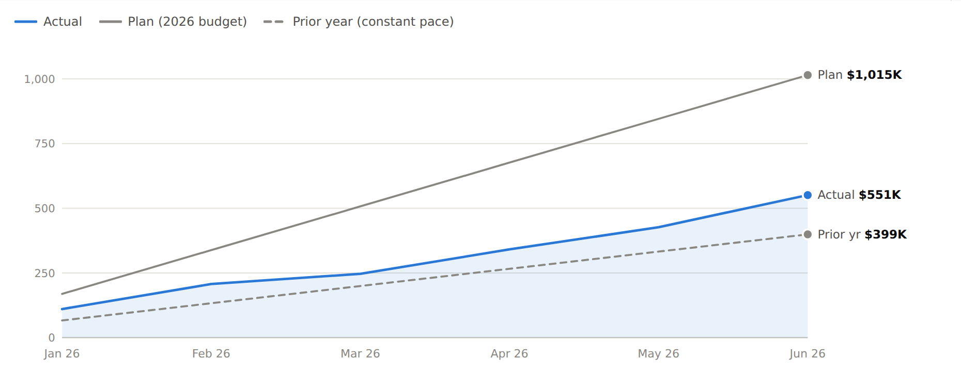
— WHERE WE STAND
Cumulative revenue — Actual vs Plan vs Prior Year
$551K
actual YTD — 54.3% of the $1,014.6K plan
+38.1%
ahead of prior-year pace ($399K)
$124.4K
June revenue — best month YTD
Prior-year line is a constant-pace approximation to the actual June YTD of $399.1K — monthly 2025 detail pending from GL history.

Slide 5
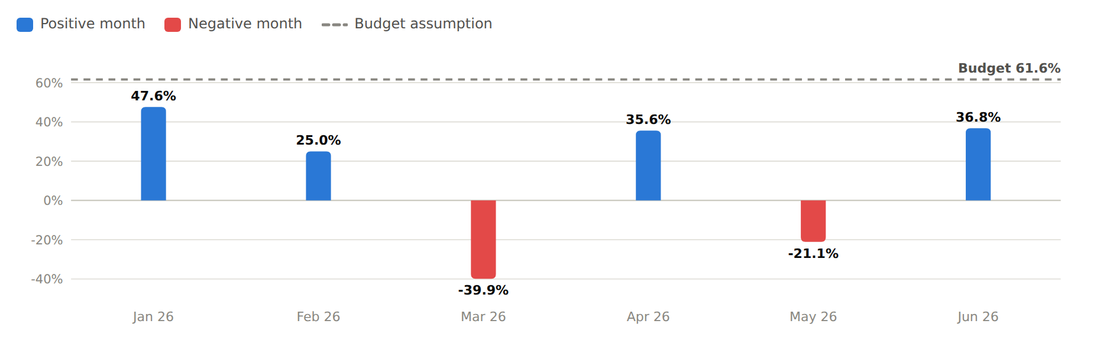
— WHERE WE STAND
Gross margin by month vs the 61.6% budget assumption
22.2%
gross margin YTD — vs 61.6% budgeted
2 months
negative gross profit (Mar, May) on write-downs and thin billing
36.8%
June margin, near-breakeven operating month (−$9.8K before interest)
GL income statements, Jan–Jun 2026. Budget gross margin implied by the 2026 budget: labor at 38.4% of revenue.

Slide 6
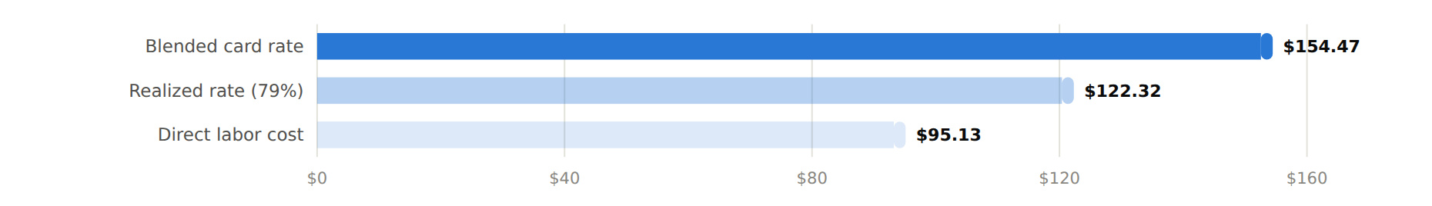
— OPERATING DRIVERS
The rate ladder — where the card rate goes
79%
realization — $32/hr of card rate not reaching revenue (~$145K in H1)
Lead suspect
intercompany pricing on HWC work (20% of sales); billing lag and write-offs also in scope
Labor multiplier: 1.29× actual vs 2.60× budgeted revenue per direct-labor dollar (healthy firms run 2.5–3.0×)
Now sourced
per-person cost confirmed from finance's 2026 budget — every role clears its rate (next slide)
2026 YTD: 5,539 billable hours (through 8/8) · blended card rate mix-weighted from actual billable hours by classification.

Slide 7
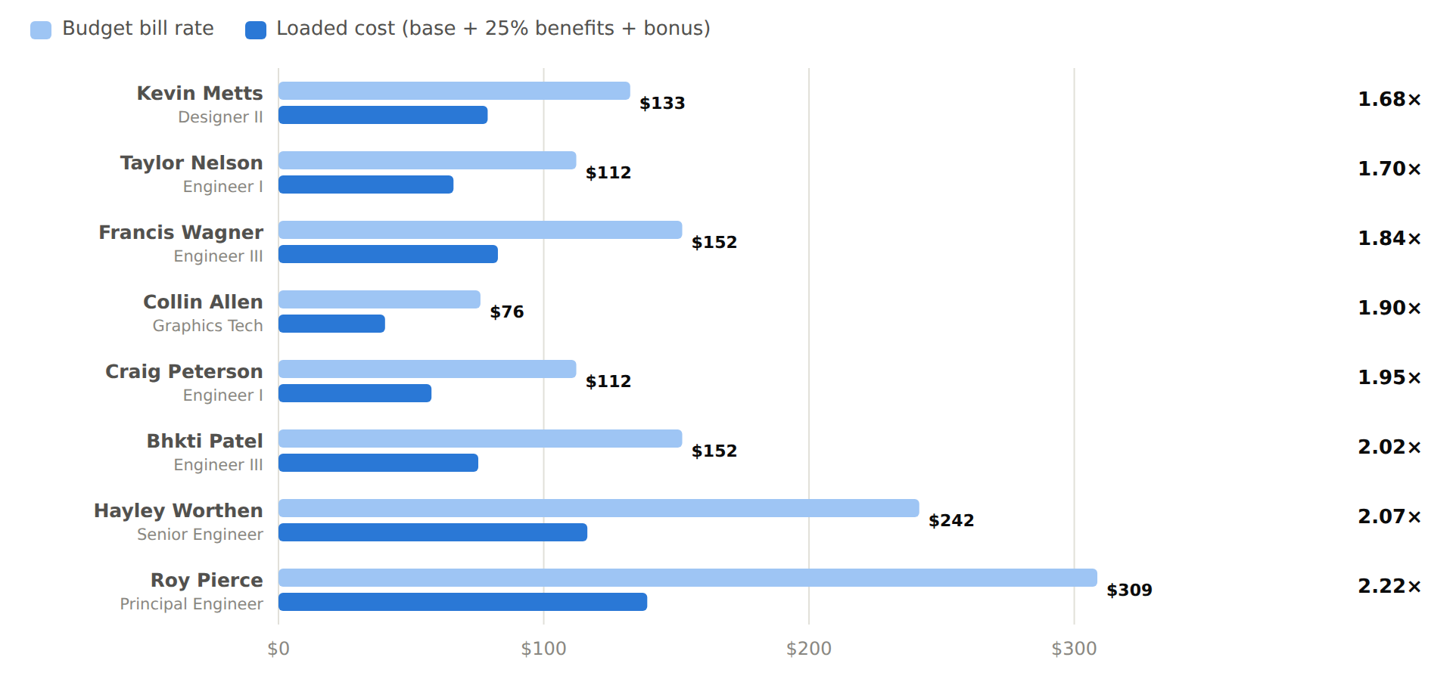
— OPERATING DRIVERS
Margin by role — the rate card holds
1.7×–2.2×
every role clears its bill rate at a healthy labor multiplier on finance's loaded-cost basis
Not a pricing problem
the rate card is adequate — no classification bills below its cost
So where's the gap?
budget blends to 2.6× revenue-per-labor-dollar; H1 actual ran 1.29× — that gap is realization and utilization, not the card
Focus the fix there
close the realization gap and lift utilization — the two levers that move margin
Loaded cost = base + 25% benefits + bonus per hour. Source: 2026 CVR Budget V5 (finance), tab Labor Rates-DP.

Slide 8
— OPERATING DRIVERS
Staff & headcount
Name | Classification | Hours YTD | Billable % | Target
Roy Pierce | VP Engineering (Principal Eng.) | 1,256 | 26.7% | 42.4%
Hayley Worthen | Senior Engineer | 1,287 | 57.3% | 61.3%
Randy Pynenberg | Engineer IV | 73 | 86.3% | 95.0%
Tom Little | Engineer IV | — * | — | —
Erin Bryden | Engineer IV | — * | — | —
Bhkti Patel | Engineer III | 1,254 | 70.2% | 70.7%
Francis Wagner | Engineer III | 1,272 | 62.0% | 70.7%
Taylor Nelson | Engineer II † | 1,096 | 58.2% | 80.1%
Craig Peterson | Engineer I | 1,315 | 76.7% | 75.4%
Kevin Metts | Designer II † | 1,223 | 32.5% | 75.4%
Patrick Nicholson | Senior Designer | — * | — | —
Collin Allen | Graphics Technician | 1,271 | 52.6% | 80.1%
Auston Hopson | Graphics Technician | 22 | 100.0% | 100.0%
Senior PM | Senior Project Manager — starts 8/24 | — | — | —
Transmission Designer | Designer, T-line — starts 9/7 | — | — | —
15
on the roster — Senior PM starts 8/24, Transmission Designer 9/7
10
active billable staff with recorded hours
3 reqs
still open — T-line, substation, structural engineers (recruiting)
~27
billable FTEs needed at target utilization to support the $6M revenue goal
* No hours on the KPI utilization page — time booking to be confirmed. † Classification assumed (not on org chart) — pending confirmation.

Slide 9
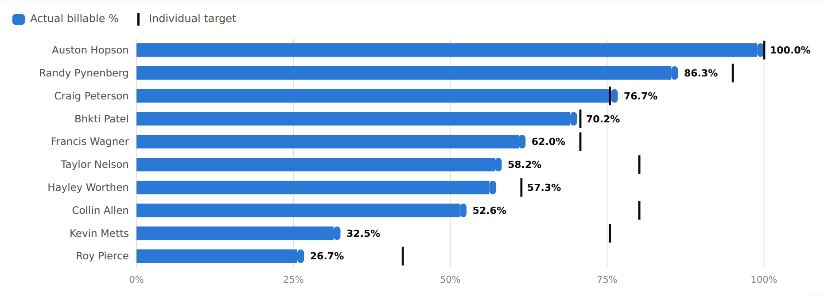
— OPERATING DRIVERS
Billable utilization vs target, by person
54.0%
team billable utilization vs 75% target — down from 60.8% as the bid push absorbed hours
638 hrs
of bid time YTD (VanMeter, Renaissance, Consumers) — 21% of non-billable
4 people
15+ points under target (Kevin, Collin, Taylor, Roy) — utilization plans in motion
Hours through 8/8/26. Randy Pynenberg (73 hrs) and Auston Hopson (22 hrs) have small YTD bases. Bids/BD time is tracked separately (638 hrs).

Slide 10
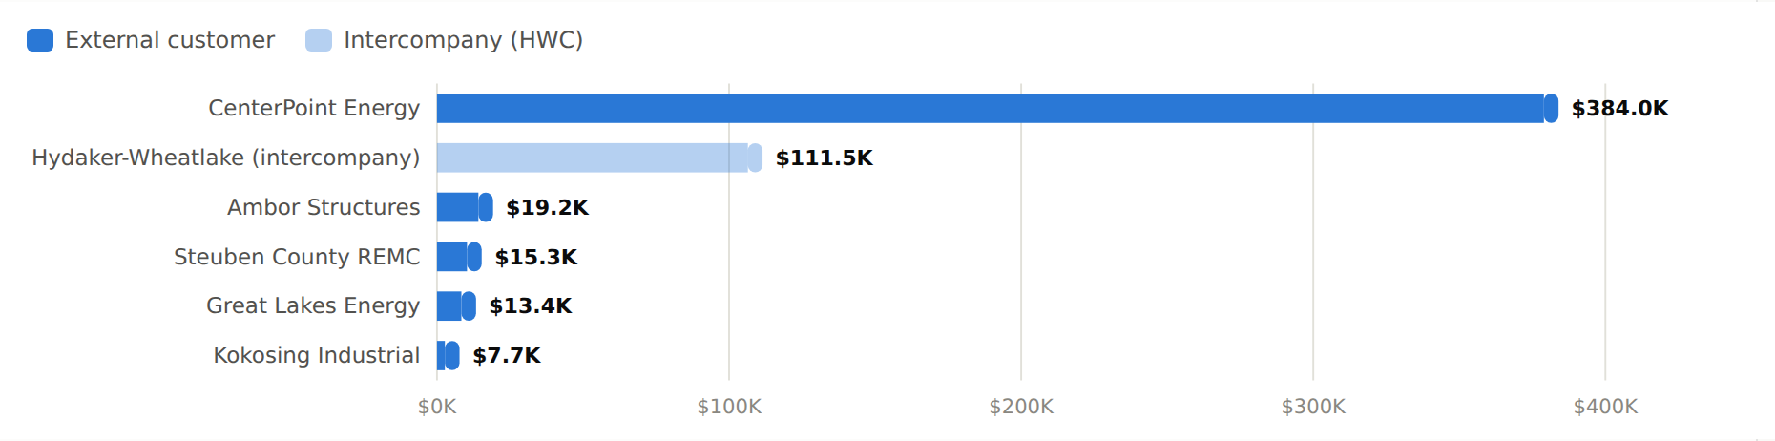
— OPERATING DRIVERS
Sales by customer — YTD June 2026
69.7%
of revenue is CenterPoint — matching its ~70% share of billable hours
20.2%
intercompany work for Hydaker-Wheatlake (rate treatment under review)
~10%
all other external customers combined — diversification is the growth agenda
GL sales-by-customer schedule, 6/30/26. Total $551.0K.

Slide 11
— WORK IN HAND
Backlog — remaining value on active jobs
Job | Customer / project | PO value | Billed | Remaining | Finish
005-0005 | Consumers — 2026 Pole Replacements (4%) | $274.7K | $0.0K | $274.7K | Jan-27
001-0003 | DTE — New Baltimore Conversion | $1,428.8K | $1,216.3K | $212.5K | Dec-27
017-0007 | CenterPoint — Leonard Rd 69kV | $200.0K | $26.5K | $173.5K | Oct-27
017-0006 | CenterPoint — Northwest 69kV | $110.6K | $27.2K | $83.4K | Aug-27
017-0003 | CenterPoint — Gateway 69kV | $203.0K | $155.3K | $47.7K | Aug-26
001-0001 | DTE — Catalina Ph 3 (support tail) | $838.5K | $806.3K | $32.1K | 2026
005-0004 | Consumers — HVD Line Sensors | $130.5K | $105.0K | $25.5K | Oct-26
017-0004 | CenterPoint — Rockport 69kV | $96.7K | $87.2K | $9.5K | Aug-26
016-0001 | Cloverland — Manistique Pump Stn | $111.5K | $106.6K | $4.9K | Sep-26
017-0005 | CenterPoint — Angel Mounds 69kV | $97.0K | $95.1K | $1.8K | Oct-26
 | Total backlog remaining |  |  | $865.6K
$866K
booked work remaining — pole program now live (005-0005); billing progress trims the rest
+30%
Consumers workload ramp expected into year-end — pole program burns hard to a Jan-27 finish
4 close-outs
Gateway, Rockport, Manistique, Angel Mounds wrap by Oct-26 — replacement work needed now
KPI project scorecard, week ending 8/8/26. Remaining = PO value − billed to date; excludes cost-overrun exposure tracked on the scorecard.

Slide 12
— WORK TO WIN
Known pipeline opportunities
Opportunity | Customer | CVR scope | Paired EPC | Win prob. | Weighted | Award
2026 Pole Replacements | Consumers Energy | $274.7K | $3,451.1K | WON | → backlog | Q3-26
Joint Use Audit | Lansing Board of Water & Light | $1,350.0K | — | 50% | $675.0K | Q4-26
Rosehill–Rockport 69kV | Hoosier Energy REC | $290.0K | $5,590.9K | 50% | $145.0K | Q4-26
Jacksonburg–Gateway 69kV | Hoosier Energy REC | $160.0K | $3,548.5K | 50% | $80.0K | Q4-26
Frontier Make Ready | Steuben County REMC | $100.0K | — | 50% | $50.0K | Q3-26
VanMeter 161kV Substation ‡ | MEC (MidAmerican) | ~$1.23M* | ~$14.5M* | 40% | ~$305K* | Oct-26
Renaissance 345kV (6 MOD switches) ‡ | DTE Energy | TBD | — | in bid | — | Sep-26
 | Pending total (ex-won) | $1,900.0K | $9,139.4K |  | $950.0K
WON
Consumers pole replacements — $275K CVR scope now a live job (005-0005)
4–5%
engineering share of paired EPC contract value — every EPC win pulls CVR scope with it
$1.6M
origination gap beyond this list to fully cover the 18-month Base forecast
KPI current-bids page, 8/8/26. ‡ VanMeter due 9/4: * = CVR pre-bid projection under the sub-management model (next slide) — weighted value is expected CVR margin at 40%. Renaissance due 9/15. Other probabilities are planning placeholders — Estimating to own final numbers.

Slide 13
— WORK TO WIN — PRE-BID PROJECTION
VanMeter 161kV — the sub-management model
Greenfield 161kV substation + 6 miles of transmission for MEC. Westwood performs most of the engineering as CVR's sub — CVR manages the sub, holds the EOR oversight, and runs material procurement. Bid due 9/4 · 40% win probability · award assumed Oct-26 · energization mid-2028.
CVR revenue stream | Basis | CVR billings | CVR margin
Material procurement (principal) | 35% of EPC = $5.08M · 13% gross, ~11% net of carry | $5.74M | $558K
Westwood engineering subcontract | ≈6% of EPC ($0.87M) passed through at +10% | $0.96M | $87K
CVR self-perform (mgmt + EOR + procurement) | 1,800 hrs at card rates — LOE below | $0.27M | $115K
Total CVR | ≈5.2% of EPC value | $6.97M | $760K
CVR level of effort (LOE) | Hours
Project management (Senior PM + new PM) | 800
EOR & design review (Roy / substation eng) | 500
Procurement & expediting (with PLS) | 300
Project controls & QA | 200
Total ≈ 0.9 FTE-yr over ~20 months | 1,800
EPC bid value (assumed)
CVR margin if won
Expected value @ 40%
Team leverage
$14.5M
$760K
$305K
0.9 FTE-yr
sub $8.5M + 6 mi line
materials + sub mgmt + LOE
probability-weighted margin
vs ~6 FTE-yr if self-performed
Why this shape: the sub-management model lets CVR take EPC-scale margin without EPC-scale headcount — the roster stays on CenterPoint/DTE/Consumers while VanMeter runs through Westwood and PLS.
Pre-bid planning projection — replace with the estimate at submittal (9/4). Rates per the at-scale model (35% materials share, 13% gross / ~11% net material margin); Westwood scope and markup to be confirmed in the sub agreement.

Slide 14
— STRATEGY — ONE DELIVERY ORGANIZATION
One pursuit engine: Engineering + Estimating
Today: two linked groups, one funnel forming
1
Single pursuit funnel
A ~10-person estimating organization (Director of Estimating plus senior estimators) sits beside the 13-person engineering roster — same leadership, same customers.
Engineering already invests 405 hours YTD in bids and proposals — 20% of its non-billable time — but informally, after the estimate is framed.
EPC-paired pursuits (Hoosier, Consumers) are already priced with engineering scope inside them — the consolidated model exists in embryo.
One bid list owned jointly; engineering hours planned into every estimate from day one, not volunteered afterward.
2
Design-to-estimate loop
Standard design packages and unit-hour norms feed estimating's cost baselines, so bids carry engineering reality.
3
Estimate-to-execution handoff
The winning estimate becomes the project budget the weekly scorecard tracks — one number from bid to closeout.
Why it matters: cost variance is the biggest margin leak on the scorecard (individual jobs overran to −92% and −206%). Early engineering input into estimates is the structural fix — and it converts estimating support from overhead into billable pursuit capacity.

Slide 15
— STRATEGY — THE CONSOLIDATED OFFERING
Refocus: pursue EPC with new clients as one offering
TODAY
TRANSITION
TARGET
Support function
Prime engineer
Engineer of Record
Engineering supports HWC construction and bills hours
Early design control; engineering priced into every EPC bid
Turnkey EPC — supply, engineering, construction sold and delivered together
What changes
$9.1M
Lead with one accountable offer — material supply, engineering, and construction priced and sold together, with single-point delivery risk the utility doesn't have to manage.
Aim it at new clients — the co-op and municipal pattern already responding (Hoosier, Steuben, Lansing BWL) — to grow revenue while cutting the 70% CenterPoint concentration.
Every EPC win feeds both P&Ls: construction margin to HWC, and 4–5% of contract value as engineering scope to CVR — the revenue that funds the capacity build toward $6M.
of EPC-paired bids still in market with Hoosier (Consumers pole program now won)
4–5%
engineering pull-through on every EPC contract won
69%
2026 win rate — the consolidated offer is landing
Integration path per the CVR strategy roadmap: support function → prime engineer → Engineer of Record / turnkey program support.

Slide 16




— STRATEGY — THE CONSOLIDATED OFFERING
The addressable EPC market in our current client base
Michigan — electric & gas
Michigan — electric & gas
>$17B 5-year capital plan; $8.5B of distribution reliability & resilience through 2029
$36.5B 5-year plan 2026–30 — up 20% on data-center load and grid reliability spend
Foothold: HVD line-sensor program live; 2026 pole replacements WON ($275K CVR scope, $3.45M EPC-paired)
Foothold: New Baltimore & Catalina conversions ($2.3M PO); Renaissance 345kV bid active (due Sep-26)
Indiana Electric + Houston Electric
Iowa — Berkshire Hathaway Energy
$65B 10-year plan 2026–35; Houston Electric $46.3B; Indiana transmission & data-center upside
$3.9B Wind PRIME program, on top of ~$14B invested in Iowa energy infrastructure since 2004
Foothold: 7 active Indiana substation jobs; Houston presence = the expansion runway
Foothold: 4 active EPC substation projects with HWC ($21.7M PO value)
≈$120B in disclosed capital plans across this client base. 0.005% captured as engineering = the $6M Year-2 goal.
Public sources: company capital-plan announcements and filings (Utility Dive, SEC 8-K, company releases), July 2026. Logos are the property of their respective owners; shown for internal reference only.

Slide 17




— STRATEGY — BEYOND THE CURRENT FOOTPRINT
Target “new logos” — the national expansion list
American Electric Power · 11-state footprint
OH · PA · NJ · WV · MD · ~6M customers
$78B Five-year capital plan raised to ~$78B (May 2026) on signed data-center load; largest transmission owner in the U.S.
$36B “Energize365” grid plan, 2026–30 — up ~30% vs. prior; transmission & distribution modernization and reliability
Where we stand: recent management changes; strong Director/PM and procurement relationships (JimC + potential BD).
Where we stand: key C-suite relationships to leverage — an open door to EPC.
Pacific Gas & Electric · N. & Central California
Georgia · Alabama · Mississippi · electric + gas
$73B $73B 2026–30 capital plan — wildfire undergrounding, grid hardening, and data-center-driven load growth
$81B Five-year plan raised to $81B (Feb 2026) — data-center & manufacturing load; Georgia Power system growth
Where we stand: BD-led — a potential long-term EPC relationship to build.
Where we stand: relationally weaker, but a major EPC distribution program at Georgia Power.
≈$268B in disclosed five-year capital plans across these four targets. The BD Lead's national pursuit list — beyond the current Michigan / Indiana / Iowa base.
Public sources: latest company capital-plan disclosures (Q1 2025–Q1 2026 earnings / SEC filings); plan windows vary (2025–29 to 2026–30) — confirm current guidance. Relationship notes are CVR-internal account intel. Logos are the property of their respective owners.

Slide 18
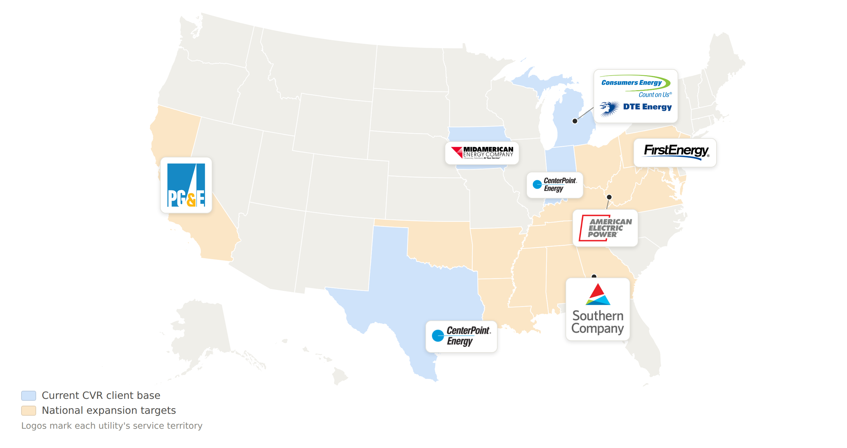
— STRATEGY — WHERE WE PLAY AND WHERE WE'RE GOING
CVR's EPC footprint and the national target map
Blue = states with a current CVR client; amber = expansion-target service territories. State shading illustrates each utility's footprint, not CVR's contracted scope.

Slide 19
— STRATEGY — BUSINESS DEVELOPMENT
An owner on every EPC account
Account | EPC pursuit focus | Proposed owner *
Outside current footprint | New utilities & regions beyond MI/IN/IA — Gulf Coast & Texas, MISO/PJM neighbors, data-center-driven grid build-out | BD Lead (new hire) — owns the map, coordinates all account managers
CenterPoint — Indiana | Substation program continuity; move from job-by-job to a program-level agreement | Roy Pierce (VP Engineering — current PM)
CenterPoint — Houston | Entry into the $46.3B Houston Electric resiliency build — new territory | SVP Engineering (Houston-based)
DTE Energy | Conversion program follow-on; advance the Renaissance 345kV pursuit (now in bid) | Assign — VP Engineering or new AM
Consumers Energy | Convert pole/sensor programs into EPC-paired awards | Frank Miller (Director of Estimating)
MidAmerican (MEC) | Extend the 4-project EPC substation program | Ethan McDaniel (EPC PM — current)
Co-op & municipal cluster | Hoosier, Steuben, Lansing BWL, Great Lakes — the consolidated-offer beachhead | New EPC Account Manager (hire)
Prospects in motion | NIPSCO, AES Ohio, AES Indiana, Duke — BD hours already flowing, no owner yet | New EPC Account Manager (hire)
Assign today — $0
Incumbent accounts get named owners from existing leadership. The 590 hours of BD & proposal time already spent YTD becomes a managed funnel instead of volunteer work.
Add two seats — BD Lead + AM
The BD Lead hunts outside the footprint and owns the consolidated-offer story to new logos; the Account Manager works the co-op/municipal cluster and prospects. One EPC win repays both seats — 4–5% engineering pull-through to CVR plus construction margin to HWC.
Run the cadence
Monthly account reviews against the pipeline tab, chaired by the BD Lead. Owners set win probabilities and award dates; BD hours tracked per account.
* Proposed from current relationships on the KPI scorecards — to be confirmed with the team. YTD BD hours by account (KPI report): Great Lakes 56 · CenterPoint 35.5 · Consumers 26.5 · DTE 19.5 · NIPSCO 10 · AES 10 — plus 408 proposal hours.

Slide 20
— FORWARD VIEW — THE EPC COMPOUNDING EFFECT
Each EPC win compounds two CVR streams
Every EPC dollar won returns ~12.5% to CVR — pull-through engineering plus captured material margin. As wins accumulate, both streams compound.
Pull-through engineering — 8% of EPC
Captured material margin — 4.6% of EPC
$20M
$18.8M
$15M
$12.6M
$10M
$6.3M
$5M
$1.9M
$0.4M
$0M
$3M
first paired wins
$15M
near-term pipeline
$50M
+ AEP program
$100M
+ FirstEnergy
$150M
at-scale run-rate
Illustrative accumulation at CVR's capture rates (8% engineering; 13% material margin on 35% materials = 4.6% of EPC). Columns are cumulative CVR annual revenue as EPC wins build toward the $150M at-scale run-rate.

Slide 21
— FORWARD VIEW — THE EPC COMPOUNDING EFFECT
The accumulation economics — and the BD payoff
EPC won ($M/yr) | Pull-through eng | Captured mat’l margin | CVR managed rev | CVR operating income | vs $400K BD
$15M | $1.2M | $0.7M | $1.9M | $0.8M | 1.9×
$50M | $4.0M | $2.3M | $6.3M | $2.5M | 6.3×
$100M | $8.0M | $4.6M | $12.6M | $5.1M | 12.6×
$150M | $12.0M | $6.8M | $18.8M | $7.6M | 18.9×
What this means
Even $15M of EPC won returns ~1.9× the BD cost in operating income.
AEP + FirstEnergy are the accelerators — they carry the ladder from $15M toward $100M+.
Every EPC dollar compounds both streams; the return scales straight down the column.
One ~$400K BD resource is the lever on the whole ladder — it converts warm relationships into booked wins.
The ladder is BD-limited, not capability-limited. CVR can engineer and procure the work today — winning it is the gate. Fund the pursuit and the accumulation follows.
Managed revenue = engineering (8%) + captured material margin (13% on 35% = 4.6%). Operating income nets ~2 pts procurement/carry and 15% engineering margin. Detail on the 'EPC At-Scale Model' tab.

Slide 22
— STRATEGY — THE REVISED BUSINESS MODEL
At scale: CVR earns engineering + material margin
Perform ~$150M of EPC a year and CVR captures the engineering scope and the material margin — while HWC keeps the equipment and the labor / construction margin.
WHERE THE $150M/YR PROGRAM REVENUE FLOWS
CVR captures the blue + green bands — $18.8M managed revenue (12.5% of the program).
$12.0M
Materials at cost · $45.7M
HWC — equipment + labor + construction · $85.5M
CVR engineering — $12.0M (8%)
CVR material margin — $6.8M (4.6%)
Materials at cost (pass-through) — $45.7M (30%)
HWC equipment + labor + construction — $85.5M (57%)
CVR managed revenue
CVR gross profit
CVR operating income
vs the $6M / 20% goal
Working capital
$18.8M
$14.0M
$7.6M
6.3×
~$6.5M
engineering + material margin
eng GP + material margin
steady-state OILI
the goal operating profit
materials carry — needs a facility
Steady-state at $150M/yr — a future-state target, not the current forecast. CVR would carry ~$6.5M working capital and material procurement / price risk; confirm payment terms and a financing line with USC / HWC.
Drivers editable in CVR_Model_Phase2_Forecast.xlsx → 'EPC At-Scale Model' tab: 35% materials share · 13% material margin (net ~2 pts carry) · 8% engineering pull-through · 15% engineering operating margin.

Slide 23
— FORWARD VIEW — ACCOUNTING ALIGNMENT
EPC bid engineering: an item to clean up, not a crisis
The facts
Intercompany bid-support billing RECOMMENDED
1
638 hrs
HWC pays CVR for pre-award engineering on EPC pursuits (cost or card). Hours become billable; cost lands where the benefit lands. Standard EPC practice.
of bid engineering YTD — ≈$98.6K at card rates ($60.7K at cost), unbilled
~60% design
2
Win / loss allocation
required before a fixed-price EPC bid can even be submitted — $200–300K of pre-award exposure on the $9.1M bid slate still in market
Bid engineering capitalizes to the pursuit — charged to the job on a win, absorbed by HWC as a BD expense on a loss.
Absorbed today
these hours land in CVR's overhead with no offsetting credit — immaterial now, but it compounds as EPC pursuit volume grows
3
Carve it out of the metrics
The misalignment
Track bid-support hours in a separate BD cost pool so CVR's utilization and realization aren't penalized for pursuit work — a reporting fix, not a cash fix.
bid hours are non-billable, so every EPC pursuit CVR supports drags the metrics CVR is judged on — utilization, realization, OILI
The ask is alignment, not subsidy. The dollars are small today — but as EPC volume scales, the accounting should reward the pursuit behavior the strategy demands.
Bid hours per the KPI report (through 8/8/26). Raise with the CFO as an EPC accounting-alignment item.

Slide 24
— NEXT 90 DAYS
Priorities
1
Fund the BD resource — now
One dedicated BD hire (~$400K/yr all-in) to convert AEP and FirstEnergy — both warm. A single mid-size EPC award pays it back in year one.
2
Win the near-term pipeline
Lansing BWL audit is the biggest swing ($1,350K); land the Hoosier/Consumers EPC-paired work — each EPC win pulls engineering + material margin to CVR.
3
Lift utilization and realization
Close the $145K H1 realization gap (confirm HWC rate treatment, chase billing lag) and fill non-billable time with the bid backlog — ~27% more capacity, no hires.
4
Start the monthly rhythm
July close into the actuals-vs-forecast cadence; the monthly cash draw on USC is the early-warning gauge for reporting.
CVR Engineering · prepared July 2026 · model workbooks and data in the CVR---Financial repository

Slide 25
— THE DECISION
The ask: a BD resource to convert AEP + FirstEnergy
Two warm IOU targets and a consolidated EPC-with-HWC offering that's ready — the missing piece is dedicated pursuit capacity.
~$78B capital plan · 11-state footprint
$36B “Energize365” grid plan (2026–30)
Why warm: Recent management changes; strong Director/PM + procurement relationships (JimC + potential BD).
Why warm: Key C-suite relationships to leverage — an open door to EPC.
Entry: Transmission & distribution substation EPC — CVR engineering + material margin, HWC construction.
Entry: Grid-modernization & substation programs across OH · PA · NJ · WV · MD.
The ask: fund one BD resource now — ~$400K/yr all-in — dedicated to AEP + FirstEnergy pursuit.
BD investment
One EPC win covers it
At 10% of the vision
Full at-scale upside
~$400K/yr
~$0.43M
~$0.76M
$7.6M
one senior BD resource, all-in
CVR take on a single $3.45M job
CVR OI at ~$15M/yr EPC
CVR OI at $150M/yr
Decision requested: approve the BD hire now to open AEP + FirstEnergy pursuit immediately.
BD cost ~$400K/yr all-in (base + benefits + travel). Returns per the 'EPC At-Scale Model' tab; a single mid-size EPC award pays back the resource in year one.

