Slide 1

AI Project
Name :- Preet Patel
Sem: VI – C
PRN:-22070521088

Slide 2

IMDb review Sentiment analysis
Global entertainment is a 2736.04 billion $ industry .Where different types of content is made so it is important to understand sentiment of different audience in different countries to cater to their needs to spread message effectively to target audience to achieve this makers use sentiment analysis based of public reviews.
IMDb is one of the most popular AI review platform which reviews movies and TV shows

Slide 3
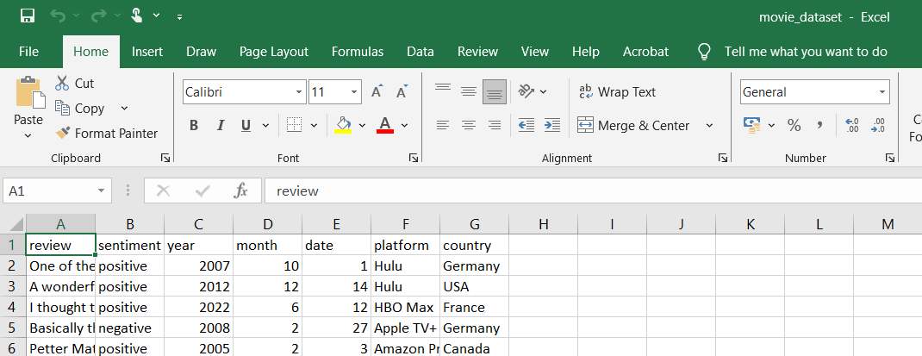
Dataset
NAME:- Movie_ dataset.csv
Variables:- review ,sentiment ,year ,month ,date and platform
Rows:- 50001

Slide 4
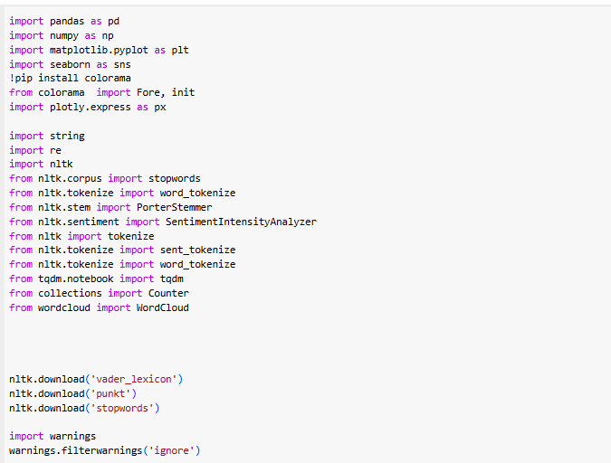
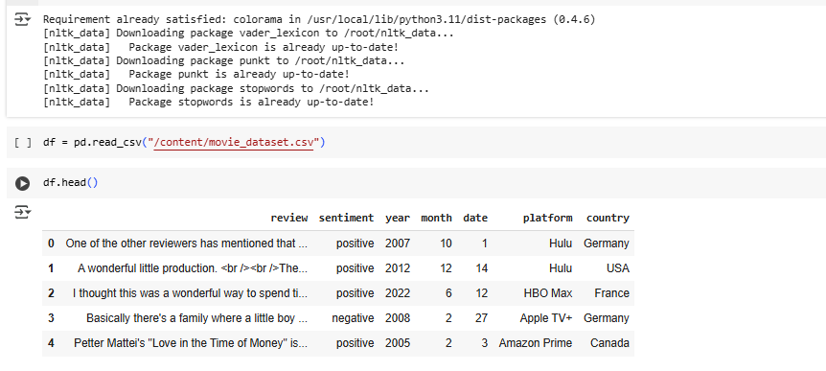
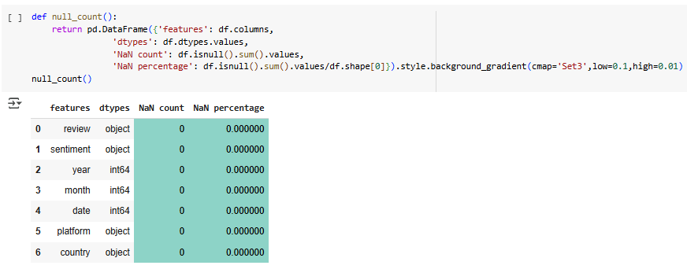
Import necessary library and load dataset
2
3

Slide 5
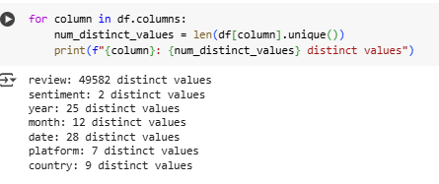
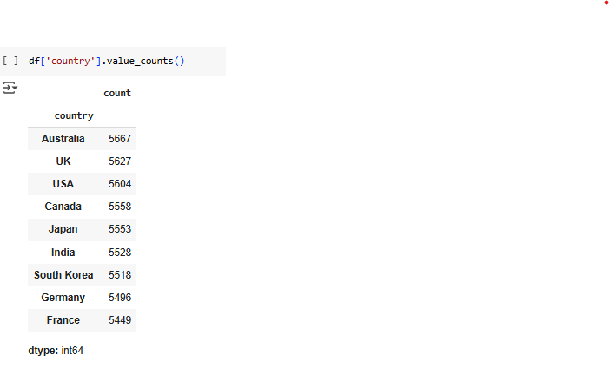
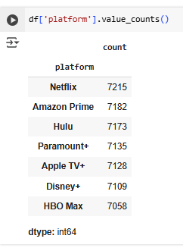
USES OF DISTRIBUTED SYSTEM
Finding distinct values
2
Finding Total reviews per each platform
Finding Total reviews from each country
3

Slide 6
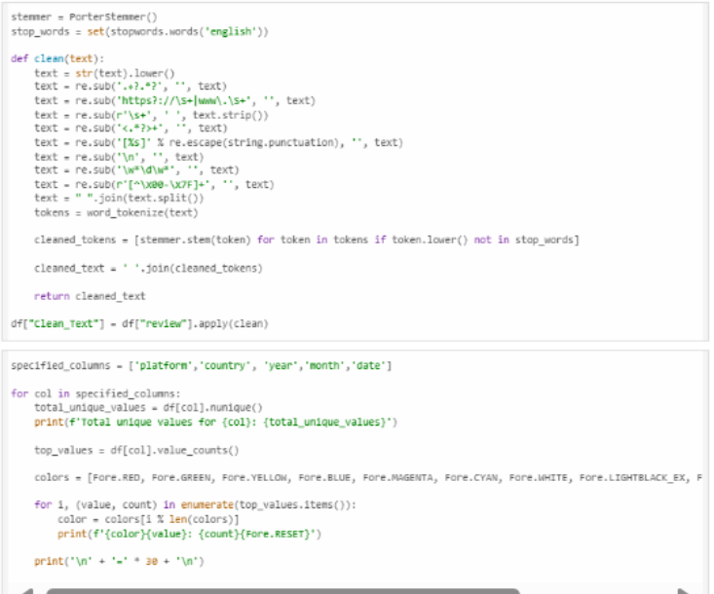
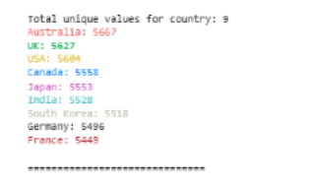
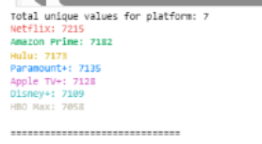
AIM 7: Feature Extraction and Analysis Techniques
This section includes:-
Text preprocessing (cleaning, tokenization, stemming
Exploratory analysis of sentiment distribution
Temporal analysis (year, month, day )
Platform and country-based sentiment analysis
Word frequency analysis by sentiment
2
3

Slide 7
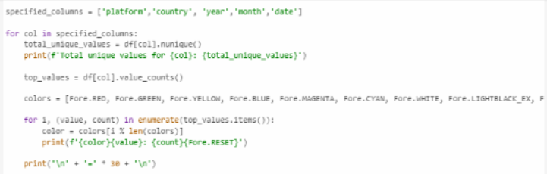
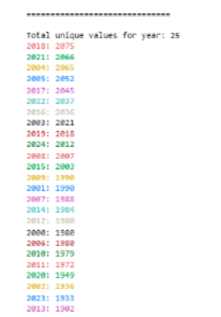
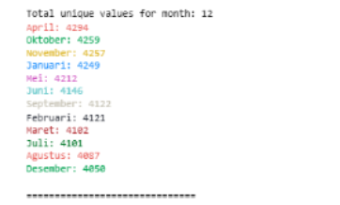
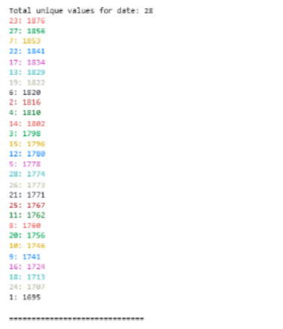
Temporal analysis (year, month, day )
Analysis by Year
Analysis by month
Analysis by month
3

Slide 8
Why did we use temporal analysis
When a person has to making movie they pick a genre(like romance,action,suspense,thriller,etc)
2
They take top 10-20 movies in that genre and they can complie data , integrate it and summarize it in form like OLAP cube.
Temporal analysis helps to summarize such huge dataset based on time interval for more accurate prediction
3

Slide 9

Exploratory Data Analysis (EDA)
EDA is used to
It consists of 6 tansformation out of which we are using multi cast transformation. This transformation creates multiple copy of dataset so you can simultaneously work with many version of dataset at a time
2
3

Slide 10
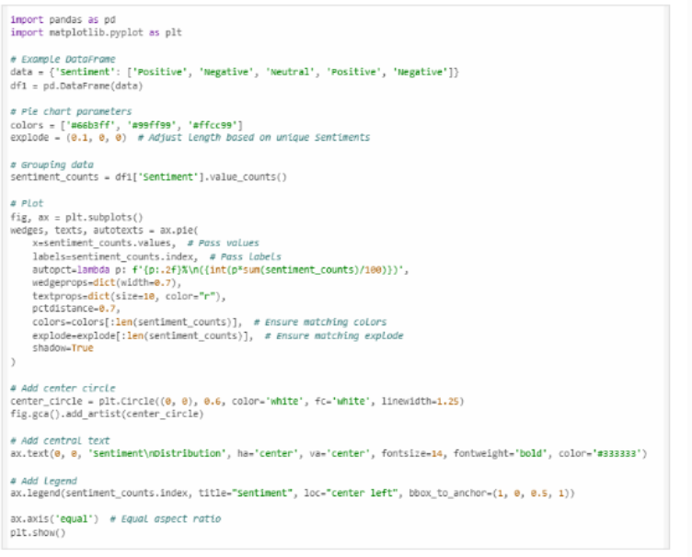
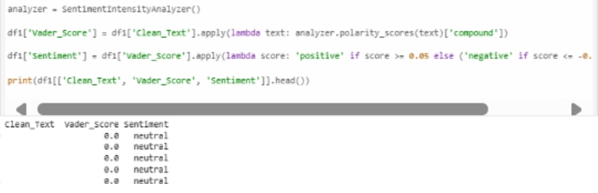
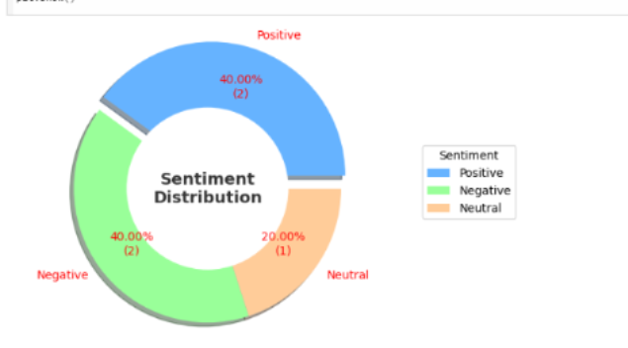
Sentiment Analysis
We have done sentiment analysis and print first five row using head() function
2
3

Slide 11
Visualization using bar chart
2
3

Slide 12
Visualization using bar chart
2
3

Slide 13
Visualization using bar chart
2
3

Slide 14
Soln to scalability
Horizontal Scaling – Adding more machines to the network.
Vertical Scaling – Upgrading existing machines.
Load Balancing – Distributes workload across servers.
2
3

Slide 15
Soln to fault tolerance
Load Balancing: Distributing network traffic across multiple servers ensures that if one server fails, others can still handle the load.
Clustering: Creating clusters of servers ensures that if one server fails, another can take over the workload seamlessly.
Virtualization: Running virtual machines on a server allows for easy migration of workloads to another server in case of hardware failure.
Microservices Architecture: Breaking down applications into smaller, independent services allows for the isolation of faults, preventing the entire system from failing if one service encounters issues.
Distributed Cloud Architecture: Distributing applications across multiple cloud regions or providers enhances fault tolerance by reducing the impact of a failure in a specific region or service.
2
3

Slide 16
Ending slide
THANK YOU FOR WATCHING
2THTH
3

