Slide 1

Capstone Presentation
Object Detection Using YOLO for Sign Recognition
Presented by :- Preet.T.Patel, Padhmanabh Wanikar, Krunal Dhapodkar
Sem: VI-C,A,A
PRN:-2207051088, 22070521058,22070521006

Slide 2
Table of Contents
1. Introduction & Problem Statement
2. Objectives
3. Methodology
4. Key Findings / Results
5. Conclusion & Future Scope
6. References
1
2

Slide 3
Introduction & Problem Statement
Sign language is a vital communication method for individuals with hearing or speech impairments. Traditional methods of sign recognition often require costly and non-portable hardware, such as gloves or depth sensors. In this project, we leverage the advanced object detection capabilities of the YOLO (You Only Look Once) model, specifically YOLOv11 and YOLOv12, to develop a lightweight and accurate sign language recognition system.
The primary challenge addressed in this project is the real-time detection and interpretation of sign language gestures, especially those involving intricate finger positions and subtle hand motions. Our problem statement revolves around creating a robust, real-time detection system that functions well under various environmental conditions, including different lighting scenarios, and across multiple platforms (e.g., desktop and mobile).
2
3

Slide 4
Objectives
Develop a YOLO-based real-time object detection model for recognizing American Sign Language (ASL) signs.
Enhance detection accuracy using multi-scale feature integration and improved attention mechanisms.
Ensure system efficiency for real-time processing and deployment on limited hardware devices.
Implement a user-friendly interface that provides textual interpretation of recognized signs.
Facilitate continuous improvement through user feedback and modular updates.
3
4

Slide 5
Methodology
Our proposed system leverages YOLOv12's advanced object detection capabilities to create a robust sign language detection system with the following components:
1.YOLOv12-based Detection Engine:
State-of-the-art object detection with improved small object detection The network design includes improved feature extraction capabilities to monitor delicate hand arrangement patterns.
The detection engine uses optimized anchor-free processing methods to speed up system operations.
2. Multi-scale Feature Integration:
The system utilizes a hierarchical feature pyramid structure to discover signs which appear at different object sizes.
The system implements improved spatial attention methods which direct focus toward important hand areas.
The detection system employs context-aware capabilities which distinguish between hand motions that have similar gestures.
4
5

Slide 6
Methodology
3. Robust Data Processing Pipeline:
During training the system uses dynamic data augmentation methods to enhance generalization capabilities.
The system enables real-time processing of images under different lighting situations. Background invariant detection techniques
4. Efficient Model Architecture:
We applied model quantization along with pruning techniques for deploying the model onto restricted devices.
The system contains a real-time detection optimization of its inference process. A video frame batch processing system works to enhance system throughput.
5. User-friendly Interface:
Text interpretation of detected warning signs appears in real-time.
User feedback mechanism for continuous improvement
Cross-platform compatibility (desktop and mobile)
The system is designed to detect common phrases/words in American Sign Language, providing immediate textual interpretation to facilitate communication.
5
6

Slide 7
System Details
Software
Python (updated to latest version possible )
Ultralytics YOLO (installed and updated )
Google Colab
OpenCV
Storage: At least 2GB for dataset and models
Hardware
T4 GPU (as we’re using YOLOV11 for sign language detection)
6
7

Slide 8
Key Findings / Results
Model trained on 233 images (204 training, 20 validation, 9 testing) using Roboflow dataset.
Achieved accurate real-time detection with YOLOv11/YOLOv12, using confidence threshold of 0.25.
Model performance verified on video input (capstone.mp4) with visual annotations.
Efficient batch processing increased throughput for video-based recognition.
Limitations include generalization to unseen data and dependency on dataset diversity.
7
8

Slide 9
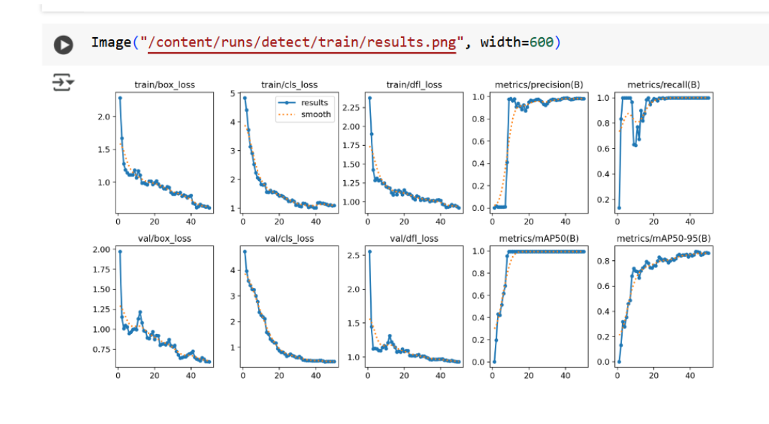
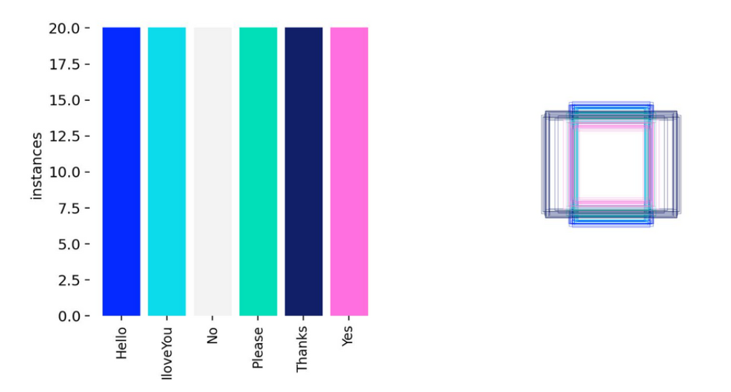
Result & Metrics
8
9

Slide 10
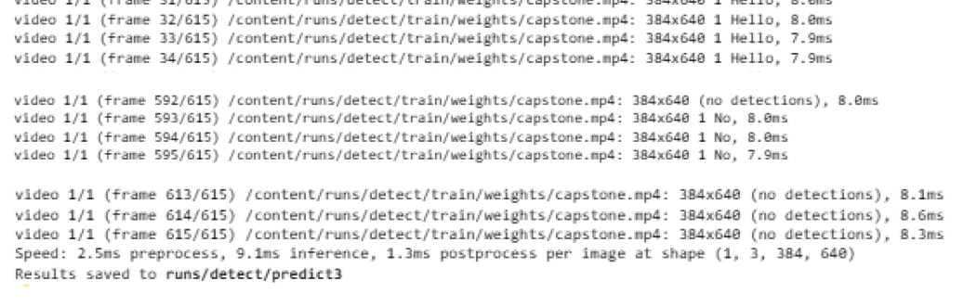
Model Prediction on Video
After training the model, it is tested on a video(capstone.mp4) to verify its performance. The best-trained weights (best.pt) are used for prediction.(conf=0.25) is the Confidence threshold for detecting an object. (save=True) is used to save the detected results as output.
9

Slide 11
Conclusion and Future Scope
The implemented YOLO-based system demonstrated efficient, real-time sign recognition capability. Its performance under standard lighting and across simple backgrounds was satisfactory. The object detection framework proved to be robust enough to interpret American Sign Language with real-time output, making it a valuable aid for communication.
Future Scope
Deploying the model on embedded systems (Raspberry Pi, Jetson Nano).
Improving accuracy with larger and more diverse datasets.
Integrating object tracking for real-time applications.
10

Slide 12
References
1. Roboflow English Sentences Dataset for Object Detection
2. Ultralytics YOLO Documentation
3. Amazon S3 Secure Storage Documentation
4. Python, OpenCV, Google Colab – various official sources
5. IPython and gdown library documentation
11

Slide 13
THANK YOU FOR WATCHING !!!
12

