Slide 1
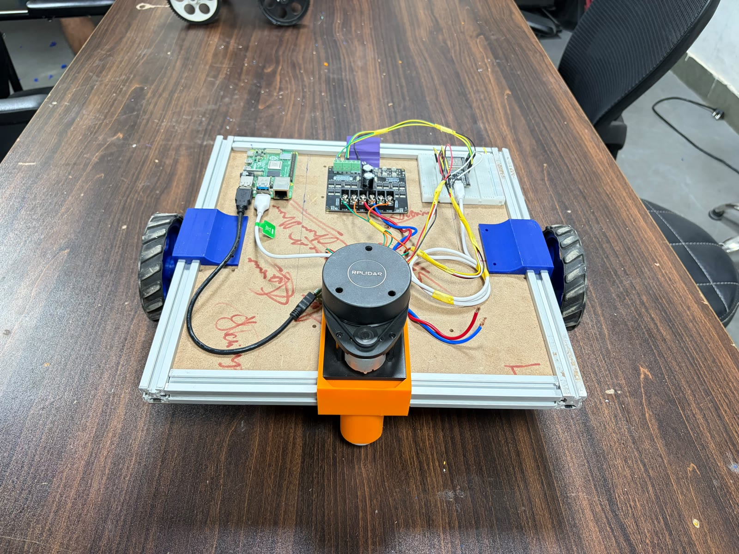
Autonomous Mobile Robot
ROS 2 Humble · micro-ROS · SLAM Toolbox · Nav2 — built from scratch in 5 days
Robotics Society, IIT Jodhpur · Core Team 2026–27
Notes:
Final-product overview of the AMR: hardware, software stack, data, how to run it, known issues and learning resources.

Slide 2
A SLAM + Nav2 robot in five days
5 days
50 Hz
17 rad/s
1 script
kickoff to autonomous navigation (23 → 28 Sep 2026)
wheel control loop on the ESP32 and odometry on the Pi
wheel speed limit ≈ 0.95 m/s top speed
./amr_bringup.sh starts the whole robot
Goal: build an AMR end to end as Inter-IIT preparation — chassis, electronics, firmware, ROS 2 stack
Maps a room with an RPLIDAR A1 (SLAM Toolbox), localizes on the saved map (AMCL) and drives to goals (Nav2)
Raspberry Pi runs ROS 2; an ESP32 closes the wheel speed loops and talks to the Pi over micro-ROS (Wi-Fi)

Slide 3
Hardware: what the robot is built from
Component | Role | Key specs
Raspberry Pi | ROS 2 computer | Ubuntu 22.04, ROS 2 Humble
ESP32 | Wheel PID, encoders, micro-ROS | 50 Hz control task on core 1
Cytron motor driver | Drives both motors | PWM + DIR, 20 kHz, 10-bit
Right motor | Drive wheel | PG36M555-19.2K, 12 V, 262 RPM
Left motor | Drive wheel | 26.9:1 gearbox
Encoders | Wheel feedback | ME-37, 7 PPR, 4× decoding
RPLIDAR A1 | 2D laser scans | 10 Hz, 12 m, /dev/ttyUSB0
Wheels | Drive | r = 0.056 m, track 0.39 m
T-slot frame · RPLIDAR on 3D-printed mount (front) · Pi · Cytron driver · ESP32

Slide 4
System architecture
Raspberry Pi · ROS 2 Humble
Laptop
RViz
DDS Wi-Fi
Nav2 + AMCL / SLAM Toolbox
amr_diff_drive (odometry + wheel cmds)
Pi: perception, mapping, planning, odometry
ESP32: hard real-time wheel control
Only Nav2 or teleop drives /cmd_vel
rplidar_ros
micro-ROS agent
ESP32
PID + encoders
Cytron driver
UDP 8888
USB serial
PWM+DIR
encoder A/B
Motors +
encoders
RPLIDAR A1

Slide 5
Data flow: topics between nodes (nav mode)
rplidar_node
/odom + TF odom→base_link (50 Hz) feed AMCL and Nav2
/scan
amcl
amr_diff_drive
ESP32
/map
map_server
/left_vel /right_vel 50 Hz →
← /encoder_telemetry 20 Hz
map→odom
/cmd_vel
Nav2 servers
planner · controller ·
bt_navigator · smoother
RViz (goal, initial pose)
goal
cmd_vel_nav
velocity_smoother
In slam mode, map_server + amcl + Nav2 are replaced by slam_toolbox, and /cmd_vel comes from teleop.

Slide 6
TF tree and one-command bringup
map
1
micro-ROS agent
./amr_bringup.sh [nav|slam|robot]
Each program in its own process group, log in ~/amr_logs/
Kills leftovers from earlier runs first
Ctrl-C: SIGINT to all, SIGKILL after 5 s
wait /encoder_telemetry
AMCL (nav) / SLAM Toolbox (slam)
2
laser TF
odom
laser_tf.launch.py
3
amr_diff_drive
amr_diff_drive, 50 Hz
wait /odom
base_link
4
rplidar_ros
wait /scan
static: x 0.175, z 0.100 m
laser
5
Nav2 or SLAM
wait 'Managed nodes are active'

Slide 7
micro-ROS: the ESP32 as a ROS 2 node
Direction | Topic | Type | QoS / rate
Pi → ESP32 | /left_vel, /right_vel | Float64 (rad/s) | reliable, 50 Hz
ESP32 → Pi | /encoder_telemetry | JointState | best effort, 20 Hz
WAITING_AGENT
ping ok
AGENT_AVAILABLE
Agent on the Pi (udp4, port 8888) creates DDS entities for the ESP32
Static message memory — no heap allocation on the ESP32
Time sync at connect: telemetry stamped with Pi time for latency compensation
Motors stop whenever the agent is lost or commands are > 500 ms old
entities created
AGENT_CONNECTED
ping fails
AGENT_DISCONNECTED
↺ back to WAITING_AGENT (auto-reconnect, no reset needed)

Slide 8
ESP32 wheel speed control loop (50 Hz)
Read encoder
Velocity filter
Setpoint ramp
Feed-forward + PI
Anti-windup
PWM + DIR
PCNT hardware, 4×
α = 0.3 (τ ≈ 56 ms)
≤ 40 rad/s²
kff·ref + min + kp·e + I
freeze I when saturated
Cytron, 0–1023
Parameter | Left (26.9:1) | Right (19.2:1)
kff (PWM per rad/s) | 49.72 | 43.54
PWM min (friction) | 11.8 | 12.0
kp / ki | 30 / 12.5 | 25 / 10
CPR (counts / wheel rev) | 752.6 | 536.1
Max speed | 17 rad/s | 17 rad/s
FreeRTOS task on core 1, never blocked by Wi-Fi
Shared state with loop() through one spinlock-protected struct
Serial console for live tuning: t, sq, pwm, kp L 12, plot

Slide 9
Feed-forward does most of the work
PWM ≈ kff · speed + friction offset
At 17 rad/s: left ≈ 857 (84 %), right ≈ 752 (74 %)
Leaves headroom for the PI correction
PI only fixes the remainder: load, battery, friction

Slide 10
Encoders: from counts to rad and rad/s
Counting
Position
Velocity
ME-37 encoder, 7 PPR. 4× decoding = 28 counts per motor revolution, × gear ratio per wheel revolution.
pos = 2π · counts / CPR, in double precision, cumulative since boot.
Δcounts over 20 ms, then low-pass filtered. One count = 0.42 rad/s (L), 0.59 rad/s (R).
Telemetry field | Value
name | [left_wheel, right_wheel]
position | rad, cumulative
velocity | rad/s, filtered
header.stamp | Pi-synchronized time
Pi integrates position differences → no drift from lost packets
Jump > 10 rad = encoder reset (ESP32 reboot), ignored

Slide 11
amr_diff_drive: kinematics and odometry
Command path (/cmd_vel → wheels)
ωL = (v − ω·L/2)/r, ωR = (v + ω·L/2)/r
Both wheels scaled together above 17 rad/s (same curve). 0.5 s timeout → stop.
Odometry path (encoders → pose)
Δs = r(ΔR+ΔL)/2, Δθ = r(ΔR−ΔL)/L
Exact arc integration → /odom and TF odom→base_link at 50 Hz.
Pose predicted from measurement time to now (≤ 0.2 s). Yaw error 4.51° → 0.01°.

Slide 12
Measured encoder latency over Wi-Fi (28 Sep run)
139 windows, 0 stamps rejected
Window means 15.1–241.7 ms, median 85.1 ms
Peak sample 409.7 ms
Above 0.2 s the prediction is skipped
Same run: frequent micro-ROS reconnects → see Known issues

Slide 13
Perception and mapping: RPLIDAR A1 + SLAM Toolbox
/scan + odom TF
Motion gate
0.3 m / 0.3 rad
Scan matching
Pose graph +
loop closure
Ceres optimize
/map + map→odom
RPLIDAR A1 | Value
Scan mode | Sensitivity, 8 kHz
Rate / range | 10 Hz, 0.15–12 m
Frame | laser (0.175 m ahead of base_link)
Port | /dev/ttyUSB0, 115200
SLAM Toolbox | Value
Mode | online async, mapping
Resolution | 0.05 m
Map update | every 5 s
Loop search | within 3 m
Save: ros2 run nav2_map_server map_saver_cli -f ~/amr/maps/<name>

Slide 14
Navigation: Nav2 from goal to wheels
Goal (RViz)
bt_navigator
replan 1 Hz
NavFn planner
global costmap
Regulated Pure
Pursuit, local costmap
velocity_smoother
0.25 m/s, 1 rad/s
amr_diff_drive
Localization: AMCL
Costmaps
Recovery
300–1500 particles, likelihood-field laser model, 60 beams. Updates after 0.15 m / 0.2 rad. Start with 2D Pose Estimate.
Local 3×3 m in odom, global in map. Obstacles to 2.5 m, inflation 0.40 m. Footprint 0.50 × 0.46 m.
Clear costmaps → spin 1.57 rad → wait 5 s → back up 0.30 m. Up to 6 retries. All Nav2 nodes in one process.

Slide 15
Code structure and how to run it
Path | Contents
amr_bringup.sh | starts everything (nav | slam | robot)
amr_ws/src/amr_diff_drive | odometry + wheel commands (Python)
amr_ws/src/amr_navigation | SLAM, Nav2, laser TF launch + params
amr_ws/src/amr_teleop | WASD keyboard teleop
amr_ws/src/rplidar_ros | LiDAR driver (vendored)
microros_ws/ | micro-ROS agent
firmware/esp32/ | Arduino sketch
docs/ | architecture, guides, hardware, calibration
ln -s <clone>/final-product ~/amr
cd ~/amr
scripts/install_deps.sh
scripts/build.sh
./amr_bringup.sh # nav
./amr_bringup.sh slam # mapping
ros2 run amr_teleop wasd_teleop
Flash the ESP32 first: set Wi-Fi SSID, password and the Pi's IP in amr_esp32.ino.

Slide 16
Known issues and next steps
Fix before the next run
Next steps
ROS domain mismatch risk (firmware uses domain 0)
Unstable micro-ROS link: 203 sessions in 22 min
High encoder latency in the same run
URDF from the CAD (robot model in RViz)
IMU + EKF fusion with wheel odometry
twist_mux so teleop can override Nav2
Network settings stored in ESP32 flash
Demo videos: AMCL, obstacle avoidance, recovery
Full list: docs/known-issues.md
Measure, then tune
Real footprint (0.50 × 0.46 m is a placeholder)
Wheel radius and separation calibration
LiDAR mount offsets; then Nav2 speed and inflation

Slide 17
Resource guide: learn the prerequisites
1 ROS 2
2 TF
3 Kinematics
4 Motor control
Humble tutorials, Articulated Robotics
tf2 docs, REP-103, REP-105
diff-drive notes, Modern Robotics ch. 13
PID video series, encoders, FreeRTOS
5 micro-ROS
6 SLAM
7 Nav2
resource-guide/README.md — foundational material in suggested order
overview, concepts, micro_ros_arduino
Stachniss lectures, Probabilistic Robotics
concepts, robot setup and tuning guides

Slide 18
Built to be continued
final-product/README.md · docs/guides/ · resource-guide/

