Slide 1
Multi-Robot Frontier Exploration with ROS 2 and Reinforcement Learning
Two TurtleBot3s · Gazebo · SLAM · map merging · Nav2 · a PPO policy that out-explores the hand-designed heuristic
Notes:
Project overview: a complete multi-robot exploration stack in ROS 2 Humble, plus a learned frontier-selection policy.

Slide 2
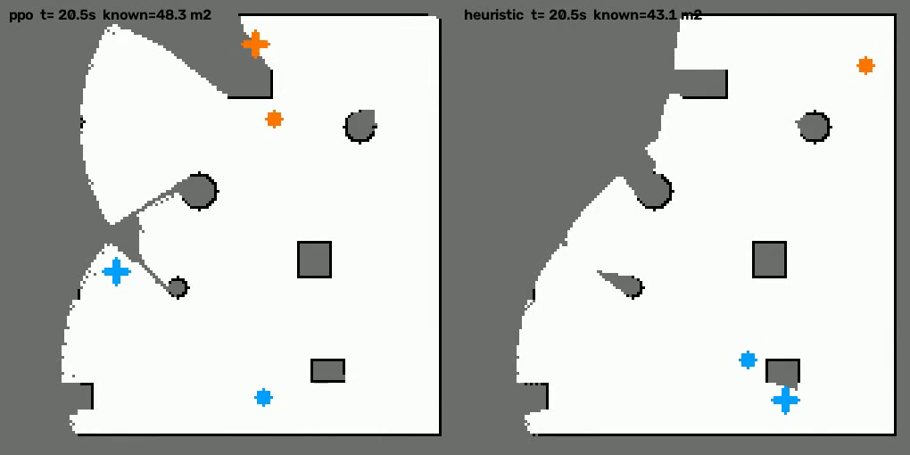
The problem: map an unknown arena as fast as possible
Two robots start in an unknown 8 × 8 m arena with random obstacles
A frontier is the boundary between mapped free space and unknown space
Exploration = repeatedly choosing which frontier each robot drives to next
Good choices spread the robots out and avoid long, low-yield trips
Question: can reinforcement learning make this choice better than a hand-tuned rule?
Grey = unknown, white = mapped, crosses = each robot's chosen frontier
−21 %
8 / 8
time to map 30 m² with the RL policy (Gazebo)
paired Gazebo runs won by RL (p = 0.008)

Slide 3
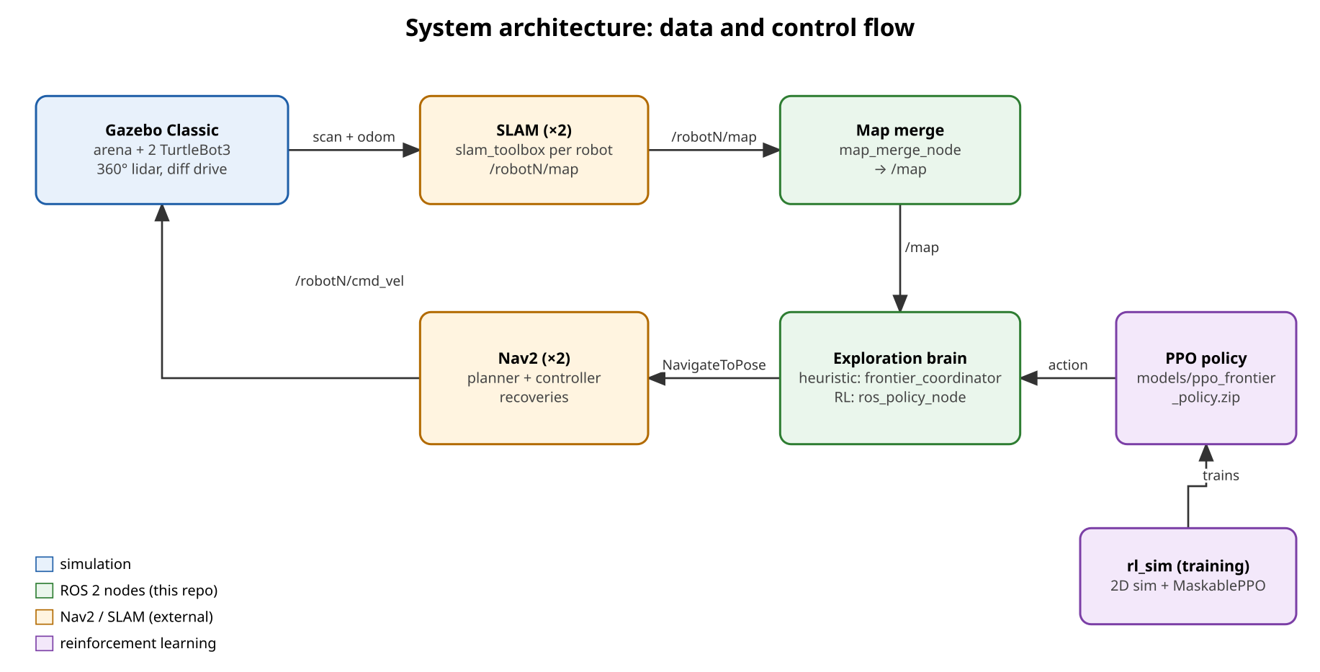
System architecture: data and control flow
Notes:
Gazebo produces scans and odometry; slam_toolbox builds a map per robot; map_merge_node fuses them; the brain reads /map and sends NavigateToPose goals to each robot's Nav2, which drives the robot.

Slide 4
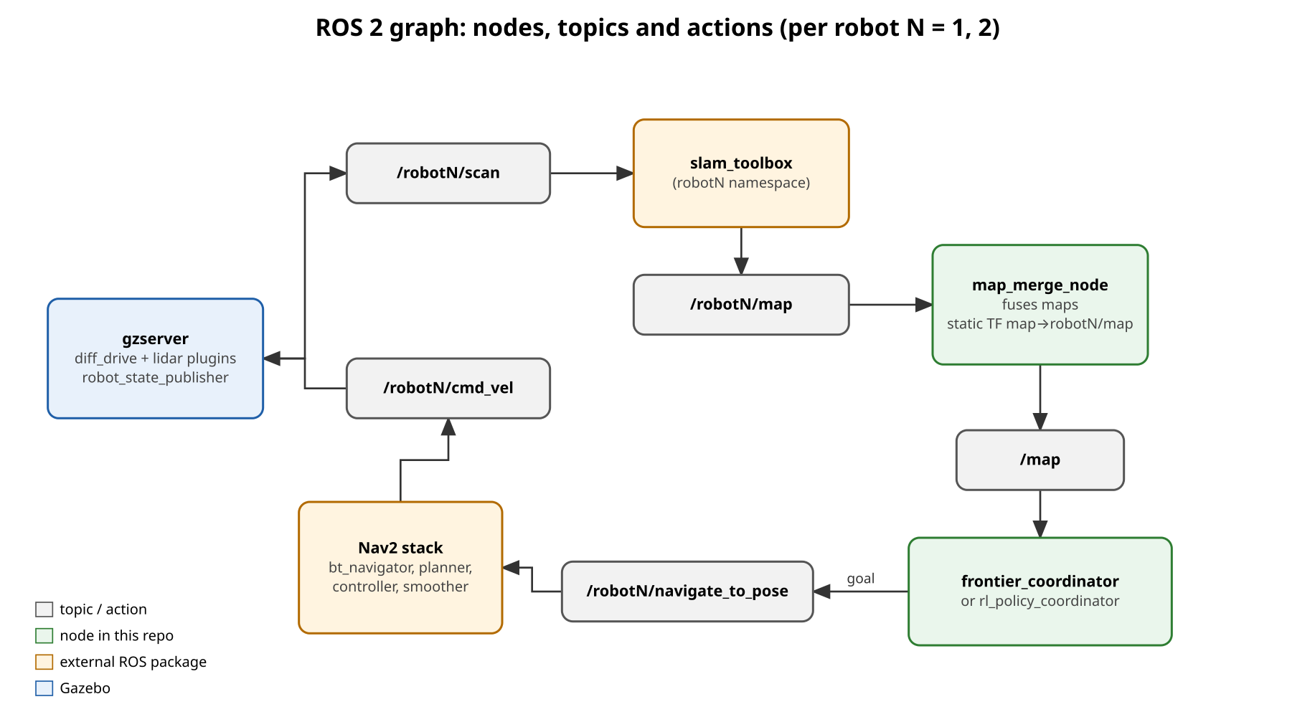
ROS 2 graph: nodes, topics and actions
Everything per robot lives in its namespace: /robot1/…, /robot2/…
slam_toolbox remaps its absolute /map to a namespaced map
Only /map is shared: the merged occupancy grid at 2 Hz
The brain talks to Nav2 through the NavigateToPose action

Slide 5
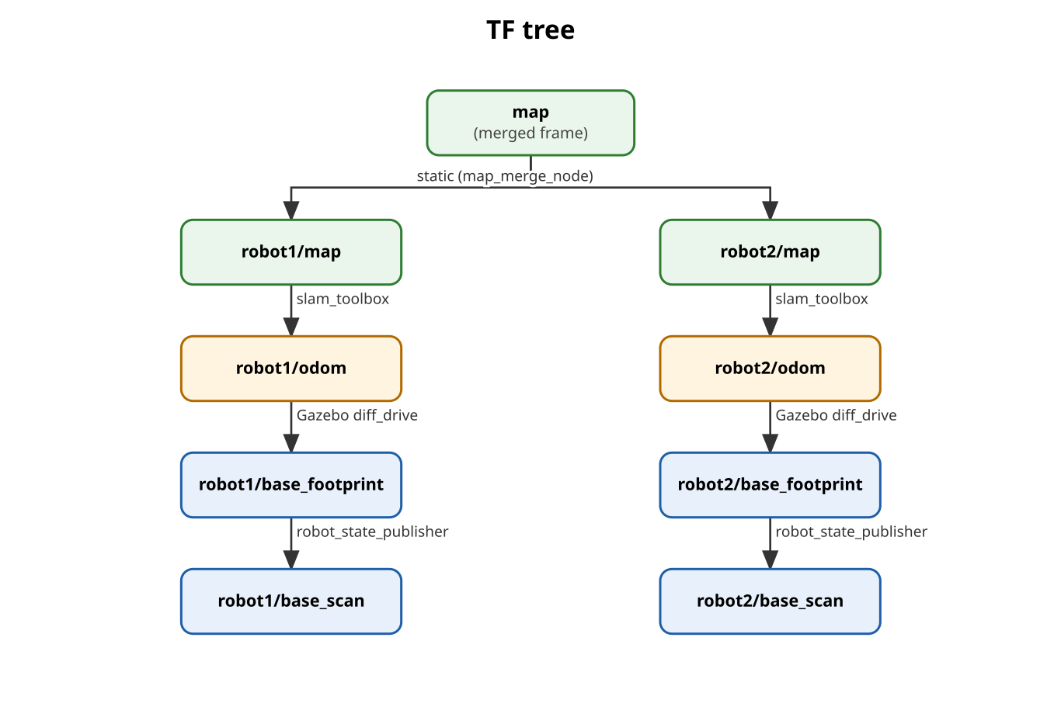
Frames and map merging
Map merge node
Reprojects every cell of /robot1/map and /robot2/map into one grid. Occupied wins, then direct assignment, then averaging. Vectorised NumPy at 2 Hz.
Why the offsets are zero
Gazebo's diff-drive odometry starts at each robot's world spawn pose, so each SLAM map is already in world coordinates. Adding the spawn pose again would double-offset the maps.

Slide 6
Fixing robots stuck next to obstacles
Cause: ghost obstacles
Each robot's SLAM map marks the other robot as an obstacle. Nav2 loaded that map as a static layer, so a robot driving onto a ghost could never clear it (lidar blind zone < 0.12 m) and stayed stuck.
Fix
Global costmap uses live lidar only (no static SLAM layer). Inflation 0.15 → 0.35 m, a stronger obstacle critic, and the training simulator's clearance raised to 0.3 m (policy retrained). Failed goals: 1.4 → 0 (PPO), 2.4 → 0.4 (heuristic).

Slide 7
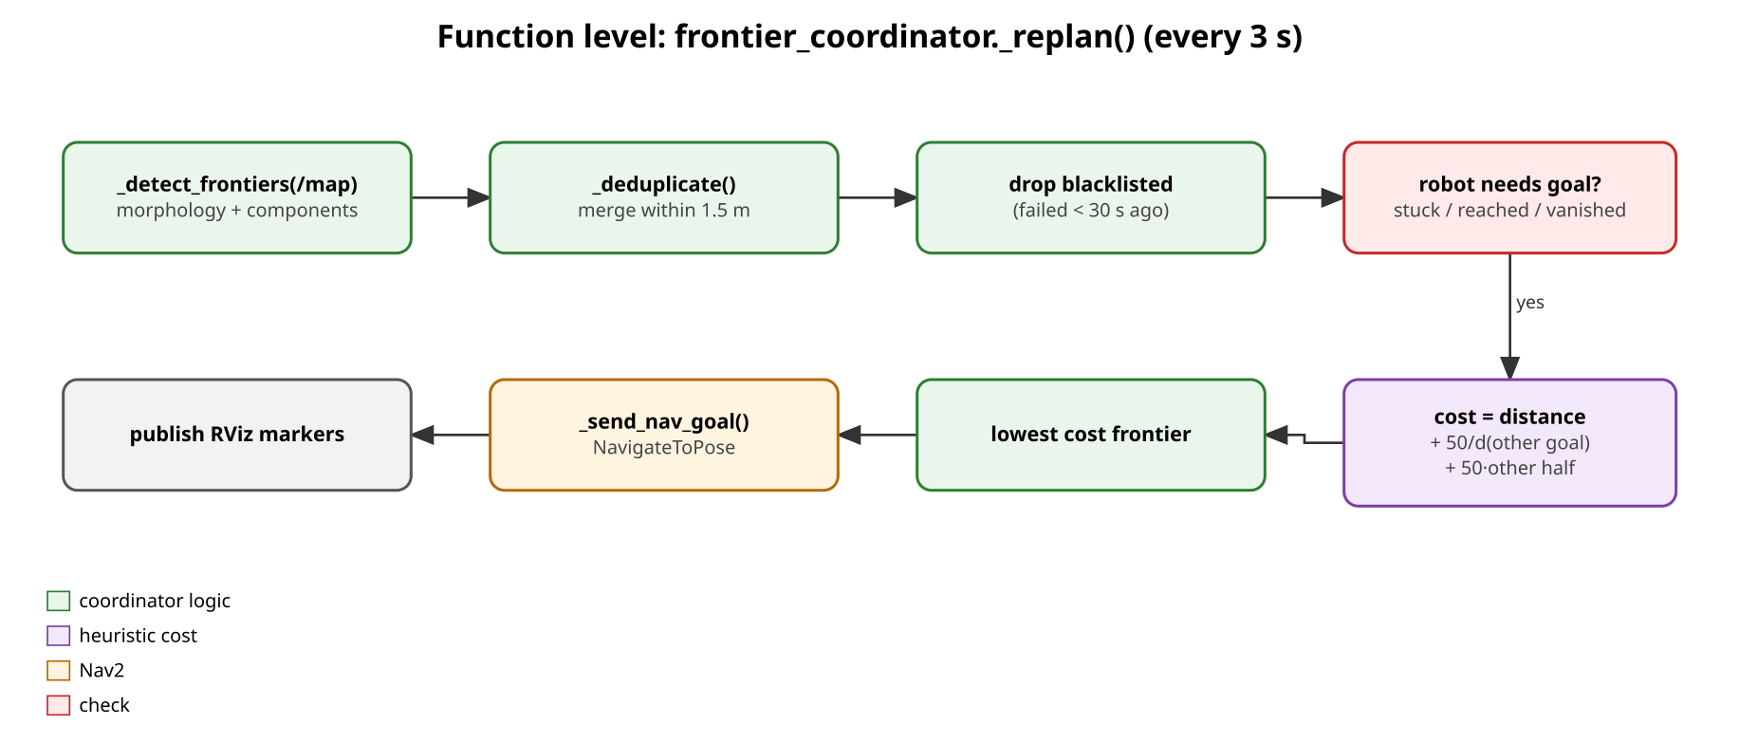
Heuristic brain: frontier_coordinator
Frontiers: morphological detection on /map, clusters > 15 px, merged within 1.5 m
Replans every 3 s; stuck detection after ~9 s without progress
Failed goals blacklisted for 30 s
Fixed hand-tuned weights: the baseline to beat
cost = distance + 50 / d(other robot's goal) + 50 · max(0, metres into other robot's half)

Slide 8
RL brain: the decision as a learning problem
Action
Observation
Reward
Pick one of the 12 nearest reachable frontiers for the robot that needs a goal. Invalid slots are masked (MaskablePPO).
153 numbers: per candidate (position, distance, unknown area around it, distance to the other robot and its goal, heading, the heuristic's pick) plus global state.
+0.1 per newly mapped m², −0.01 per simulated second. Finishing sooner scores higher.
One step = one whole trip, so episodes are ~10 decisions, not hundreds of motor commands
A compact, ego-centric feature vector instead of a raw map image
A deterministic 2D simulator: a clean learning signal, ~0.1 s per episode
Policy: 2×128 MLP actor and critic; PPO with 8 parallel environments

Slide 9
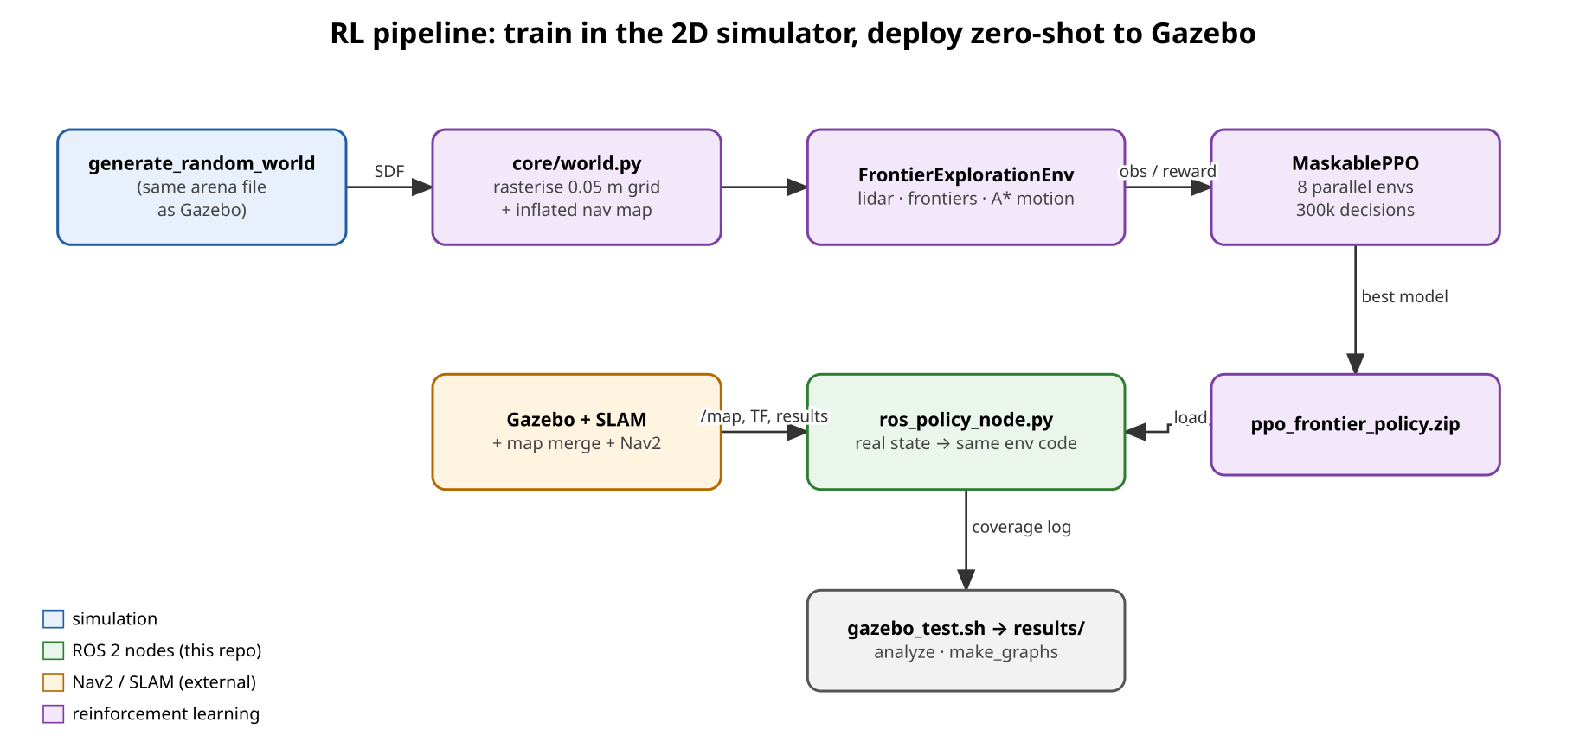
RL pipeline: train in 2D, deploy zero-shot to Gazebo

Slide 10
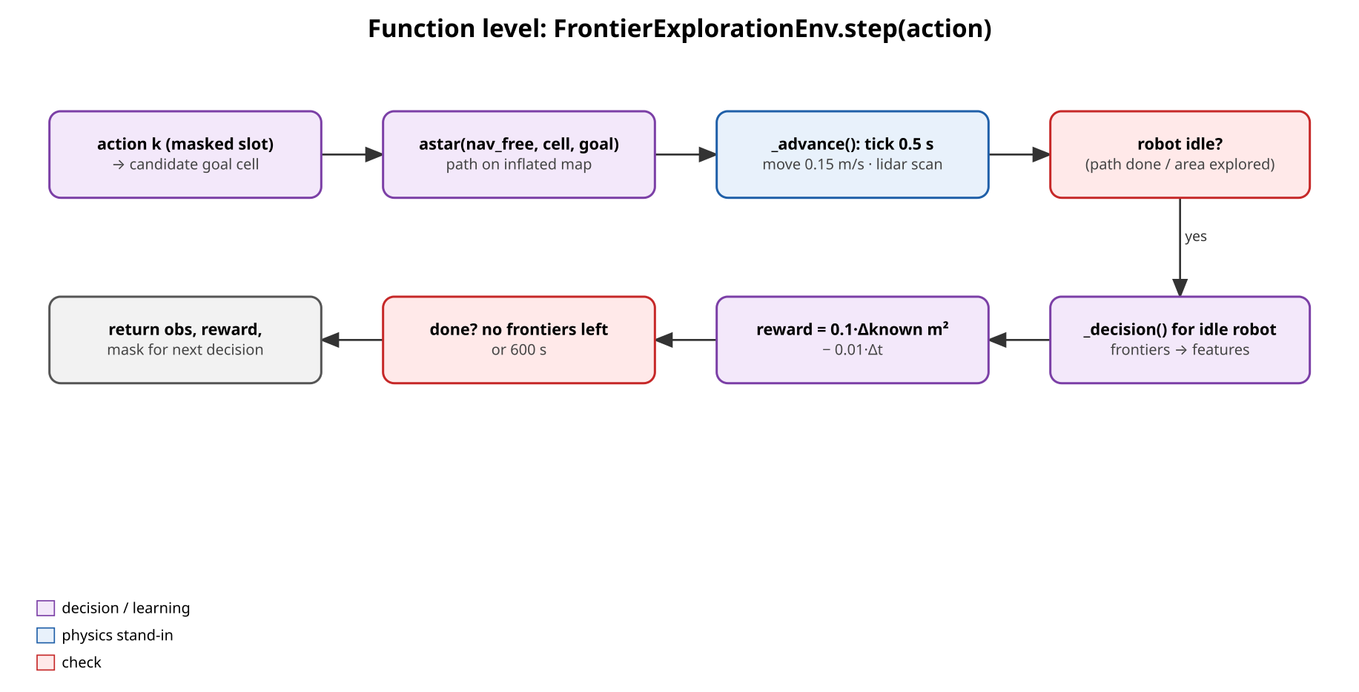
The 2D training simulator (rl_sim)
Arena parsed from the same world file Gazebo loads, at 0.05 m resolution
360-ray lidar, 3.5 m range (TurtleBot3 LDS-01)
A* on a 0.3 m-inflated map at 0.15 m/s (stand-in for Nav2)
Frontier detection identical to the coordinator
~0.1 s per episode in 2D vs ~5 min per episode in Gazebo: the reason training happens here

Slide 11
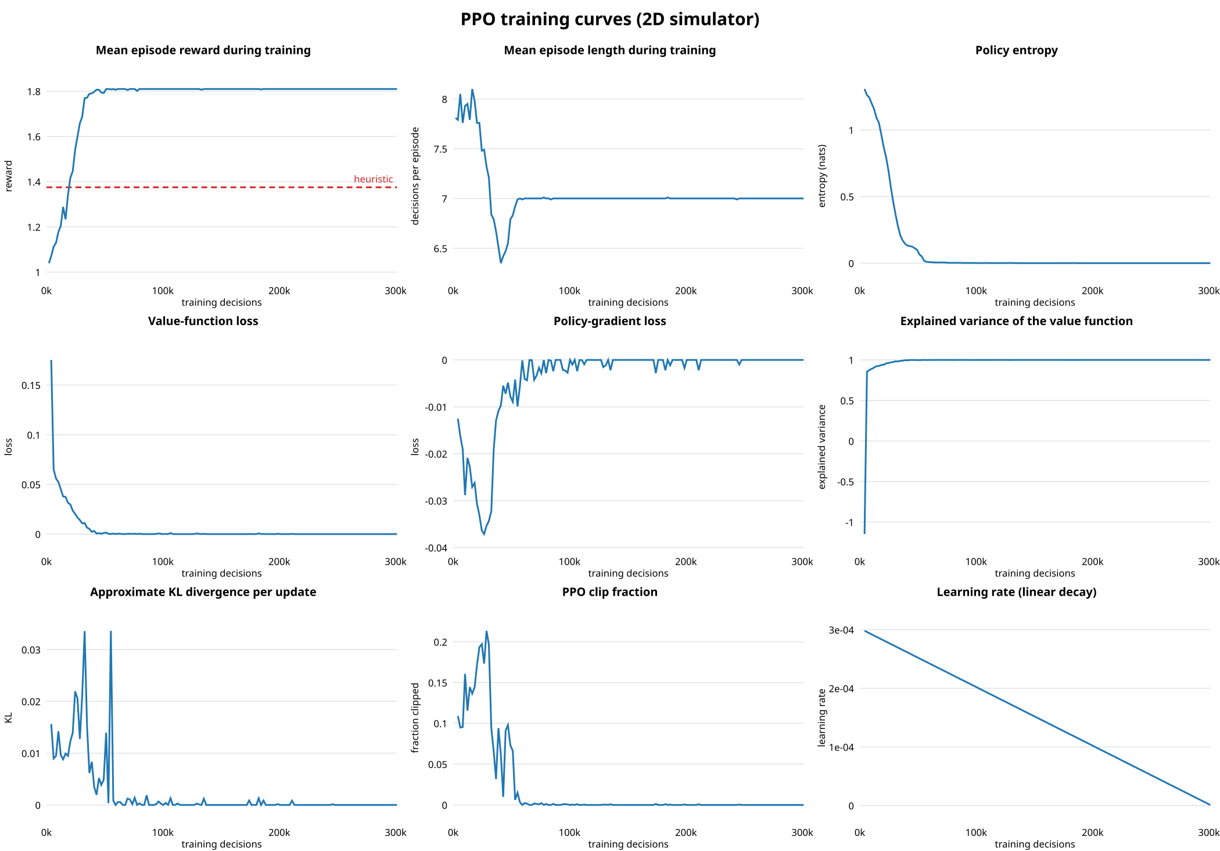
Training converges within ~30k decisions
Reward passes the heuristic level (dashed) and stays flat
Entropy → 0: the policy becomes confident
Explained variance → 1: the critic predicts returns
KL and clip fraction fall to ≈ 0: updates stop changing the policy
300k decisions in ~25 min on a laptop CPU

Slide 12
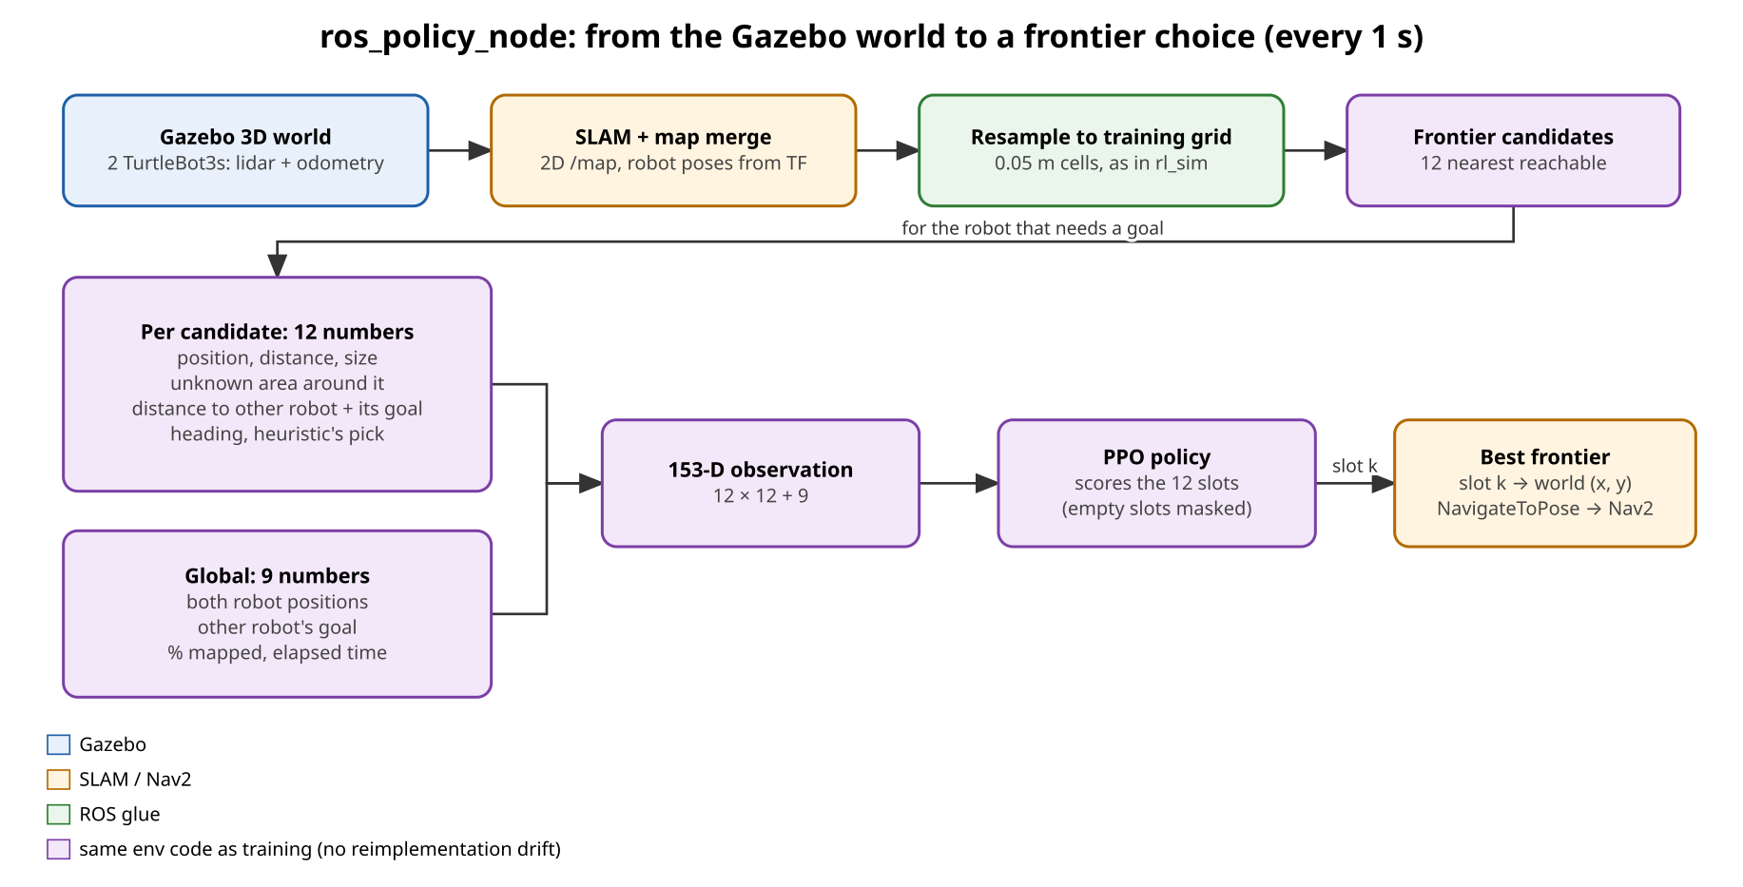
Sim-to-sim transfer: ros_policy_node
Every second: the live /map is resampled onto the training grid
Robot poses come from TF; goal state comes from Nav2 results
The same env code builds the observation, so there's no reimplementation drift
--policy heuristic runs the baseline through identical goal handling

Slide 13
2D simulator: time to fully explore the arena
−40 %
exploration time vs the heuristic (67 s vs 111 s)
7 vs 9
decisions per episode: fewer, better-chosen trips
Deterministic simulator: one episode is exact.

Slide 14
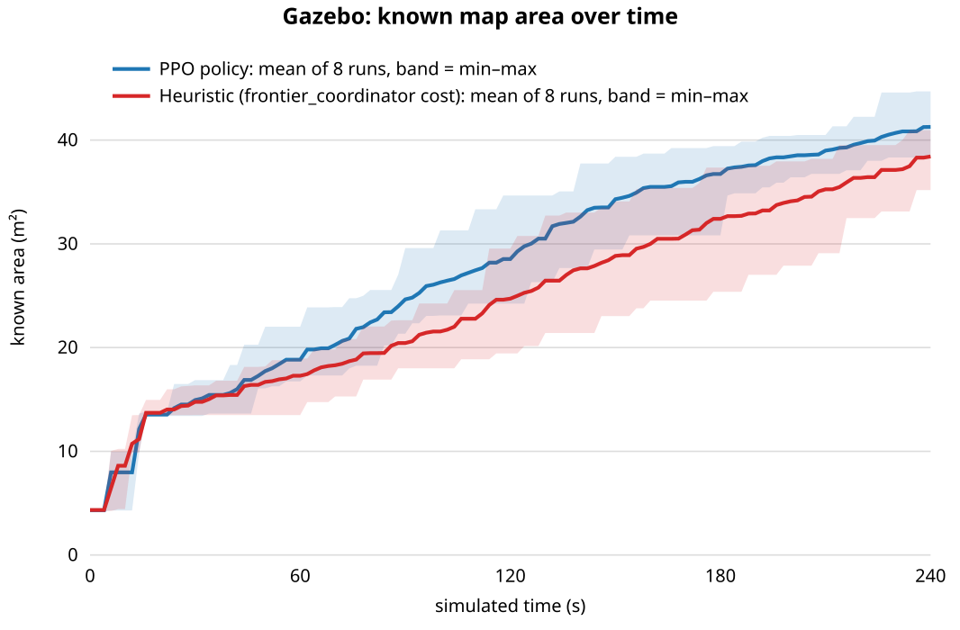
Gazebo: the advantage transfers to the full stack
36.7 m²
PPO, known area at 180 s (± 2.8)
32.4 m²
Heuristic, known area at 180 s (± 3.8)
−21 %
time to map 30 m² (127 s vs 160 s), 8/8 pairs, p = 0.008
8 alternating paired headless runs, 240 s each

Slide 15
PPO maps faster through the run, in every pair
PPO faster in 8/8 pairs (mean −33 s), exact paired permutation p = 0.008

Slide 16
Demo videos
sim2d_ppo_vs_heuristic: side-by-side main result
sim2d_ppo: the learned policy alone
sim2d_heuristic: the hand-designed coordinator rule
sim2d_nearest, sim2d_random: baselines
All in final-product/media/demo-videos, with descriptions
Same moment (t = 20.5 s): PPO has mapped 48.3 m², the heuristic 43.1 m²

Slide 17
Repository and how to run
final-product/
multi_robot_exploration/ launch/ config/
ROS 2 package
rl_sim/ simulator, training, policy node
models/ results/ graphs/ docs/ media/
presentation/
resource-guide/ foundational material
Heuristic mode
Terminals 1–4: spawn, SLAM, map merge, Nav2.
Terminal 5: ros2 launch multi_robot_exploration frontier_exploration.launch.py
Headless benchmark: rl_sim/gazebo_test.sh
Train: python3 rl_sim/train.py (~25 min)
Stats and charts: analyze_gazebo_tests.py, make_graphs.py
RL mode
Terminal 1 on the benchmark arena (GAZEBO_WORLD_SEED=42).
Terminal 5: python3 rl_sim/ros_policy_node.py --model models/ppo_frontier_policy.zip

Slide 18
Limitations and next steps
Limitations
Next steps
Results measured on the benchmark arena only
2D simulator assumes ideal sensing and navigation
Final-area gap at 240 s not significant; full coverage not measured
Simulation only; two robots
Train across many randomised arenas
SLAM-like sensing and navigation failures in the 2D sim
N-robot generalisation
Deploy on physical TurtleBot3s
Longer, more numerous Gazebo trials

