Slide 1
Audio based Activity Recognition
Chandhini Grandhi, A53272378
Sivasankar Palaniappan, A53275703

Slide 2
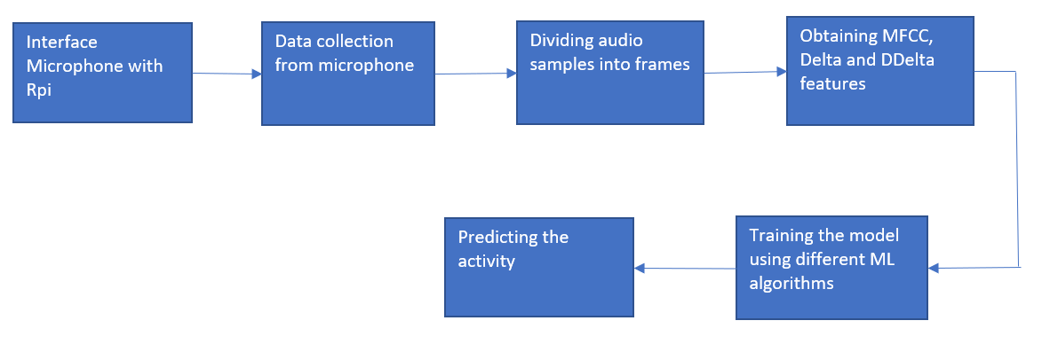
Key idea and System Design
Key idea: Detect sound based activities using a simple and cheap microphone based setup.
System Design:

Slide 3
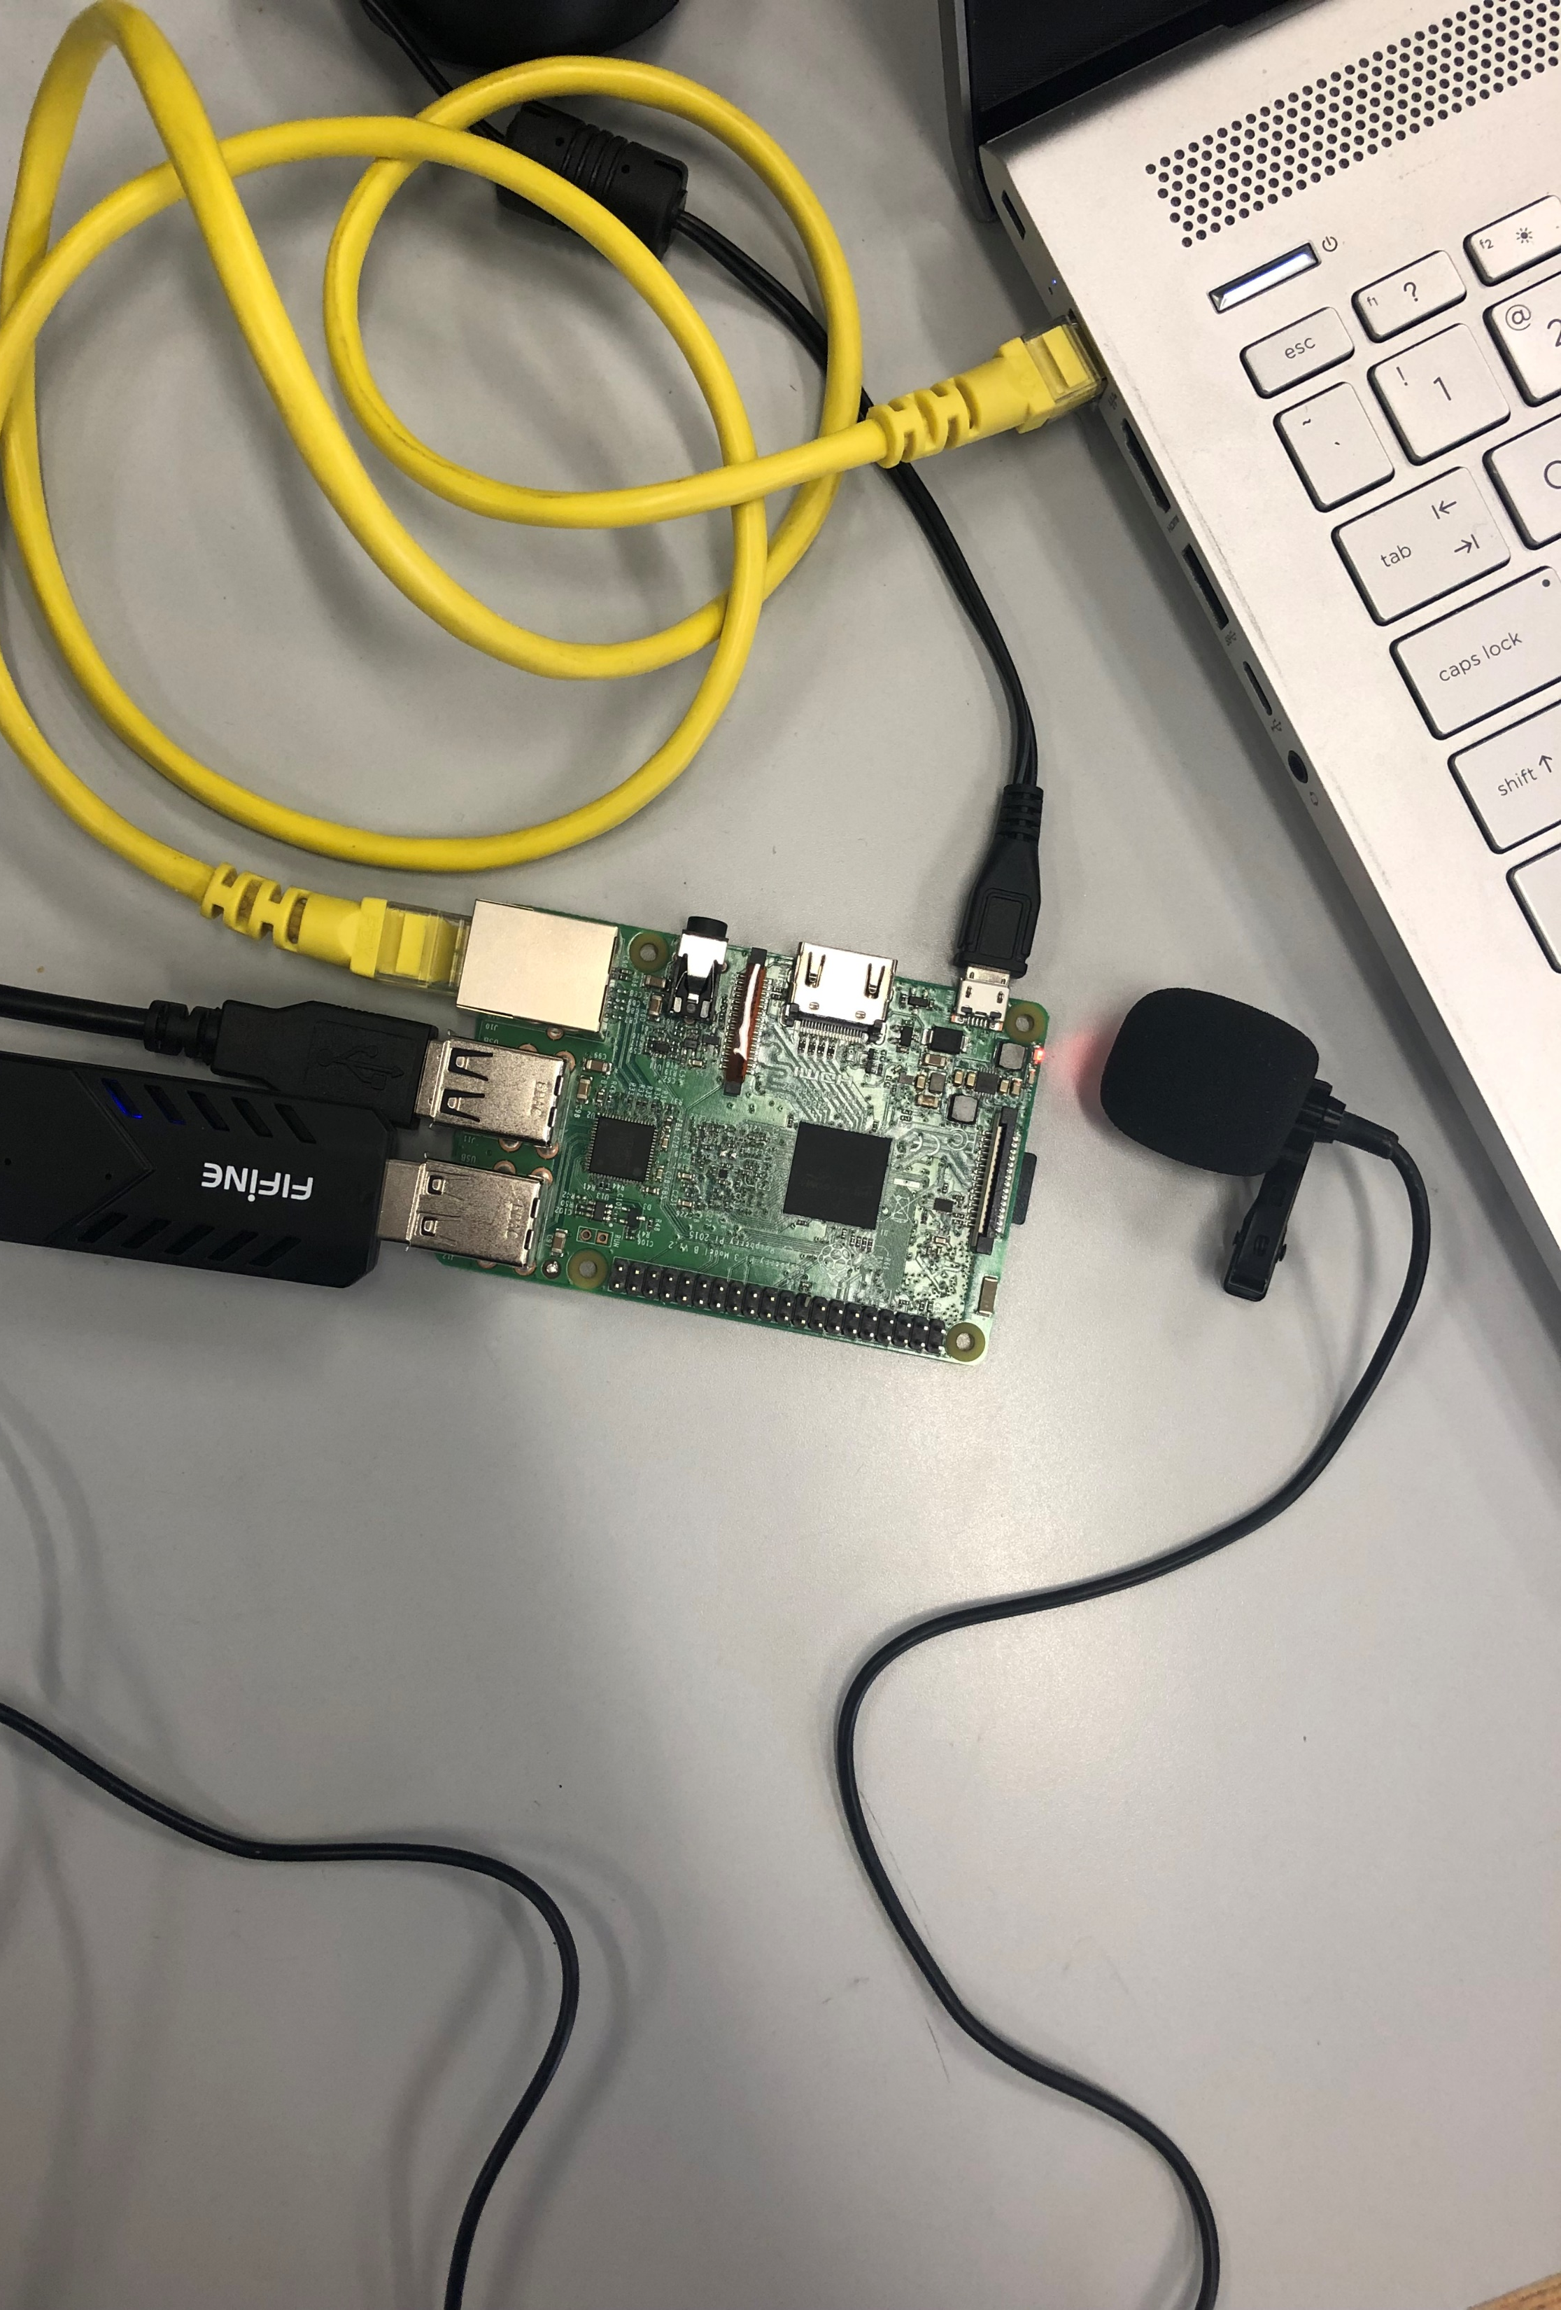
HW and SW components
Hardware:
Raspberry pi 3 – Model B
Computer USB Microphone
Software:
Python
Frameworks:
Mic : Alsa Audio, Pyaudio
ML algorithms - Scikit-Learn, Numpy
GUI - Tkinter

Slide 4
Results:
ML algorithm | Accuracy Percentage | Time taken to execute (in seconds)
Logistic Regression | 73.01% | 95.17
SVM- Linear Kernel | 66.67% | 7.58
SVM – RBF Kernel | 66.67% | 110
KNN | 79.36% | 3.192
Decision Tree | 100% | 7.6s
MLPC | 47% | 23.28
Random Forest | 100% | 0.6
Boosting – Ada Boost | 99.92% | 185
Non-Real Time Processing:
Detected 5 activities with 10sec audio samples – 50 audio files for each activity.
Compared different ML classification algorithms based on accuracy and time for Raspberry Pi.

Slide 5
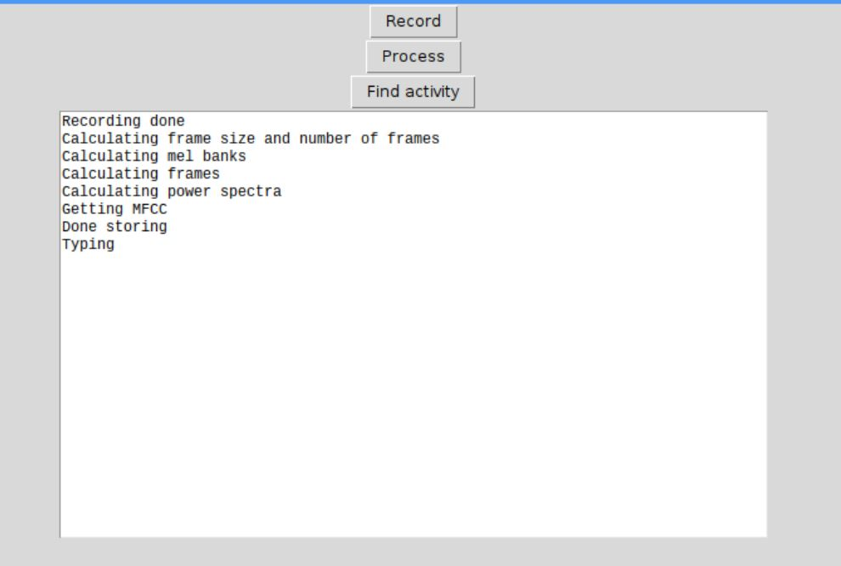
GUI - Non-Real Time Processing

Slide 6
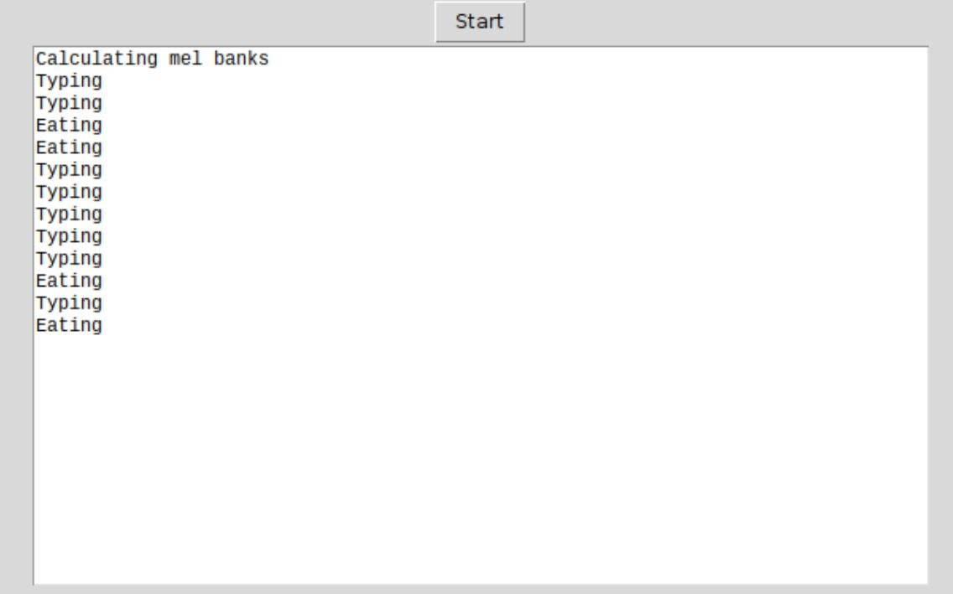
GUI – Real Time Processing
Built feature vector comprising of 3 features – MFCC, Delta, DDelta
Predicted the model using Random Forest as it gave a better accuracy with better execution time in non-real time processing

Slide 7
Video Demo
Laundry – Non Real Time: https://youtu.be/0m3kBEFjWR4
Laundry – Real Time : https://youtu.be/Ud1WwnJU2n0
Vacuum- Non Real Time: https://youtu.be/f9YrJ3E30Mk
Vacuum- Real Time: https://youtu.be/93BD09TxFtk

