Slide 1
Chapter 07: Hindley-Milner and Me

Slide 2
Hindley-Milner Types
a classical type system
Described in the 60s for algebra, rediscovered in the 70s for programming
Describes the types a function expects and returns
^ Simple syntax. Takes a string, returns a string.
A variable can have any name, such as “a” or “b”, but every “a” must be the same type as every other “a”.
“a” and “b” may or may not be the same type

Slide 3
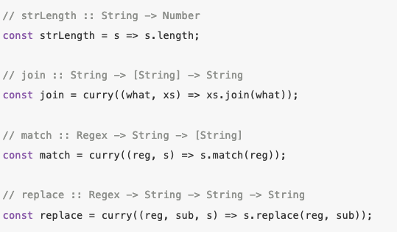
Hindley-Milner Types
The syntax extends to first-class functions, such that function can return another hindley-milner type that in turn returns more.
I.E. when currying a function, it returns a function that takes a type that returns another function.
It’s important to note that the variable names in Hindley-Milner only have equivalent types, not values. Hence in replace “String -> String -> String” represents three very different things- the haystack, the search term, and the result.

Slide 4



Hindley-Milner Types
Can also add parentheses to make the expression clearer- see “match”
Note how the expression of “onHoliday” is equal to the expression within the parentheses of ”match”
Note how the parentheses is required for “map”, because it takes a function as an argument. Without the parentheses, it would read as if it were two parameters of the same function.

Slide 5
Paramatericity
In HM, “head :: [a] -> a” tells us that “a” can be of any type. If the function could only handle strings, it would be “// head :: [String] -> String”.
A HM signiature, such as “reverse :: [a] -> [a]”, narrows the possible behaviors of the function. We can infer that because ”a” is a generic type that doesn’t change it’s type from the function, the function isn’t acting upon the contents of the array themselves but instead upon the array.
Neat search engine for Haskell functions based on HM signiatures: https://www.haskell.org/hoogle

Slide 6
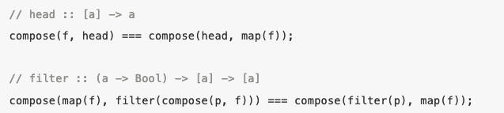
Free Theorems
“From the type of a polymorphic function we can derive a theorem that it satisfies. Every function of the same type satisfies the same thorem.”
These theorems can be used to simplify our function compositions, as in the example on the left.
Similar to Liskov Substitution

Slide 7
Constraints
In HM you can also constrain types to one or more interfaces.
“sort :: Ord a => [a] -> [a]”
Here we can determine that the Ord interface includes some comparison methods for ordering a list. Sort must use these methods to sort the list, otherwise it wouldn’t have specified them.
“assertEqual :: (Eq a, Show a) => a -> a -> Assertion”
This syntax allows one type to have two interface constraints

