Slide 1
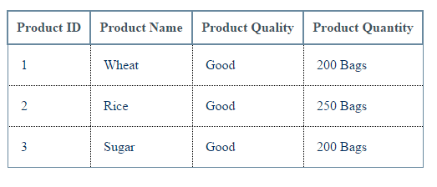
HTML Tables

Slide 2
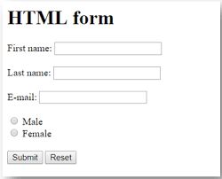
HTML Forms

Slide 3
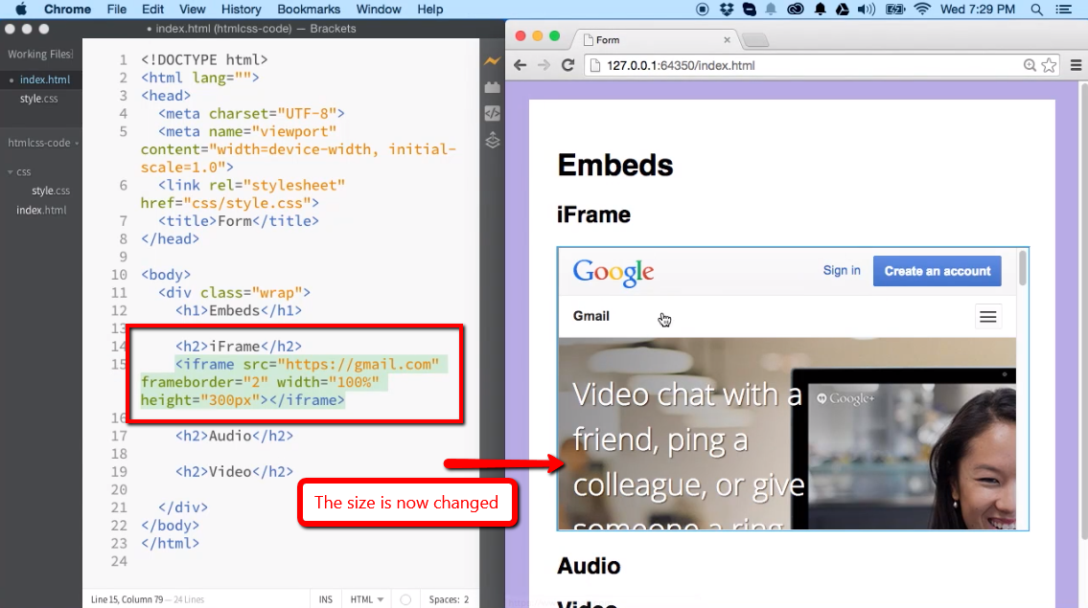
HTML iframes

Slide 4
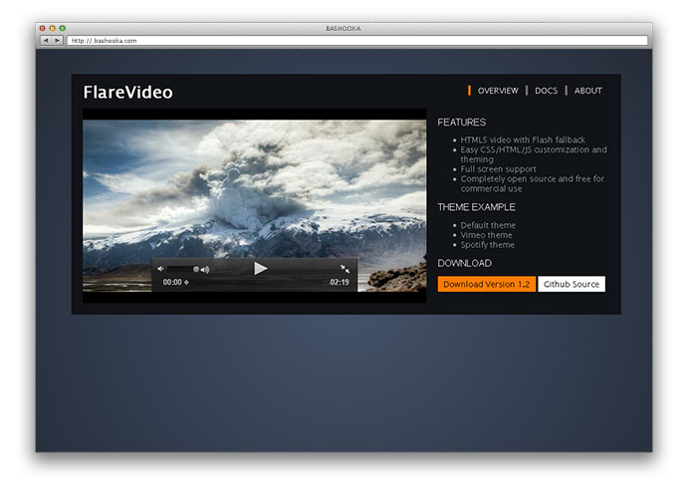
HTML Video

Slide 5
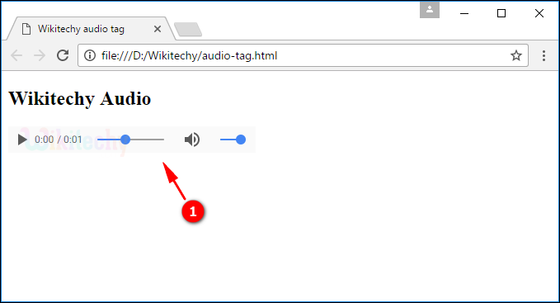
HTML Audio

Slide 6
HTML Meta HTML Scripts

Slide 7
HTML YouTube

