Slide 1
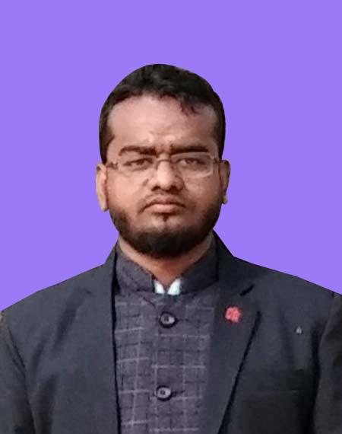
Personal Biography
Md Shafiqul Islam
mdshafiqulislam822@gmail.com
+8801768987779
My name is Shafiqul Islam. I am from jhalakathi . I have completed my diploma Engineering in Computer Science at barguna polytechnic institute Bangladesh . Now I am studding B.Tech Engineering at kurukshetra university Delhi India . I have 2 years experience web Computer training Bangladesh Post-E-Center and pyra training center barguna.

Slide 2

About LEDP

Slide 3
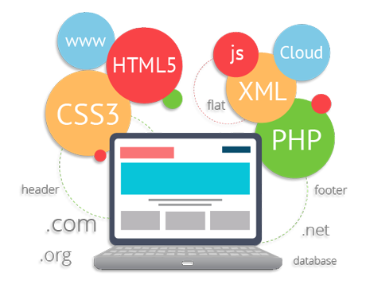
Choose Web Development For Best Career

Slide 4
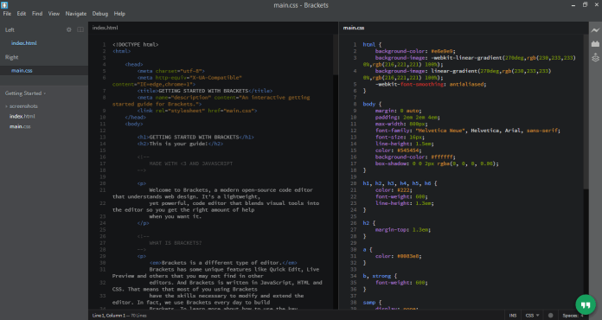
HTML text Editor?

Slide 5
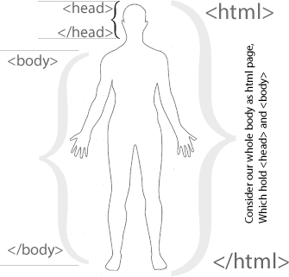

Slide 6
What is HTML?
How HTML Work (Introduction to HTML Tags)
HTML Formatting
HTML DoctypeTag
HTML Headings (H1-H6)
HTML Paragraphs (P)
HTML Links (a)
HTML Images (img)
HTML Attributes
HTML Lists

