Slide 1
What is bootstrap
Bootstrap is a free front-end framework for faster and easier web development
Bootstrap includes HTML and CSS based design templates for typography, forms, buttons, tables, navigation, modals, image carousels and many other, as well as optional JavaScript pl 0u0gins

Slide 2
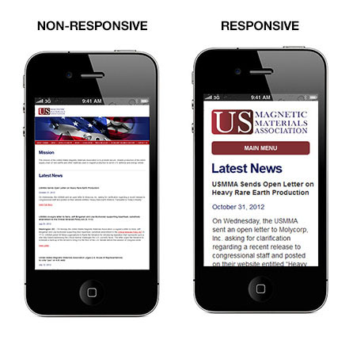
Bootstrap also gives you the ability to easily create responsive designs

Slide 3
Settings up bootstrap
How to download ,setup and create first web page by bootstrap

Slide 4
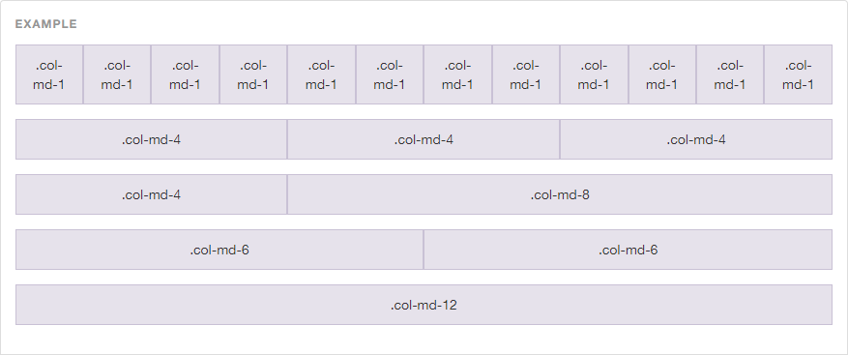
Bootstrap Grid System

Slide 5
.lead
.small
.text-left
.text-center
.text-right
.text-justify
.text-nowrap
.text-lowercase
.text-uppercase
.text-capitalize
.list-unstyled
.list-inline

Slide 6
Bootstrap Table Classes
Table
table-striped
table-bordered
table-hover
table-condensed
Active
Success
Info
Warning
danger

Slide 7
Bootstrap Buttons
.btn
.btn-default
.btn-primary
.btn-success
.btn-info
.btn-warning
.btn-danger
.btn-link
.btn-lg
.btn-md
.btn-sm
.btn-block
Active
disabled

Slide 8
